Slide 1
Stroke Prediction
Group: Kappa
Members:
Ezedin Mohammed
Goutham Thota
Jaya Surya Thota
CS 5831 Project Presentation
Michigan Technological University
4/14/2023

Slide 2
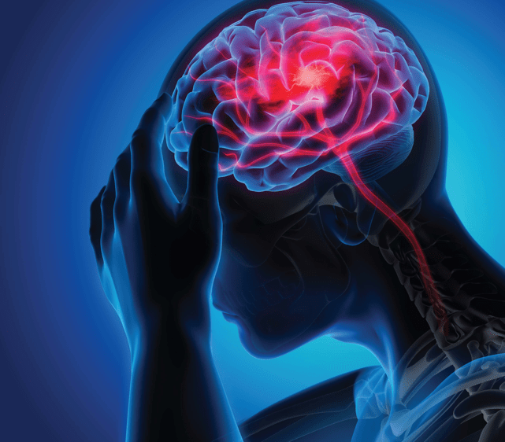
Introduction
Stroke is a major cause of death and disability worldwide.
According to the CDC Every 40 seconds, someone in the US has a stroke and every 3.5 minutes, someone dies of stroke
Late diagnosis leads to increased deaths and sudden stroke.
The goal of the project is to develop an accurate and reliable model for stroke detection based on our dataset that can help healthcare professionals in their decision-making process.

Slide 3
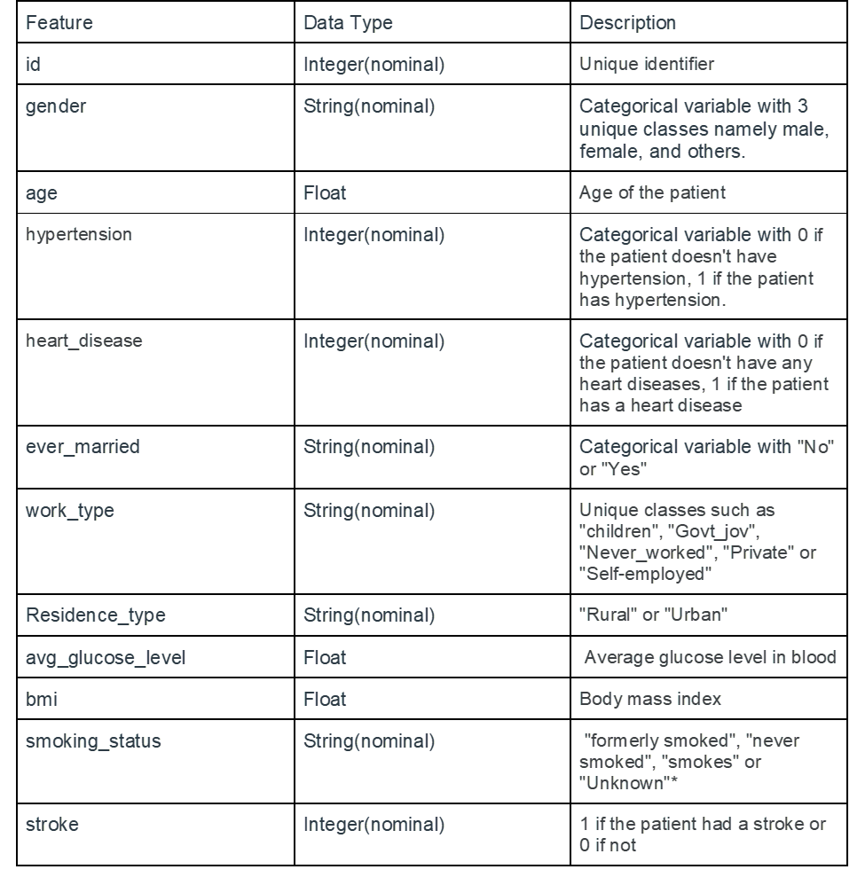
Dataset
Kaggle Dataset
(healthcare-dataset-stroke-data.csv)
Data Summary:
5110 records
12 columns(11 features, 1 Target Variable)
201 missing values (‘bmi’)
Imbalance Data(‘stroke’) 249/5110

Slide 4
System Overview
1
2
3
4
Data preprocessing
Cross validation
Model development
Classification
handling duplicates columns/rows, missing values, outliers, correlation, label encoding,balanced/imbalanced
Cross validation
random forest, XGBoost classifier, SVM, KNN, Decision tree
Stroke / No stroke

Slide 5
Data Preprocessing
The EDA process revealed that the dataset had missing values, outliers, and imbalanced classes.
The distribution of the data was skewed, and some variables had a significant correlation with the target variable (stroke).
The EDA process helped identify the variables that had the most significant impact on stroke prediction.
The EDA process helped to ensure that the dataset was ready for the modeling phase.
The EDA process revealed that age, hypertension, and heart disease were the most significant predictors of stroke.

Slide 6
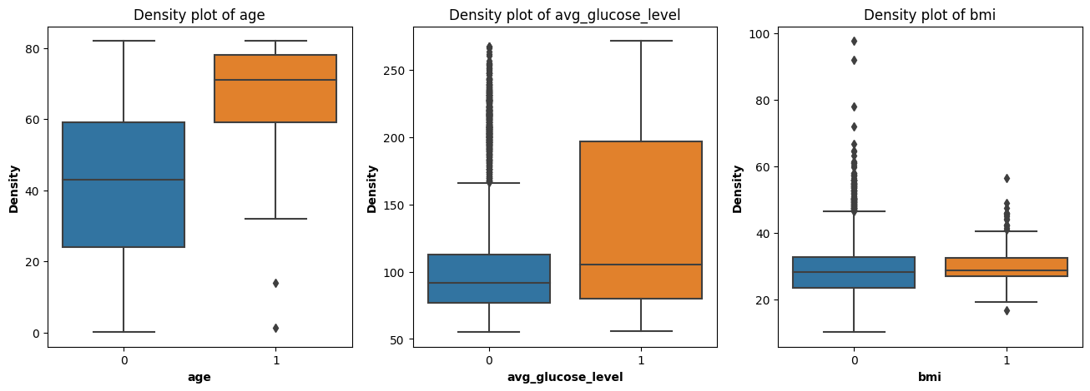
Outliers

Slide 7
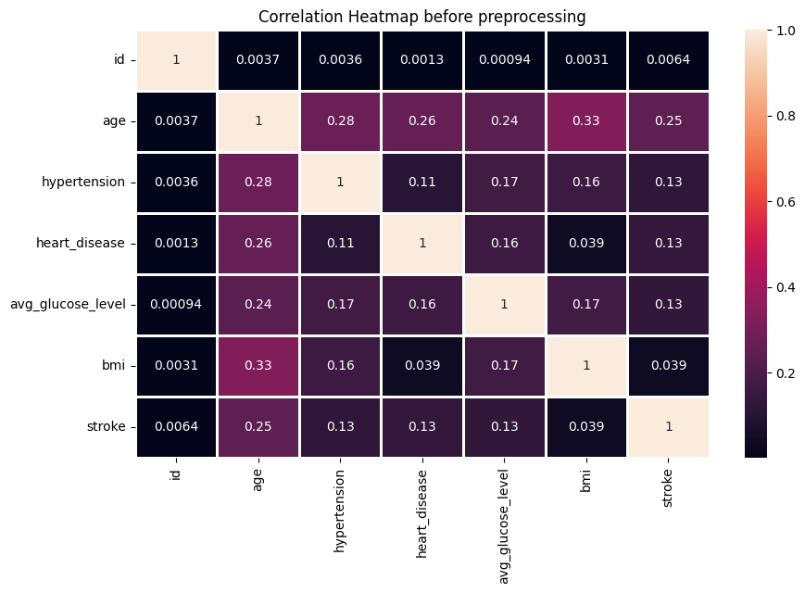
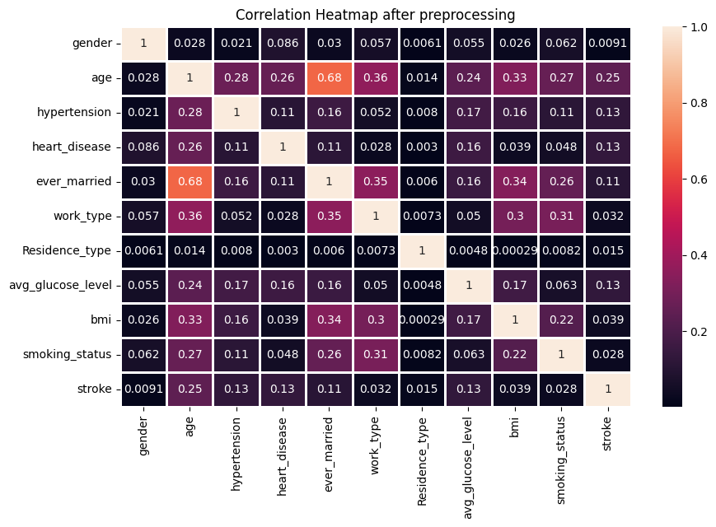
Correlation Heatmaps
Before Preprocessing
After Preprocessing

Slide 8
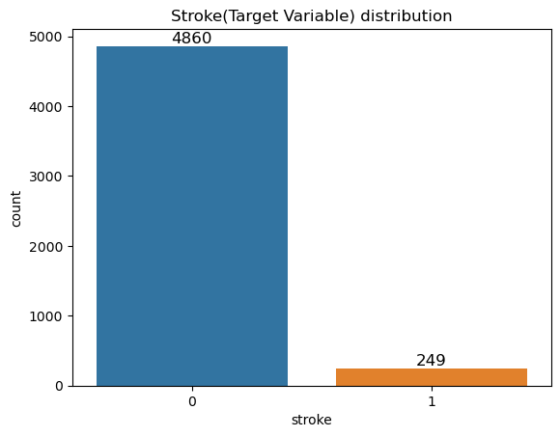
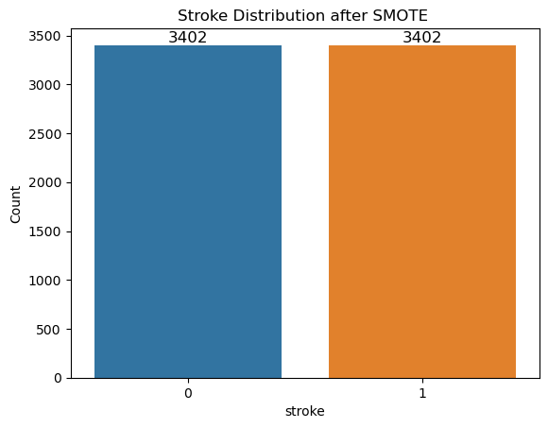
Data Preprocessing
SMOTE (Synthetic Minority Over-sampling Technique).

Slide 9
Classification models
The project tested the following different models, to identify the best model for stroke prediction.
Random forests,
KNN- K-nearest neighbors,
SVM- Support vector Machines

Slide 10
Evaluation methods
The models were evaluated based on their accuracy, precision, recall, and F1 score.
The model was further optimized through hyperparameter tuning to improve its performance.
The project selected the random forest model as the best model for stroke prediction based on its high accuracy and F1 score.
Split: 70%(Train) & 30%(Test)
Scaling: StandardScaler()
Tuning Parameters: GridSearchCV()
5-fold Cross-validation

Slide 11
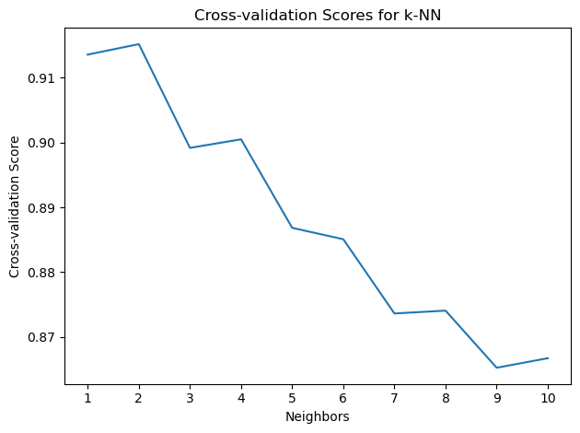
Selecting Best Hyperparameters
KNN (GridSearchCV)
Best Hyperparameters: {'n_neighbors': 2}
Best Accuracy Score: 0.9151994640618921
Random Forest (GridSearchCV)
'max_depth': None
'max_features': 'auto'
'min_samples_leaf': 1
'min_samples_split': 2
'n_estimators': 50
'random_state': 42
SVM (GridSearchCV)
'C': 10
'kernel': 'rbf'
'random_state': 42

Slide 12
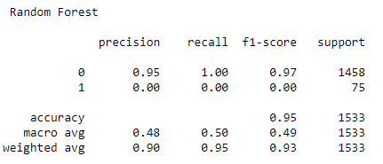
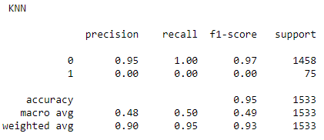
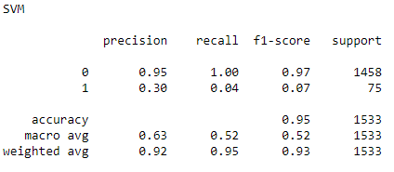
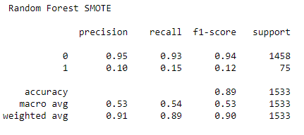
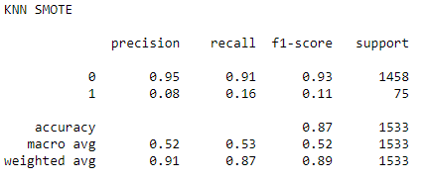
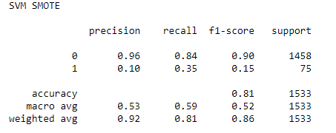
Classification Charts
Original Data
SMOTE Data

Slide 13
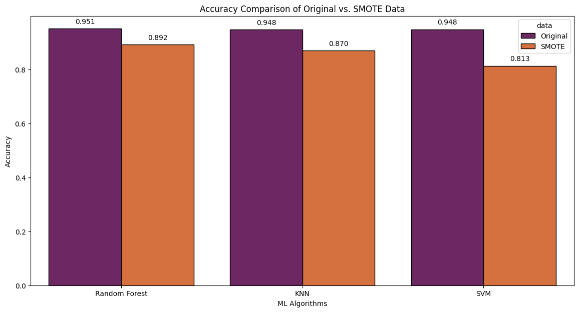
Results

Slide 14
Conclusion
The project developed a model for stroke detection using data analytics techniques.
The model achieved high accuracy and reliability in stroke prediction.
The model identified age, hypertension, and heart disease as the most significant predictors of stroke.
The project has the potential to significantly impact public health by reducing the number of stroke-related deaths and disabilities.
Future work
Future work can focus on improving the current model's performance through the addition of new variables or exploring other model types.

Slide 15
Summary
Questions?
Stroke is a major cause of death worldwide, the number can be decreased if doctors can identify it early.
We used SVM, KNN, and Random forest model to make predictions resulting in accuracy of 0.813,0.870 and 0.892 respectively.
Future work will include the use of different models with different method of classification.

