Slide 1
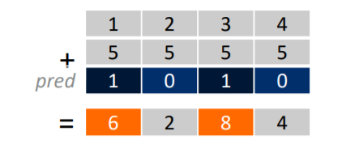
Predicate Vector registers
Consider this addition operation. Here pred is a predicate vector register.
For each value of data there is a particular predicate value which defines if the element is active or not. Here 1 refers to active and 0 refers inactive. Hence the operation is performed on only the elements which are active.

Slide 2
Predicate Loop Control
void daxpy(int64_t n, double a, double *x, double *y){
int64_t i = 0;
svbool_t pg = svwhilelt_b64(i, n); // 1
do {
svfloat64_t x_vec = svld1(pg, &x[i]); //2
svfloat64_t y_vec = svld1(pg, &y[i]);
svst1(pg, &y[i], svmla_x(pg, y_vec, x_vec, a));
i += svcntd(); // 2
pg = svwhilelt_b64(i, n); //3
}
while (svptest_any(svptrue_b64(), pg)); //5
}
1 => Here pg is a predicate variable which keeps elements active till i is less than n
2 => loads 64 bit float values form dx till the vector fills out. If 256 bit arch then, 4 eles are loaded
3=> svcntd() returns number of 32 bit elements in a full vector of that architecture. If the architecture implements 128 bit then, 4 is returned. Hence we can know by how many elements to skip to
4 => updates the predicate for the next loop
5 => checks if any of the elements in pg predicate are true that active.
I have explained this in the matrix multiplication code as well

