Slide 1
VISHWAKARMA AWARDS 2026-27
Wearable Posture Sensor
Dual-IMU spinal posture tracking with silent haptic biofeedback
Application ID:VK26-IITI-HT-0259 Team ID: VK26-IITI-HT-0259 Track: Rehabilitation and Physical Therapy Aids
Core innovation: relative lumbar-vs-thoracic flexion measured by two MPU-6050 IMUs on one I2C bus, with a personal tare baseline and a vibration alert from a XIAO ESP32-C3.

Slide 2
Problem Context & User Journey
PROJECT OVERVIEW
619 M
843 M
1.2 s
people with low back pain (2020)
projected by 2050 (+36.4%)
posture-to-alert delay in our design
Before: no real-time feedback
After: personal, silent alert
Target user: students and desk workers who sit for hours
Slouching goes unnoticed until pain appears
Single-sensor trackers cannot tell whole-body tilt from spinal flexion
No private, in-the-moment cue
Lumbar (0x68) and thoracic (0x69) IMUs give relative flexion
Tare button saves the user's own good posture
18° deviation held for 1.2 s triggers ERM buzz + LED
3.5 s cooldown prevents nagging
Source: GBD 2021 Low Back Pain Collaborators, Lancet Rheumatology (2023); WHO low back pain fact sheet.
VISHWAKARMA AWARDS A Maker Bhavan Foundation initiative
MAKER BHAVAN FOUNDATION

Slide 3
System Architecture & Specs
SYSTEM DESIGN
2x MPU-6050
lumbar 0x68 / thoracic 0x69
Parameter | Target spec | Hardware
Sampling | ~25 Hz (40 ms loop) | MPU-6050 x2
Alert logic | 18° / 1.2 s / 3.5 s | EMA filter, alpha 0.2
Controller | BLE 5.0, RISC-V | Seeed XIAO ESP32-C3
Haptics | ERM library 1 | DRV2605L + coin ERM
Power | 3.7 V, 350 mAh | LiPo + onboard charger
DRV2605L
haptic driver 0x5A
XIAO ESP32-C3
posture maths, BLE 5.0, LiPo charger, 3V3 LDO
LiPo 3.7V 350mAh
via SW1 to BAT+
ERM motor
3.0V 75mA
Tare button + LED
D1 / D2 (GPIO3, GPIO4)
Shared I2C: D4 = SDA, D5 = SCL, 400 kHz
Rationale: one 2-wire bus serves all three I2C devices; INT pins stay unused (polled design), so every MCU pin has one job.
VISHWAKARMA AWARDS A Maker Bhavan Foundation initiative
MAKER BHAVAN FOUNDATION

Slide 4
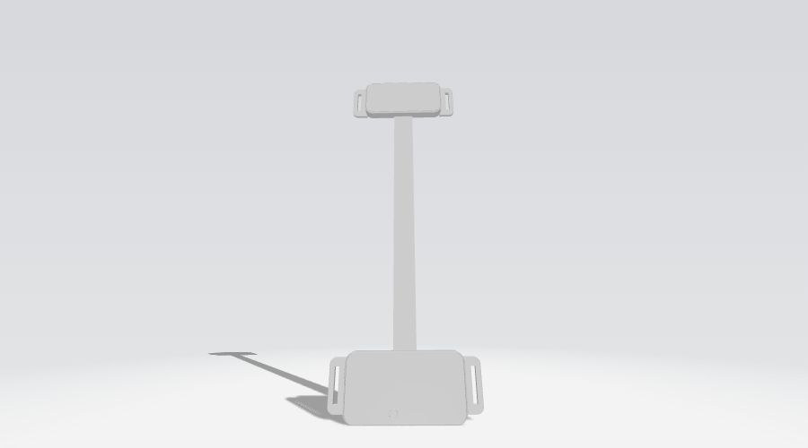
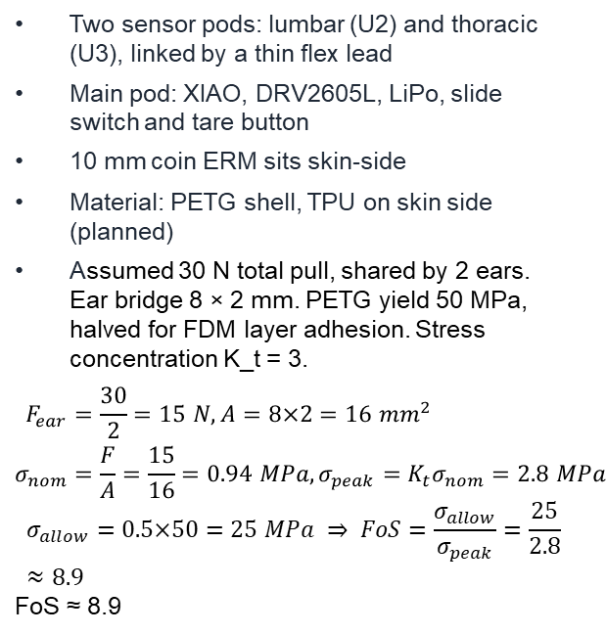
CAD Design & Mechanical Specs
MECHANICAL
Planned mechanical design
Two sensor pods: lumbar (U2) and thoracic (U3), linked by a thin flex lead
Main pod: XIAO, DRV2605L, LiPo, slide switch and tare button
10 mm coin ERM sits skin-side
Material: PETG shell, TPU on skin side (planned)
Assumed 30 N total pull, shared by 2 ears. Ear bridge 8 × 2 mm. PETG yield 50 MPa, halved for FDM layer adhesion. Stress concentration K_t = 3.
$$\begin{aligned}F_{ear}&=\frac{30}{2}=15 N, A=8×2=16 mm^{2} \\ σ_{nom}&=\frac{F}{A}=\frac{15}{16}=0.94 MPa, σ_{peak}=K_{t}σ_{nom}=2.8 MPa\end{aligned}$$
$$σ_{allow}=0.5×50=25 MPa ⇒ FoS=\frac{σ_{allow}}{σ_{peak}}=\frac{25}{2.8}≈8.9$$
FoS ≈ 8.9
[Insert isometric and exploded CAD render of the enclosure here]
VISHWAKARMA AWARDS A Maker Bhavan Foundation initiative
MAKER BHAVAN FOUNDATION

Slide 5
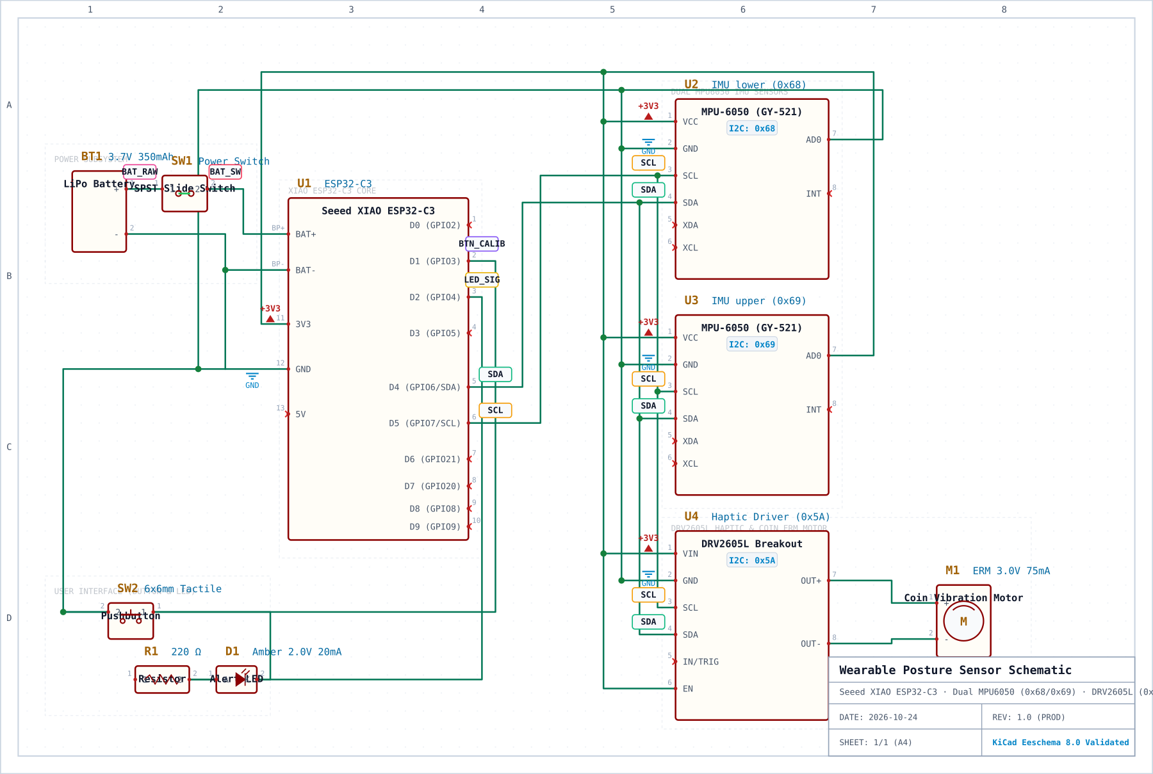
Electronics Schematic & BOM
ELECTRONICS
All prices are in rupees.
Ref | Part | Qty | Cost
U1 | Seeed XIAO ESP32-C3 | 1 | 734
U2 | MPU-6050 GY-521 (0x68) | 1 | 263
U3 | MPU-6050 GY-521 (0x69) | 1 | 263
U4 | DRV2605L breakout (0x5A) | 1 | 1103
M1 | ERM coin motor 3V 75mA | 1 | 65
BT1 | LiPo 3.7V 350mAh | 1 | 164
SW1 | SPST slide switch | 1 | 221
SW2 | 6x6 mm tactile button | 1 | 60
R1 | 220 ohm 0805 | 1 | 176
D1 | Amber LED 0805 | 1 | 95
Procurement: all products are procured domestically and will arrive within 10 days of purchase.
VISHWAKARMA AWARDS A Maker Bhavan Foundation initiative
MAKER BHAVAN FOUNDATION

Slide 6
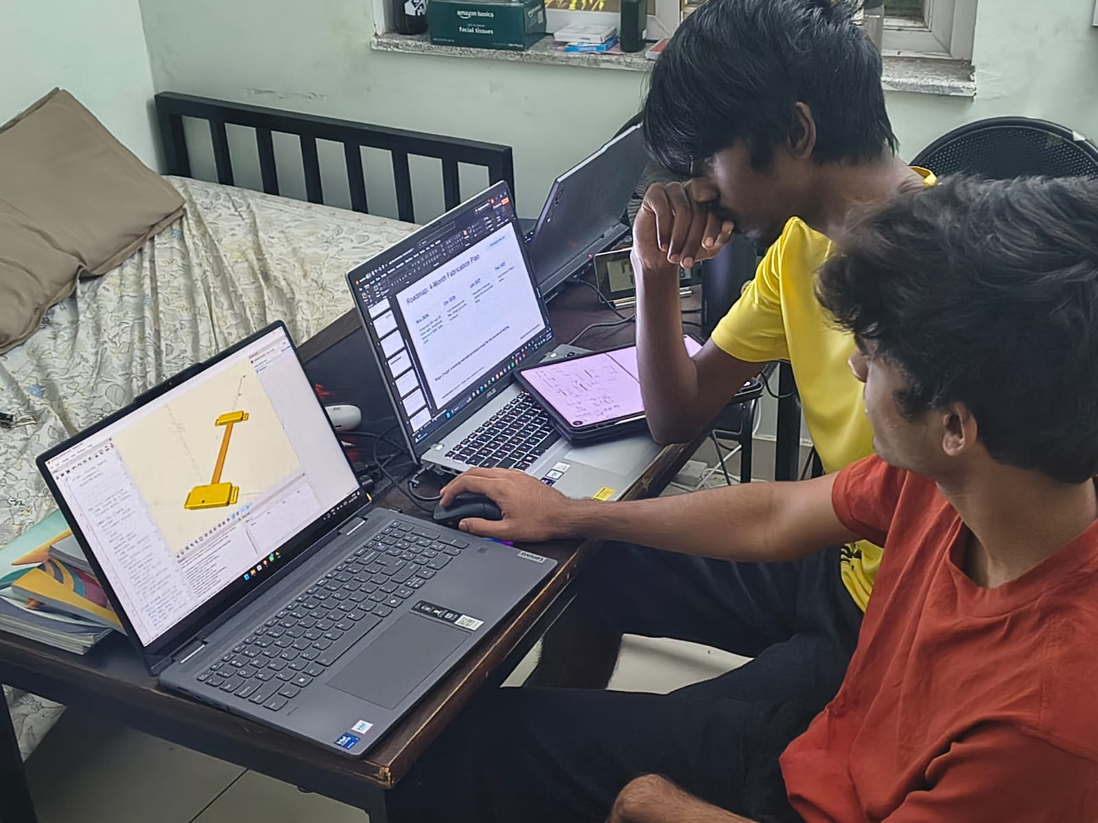
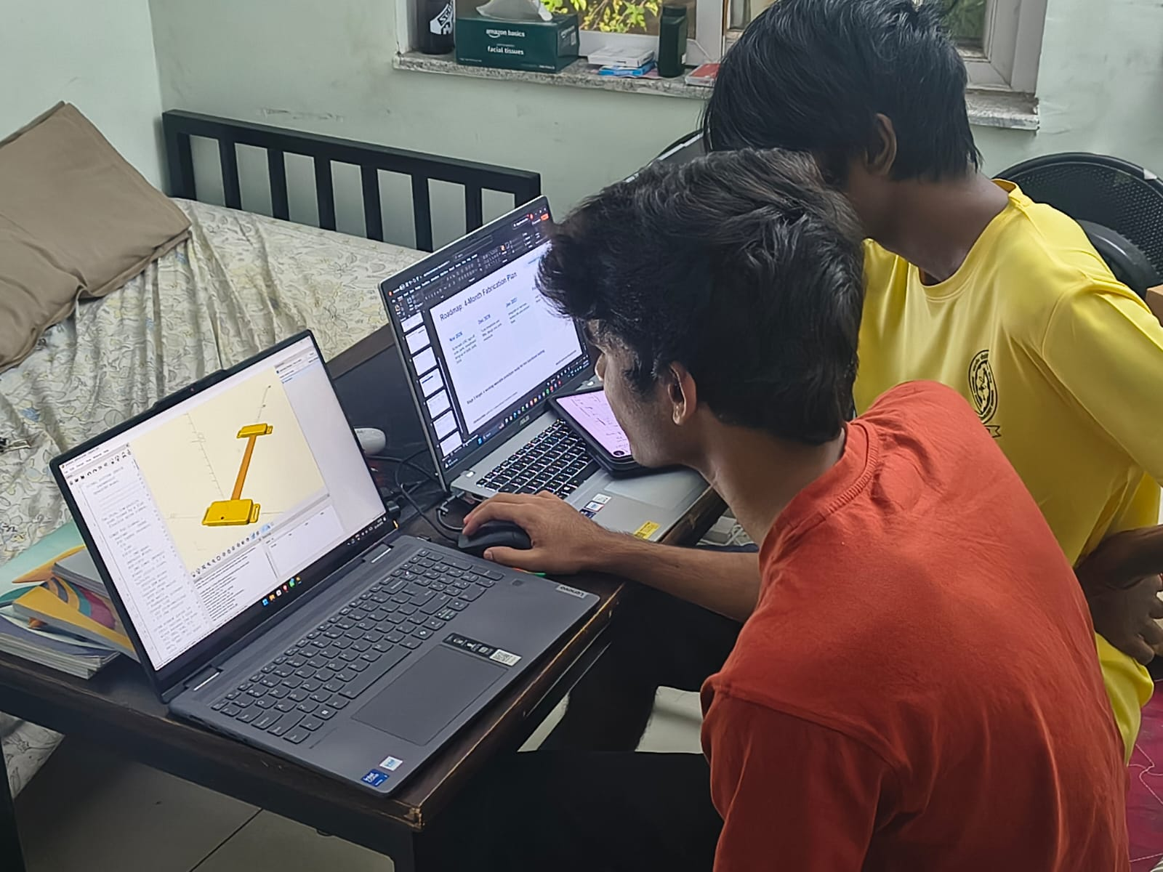
Maker Journey
WORK IN PROGRESS
Work-in-progress evidence
Raw repository
Link: https://github.com/Aadyant2/Posture-Correction-Device
VISHWAKARMA AWARDS A Maker Bhavan Foundation initiative
MAKER BHAVAN FOUNDATION

Slide 7
Safety & Hazard Mitigation
SAFETY
Failure mode | Hazard | Fail-safe / mitigation
LiPo short or overcharge | Heat, fire | Protected cell, onboard charger, SW1 isolates battery
IMU or driver not found | Silent failure | Firmware halts, LED blinks 200/100/400 ms per device
False slouch alert | Alert fatigue | EMA filter, 1.2 s debounce, 3.5 s cooldown, tare
I2C lock-up | Frozen reading | Planned: watchdog + bus reset
Skin contact | Irritation | TPU skin side, 3.0 V motor only
Standards considered
IEC 62133-2: lithium cell safety
ISO 10993-1: skin contact
IEC 60529: sweat/dust IP rating
VISHWAKARMA AWARDS A Maker Bhavan Foundation initiative
MAKER BHAVAN FOUNDATION

Slide 8
Roadmap: 4-Month Fabrication Plan
PROPOSED TIMELINE
Nov 2026
Dec 2026
Jan 2027
Feb 2027
Schematic ERC sign-off, order parts, breadboard bring-up of 0x68, 0x69, 0x5A
Tune thresholds and filter, design and print enclosure
Integrate on harness, battery-life and comfort tests
User trial and Stage 3 demo
Stage 3 target: a working wearable prototype ready for live functional testing.
VISHWAKARMA AWARDS A Maker Bhavan Foundation initiative
MAKER BHAVAN FOUNDATION

Slide 9
Technical Challenges & Risk Mitigation
RISKS
Accelerometer-only pitch
Three devices on one bus
Risk: Motion adds error to tilt readings
Fix: Gyro is already sampled: add a complementary filter
Risk: Body-length leads at 400 kHz
Fix: Short twisted leads; fall back to 100 kHz; check pull-ups
350 mAh battery
Per-user baseline
Risk: Estimated ~40 mA draw, about 8 h (to verify)
Fix: Lower sample rate, light sleep between reads
Risk: Posture varies by body
Fix: Tare button now; store baseline in flash next
VISHWAKARMA AWARDS A Maker Bhavan Foundation initiative
MAKER BHAVAN FOUNDATION

Slide 10
References & Sources
REFERENCES
GBD 2021 Low Back Pain Collaborators. Lancet Rheumatology, 2023 (pmc.ncbi.nlm.nih.gov/articles/PMC10234592)
WHO fact sheet: Low back pain (who.int)
InvenSense / TDK: MPU-6050 datasheet (invensense.tdk.com)
Texas Instruments: DRV2605L datasheet (ti.com)
Seeed Studio: XIAO ESP32-C3 wiki (wiki.seeedstudio.com)
Adafruit MPU6050 and DRV2605 Arduino libraries (github.com/adafruit)
Schematic, firmware and BOM: original team files, exported from KiCad
VISHWAKARMA AWARDS A Maker Bhavan Foundation initiative
MAKER BHAVAN FOUNDATION

