Slide 1
STOCK MANAGEMENT SYSTEM
(USING PYTHON)
TEAM : 9
Dhondi Gouthamraj

Slide 2
Contents
Introduction
Existing System
Proposed System
Technolgies used
Application Interface
Advantages
Conclusion
References

Slide 3
Introduction
For optimal sales and inventory management processes, you need robust functionality for managing your logistics facilities.
Tracking things manually and maintaining record in books may lead to manual errors and it increases human efforts.
This “Stock Management” helps you record, and track materials based on both quantity and value. Inventory management functions cover internal warehouse movements and storage.

Slide 4
Existing System
As we know manual system are quite tedious, time consuming and less efficient and accurate in comparison to the computerized system.
Some disadvantages of the old system:
  Time consuming
  Less accurate
  Lot of paperwork
  Slow data processing
  Not User-friendly environment

Slide 5
Proposed System
Tracking things manually and maintaining record in books may lead to manual errors and it increases human efforts.
This system is developed in such a way that even a naive user can also operate the system easily.
Records are directly saved into databases.
Also, this system provides high level of security for data leaking.

Slide 6

Techologies used
Python:
Pandas
Tkinter

Slide 7
DataBase Used:
SQL
pyMySQL

Slide 8
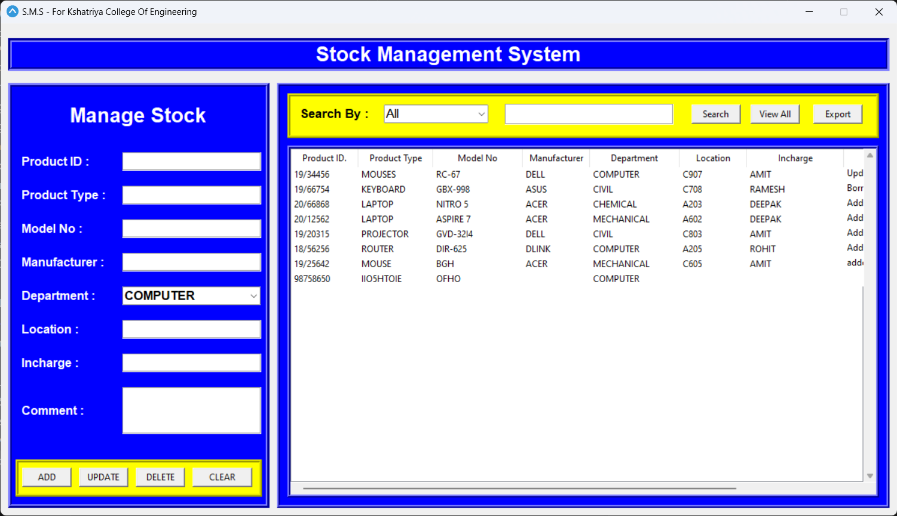
Application Interface

Slide 9
Advantages

Slide 10
Conclusion
  The goal of semantic web is to trigger the evolution of existing web to enable users to search, discover, share and join information with less effort. It aims to make data machine-readable, it enable’s interaction between user and computer to complete any task.

Slide 11
Thank You..!

