Slide 1
Zulip Bike Share Analysis

Slide 2
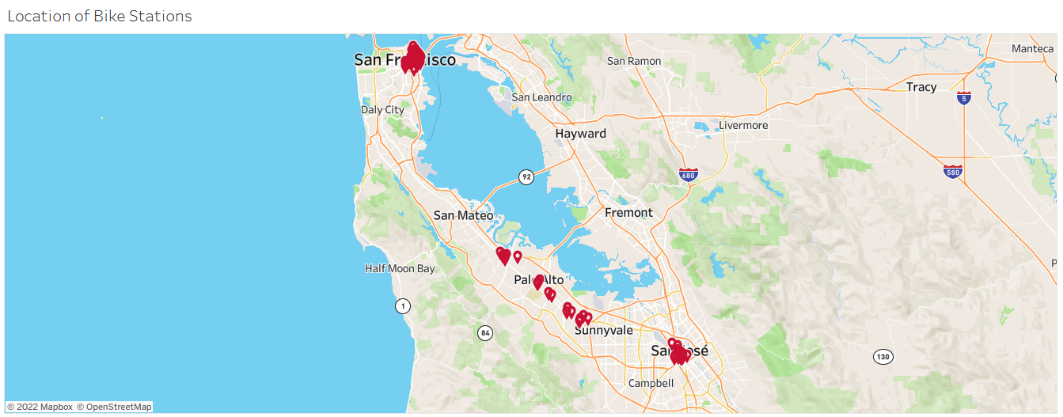
Task 1: Know you’re company
There are around 70 bike stations located in between city San Francisco and city San Jose.

Slide 3
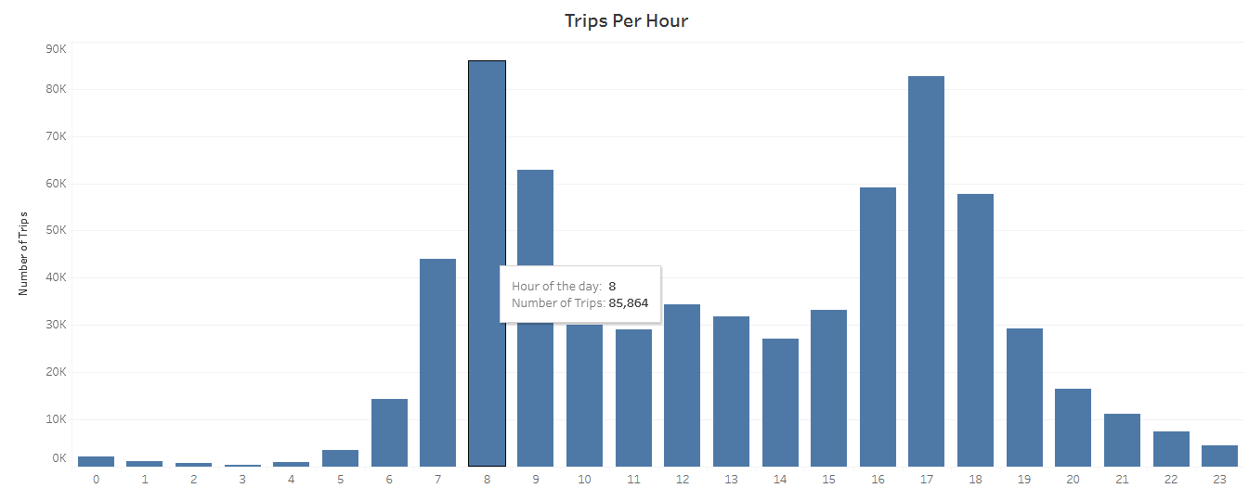
Know you’re company contd..
The business or peak hours of bike rentals is from 8AM to 6PM.

Slide 4
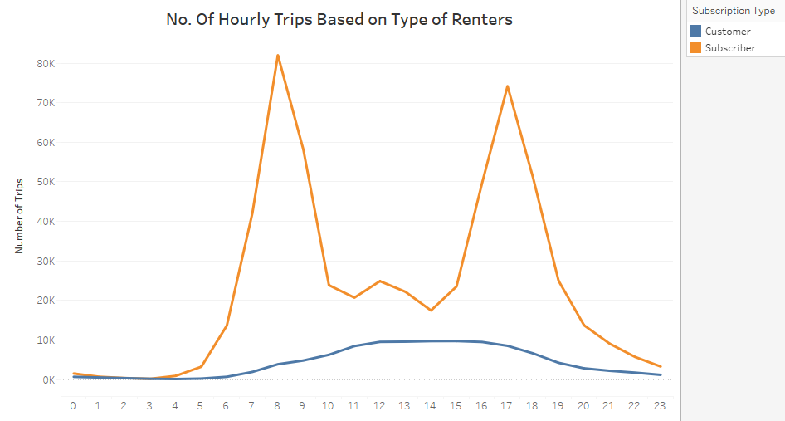
Know you’re company contd..
There are two type of bike renters 1. Subscriber 2. Customers
Subscriber are the renters who bought subscription
Customers are the renters who walk in for bike rentals.

Slide 5
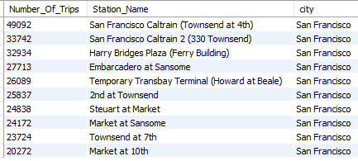
Know you’re company contd..
The following are the top 10 popular stations based on the number of trips.
All the popular stations are present in the city San Francisco
We can start couple bikes trial in these top 10 stations during the peak rental hours like 8AM to 6PM .

Slide 6
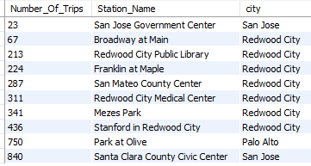
Know you’re company contd..
The following are the top 10 least popular stations based on the number of trips.
Most of the unpopular stations present in the city Redwood City. We can shut down few stations if two stations are closer by in this city.

Slide 7
Thank You

