Slide 1

CLOUD COMPUTING AND BIG DATA (COMS E6998_008_3) PROJECT
NOTE SHARE
Team Members:
gk2547 Goutham Reddy
ra3027 Reshma Asharaf Beena
skv2109 Shiv Venkatagiri
sj3003 Shashank Jaiprakash

Slide 2
OBJECTIVES
Collaboration tool to help engage in discussion over class notes
Hand written text
Scanned material
Ease of search to locate particular content
Provide supporting content off the web
Cloud services to provide a web application
Scalable
Reliable
Secure

Slide 3
HIGH LEVEL FEATURES
Secure Login
Groups
Documents
Search
Commenting

Slide 4
ARCHITECTURE

Slide 5
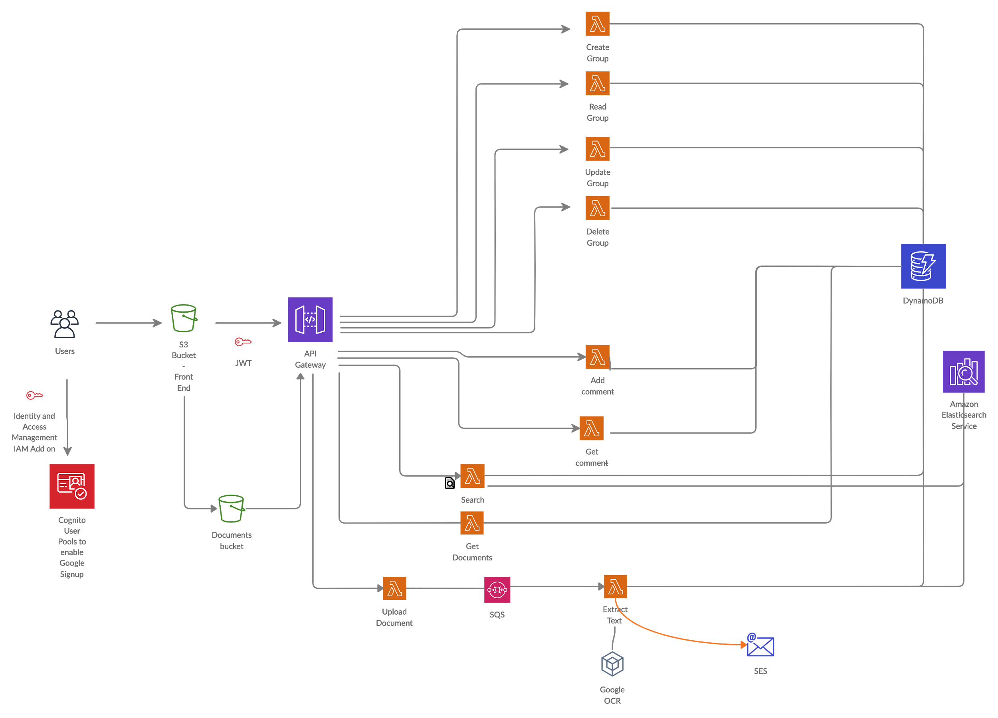

Slide 6
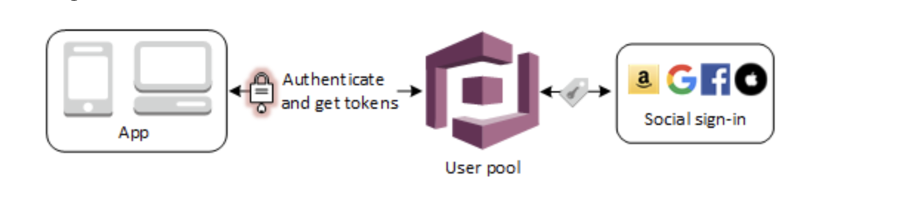
Secure sign in using Google OAuth

Slide 7
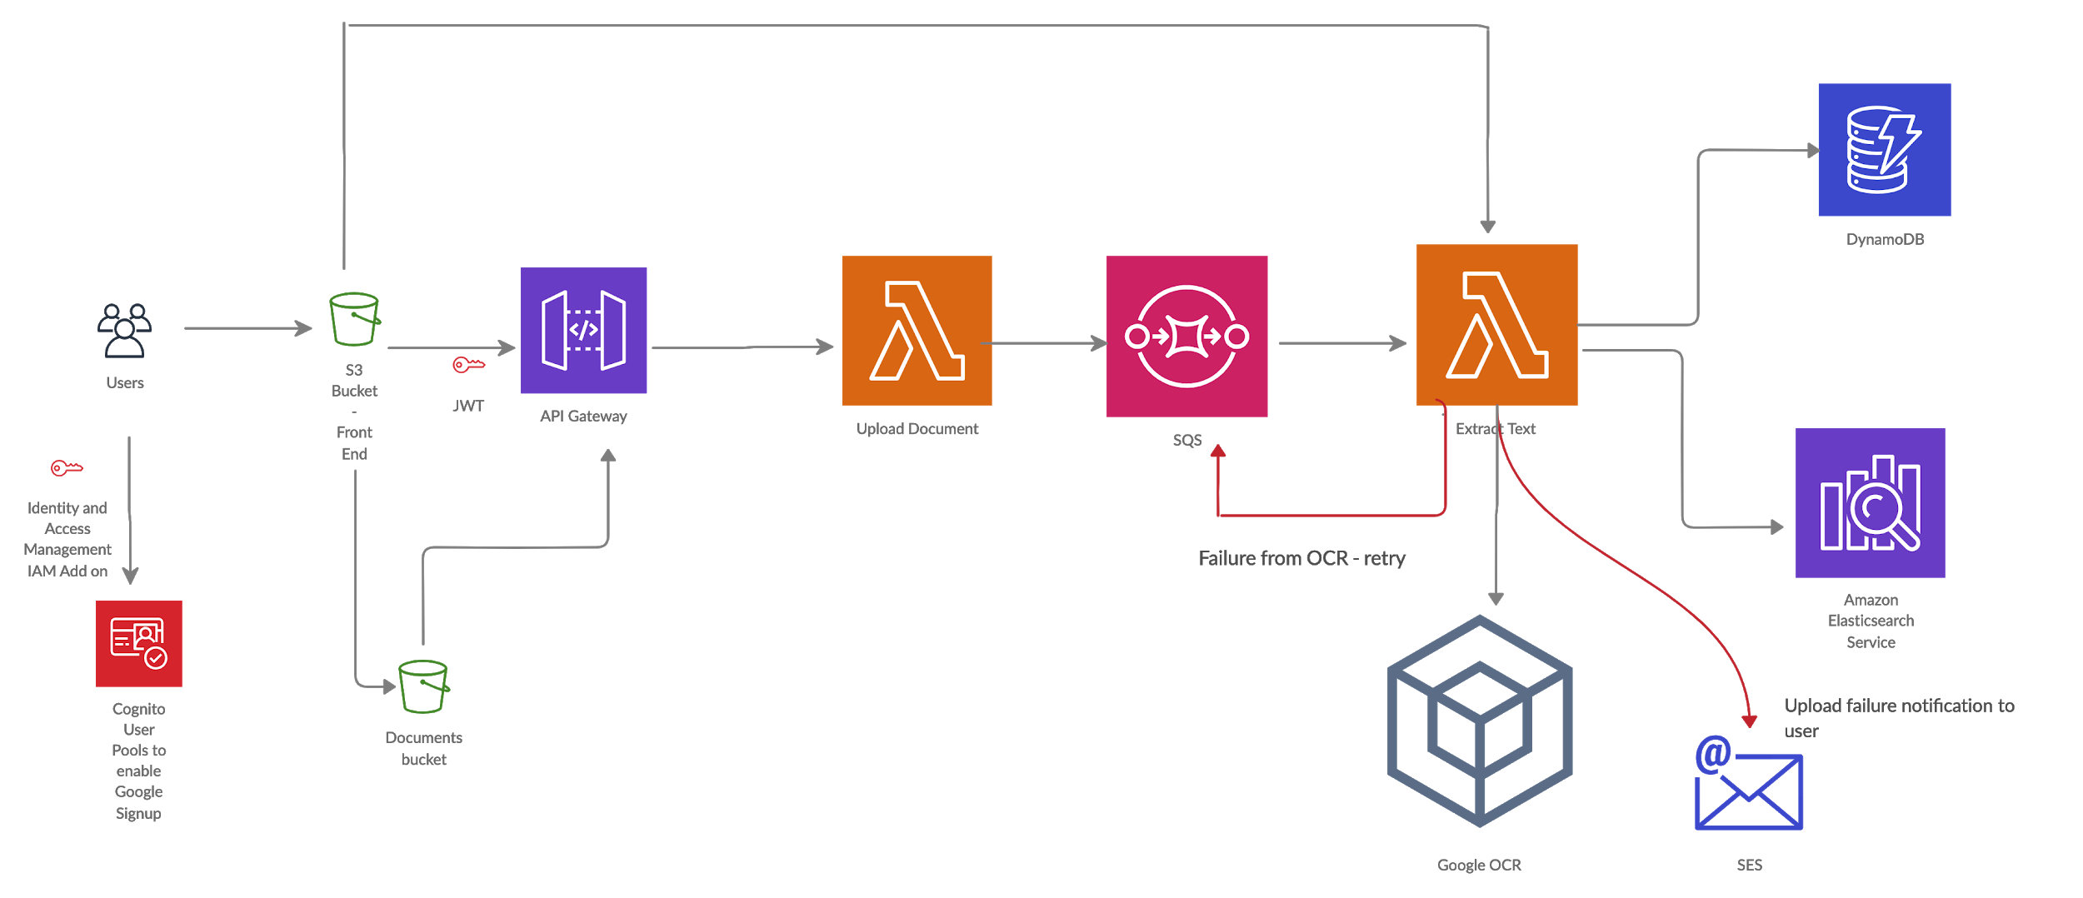
Upload

Slide 8
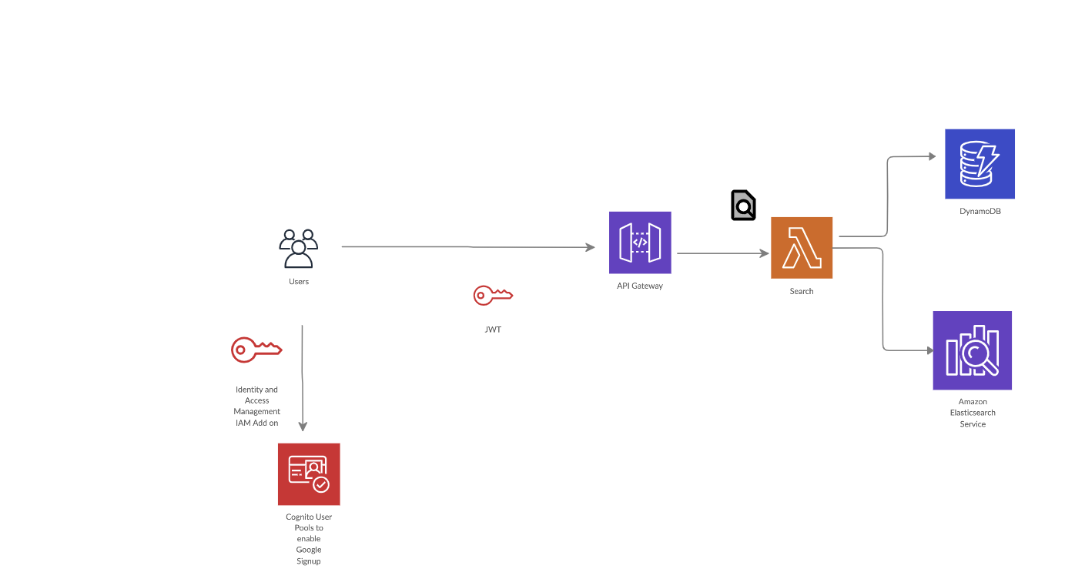

Search

Slide 9
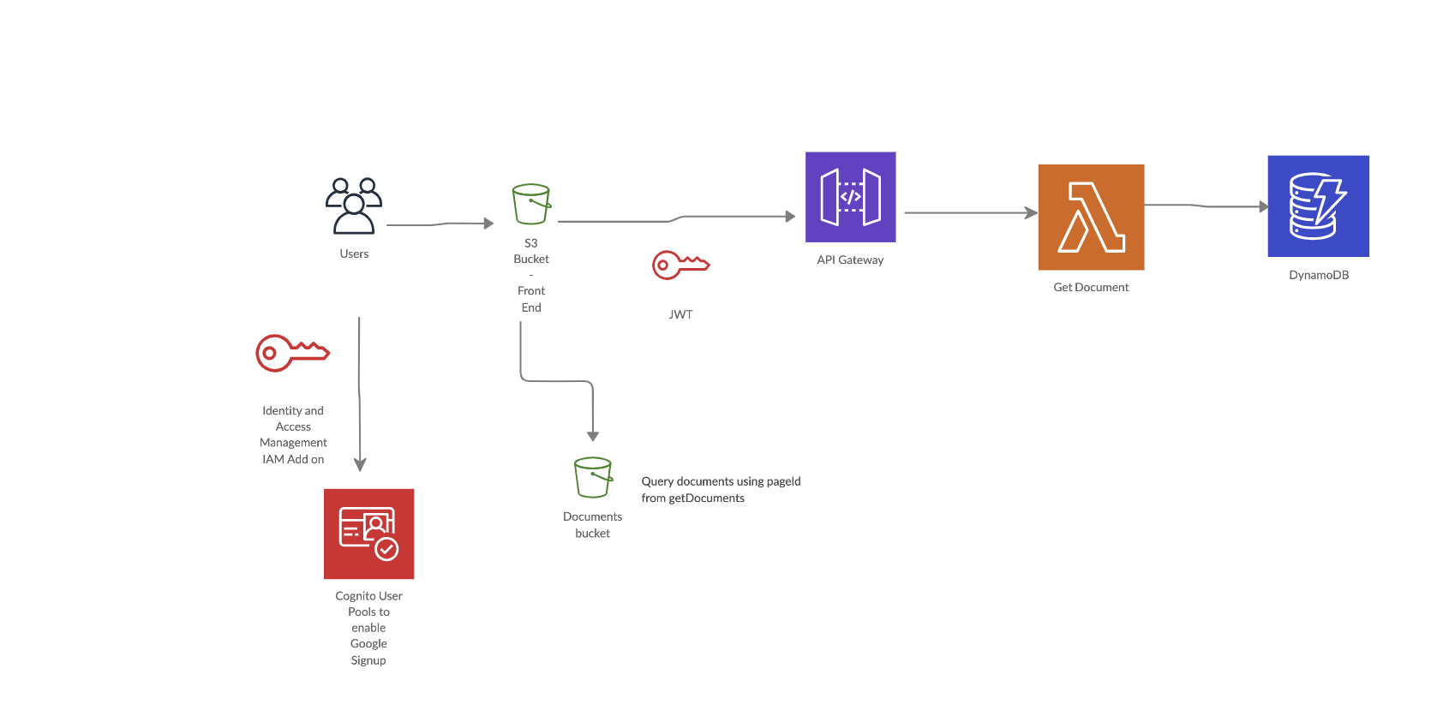
Fetch documents

Slide 10
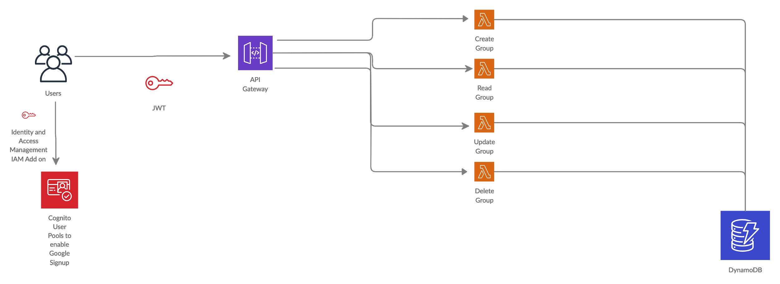
Groups

Slide 11
DEMO
https://s3.amazonaws.com/frontend.noteshare/index.html

Slide 12












TECHNOLOGIES

Slide 13
FUTURE SCOPE
Move sensitive data to VPC
Limitation of cloud vision
Schedule meetings
Support for multiple input formats
Send invites to people who are currently not there in the platform

