Slide 1

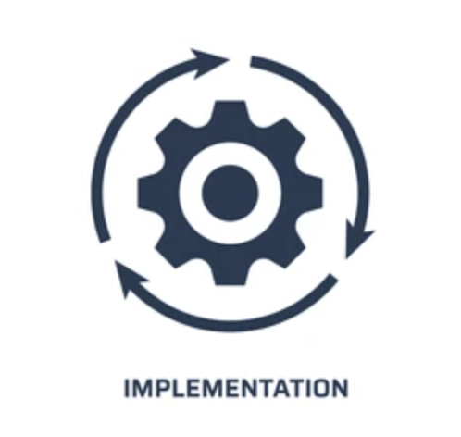

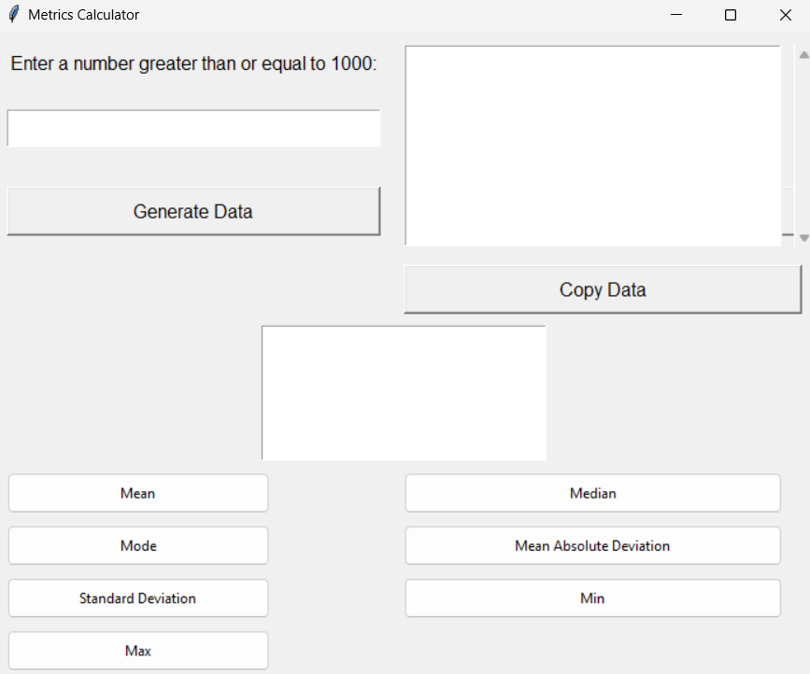

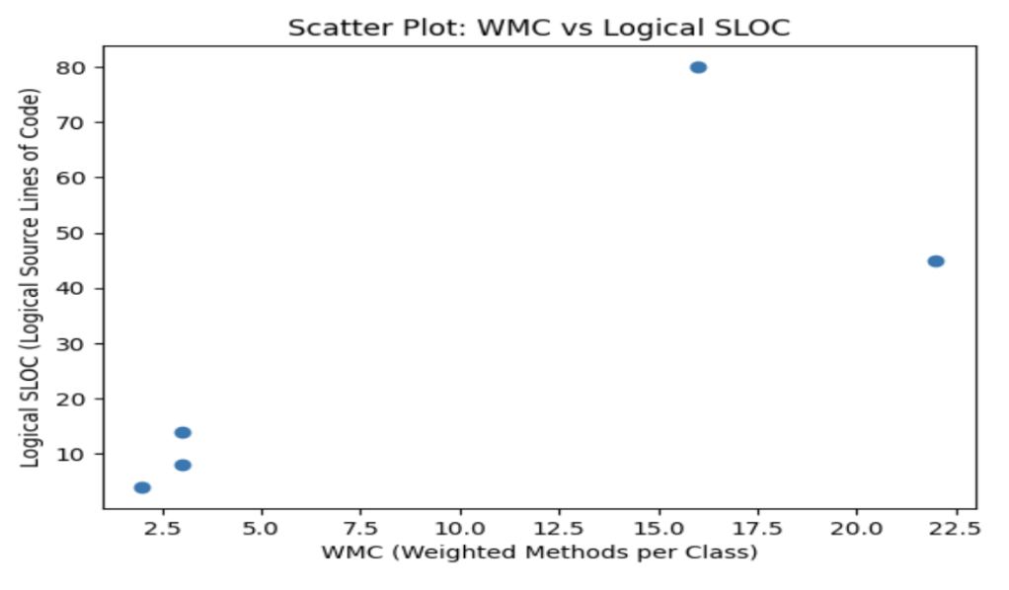




SOEN 6611- SOFTWARE MEASUREMENT POSTERATION
Team Q (Quasar Knights) -. Goutham Susarla, Vishwassingh Tomar, Bharath Ummaneni Ashish Upadhyay, Hema Deepthi Vangipurapu, Saryu Vasishat
Introduction:
Implementation:
METRICSTICS is a project aiming to develop a descriptive statistics measurement system. It calculates key statistics like minimum, maximum, mode, arithmetic mean, mean absolute deviation, and standard deviation. The project comprises three deliverables:
1. Deliverable 1: Establishing METRICSTICS goals using the Goal-Question-Metric (GQM) approach and defining related questions.
2. Deliverable 2: Creating a use case model, estimating project effort through use case points (UCP) and Basic COCOMO 81, and implementing METRICSTICS in Python using object-oriented programming.
3. Deliverable 3: Presenting a poster that defends critical decisions, shares project insights, and addresses audience questions regarding the project's journey.
Deliverable 1 of the project involves using the Goal-Question-Metric (GQM) approach to establish a SMART goal for METRICSTICS and articulate 2N questions related to that goal, where N is the team size. To achieve this, we:
1. Familiarized ourselves with the GQM approach: Understanding its concept and methodology.
2. Defined a SMART goal for METRICSTICS: Identifying a specific, measurable, achievable, relevant, and time-bound objective.
3. Articulated 2N questions: Generated a set of questions linked to the goal, tailored to the team size for clarity.
4. Documented the deliverable: Prepared a comprehensive report or presentation, outlining the goal, questions, and metrics for achieving the goal.
For Deliverable 2, we addressed the following problems:
1. Effort Estimation: Used UCP and Basic COCOMO 81 to estimate project effort, comparing the results with actual effort.
2. Implementation: Built METRICSTICS from scratch in Python, testing with 1000 randomly distributed values.
3. Cyclomatic Complexity: Calculated and interpreted cyclomatic complexity for software quality and maintainability.
4. Code Metrics: Computed WMC, coupling factor (CF), and LCOM for each class, comparing values with established thresholds for quality and maintainability assessment.
5. Code Size and Complexity: Calculated Physical and Logical SLOC for METRICSTICS, comparing values with thresholds to assess code size and complexity.
6. Correlation Analysis: Investigated correlations between Logical SLOC and WMC using Scatter Plot and correlation coefficient.
Project Goal:
Lessons Learned:
The overarching aim of the project is the development of a system named METRICSTICS, designed with the capability to perform comprehensive measurements. METRICSTICS is engineered to provide a quantitative portrayal of datasets. This system is able to calculate the minimum, maximum, mode, arithmetic mean, mean absolute deviation, and standard deviation within a given dataset.
In addition, Bby encompassing the intricacies of both real and artificial data, METRICSTICS stands as a robust and adaptable tool.
We covered key aspects in our software project journey:
Requirement Gathering: Mastered the art of gathering and analyzing software project requirements.
Use Case Model Construction: Learned the process of creating a use case model, defining actors, use cases, and describing scenarios.
Quality Constraints: Understood the significance of programming and documentation quality, emphasizing modularity, readability, maintainability, adherence to programming styles, and the use of version control systems.
Documentation and Knowledge Sharing: Acquired skills in comprehensive documentation using LaTeX.
Challenges:
Testing:
Quality Constraints: Ensuring the quality of programming and documentation, including modularity, readability, maintainability, and adherence to an established Python programming style for the source code.
Ensuring the program’s calculations are correct and accurate for a wider range of input values, including large and small values.
Metrics Calculation and Analysis: Calculating the cyclomatic number, object-oriented metrics (WMC, CF, and LCOM*), Physical SLOC, and Logical SLOC for METRICSTICS. Analyzing the correlation among them was a bit tricky part.
To minimize any unnecessary computational overhead.
From coding side of view, regularly testing to ensure the correctness and accuracy of the project.
Our team did different types of testing the project. These testings include:
Unit Testing: This involves testing individual components or functions of the system to ensure they work as expected.
Integration Testing: This tests the interaction between different components to ensure they work together as intended.
System Testing: This tests the entire system as a whole to ensure it meets the specified requirements.
Acceptance Testing: This involves testing the system with real data to ensure it meets the user's requirements and is ready for deployment.
Future Work:
Refinement of Use Case Model: Further refining the use case model for METRICSTICS by adding more detailed descriptions of use case scenarios and considering additional use cases.
Reactive Programming: This trend helps developers handle more requests at a time without wasting threads. It also indirectly enables developers to be more creative and innovative in their software.

