Slide 1
AI Chat Assistant
Development with GoLang
{
< Sai Goutham Karanam >
< GiriKamal Tej Murahari >
< Reshma Shaik >
< Sai Krishna Prasad Banjara >
< Jagadeshwar Reddy Panta >
}
...

Slide 2
Go Language Paradigm
{
..
Simplicity, Efficiency, Readability:
Statically Typed
Error Handling:
Requires explicit variable type declaration
Compile-time type checks for safety
Explicit return values for clean error management
Emphasizes simplicity and efficiency
Minimalist syntax for readability
Concurrency
Structs and Methods
Pragmatic Approach
Built-in support with goroutines and channels
Simplifies concurrent programming
Pragmatic object-oriented programming
Efficient code organization
Balances simplicity and efficiency
Versatile for various applications
*
}
..

Slide 3
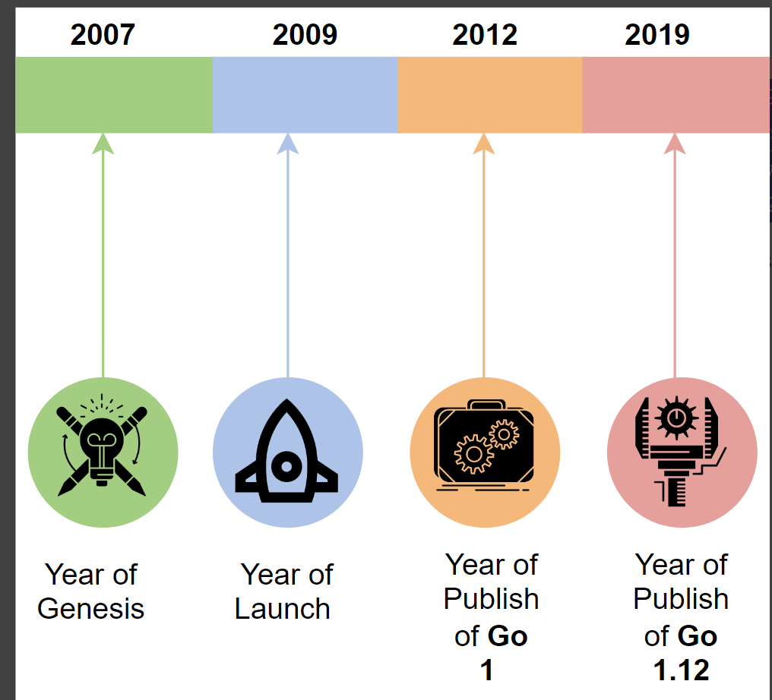
Go’s year of genesis was 2007 at Google, and it was publicly launched in 2009 with a fully open-source BSD-style license released for the Linux and Mac OS platforms. The first Windows-port was announced on November 22 of the same year. Go 1.0 (the first production-ready version) was released in March 2012. Since 2012, Go has grown from version 1.1 to 1.12 (March 2019), and work for Go 2.0 is underway
Historic Evolution of
Go Programming
*

Slide 4
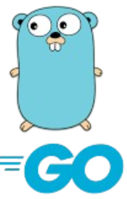
Features found helpful
Concurrency
Defer Keyword
Implicit
Interfaces
Functional Programming Features
Error Handling
Call-by-Value
Binaries
Testing Support

Slide 5
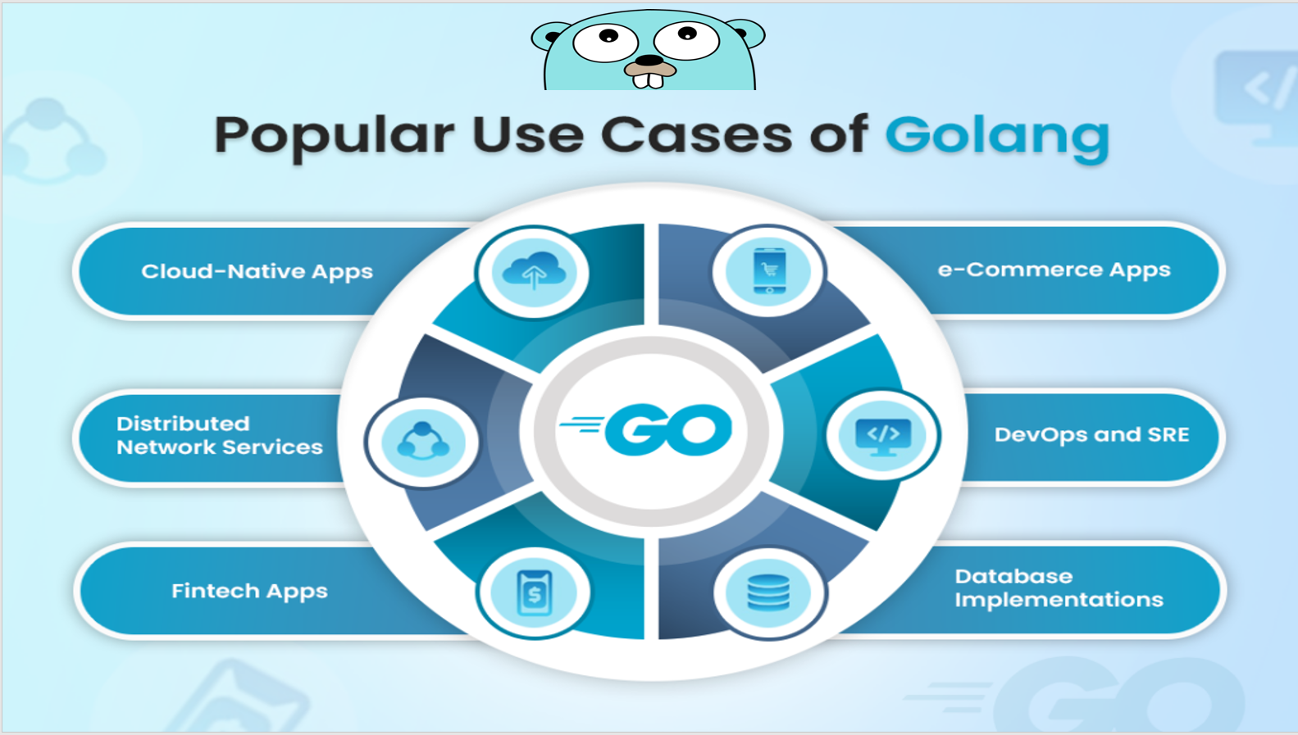
A picture is worth a thousand words

Slide 6
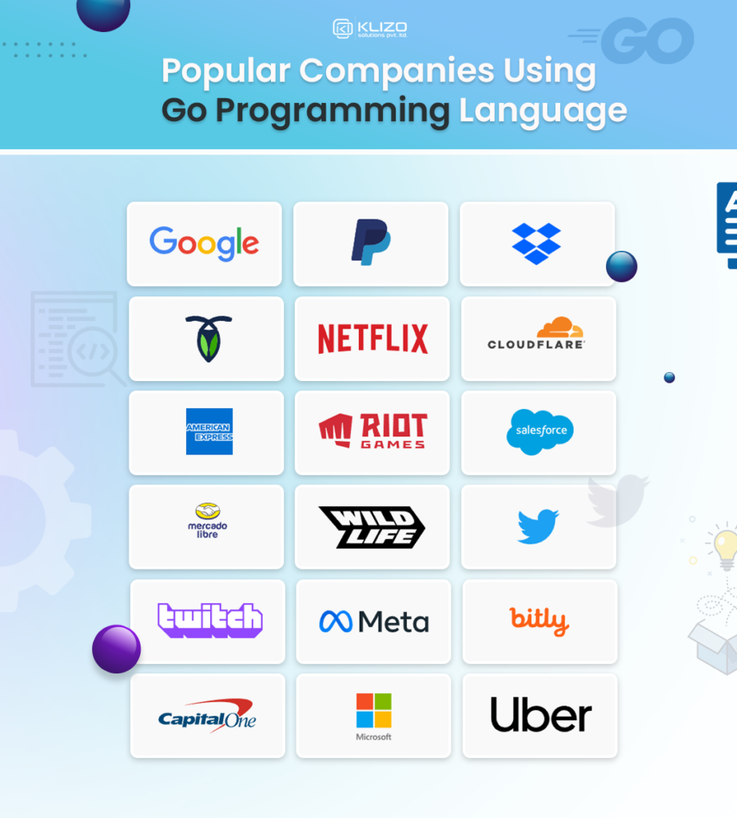
Popular Companies Using
Go Programming
*

Slide 7
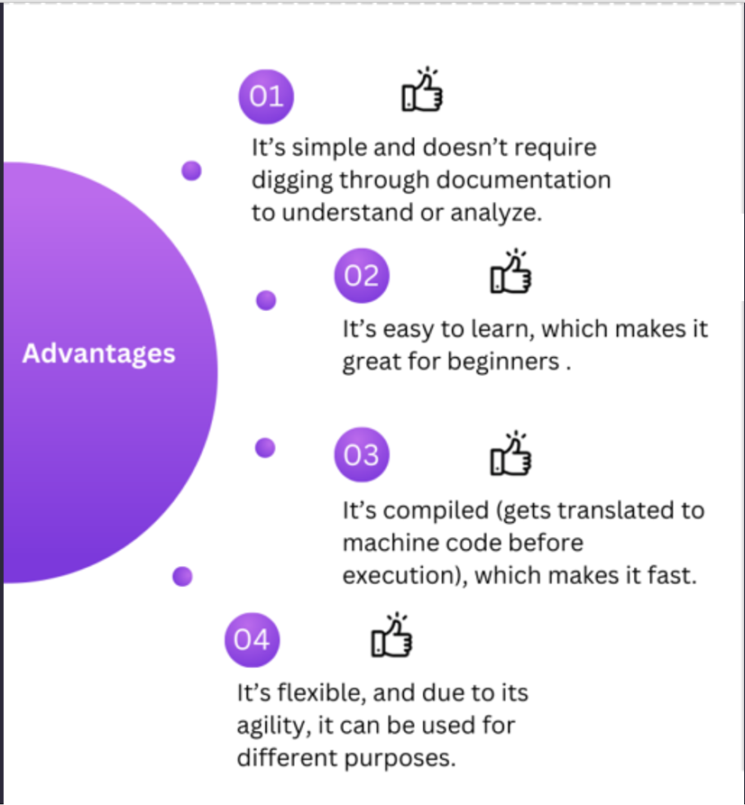
Pros of
Go Language
*

Slide 8
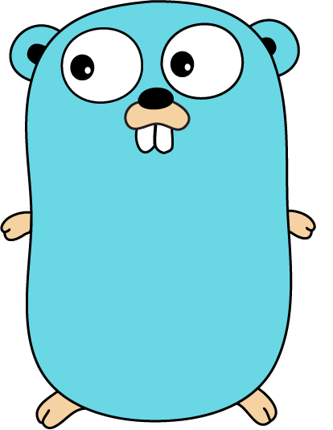
USE CASES
{
}

Slide 9
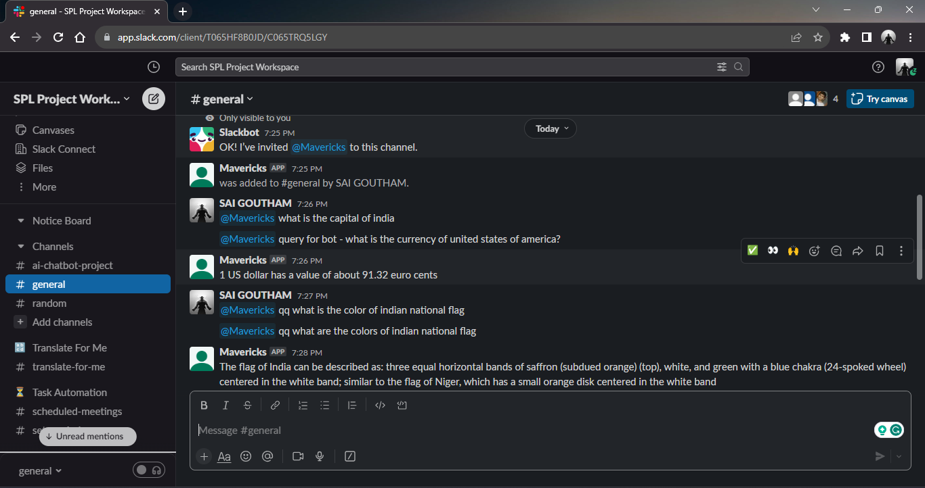
User Assistance

Slide 10
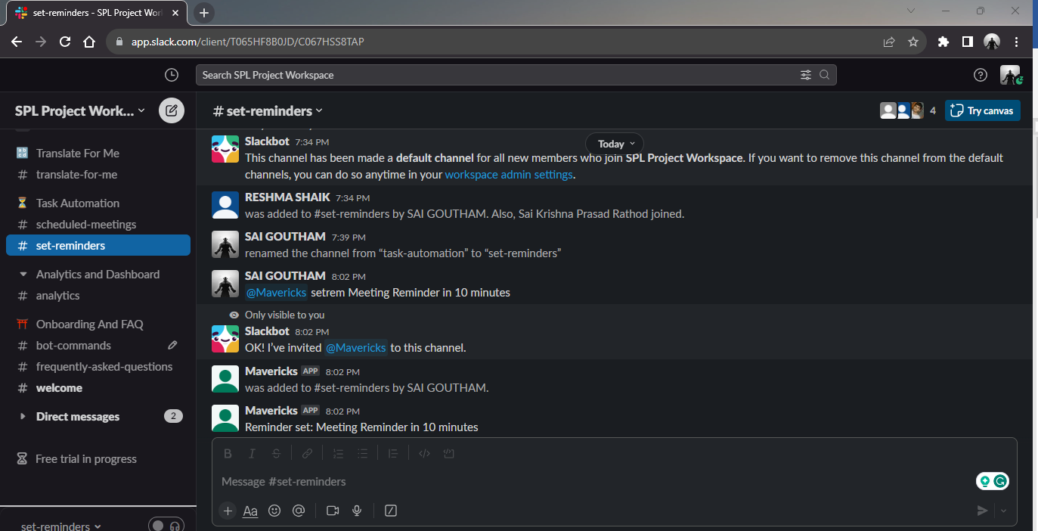
Task Automation

Slide 11
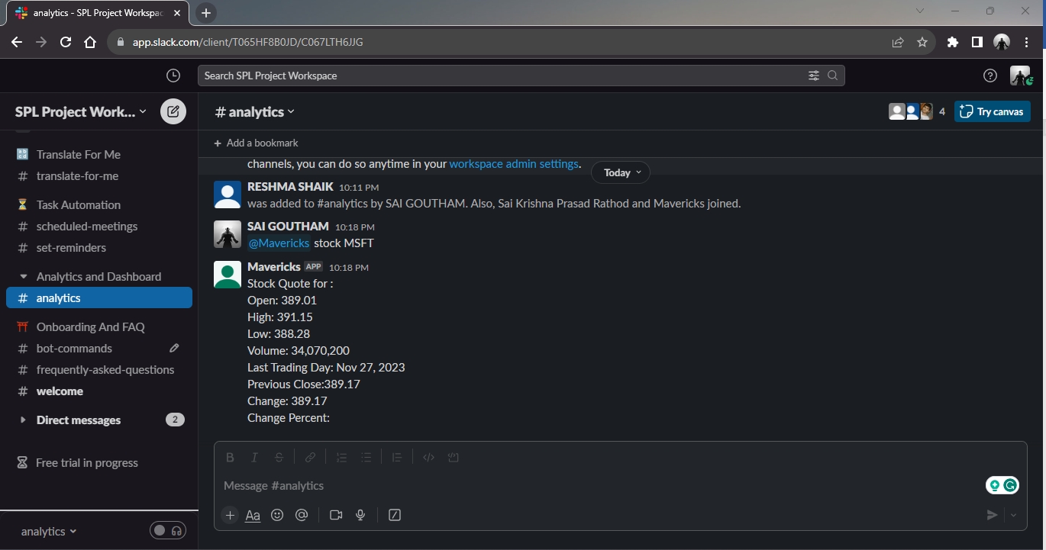
Analytics

Slide 12
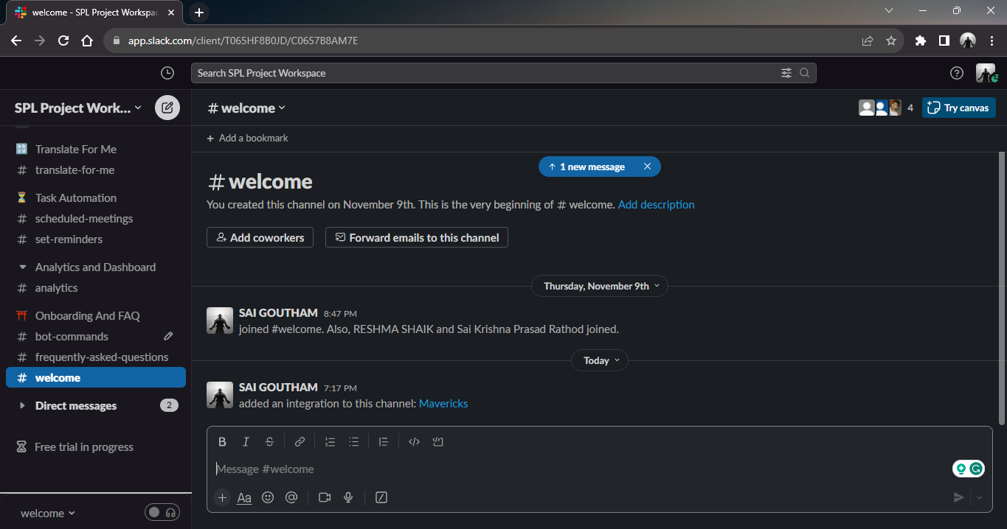
Onboarding & FAQ

Slide 13
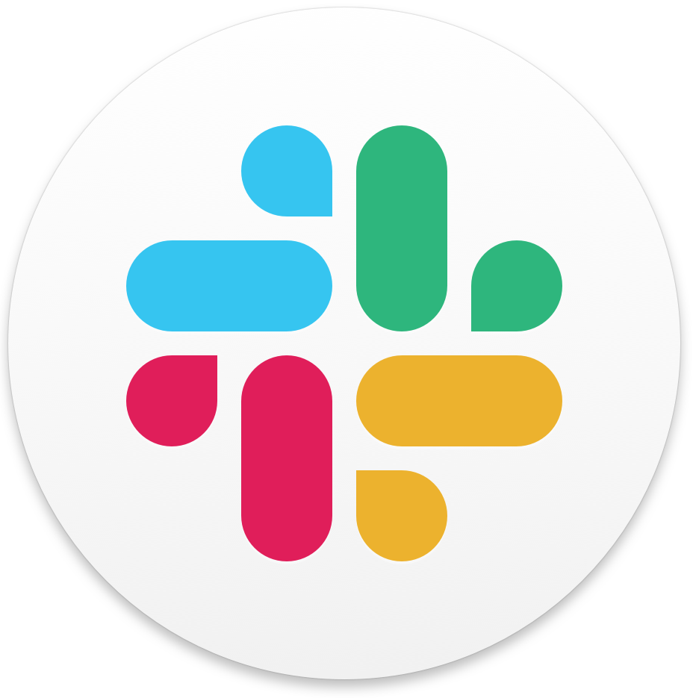
Into the Slack
}
*

Slide 14
