Slide 1

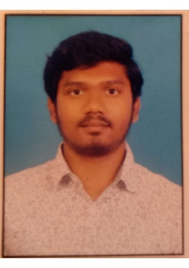



Govardhan
Education
Bachelor of Engineering : 2016 - 2020
Skills
Analyst/Software Engineer
Base Location: Bangalore
Email ID: GOVARDHAN.GOVARDHAN@CAPGEMINI.COM
Mobile No: +918147025716
Grade: A4
Java | OOPS, Collections, Array, Loops, Exceptions.
Spring | Spring Framework, DAOs, Services, Controllers
Database | Postgre SQL
UI Tech | HTML 5 & CSS3, JavaScript, Typescript, Bootsrap
Tools | Git & GitHub, Eclipse, Swagger, Visual Studio Code, SQL shell.
Strengths
Full Stack Developer
Hands on experience on Core java, Spring Boot Jpa, Swagger , Postgre SQL.
Proficient in creating Single page Web Application in Angular with Authentication with routing.
Hands on experience in developing web pages using HTML5, CSS3, TypeScript.
Ready to learn new technologies and implement them for the Future Knowledge improvement.
Achievement
Incentive System for Car Dealer
Case study of Incentive System for Car Dealers with Swagger, backend was design with Spring boot Jpa and with Postgre Sql as database, responsive UI with HTML5, CSS3, Bootstrap and ANGULAR used as User Interface.
https://github.com/41Shahid/one-page-resume.git
Presentation Title | Author | Date © Capgemini 2017. All rights reserved | 1

