Slide 1
MongoDB Relations

Slide 2
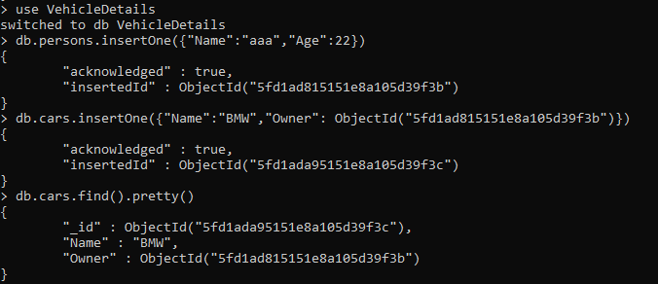
One-to-One

Slide 3


One-to-Many

Slide 4
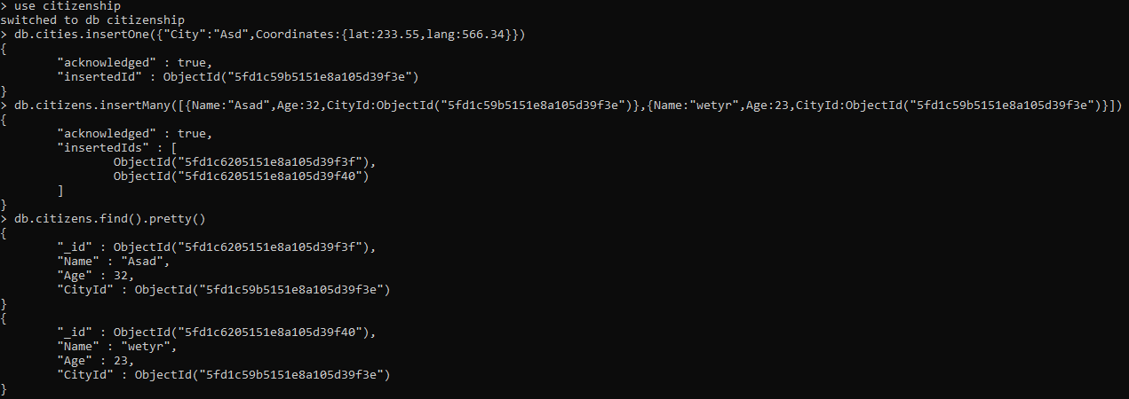
One-to-Many

Slide 5
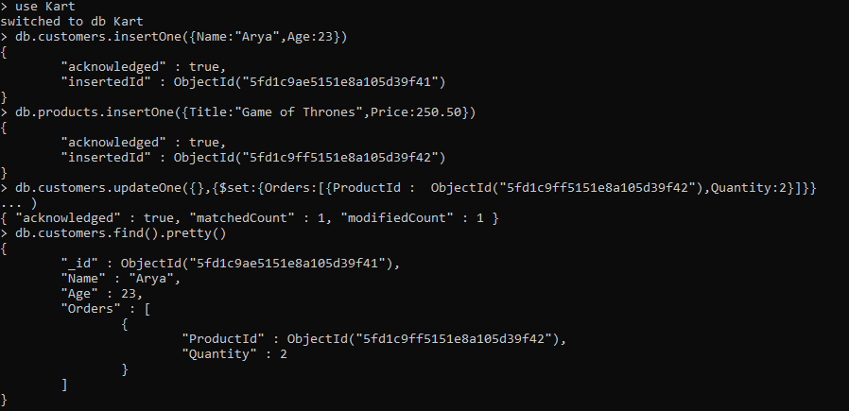
One-to-Many

Slide 6
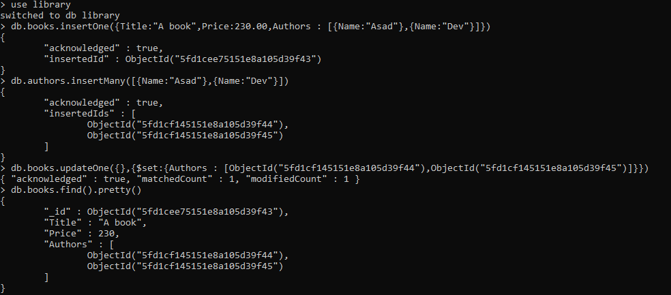
Many-to-Many

Slide 7

Joining using $lookup

Slide 8

Blog-Project

Slide 9
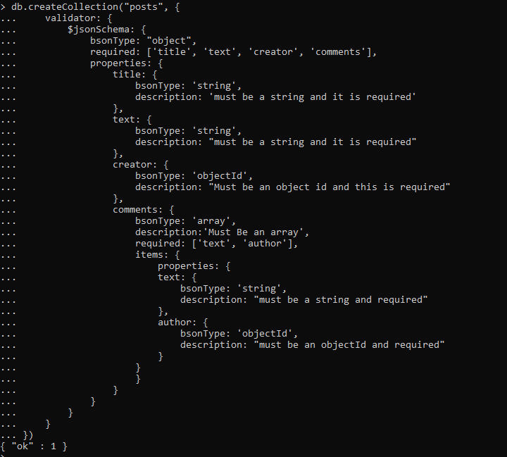
Validator Schema

Slide 10
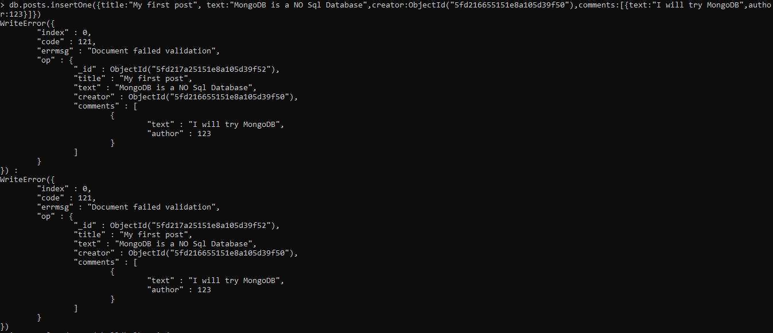
Validator Schema Test

Slide 11
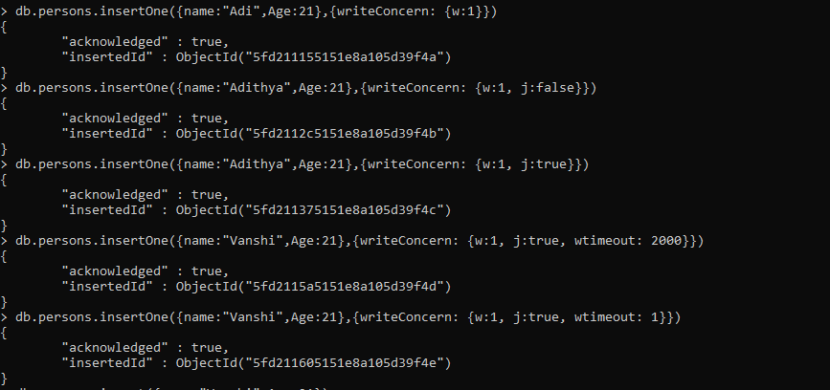
Insert - writeConcern

