Slide 1
Mongo DB

Slide 2
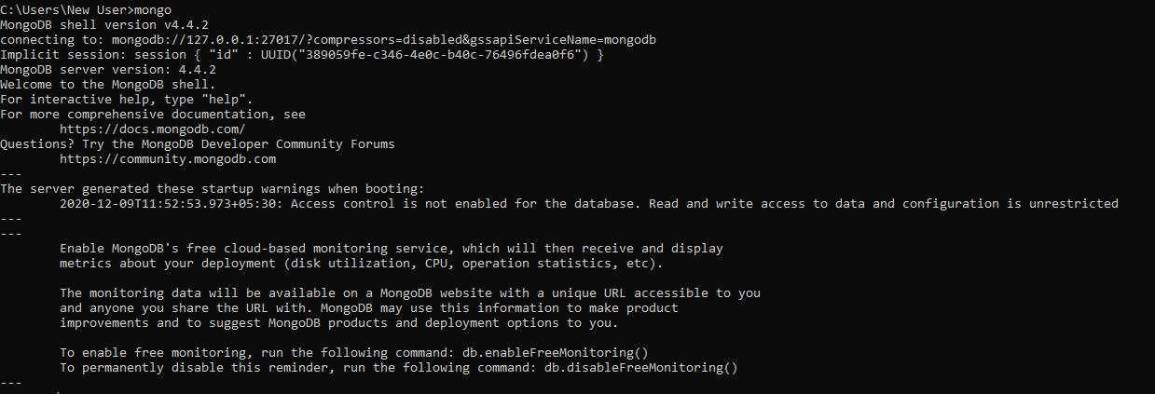
Mongo

Slide 3

Create Database
Display Database

Slide 4


Create Collection
Insert one document

Slide 5
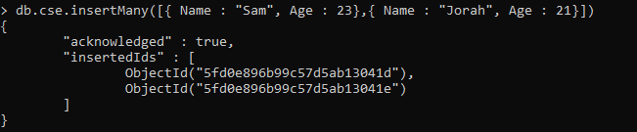
Insert Many Documents
Insert Document with custom ID

Slide 6
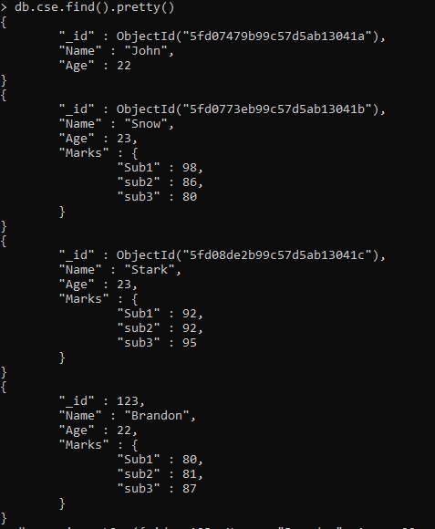
Read All Documents

Slide 7
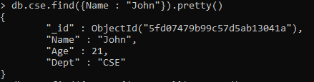
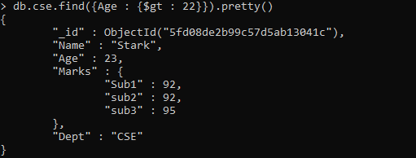
Read Based on Conditions

Slide 8
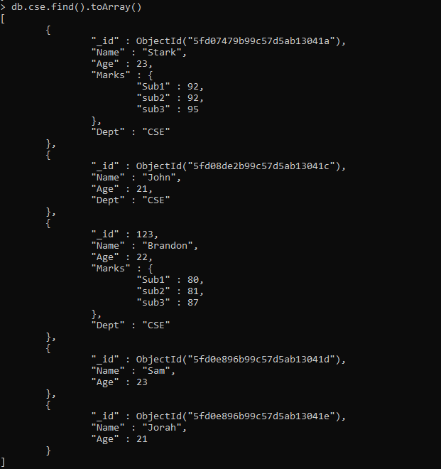
Read As Array

Slide 9

Read a Single Field From Documents
Read Field Value From a Document

Slide 10
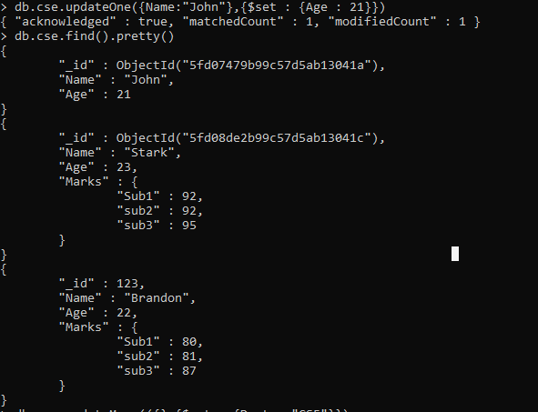
updateOne on Documents

Slide 11
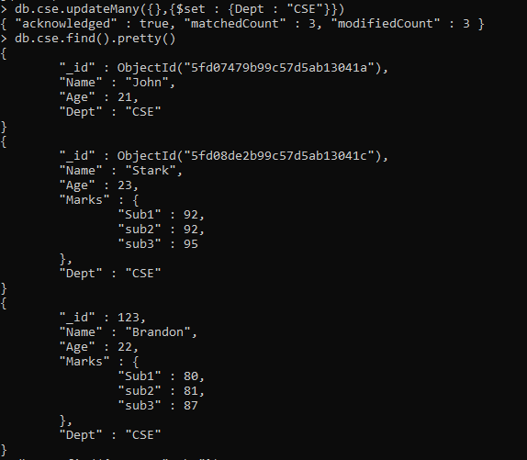
updateMany on Documents

Slide 12
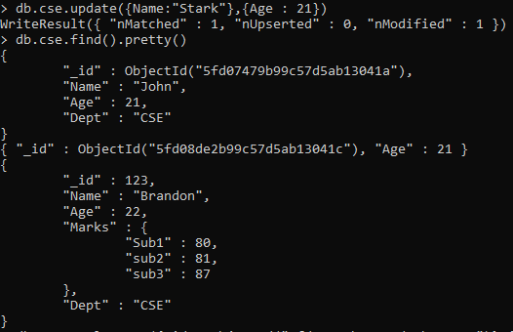
update on document

Slide 13
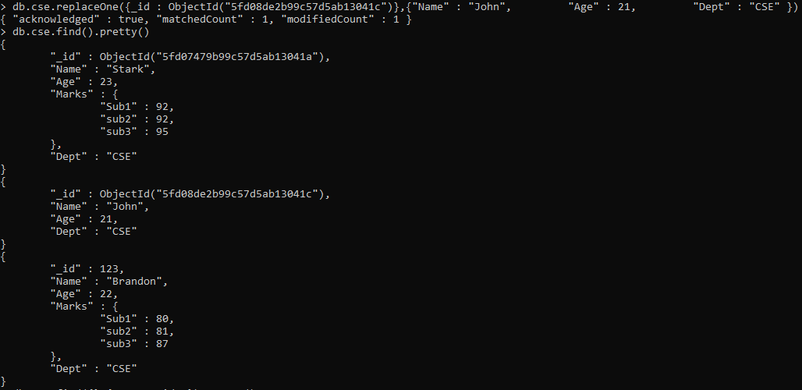
replaceOne on documents

Slide 14
deleteOne on Documents
deleteMany on Documents

