Slide 1
Indexes

Slide 2
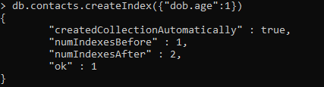
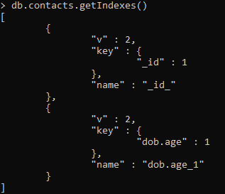
Create Index
Get Index
Drop Index

Slide 3
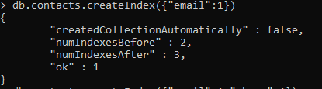
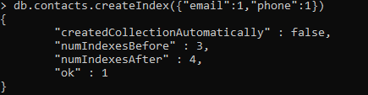
Single Index
Compound Index

Slide 4
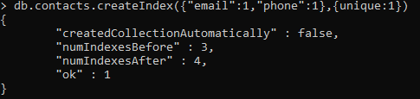
Unique Index
Index created by unique fields or fields should have only unique values

Slide 5
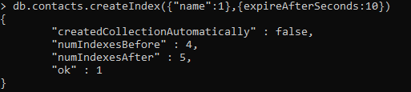
TTL Index
The data indexed based on this index will be expired after specified time in seconds

Slide 6
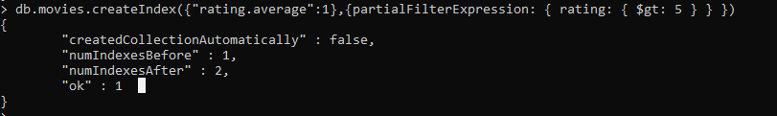
Partial Filter Index
Index is created or used based on specific rules

