Slide 1
Query and Projection Operators

Slide 2
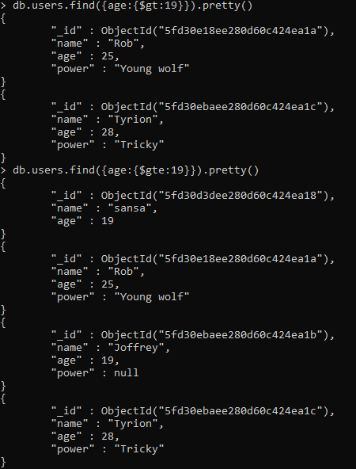
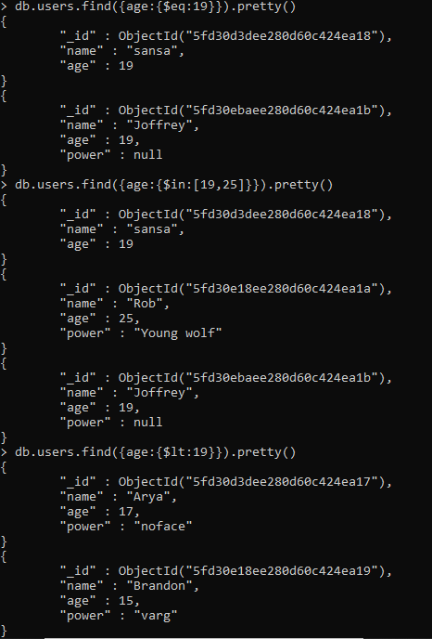
Comparison
$gt
$gte
$eq
$in
$lt

Slide 3
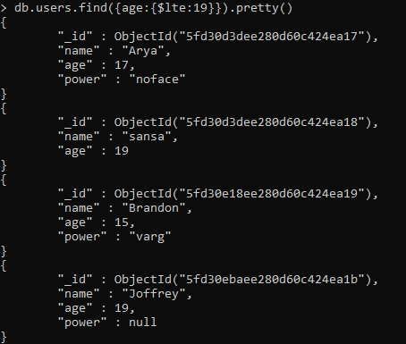
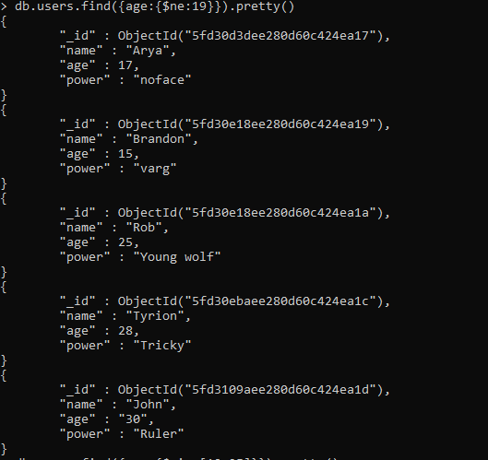
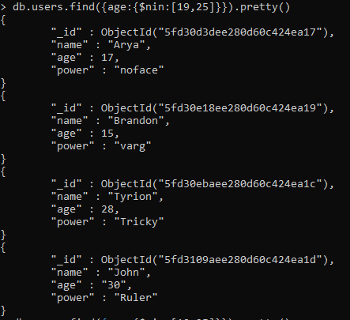
$lte
$nin
$ne

Slide 4
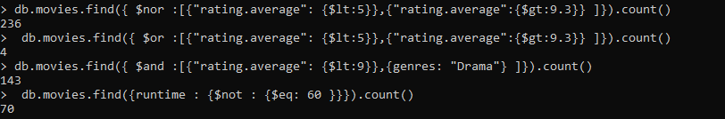
Logical
$and
$or
$nor
$not

Slide 5
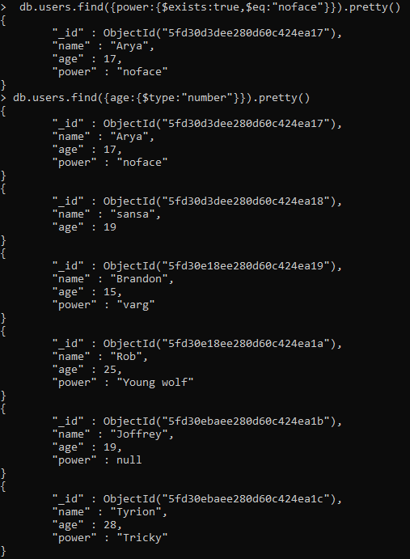
Element
$exists
$type

Slide 6
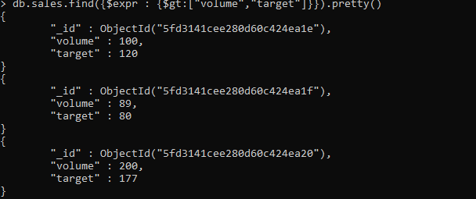
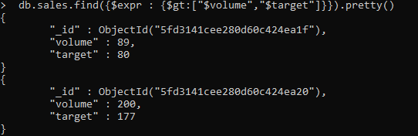
Evaluation
$expr
$regex

Slide 7
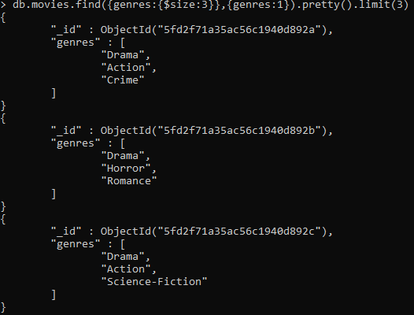
Array Operations
$size

Slide 8
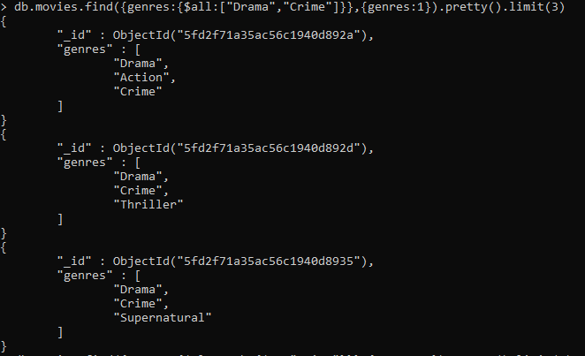
Array Operations
$all

Slide 9
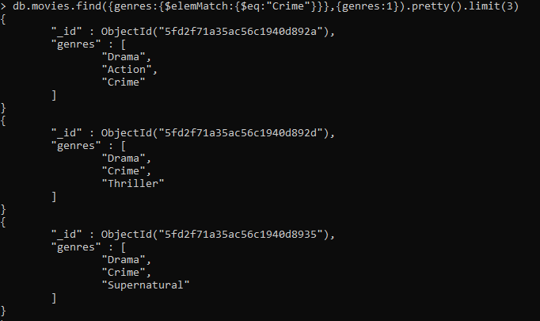
Array Operators
$elemMatch

Slide 10
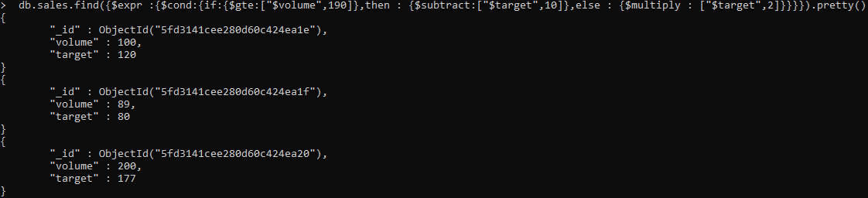
Aggregation Pipeline Operators
$cond
$subtract
$multiply
If – then - else

