Slide 1
SCANS
COLLSCAN
Scans the each document in the collection for processing query
IXSCAN
Process the queries based on the indexes and scans the indexes for results

Slide 2
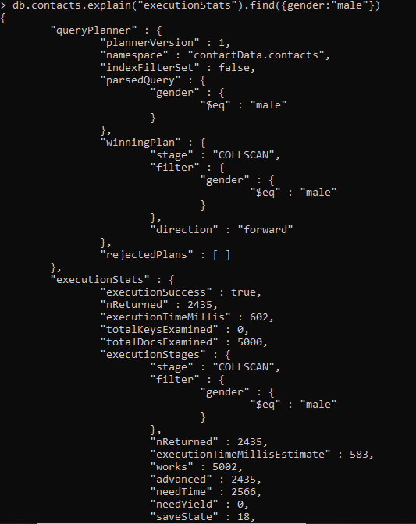
COLLSCAN

Slide 3
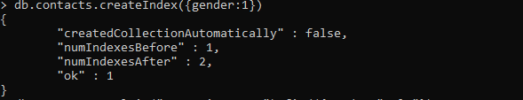
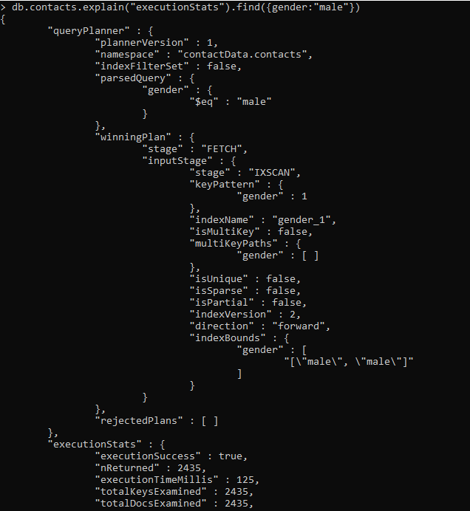
IXSCAN

