Slide 1
Scans-MongoDB
--Govardhan R S
161086

Slide 2
Scan
A collection scan occurs where no index can satisfy the query and we have to scan the full collection in order to find the required documents. See the link for all the information. Further if we have an index on name and query the DB using, d
COLLSCAN for a collection scan
IXSCAN for scanning index keys
FETCH for retrieving documents
SHARD_MERGE for merging results from shards
SHARDING_FILTER for filtering out orphan documents from shards

Slide 3
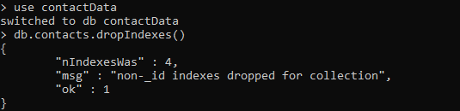

Slide 4
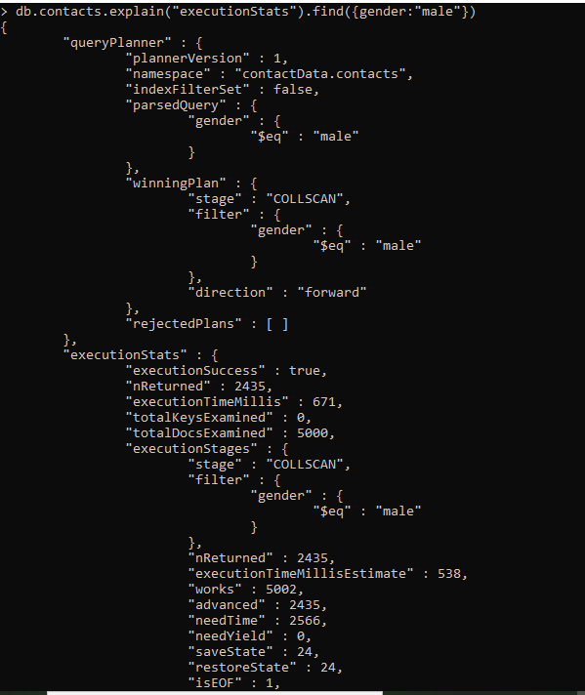

Slide 5
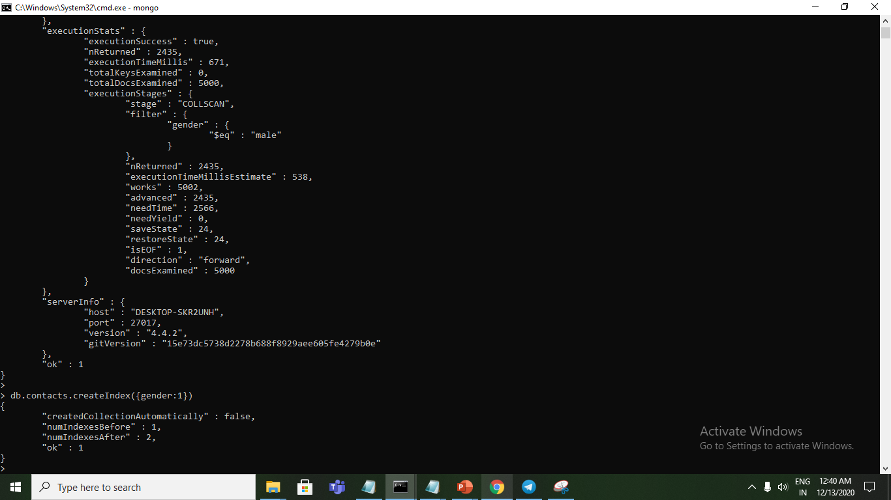

Slide 6
