Slide 1




Introduction to Sentiment Analysis
Sentiment analysis is a powerful tool for understanding the emotional context behind text data. By analyzing the sentiment expressed in customer reviews, social media posts, and other sources, businesses can gain valuable insights to improve their products, services, and customer experience.

Slide 2

Understanding Sentiment
Sentiment analysis is the process of determining the emotional tone behind a series of words, used to gain an understanding of the attitudes, opinions and emotions expressed within an online mention, text, or document. It's a crucial step in natural language processing and text analytics.

Slide 3

Sentiment Analysis Techniques
Sentiment analysis employs a variety of techniques to determine the emotional tone or sentiment within text data. These include machine learning algorithms, lexicon-based approaches, and hybrid models that combine both. The choice of technique depends on the specific use case and the available data.

Slide 4

Sentiment Lexicons and Dictionaries
Sentiment analysis relies heavily on sentiment lexicons and dictionaries - comprehensive lists of words and phrases with associated sentiment scores or labels. These resources are critical for understanding the emotional context and tone within text, enabling accurate sentiment detection.

Slide 5
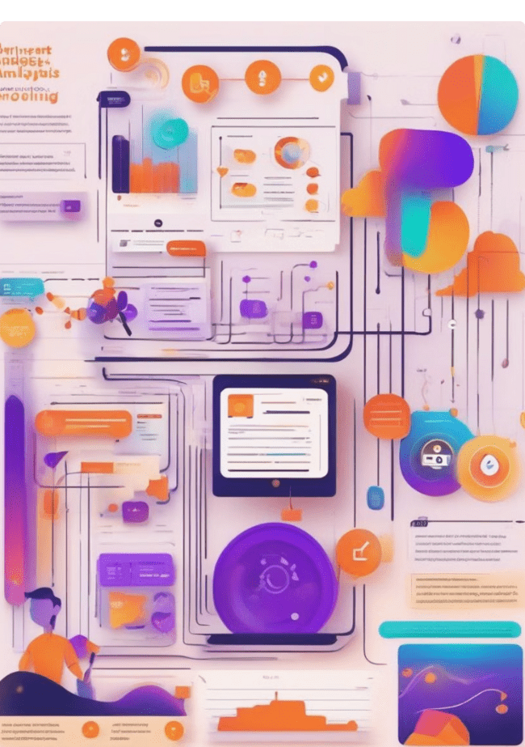
Steps followed in the Sentiment Analysis
Sentiment analysis involves a well-defined process to extract and analyze the emotional content within textual data. This typically includes steps such as data collection, preprocessing, feature extraction, model training, and result interpretation.

Slide 6
Functions used in Sentiment analysis
Sentiment analysis involves a variety of functions to process and interpret text data. These include text preprocessing, feature extraction, sentiment scoring, and classification algorithms. Together, these functions work to identify the emotional tone and sentiment expressed in written content.

Slide 7

Sentiment Analysis Applications
Sentiment analysis has a wide range of applications across various industries, from marketing and customer service to finance and healthcare. By understanding sentiment, businesses can make informed decisions, enhance customer experiences, and drive growth.

Slide 8
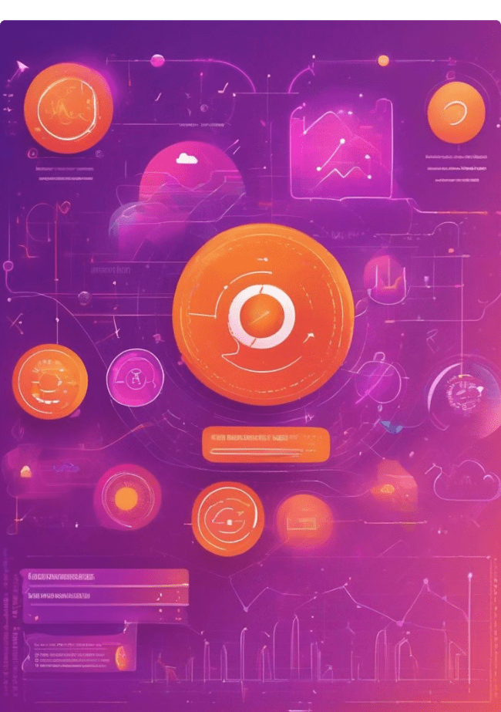
Challenges in Sentiment Analysis
Sentiment analysis faces several challenges, including dealing with sarcasm, idioms, and context-dependent language. Ambiguous or subjective language and lack of labeled training data can also limit the accuracy of sentiment models.

Slide 9



Sentiment Analysis Tools and Libraries
Numerous open-source and commercial tools and libraries are available for sentiment analysis, catering to a variety of needs and use cases. These range from simple sentiment scoring to advanced sentiment classification and topic modeling capabilities.

Slide 10

The Future of Sentiment Analysis
As sentiment analysis continues to evolve, experts predict exciting advancements in its capabilities and applications. From enhanced natural language processing to the integration of multimodal data, the future holds great potential for more accurate, nuanced, and impactful sentiment analysis solutions.

