Slide 1
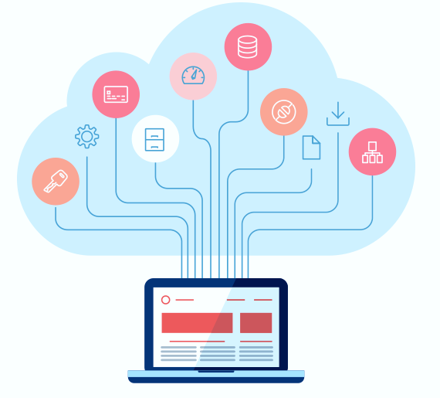
Introduction to
Cloud Computing
Fundamentals of Cloud Computing
Rohit Agrawal
Corporate trainer
OCI , Python, Java, Databases

Slide 2

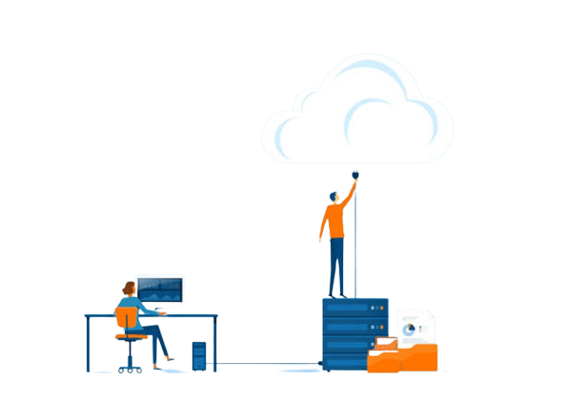
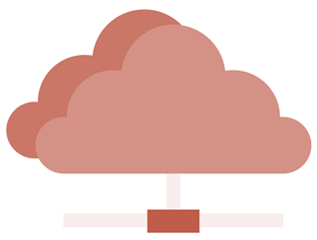
Introduction
What is cloud computing?
Cloud computing refers to the delivery of computing services over the internet, including storage, processing power, and software applications.
It allows users to access resources and services on-demand, without the need for physical infrastructure or local servers.

Slide 3
Characteristics of Cloud Computing
Key Characteristics of Cloud Computing
On-Demand Self-Service: Users can provision resources and services as needed, without requiring human interaction with service providers.
Broad Network Access: Services are accessible over the internet via standard protocols and devices.
Resource Pooling: Computing resources are pooled together to serve multiple users, allowing for efficient utilization and scalability.
Rapid Elasticity: Resources can be scaled up or down quickly to meet changing demands.
Measured Service: Cloud service usage is measured, monitored, and billed based on actual consumption.

Slide 4
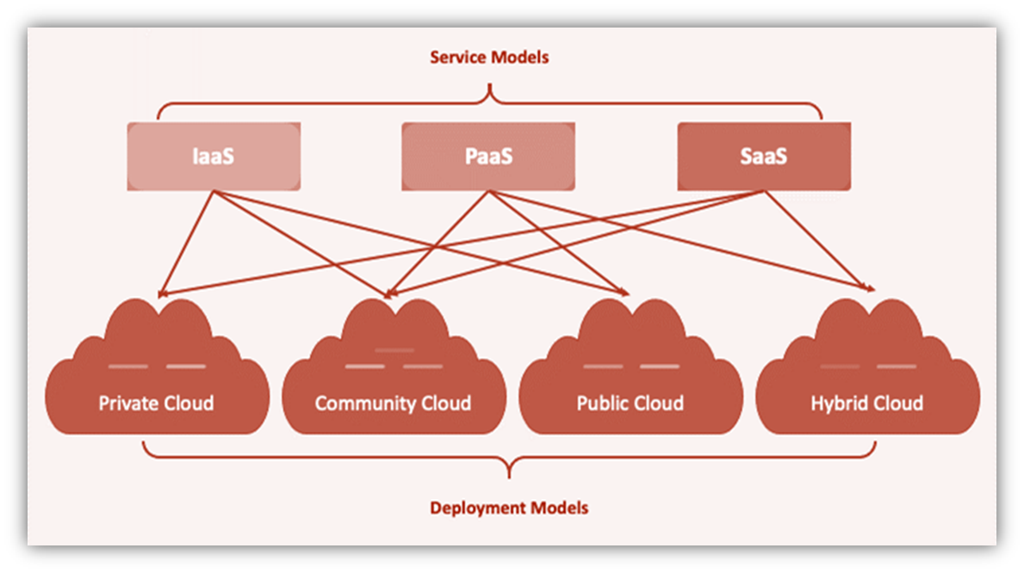
Cloud Deployment Models

Slide 5
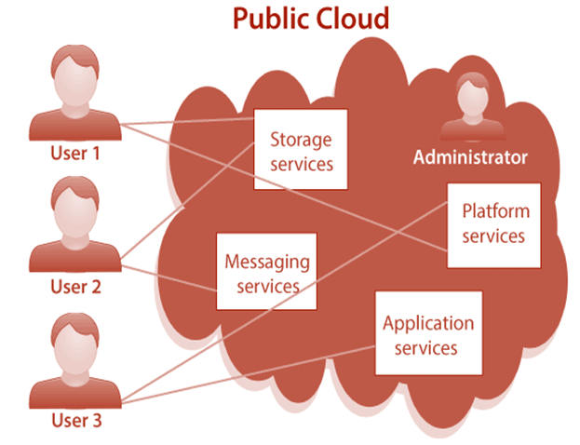
Cloud Deployment Models
Public Cloud
Services are provided over a public network and available to anyone who wants to use them.
It is a cost-effective option for businesses and individuals looking for scalability and flexibility.
Public cloud providers, such as Oracle (OCI),AWS, Azure, and GCP, offer a wide range of services accessible to the general public.

Slide 6
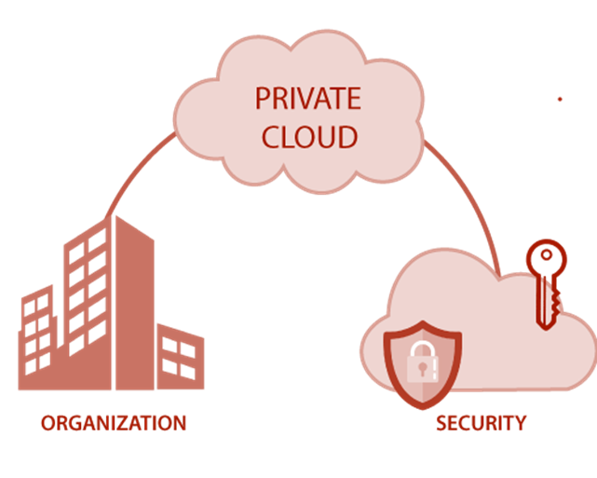
Cloud Deployment Models
Private Cloud
Infrastructure is dedicated to a single organization and may be located on-premises or off-premises.
Private cloud environments are designed to meet specific security, compliance, or performance requirements.
They offer enhanced control, customization, and privacy but require significant upfront investment.

Slide 7
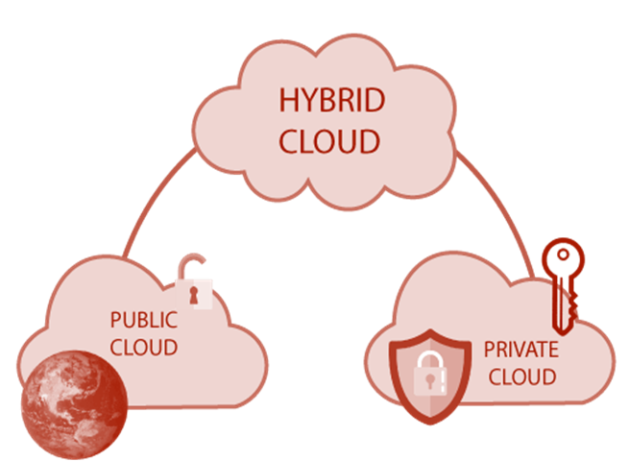
Cloud Deployment Models
Hybrid Cloud
Combines public and private cloud environments, allowing for flexibility and data sharing between the two.
Organizations can leverage the benefits of both public and private clouds, ensuring optimal resource allocation.
Hybrid cloud deployments enable workload portability and seamless integration between different environments.

Slide 8
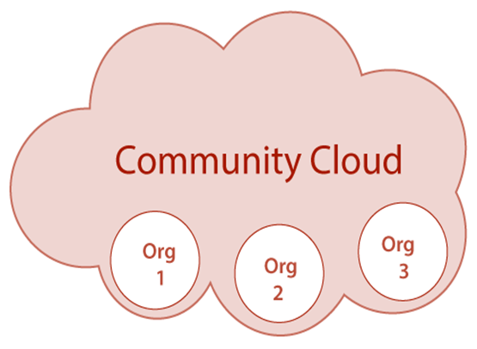
Cloud Deployment Models
Community Cloud
Community cloud is a deployment model where infrastructure and services are shared among a specific community or group of organizations.
It caters to the needs of a particular community, such as government agencies, educational institutions, or research organizations.
Community cloud provides a cost-effective solution while addressing specific requirements and compliance standards of the community.

Slide 9
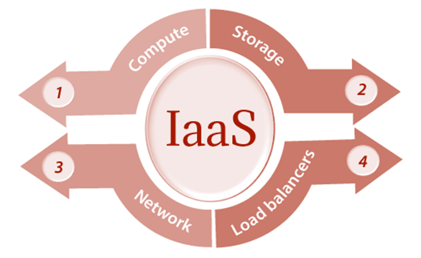
Service Models
Infrastructure as a Service (IaaS)
IaaS provides virtualized computing resources over the internet. Users have control over the operating systems, storage, and networking components.
They can provision and manage virtual machines (VMs), storage, and networks according to their requirements. Examples of IaaS providers include - OCI – Networking, Compute and Storage, AWS EC2, Azure Virtual Machines, and Google Compute Engine.

Slide 10
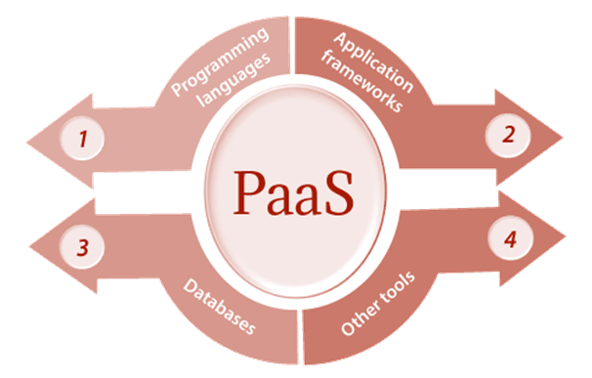
Service Models
Platform as a Service (PaaS)
PaaS offers a platform for developing, testing, and deploying applications.
Users can focus on application development without worrying about infrastructure management.
PaaS providers manage the underlying infrastructure, including servers, storage, and networking.
Developers can leverage pre-configured environments, development frameworks, and deployment tools.
Examples of PaaS providers include –OCI – Migration to cloud, app dev , Cloud Application Foundations, Analytics etc

Slide 11
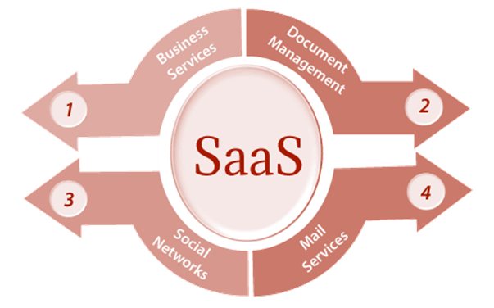
Service Models
Software as a Service (SaaS)
SaaS delivers software applications over the internet on a subscription basis.
Users can access and use applications directly through a web browser or APIs.
The provider hosts and manages the underlying infrastructure, application, and data.
Users can typically customize certain aspects of the application to fit their needs.
Examples of SaaS include –Oracle financials, EPM, SCM, HCM, Advertising and Customer experience etc etc

Slide 12
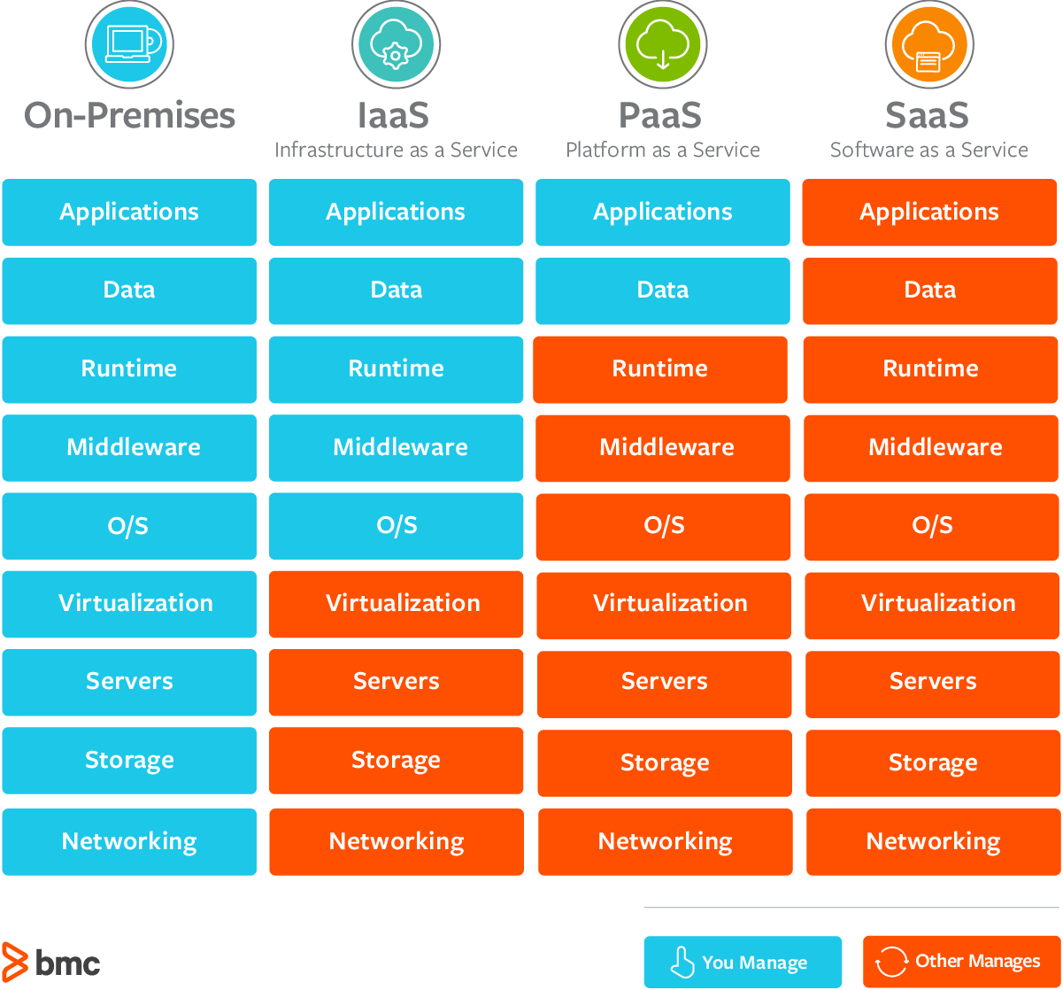
Service Models: IaaS vs PaaS vs SaaS

Slide 13
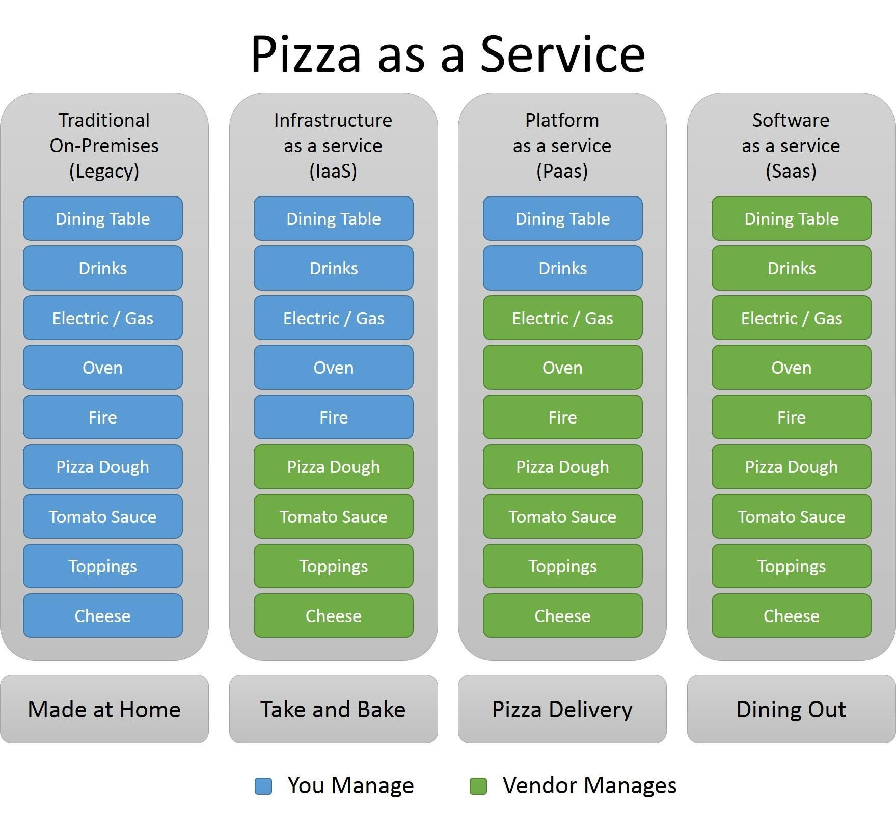
Service Models Example

Slide 14
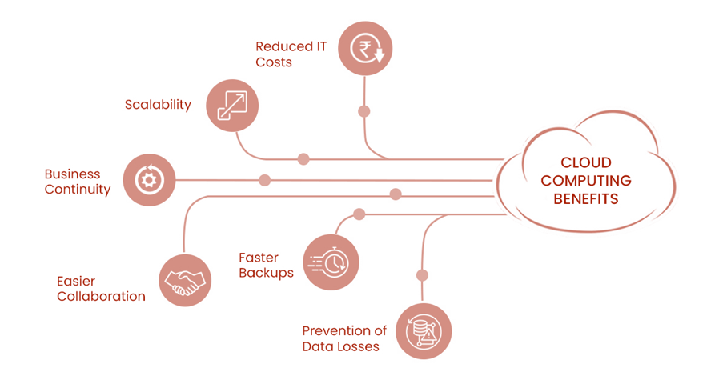
Benefits of Cloud
Cost Savings: Pay for what you use, with no upfront infrastructure costs.
Scalability: Easily scale resources up or down based on demand.
Flexibility: Access resources and applications from anywhere with an internet connection.
Reliability: Cloud providers typically offer high uptime and data redundancy.
Collaboration: Enable seamless collaboration and data sharing among teams.

Slide 15
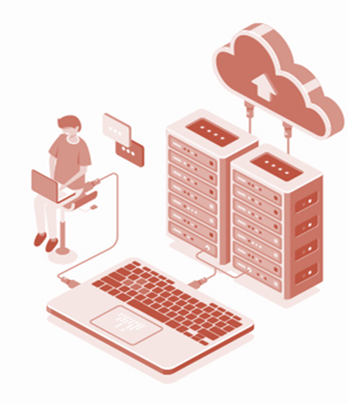
Common Cloud Computing Use Cases
Data Storage and Backup: Store and back up large amounts of data securely.
Software Development and Testing: Rapidly create and deploy applications in a scalable environment.
Web and Mobile Applications: Host web and mobile applications in the cloud for global accessibility.
Big Data Analytics: Process and analyze vast amounts of data using cloud resources.
Disaster Recovery: Maintain data backups and recovery plans in the cloud for business continuity.

Slide 16
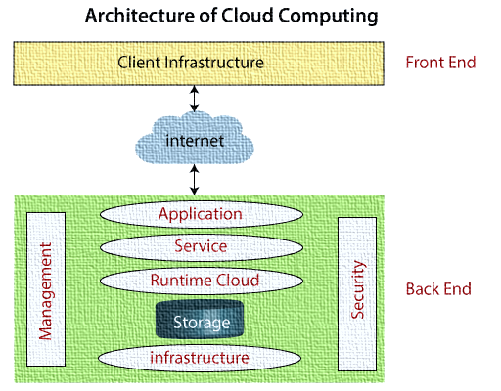
Cloud Architecture
Cloud architecture refers to the design and structure of cloud computing environments, including the arrangement of components and the relationships between them.
It involves various elements that work together to deliver cloud services and ensure reliability, scalability, and security.

Slide 17
Conclusion
Cloud computing enables the delivery of computing services over the internet, eliminating the need for local infrastructure.
Key characteristics of cloud computing include on-demand self-service, broad network access, resource pooling, rapid elasticity, and measured service.
Deployment models include public, private, and hybrid clouds, offering flexibility and data sharing options.
Service models such as IaaS, PaaS, and SaaS provide virtualized computing resources, platform for application development, and software delivery respectively.
Cloud computing offers benefits like cost savings, scalability, flexibility, reliability, and enhanced collaboration.
Cloud computing presents a transformative approach to computing, offering cost-effective solutions, scalability, and flexibility for organizations across various industries. By leveraging the benefits of cloud computing and aligning with the appropriate deployment and service models, organizations can drive innovation, improve efficiency, and adapt to evolving business needs.

Slide 18
Remember
Understand your specific needs and requirements when selecting a cloud deployment and service model.
Prioritize security measures such as data encryption and access controls to protect against unauthorized access.
Plan for disaster recovery and high availability to ensure business continuity.
Continuously monitor and optimize resource utilization for optimal performance and cost savings.
Regularly assess and adapt your cloud architecture to evolving business needs and emerging technologies.

Slide 19

THANK YOU

