Slide 1
VidyaSetu (Smart Solutions for Rural Education)
CSE7301 University Project
Review-4
Batch Number: CSE_G65
Roll Number | Student Name
20211CSE0634 | VEDAKUMARA K H
20211CSE0654 | GIRISH GOWDA H P
20211CSE0660 | GOVARDHAN M
Under the Supervision of,
Dr. Naveen N M,
Associate Professor
CSE
School of Computer Science and Engineering
Presidency University
Name of the Program: CSE
Name of the HoD: Dr.Asif Mohammed H.B
Name of the Program Project Coordinator: Dr. Jayanthi. K.
Name of the School Project Coordinators: Dr. Sampath A K / Mr. Md Ziaur Rahman

Slide 2

Abstract
Rural education in India encounters numerous obstacles, primarily due to poor infrastructure, weak internet connectivity, and limited availability of quality learning materials. These issues prevent students from accessing a well-rounded education, thereby deepening the divide between urban and rural learning environments. This project aims to address these disparities by introducing customized software solutions designed specifically for rural schools. The proposed approach includes several innovative features: cloud-enabled virtual classrooms for both live and on-demand sessions, systems for efficient distribution of textbooks and digital resources, tools to optimize internet usage for consistent connectivity, and platforms to develop curriculum-aligned multimedia lessons. To support areas with limited connectivity, offline-capable mobile learning applications will be provided. Furthermore, data analytics will be used to guide infrastructure planning and improve resource distribution and policy making. By implementing these technologies, the project aspires to increase access to education, boost student engagement, and improve academic outcomes in rural areas. This integrated strategy aims to empower schools, strengthen digital infrastructure, and contribute significantly to the advancement of rural education in India.

Slide 3
Github Link
Link to our project: Click me

Slide 4
Literature Survey
Serial Number | Paper
1 | E-Learning for Rural Development in India: Closing Disparities and Enhancing Opportunities
2 | Online Education in Rural India: Issues and Challenges
3 | Technology and Rural Education
4 | E-Learning in Rural India
5 | Using Technology to Overcome the Challenge of Place and Space in Rural Education
6 | The Digital Revolution in India: Bridging the Gap in Rural Technology Adoption
7 | The Challenges and Solutions of Technology Integration in Rural Schools: A Systematic Literature Review
8 | A Study on Challenges and Solutions for Implementing Digital Literacy Programmes in India's Rural Areas
9 | Rural Schools and the Digital Divide: Technology in the Learning Experience
10 | Scrutinizing E-Learning in Rural India: COVID-19 Pandemic

Slide 5
Objectives
Enhance Digital Learning Access
Provide a structured online platform to facilitate remote education for students in rural areas.
Develop a virtual classroom system with live and recorded sessions for flexible learning.
Optimize Educational Resource Management
Create a digital repository for books, study materials, and e-learning content.
Ensure efficient distribution and access to learning resources.
Improve Connectivity and Infrastructure
Develop tools to optimize internet connectivity for seamless online learning.
Enable offline access to essential educational content through mobile applications.
Personalized Learning Experience
Implement a user-friendly Dashboard for students, teachers, and administrators to track progress and engagement.
Provide insights through data analytics to improve learning outcomes.
Promote Community Engagement and Collaboration
Establish an interactive Community section for students and educators to share knowledge and experiences.
Encourage discussions, mentorship, and peer-to-peer learning.
Ensure Scalability and Sustainability
Design the platform to be adaptable for different educational institutions and learning environments.
Use modern technologies to maintain a visually appealing, responsive, and user-friendly interface.

Slide 6
Existing Methods with Drawbacks
Traditional Classroom-Based Learning
Method: Education is delivered in physical classrooms with textbooks and face-to-face teaching.
Drawbacks: Limited infrastructure, lack of trained teachers, and unavailability of quality learning materials in rural areas hinder effective education.
Offline Learning with Printed Materials
Method: Schools provide printed books and notes to students for self-study.
Drawbacks: No interactive learning experience; outdated and limited content; students struggle without proper guidance.
Government E-Learning Portals (e.g., SWAYAM, DIKSHA)
Method: Online platforms provide free digital courses and study materials.
Drawbacks: Requires stable internet access, which is often unavailable in rural areas; lacks interactive engagement for students.
Mobile Learning Apps (BYJU’S, Unacademy, Vedantu, etc.)
Method: Mobile apps provide interactive video lessons, quizzes, and live classes.
Drawbacks: Subscription costs make them inaccessible to underprivileged students; heavy reliance on internet connectivity limits their usability in remote areas.

Slide 7
Proposed Method
Centralized Digital Learning Platform
The platform will serve as a one-stop solution for students, teachers, and educational institutions in rural areas, offering a structured and accessible online learning experience. It will integrate essential educational services such as virtual classrooms, resource management, and community engagement into a single digital ecosystem, simplifying the process of accessing quality education.
Virtual Classroom and Live Learning
A cloud-based virtual classroom will be implemented to enable live streaming of lectures, real-time interaction, and recorded sessions for later access. Interactive tools like quizzes, discussion boards, and collaborative whiteboards will enhance student engagement and improve learning outcomes.
Educational Resource Management System
The platform will provide a centralized repository for managing textbooks, digital content, and multimedia learning materials. Teachers will be able to upload, organize, and distribute study materials efficiently, while students can access and download content even in low-connectivity environments.
Mobile and Web Accessibility
To maximize reach, the platform will be developed as both a web application and a mobile, ensuring accessibility across different devices.

Slide 8
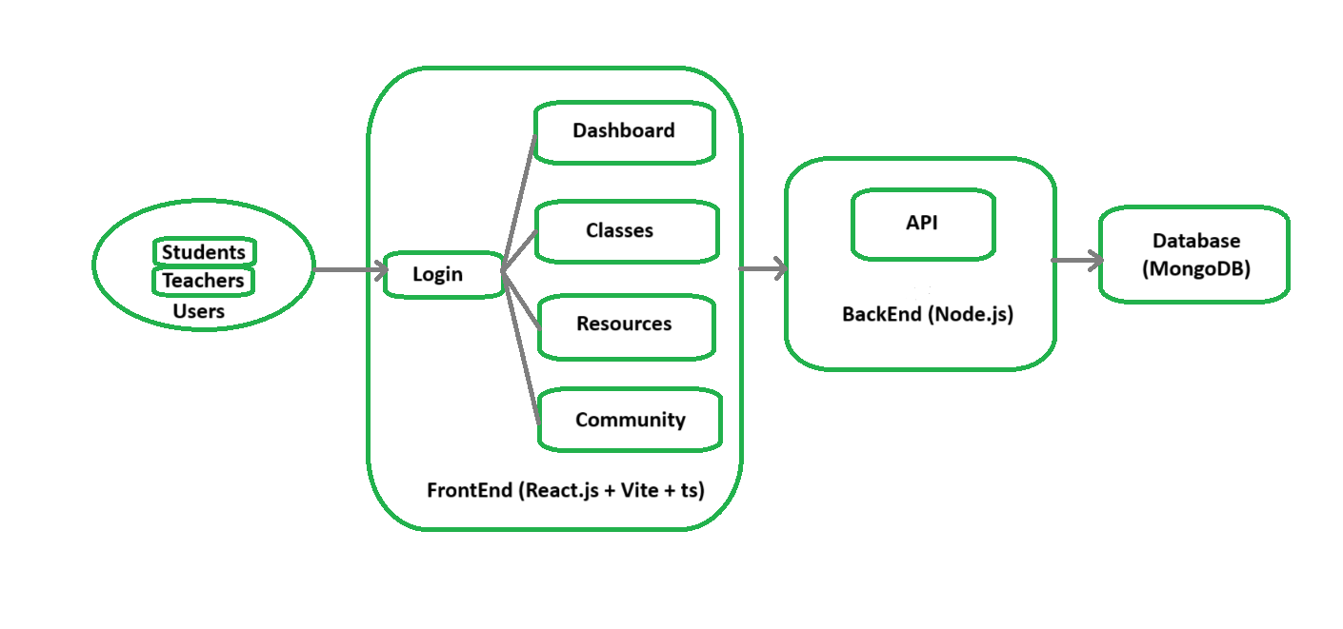
Architecture Diagram

Slide 9
Modules
Technology Stack Components:
Frontend
React.js – For building fast, component-based user interfaces
TypeScript – Ensures type safety and better code maintainability
Vite – Lightweight and fast bundler for React applications
Tailwind CSS – Utility-first CSS framework for responsive design
Framer Motion – For smooth animations and transitions in the UI
Other Tools and Integrations
Google Calendar API – To set class reminders and schedules
Google Meet – Integrated for live virtual class sessions

Slide 10
Software and Hardware Details
Software Requirements:
Operating System: Windows/Linux/Mac
Mobile/Web Framework: React.js (web)
Database: MongoDB
Programming Language: JavaScript (React.js)
API Framework: REST API
IDE: Visual Studio Code
Version Control: GitHub
Hardware Requirements:
Processor: Intel i5 or higher
RAM: 8GB or more
Storage: 256GB SSD or more

Slide 11
Timeline of the Project (Gantt Chart)
Project Initialization
Requirement Gathering & Analysis [01/02/25 - 10/02/2025]
Technology Stack Setup [11/09/24 - 21/02/24]
Design Phase
System Architecture Design [15/02/25 – 25/02/24]
UI/UX Design [25/02/25 – 05/03/25]
Backend Development [10/03/25 – 01/04/25]
Frontend Development [06/03/25 – 01/04/25]
Development Phase
Deployment & Documentation
Database Integration [15/03/25 – 01/04/25]
Deployment [02/04/24 – 12/04/25]
Final Documentation [13/04/25 – 20/4/25]

Slide 12
Expected Outcomes
Enhanced Accessibility to Quality Education
Students and teachers from rural areas gain access to structured and interactive learning materials.
Learning resources are available anytime, reducing dependency on traditional classroom infrastructure.
Support for low-connectivity environments through offline access to educational content.
Interactive and Engaging Learning Experience
Virtual classrooms enable real-time interaction between students and teachers, improving engagement.
Features like quizzes, collaborative whiteboards, and discussion forums enhance participation.
Recorded sessions allow students to revisit lessons anytime for better understanding.
Efficient Educational Resource Management
Centralized repository ensures all learning materials (textbooks, videos, quizzes) are well-organized.
Teachers can easily upload and update content without technical difficulties.
Students can search, access, and download study materials effortlessly.
Inclusive Learning for Underprivileged Students
Provides free or affordable learning solutions, bridging the gap between urban and rural education.
Mobile and web-based access ensures learning is available on different devices.
Encourages community-driven learning, allowing students to collaborate and grow together.

Slide 13
References
[1] M. Campaña-Cordova, F. Castillo-Ledesma, J. Oleas-Orozco, H. Moncayo, and F. Avilés-Castillo, "Enhancing the teaching of natural sciences in rural environments through educational videos," in Proc. IEEE, 2024. [Online]. Available: [Link]
[2] V. R. Bhanotu, "Online education in rural India—Issues and challenges," in A Study on Corporate Governance Practices in USA, UK & India: A Comparative Analysis, Dec. 2023. [Online]. Available: [Link]
[3] P. Kumar and A. Das, “E-Learning in Rural India,” IJSET, vol. 5, no. 2, pp. 10-15, 2016. [Online]. Available: [Link].
[4] A. Sharma and B. Nair, “The Digital Revolution in India: Bridging the Gap in Rural Technology Adoption,” SpringerOpen, vol. 12, no. 3, pp. 225-238, 2024. [Online]. Available: [Link].
[5] Y. Zeng, Y. Zheng, X. Li, and H. Ma, "An effective path for rural teachers to use digital education resources in Chinese underdeveloped areas: A study based on grounded theory," in Proc. IEEE, 2024. [Online]. Available: [Link]

Slide 14
References
[6] V. B. Hans, “E-Learning for Rural Development in India: Closing Disparities and Empowering Communities”, Srinivas University, Mangalore, India, Jan. 22, 2024. [Online]. Available: [Link]
[7] F. Mustafa, H. T. M. Nguyen, and A. Gao, "The challenges and solutions of technology integration in rural schools: A systematic literature review," Int. J. Educ. Res., vol. 126, p. 102380, May 2024. [Online]. Available: [Link]. doi: 10.1016/j.ijer.2024.102380.
[8] J. S. Kumar and D. Shobana, "A study on challenges and solutions for implementing digital literacy programmes in India's rural areas," in Proc. ICSSR-Sponsored Int. Seminar on Building a Cognitive Enterprise through AI-Powered Transformation: A Digital Paradigm for Societal and Tribunal Success in Rural Areas, Coimbatore, Tamil Nadu, India, Jul. 2024. [Online]. Available: [Link]
[9] E. Kormos and K. Wisdom, "Rural schools and the digital divide: Technology in the learning experience," Tech. Pedagog. Educ., vol. 11, no. 1, pp. 25–39, 2021. [Online]. Available: [Link]
[10] Scrutinizing E-Learning in Rural India: COVID-19 Pandemic, ScienceOpen, [Online]. Available: [Link]

Slide 15

Project work mapping with SDG
The developed software solution focuses on enhancing education infrastructure and connectivity in rural areas.
Aligns with SDG 4 – Quality Education by:
Promoting inclusive and equitable access to learning resources.
Utilizing digital platforms to support education in remote areas.
Supports SDG 9 – Industry, Innovation and Infrastructure by:
Improving digital infrastructure in rural regions.
Fostering technological innovation in underserved areas.

Slide 16


