Slide 1

cv
A BLOCKCHAIN-BASED
HEALTH INFORMATION EXCHANGE
WITH A PATIENT-CENTRIC APPROACH
Phase 2 – Review 2
Final Review
Team members
Govardhan R
Jagadeesh V Ranagatti
Lakshminath S M
Linganand Sangamad
Under the guidance of
Dr. Nagaraja J,
Associate Professor,
Dept of Computer Science and Engineering
Department of Computer Science & Engineering, DSCE

Slide 2
TABLE OF CONTENTS
Abstract 03
Introduction 04
Literature Survey 05
System Design 06
Authentication Module 09
Appointments Module 10
Record storage & Retrieval Module 11
Access Management Module 12
Pharmacy Module 13
Smart Contracts
Patient Functions 14
Doctor Functions 16
Pharmacist Functions 18
Tech Frameworks Used 19
Experimental Results 20
Team Contributions 24
Co-guide Interactions 25
Conclusion and Future Work 26
Project Management Tool 28
Department of Computer Science & Engineering, DSCE

Slide 3
cv
ABSTRACT
Patient health data is very sensitive and digitization of healthcare data has led to increased concerns regarding patient privacy, data security, and control over personal health information.
Healthcare organizations face numerous obstacles, including unauthorized access to sensitive patient information, data breaches, lack of transparency in data sharing, and difficulties in achieving regulatory compliance.
This project proposes a solution that uses the decentralized and immutable nature of blockchain technology, integrated with the distributed storage capabilities of the InterPlanetary File System (IPFS), to address these challenges effectively.
Department of Computer Science & Engineering, DSCE

Slide 4
cv
INTRODUCTION
Health related data is very sensitive. Access to such critical data must be limited to the individuals and entities that are directly associated with them, consequent to request and approval. Unauthorized access to the personal health data may expose the concerned person or group of people to potentially life threatening situations.
Blockchain technology has emerged in the last decade and has profoundly addressed concerns such as availability, distribution, trust, and privacy. This technology has ignited research in different platforms to implement its fascinating characteristics. It has circumvented the hurdle of the trust that undermined the performance of trustless distributed-nature systems by providing a tamper-proof and time-stamped record keeping properties. In addition to cryptocurrency, the technology has been adopted in several sectors such as but not limited to education, energy, governance and healthcare.
Department of Computer Science & Engineering, DSCE

Slide 5
cv
LITERATURE SURVEY
Author | Year | Blockchain Type | Consensus Mechanism | Implementation | Performance Analysis
Liu et. al. [1] | 2019 | Private Blockchain | Improved delegated proof of stake | ✔ | ✔
Jiang et. al. [2] | 2018 | Two loosely-coupled Blockchain | Proof of Work (PoW) | ✔ | ✔
Azaria et. al. [3] | 2016 | Ethereum based Blockchain | Proof of Work (PoW) | ✔ | ✘
Griggs et. al. [4] | 2018 | Private Blockchain | Practical Byzantine Fault Tolerance (PBFT) | ✔ | ✘
Dagher et. al. [5] | 2018 | Permissioned Ethereum Blockchain | QuorumChain Consensus algorithm | ✔ | ✔
Han et. al. [6] | 2018 | Consortium Blockchain and Fully Private Blockchain as a Hybrid Blockchain | Proof of Work (PoW) | ✘ | ✘
Purohit et. al. [7] | 2021 | Consortium Blockchain | Proof of Authorization (POA) | ✔ | ✔
Zhuang et. al. [8] | 2018 | Private Blockchain | Proof of Stake (PoS) | ✔ | ✘
Buzachis et. al. [9] | 2019 | Private Blockchain | Clique - Proof-Of-Authority (PoA) | ✔ | ✔
Zhang et. al. [10] | 2018 | Private blockchain and consortium blockchain | Proof of conformance | ✔ | ✔
Department of Computer Science & Engineering, DSCE

Slide 6
cv
LITERATURE SURVEY
We surveyed the relevant papers of research on blockchain technology and how blockchain is being utilized in the sphere of healthcare, we mapped all of the relevant research into a literature review. Our findings show that blockchain has generated a lot of interest and attention to be implemented as a platform to improve the authenticity and transparency of healthcare data.
We have observed that in majority of the papers surveyed, the patient is not given enough control over his data. Health providers are effectively free to access the client’s entire health information. In order to bring back the balance and control to the hands of the patient, we suggest a patient-centric approach. Here, the patient can control who can access his data, and to what extent.
Department of Computer Science & Engineering, DSCE

Slide 7
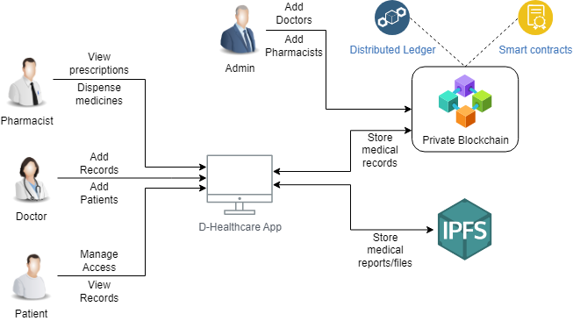
cv
SYSTEM DESIGN
Fig 1 System Diagram
Department of Computer Science & Engineering, DSCE

Slide 8
cv
SYSTEM DESIGN
Authentication Module
Users can register/login themselves
Several checks are performed to protect the users
Access Management Module
Patients can view the various doctors available
They can then grant/revoke access to doctors to use their medical data
Record Storage & Retrieval Module
Appointment Module
Doctors can add patient records to blockchain Files can be stored on IPFS and blockchain contains pointers to these files
Pharmacy Module
Patients can register for appointments by directly requesting the medical service providers
Doctors send the prescriptions of the patients directly to the pharmacy
Patients can collect their medicines using their address
Department of Computer Science & Engineering, DSCE

Slide 9

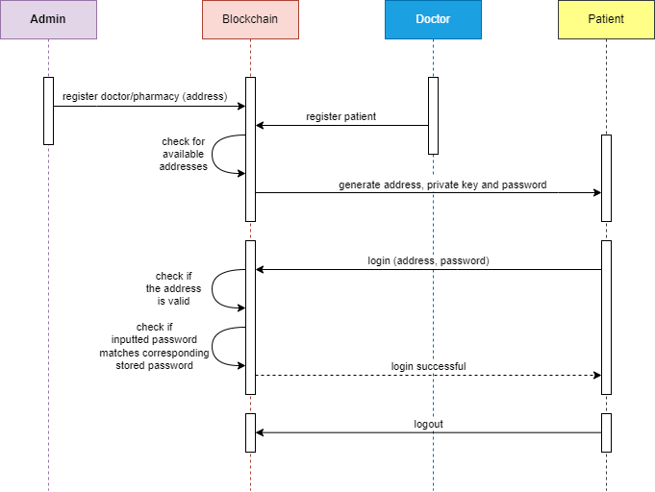
1. Authentication Module
SYSTEM DESIGN
Fig 2 Authentication Module Sequence Diagram
Department of Computer Science & Engineering, DSCE

Slide 10
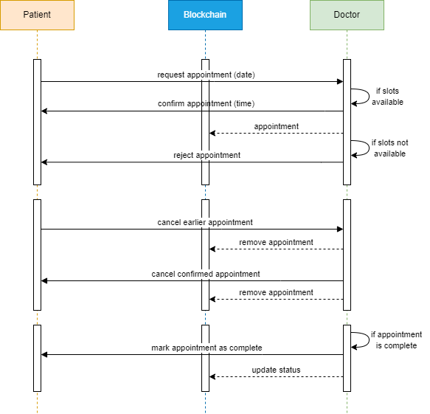
2. Appointment Module
SYSTEM DESIGN
Fig 3 Appointment Module Sequence Diagram
Department of Computer Science & Engineering, DSCE

Slide 11
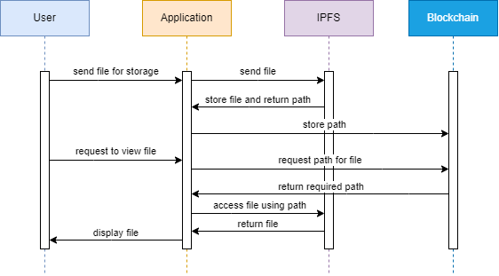
3. Record Storage & Retrieval Module
SYSTEM DESIGN
Fig 4 Record Storage & Retrieval Sequence Diagram
Department of Computer Science & Engineering, DSCE

Slide 12
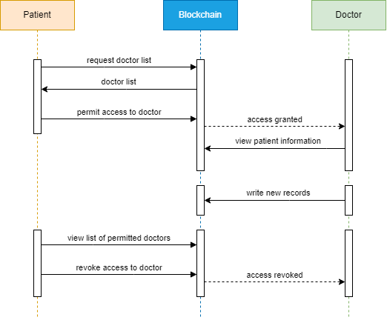
4. Access Management Module
SYSTEM DESIGN
Fig 5 Access Management Sequence Diagram
Department of Computer Science & Engineering, DSCE

Slide 13
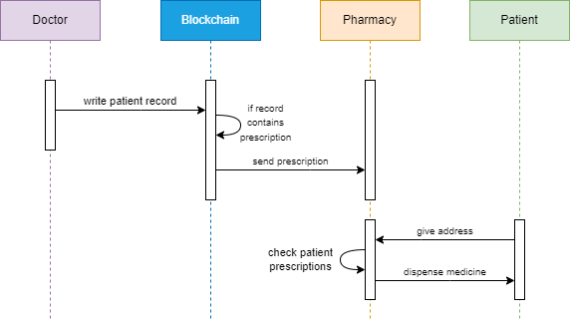
5. Pharmacy Module
SYSTEM DESIGN
Fig 6 Pharmacy Module Sequence Diagram
Department of Computer Science & Engineering, DSCE

Slide 14
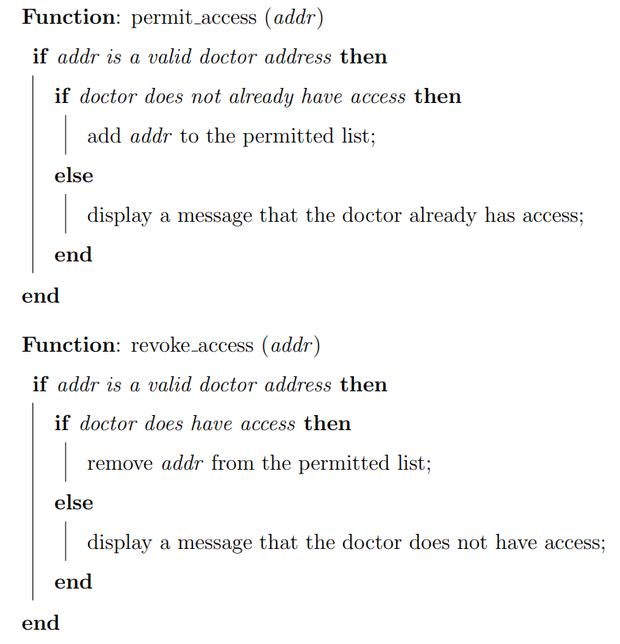
cv
SMART CONTRACTS
Patient Functions
Department of Computer Science & Engineering, DSCE

Slide 15
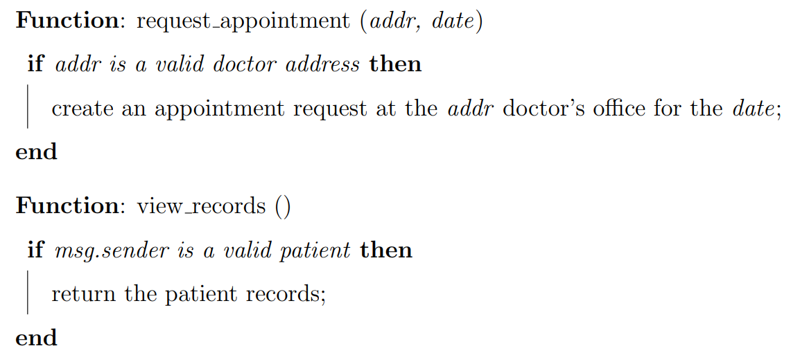
cv
SMART CONTRACTS
Patient Functions
Department of Computer Science & Engineering, DSCE

Slide 16
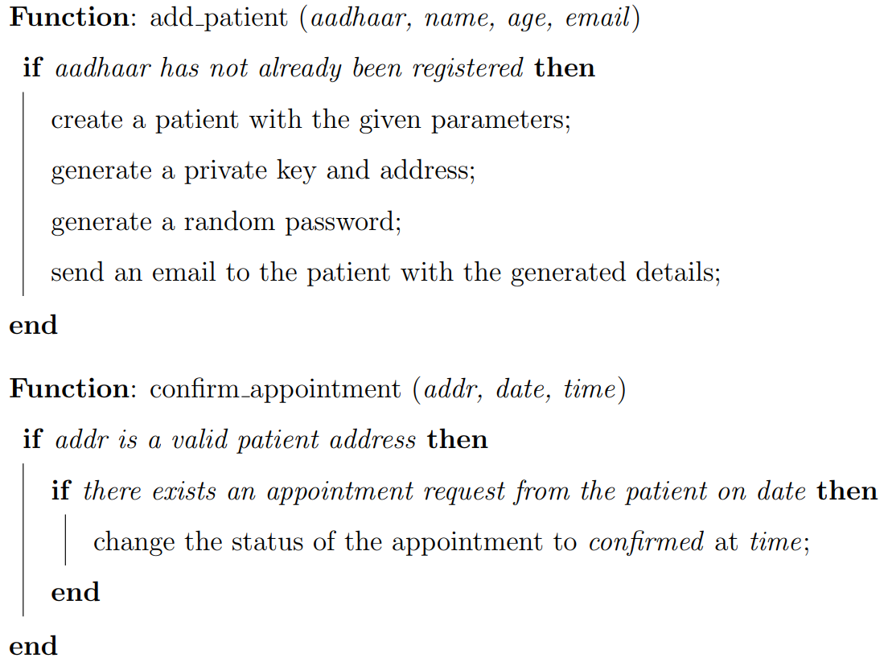
cv
SMART CONTRACTS
Doctor Functions
Department of Computer Science & Engineering, DSCE

Slide 17
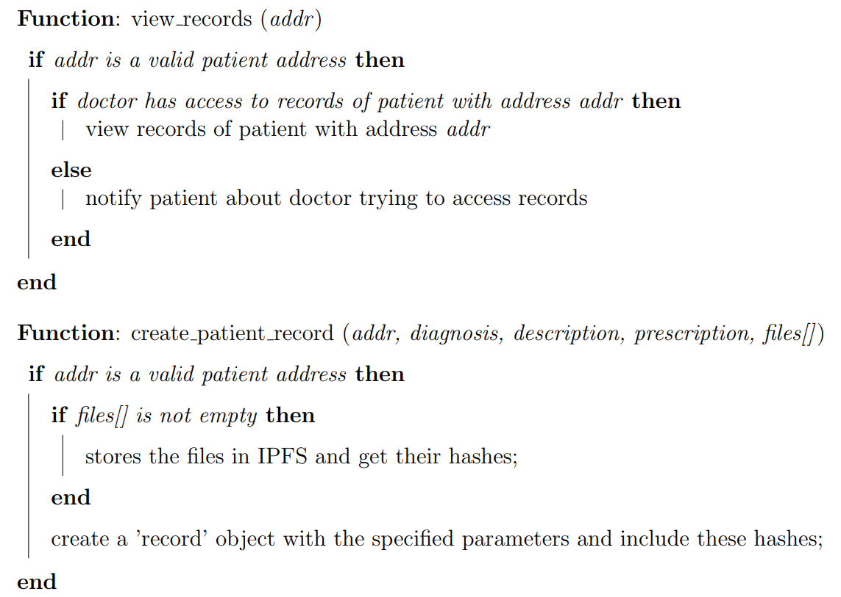
cv
SMART CONTRACTS
Doctor Functions
Department of Computer Science & Engineering, DSCE

Slide 18
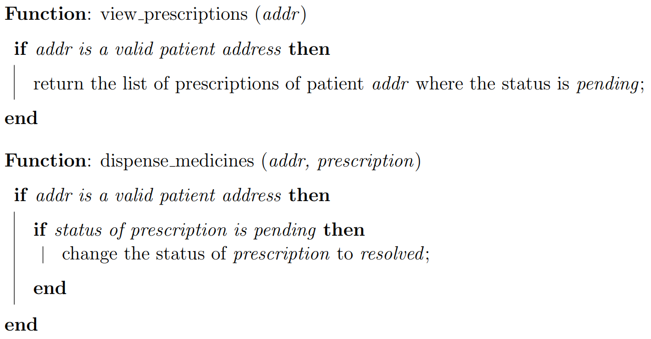
SMART CONTRACTS
Pharmacist Functions
Department of Computer Science & Engineering, DSCE

Slide 19
TECH FRAMEWORKS USED
BLOCKCHAIN NETWORK Ethereum
LOCAL BLOCKCHAIN Ganache
FRONTEND ReactJS
DEVELOPMENT ENVIRONMENT Truffle
IPFS SERVICE PROVIDER Infura
CRYPTOCURRENCY WALLET MetaMask
JAVASCRIPT FOR BLOCKCHAIN Web3.js
Department of Computer Science & Engineering, DSCE

Slide 20
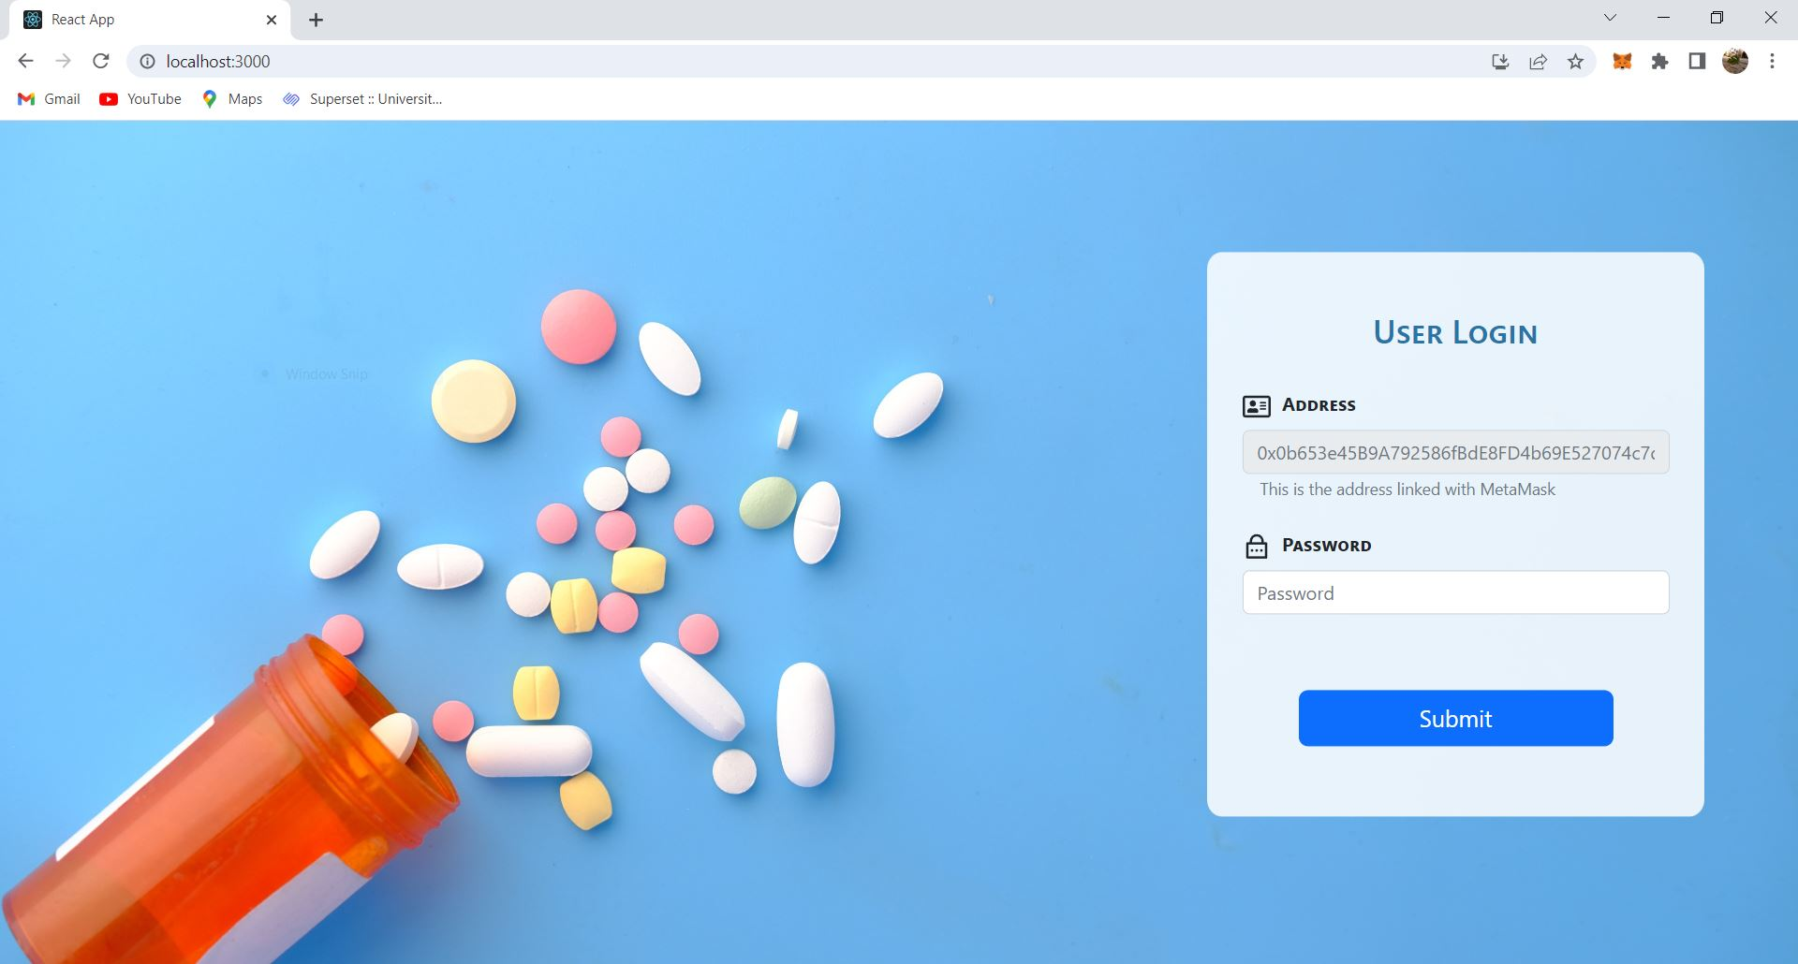
EXPERIMENTAL RESULTS
Screenshot 1 Login Page
Department of Computer Science & Engineering, DSCE

Slide 21
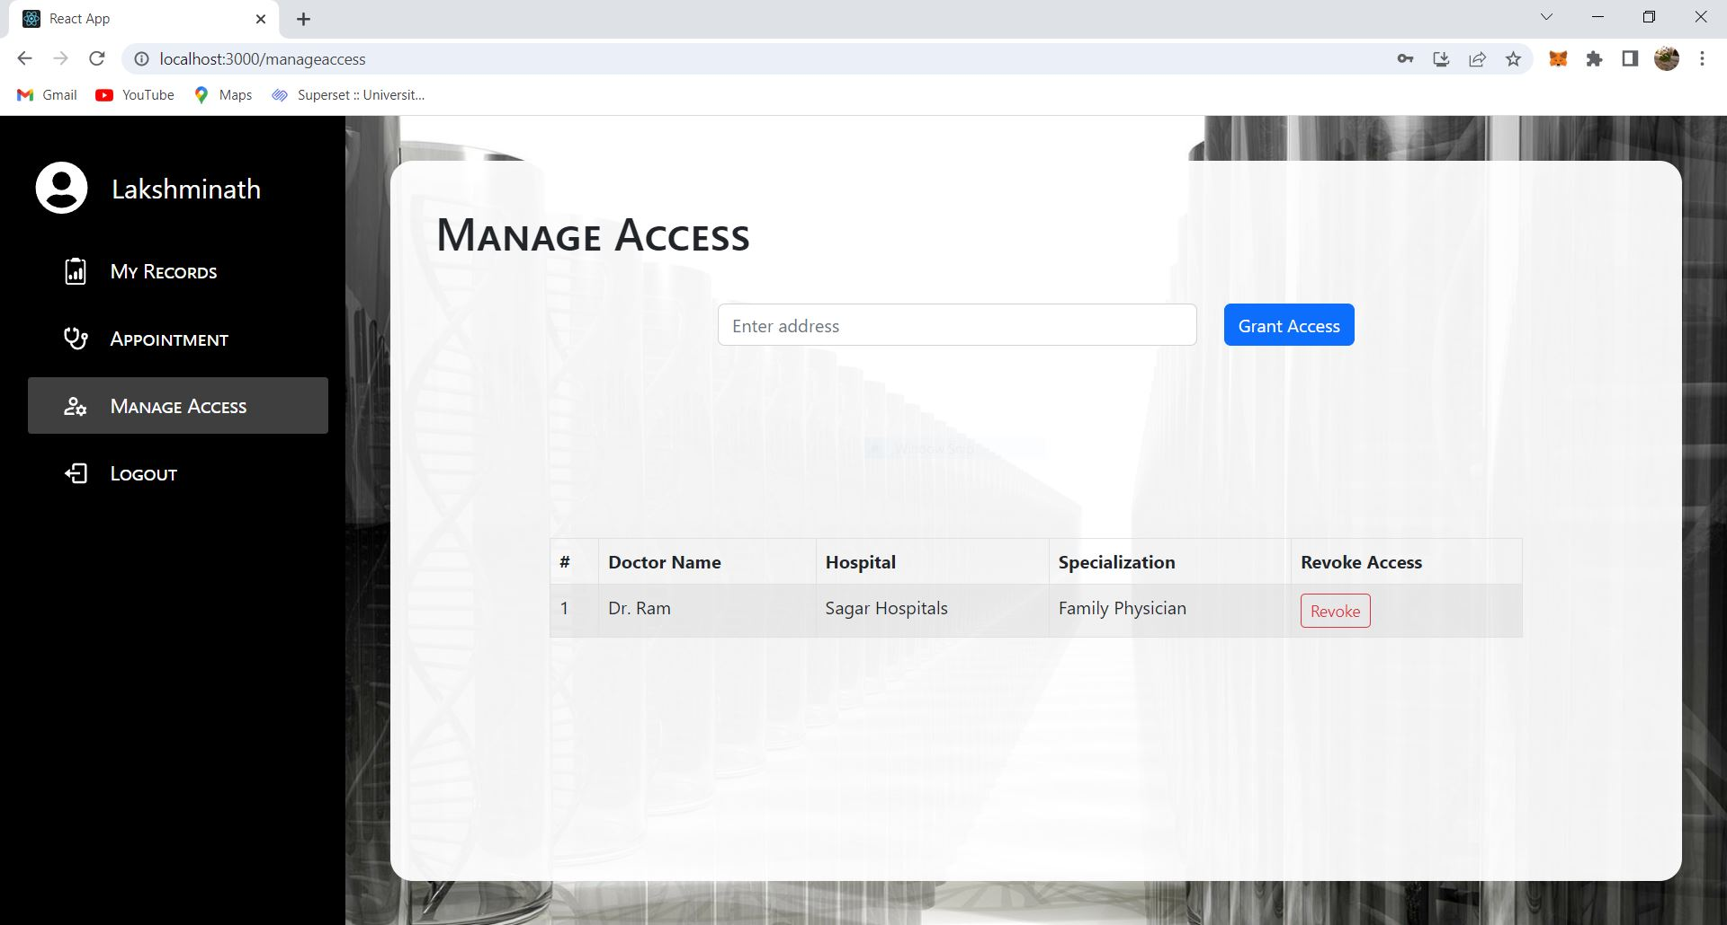
EXPERIMENTAL RESULTS
Screenshot 2 Patient – Manage Access Page
Department of Computer Science & Engineering, DSCE

Slide 22
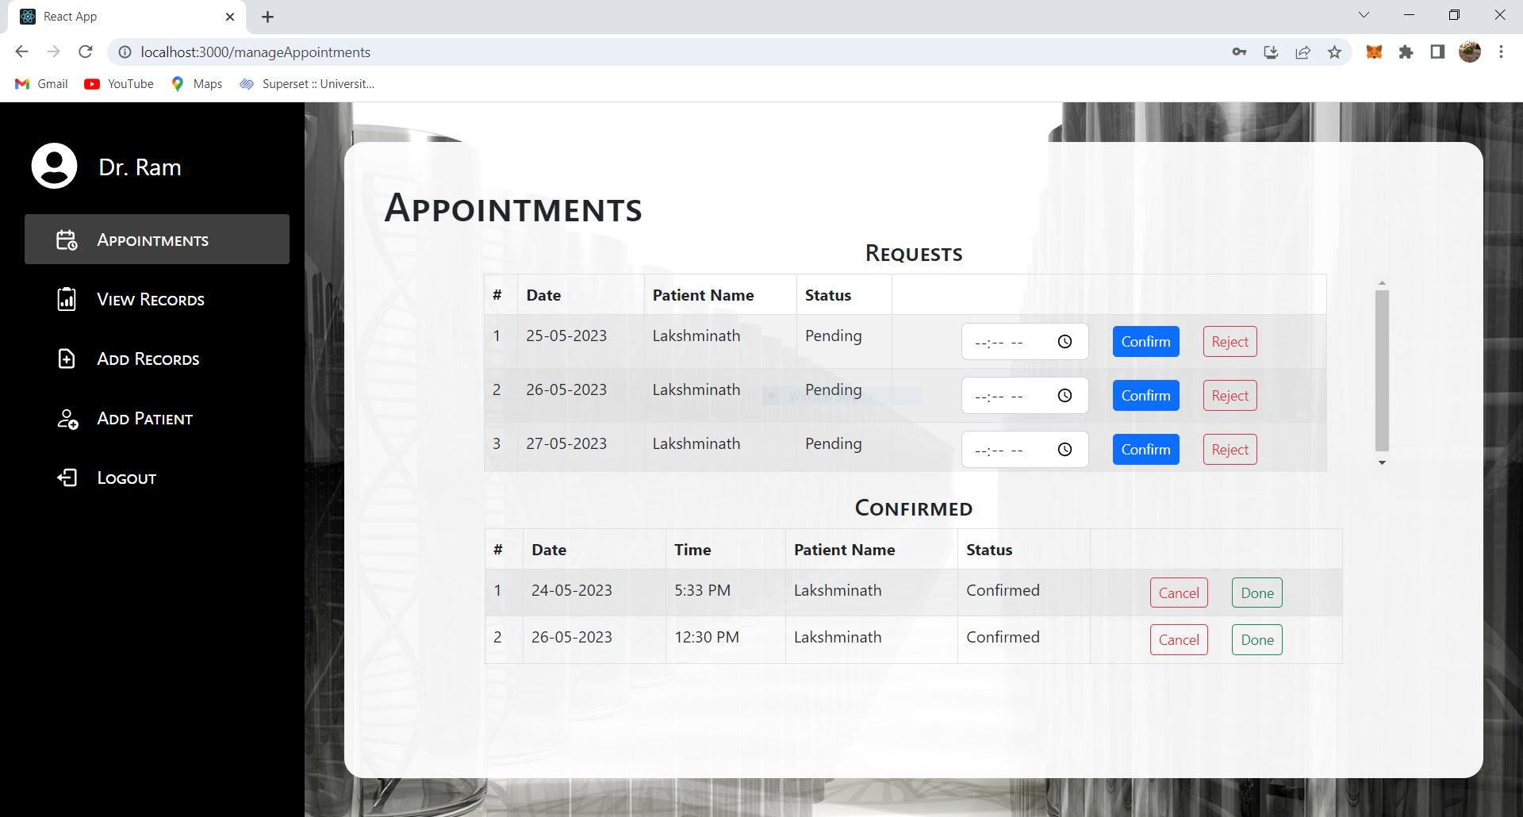
EXPERIMENTAL RESULTS
Screenshot 3 Doctor – Appointment Page
Department of Computer Science & Engineering, DSCE

Slide 23
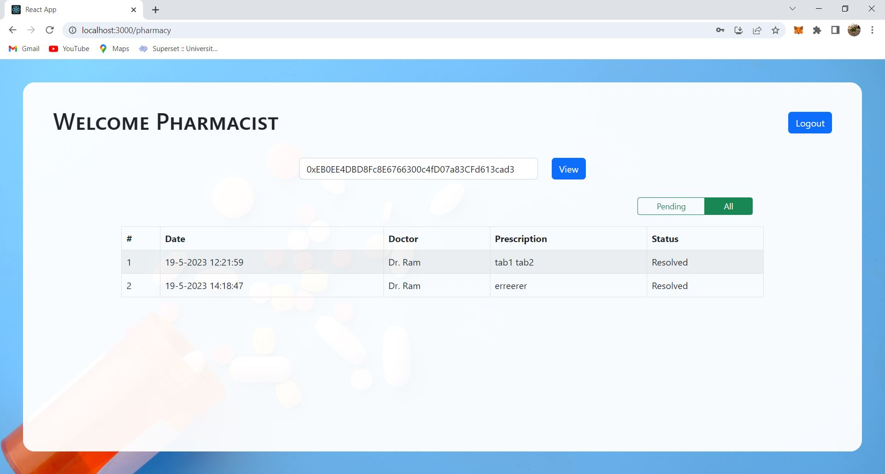
EXPERIMENTAL RESULTS
Screenshot 4 Pharmacy Page
Department of Computer Science & Engineering, DSCE

Slide 24
TEAM CONTRIBUTIONS
Member | Contribution
Govardhan R 1DS19CS052 | Design and development of Health smart contract Design and development of Appointment smart contract
Jagadeesh V Ranagatti 1DS19CS058 | Development of the Login page Development of the Pharmacy page
Lakshminath S M 1DS19CS079 | Designing the look and feel of the website IPFS setup and integration Development of the Doctor webpages
Linganand Sangamad 1DS19CS080 | Truffle and Ganache setup and configuration Development of the Patient webpages
Department of Computer Science & Engineering, DSCE

Slide 25
CO-GUIDE INTERACTIONS
Date | Particulars
14th January 2023 | We discussed the problem statement selected We put forth our understanding of the base paper
30th January 2023 | We presented our literature survey work Some implementation ideas were discussed Suggestions given: Use boilerplate code to get started, and build from there
12th April 2023 | We demonstrated the completed modules Discussed about the pending modules Suggestions given: Optimize of smart contract code by avoiding code repetitions
Department of Computer Science & Engineering, DSCE

Slide 26
cv
CONCLUSION
This system represents a promising blockchain-based health solution designed to address the challenges faced by existing systems.
By leveraging the advantages of blockchain technology and smart contracts, proposed system offers a secure, reliable, and decentralized system for managing health-related information.
The proposed system provides a complete solution for all the processes involved in the healthcare service from making an appointment to dispensing of medicines.
Department of Computer Science & Engineering, DSCE

Slide 27
cv
FUTURE WORK
A separate application can be built for Admin for managing doctors and pharmacists.
Granular access to medical records can be provided. This will allow patients to manage who will have access to individual records of patient.
Pharmacy module can further be developed to manage availability of medicines.
Further, lab technicians can also be added into the system that will allow them in adding the reports or scan results of patients directly.
Department of Computer Science & Engineering, DSCE

Slide 28
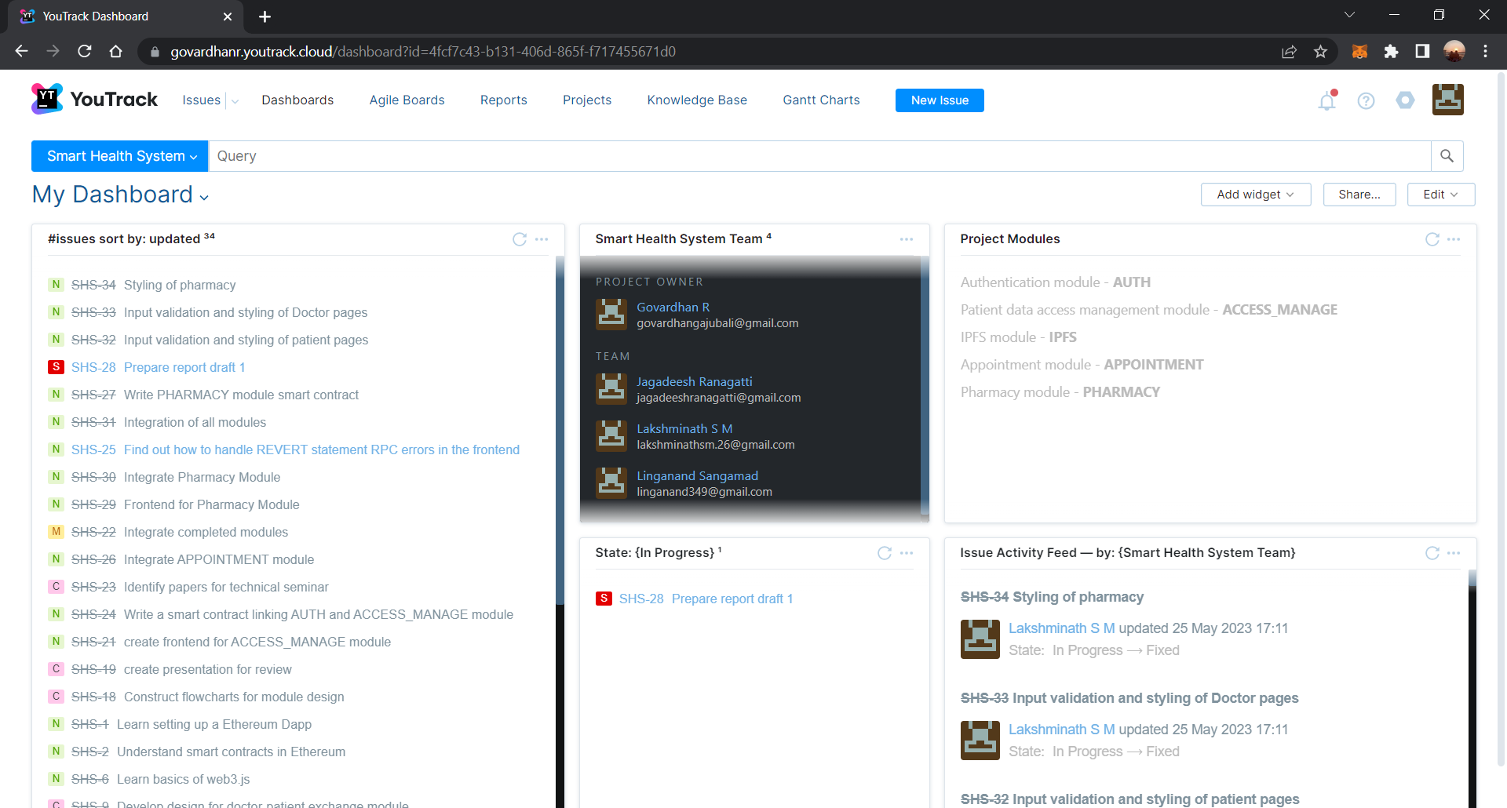
PROJECT MANAGEMENT TOOL YouTrack

Slide 29
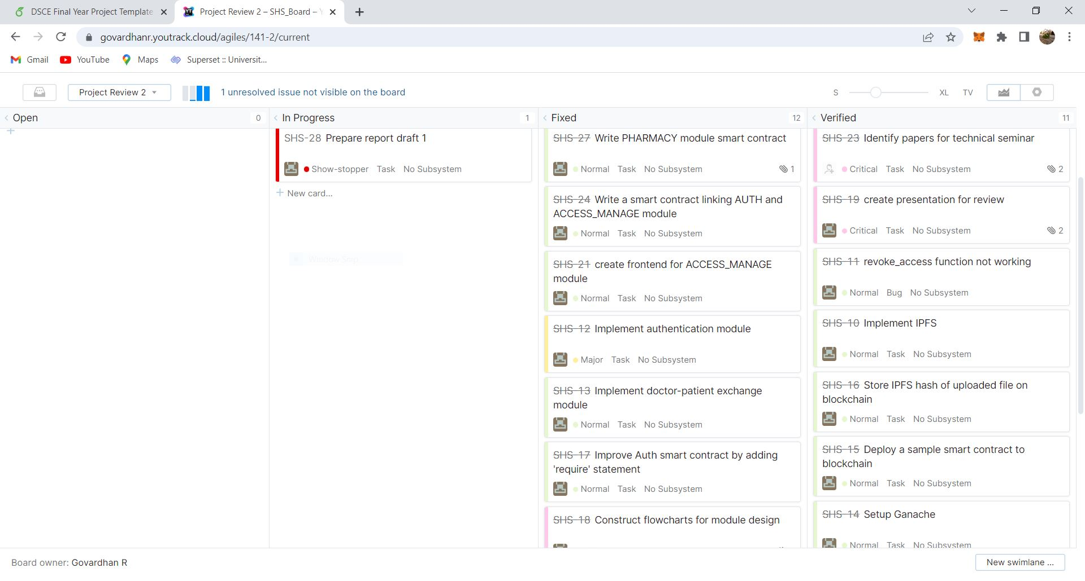
PROJECT MANAGEMENT TOOL YouTrack

Slide 30
REFERENCES
[1] X. Liu, Z. Wang, C. Jin, F. Li and G. Li, "A Blockchain-Based Medical Data Sharing and Protection Scheme," in IEEE Access, vol. 7, pp. 118943-118953, 2019, doi: 10.1109/ACCESS.2019.2937685.
[2] S. Jiang, J. Cao, H. Wu, Y. Yang, M. Ma and J. He, "BlocHIE: A BLOCkchain-Based Platform for Healthcare Information Exchange," 2018 IEEE International Conference on Smart Computing (SMARTCOMP), 2018, pp. 49-56, doi: 10.1109/SMARTCOMP.2018.00073.
[3] A. Azaria, A. Ekblaw, T. Vieira and A. Lippman, "MedRec: Using Blockchain for Medical Data Access and Permission Management," 2016 2nd International Conference on Open and Big Data (OBD), 2016, pp. 25-30, doi: 10.1109/OBD.2016.11.
Department of Computer Science & Engineering, DSCE

Slide 31
REFERENCES
[4] Griggs, K.N., Ossipova, O., Kohlios, C.P. et al. Healthcare Blockchain System Using Smart Contracts for Secure Automated Remote Patient Monitoring. J Med Syst 42, 130 (2018). https://doi.org/10.1007/s10916-018-0982-x
[5] Gaby G. Dagher, Jordan Mohler, Matea Milojkovic, Praneeth Babu Marella, Ancile: Privacy-preserving framework for access control and interoperability of electronic health records using blockchain technology, Sustainable Cities and Society, Volume 39, 2018, Pages 283-297, ISSN 2210-6707, https://doi.org/10.1016/j.scs.2018.02.014
[6] Han, H., Huang, M., Zhang, Y., Bhatti, U.A. (2018). An Architecture of Secure Health Information Storage System Based on Blockchain Technology. In: Sun, X., Pan, Z., Bertino, E. (eds) Cloud Computing and Security. ICCCS 2018. Lecture Notes in Computer Science(), vol 11064. Springer, Cham. https://doi.org/10.1007/978-3-030-00009-7_52
Department of Computer Science & Engineering, DSCE

Slide 32
cv
REFERENCES
[7] Purohit, S., Calyam, P., Alarcon, M.L. et al. HonestChain: Consortium blockchain for protected data sharing in health information systems. Peer-to-Peer Netw. Appl. 14, 3012–3028 (2021). https://doi.org/10.1007/s12083-021-01153-y
[8] Zhuang Y, Sheets L, Shae Z, Tsai JJP, Shyu CR. Applying Blockchain Technology for Health Information Exchange and Persistent Monitoring for Clinical Trials. AMIA Annu Symp Proc. 2018 Dec 5;2018:1167-1175. PMID: 30815159; PMCID: PMC6371378.
[9] A. Buzachis, A. Celesti, M. Fazio and M. Villari, "On the Design of a Blockchain-as-a-Service-Based Health Information Exchange (BaaSHIE) System for Patient Monitoring," 2019 IEEE Symposium on Computers and Communications (ISCC), 2019, pp. 1-6, doi: 10.1109/ISCC47284.2019.8969718.
[10] Zhang, A., Lin, X. Towards Secure and Privacy-Preserving Data Sharing in e-Health Systems via Consortium Blockchain. J Med Syst 42, 140 (2018). https://doi.org/10.1007/s10916-018-0995-5
Department of Computer Science & Engineering, DSCE

