Slide 1


Topic : Monitoring System for classroom session in skill training programe Domain : Innovation Team ID : 303 Team name : Hackstronauts Team members :2303A54044 – R.Govardhan Sai Ganesh 2303A54022 – R.Greeshma 2303A54066 – BG Sreevani 2303A54063 – M Sai Pallavi 2303A54011 – G Poojitha Sharini

Slide 2
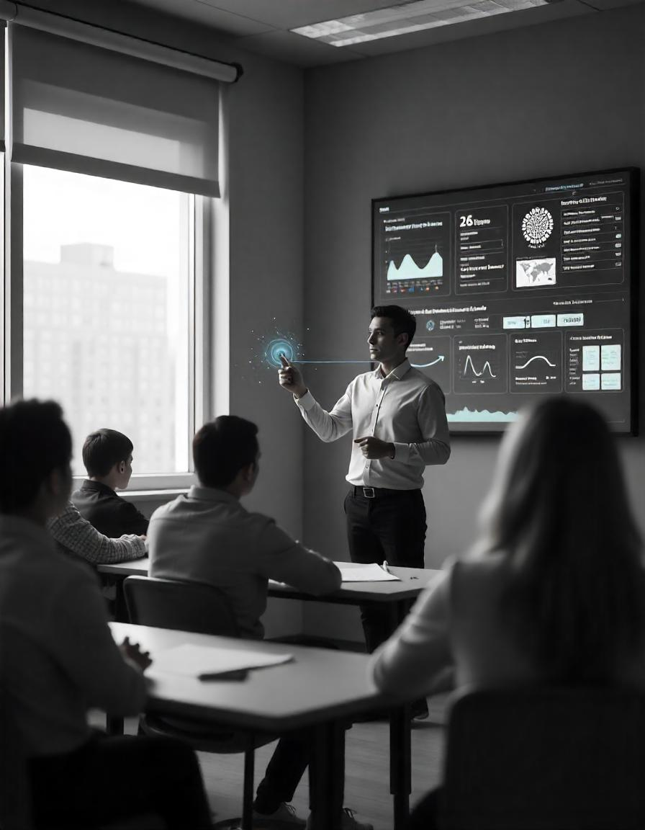

Objective
Purpose and Goals
Automated Classroom Monitoring System
Purpose: Develop an AI-powered system to assess and improve classroom training in skill development programs.
Main Goals
- Analyze classroom images to track activities and interactions
- Evaluate training quality and relevance
- Identify and flag low-performing institutions
Expected Outcomes
- Higher training standards and effectiveness
- Better monitoring of institutions
- Data-driven improvements in skill development programs

Slide 3



Problem Statement
Problem Statement
The problem is to design and develop an automated monitoring system that can analyse classroom images to assess the effectiveness of skill training programs, detect subpar training institutions, and identify areas that require enhanced monitoring or improvement.
Challenges in Current Scenario
1. Manual monitoring is time-consuming, prone to errors, and lacks objectivity.
2. Difficulty in analysing visual data from classroom images.
3. Limited scalability and delayed feedback.
Delay in identifying low-performing centres.
Poor training affects student outcomes and employability.
No centralized system for monitoring and evaluation.

Slide 4




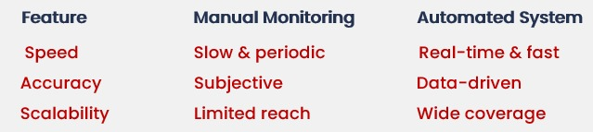
Existing system
1. Describe the current system or method in use.
1. Classroom sessions in skill training programs are monitored using manual inspections, institute-submitted reports, and occasional audits.
2. Monitoring is infrequent, subjective, and resource-intensive.
2. Mention its limitations and inefficiencies.
Delayed Evaluations
Lack of Transparency
Bias & Human Error
Subjective Analysis
3. Explain why a new system is needed.
Automated image analysis enables real-time, unbiased monitoring, allowing institutions to swiftly address training gaps before they impact learning outcomes.
Comparative Table

Slide 5
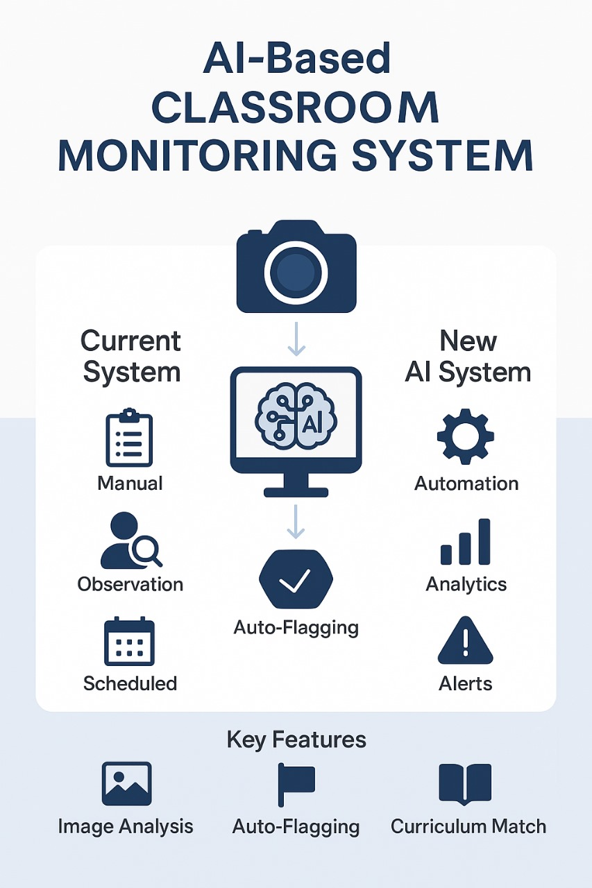
Proposed system
Introducing "ClassEye" ClassEye is an AI-powered automated monitoring system designed to assess and enhance the effectiveness of classroom training in skill development programs.
Key Features and Functionalities
1. Image Analysis: AI-powered analysis of classroom images
2. Activity Recognition: Identification of activities and interactions
3. Quality Assessment: Evaluation of training quality and relevance
Advantages over Existing Systems
1. Automated Monitoring: Reduces manual effort and bias 2. Real-time Analysis: Enables prompt action and improvement 3. Data-Driven Insights: Provides actionable recommendations

Slide 6
Workflow
📝 Preprocess & Label Data
Ensure images are clear, correctly formatted, and labeled with relevant metadata (instructor, student activity, infrastructure).
🚦 Flagging & Evaluation
Categorize training sessions based on quality scores and flag cases needing intervention.
Step 02
Step 04
Step 01
Step 03
Step 05
📊 Collect Classroom Images
Capture images from training sessions using installed cameras or periodic snapshots.
🧠 AI Model Analysis
Use deep learning models to detect classroom engagement, activity types, and compliance with training standards.
📢 Dashboard & Reports
Display insights, alerts, and recommendations on an interactive dashboard for decision-makers.

Slide 7
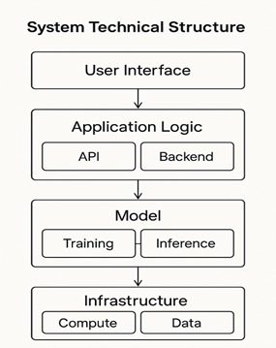
System Architecture
Tech Stack
Key points to cover
Languages used (UI: HTML, CSS, JS | App Logic: Python, Java, Node.js | Model: Python, R | Infra: Bash, SQL, YAML.)
Data base used (SQL (MySQL, PostgreSQL), NoSQL (MongoDB, Cassandra),Cloud DB (Firebase, DynamoDB)
Database security (Encryption (AES, TLS) | Access Control (RBAC, IAM) | Firewalls | Backups | Audit Logs | SQL Injection Prevention.
Cloud service used for hosting AWS (EC2, S3, RDS) | Google Cloud (GCE, Firestore) | Azure (VMs, Blob Storage) | Firebase | DigitalOcean.
API’s used (REST | GraphQL | gRPC | WebSockets )

Slide 8
Conclusion & Future Scope
Conclusion
The Automated Classroom Monitoring System uses AI to improve training quality, provide real-time feedback, and enable data-driven decisions.
Impact & Benefits
- Automated monitoring reduces manual effort and covers multiple institutions.
- Accurate and data-driven analysis provides real-time insights.
- Early detection and intervention identify low-performing institutions for improvement.
Future Scope
- Advanced AI and deep learning for enhanced image recognition.
- Real-time alerts and dashboards for continuous improvement.
- IoT integration for live monitoring.
- Personalized training insights for optimized learning methods.
This system marks a leap toward smart, data-driven education monitoring, empowering institutions to deliver higher-quality training and ensuring that every learner receives the support they deserve.

