Slide 1



Student Innovation Project - 2025
SIP ID - 2526S0197
Development of an Intelligent On-Board Weighing Equipment (OBW) Kit using Vehicle ECU Data and AI-Driven Estimation Techniques
Presented By
A.Govindaswamy O.S.Rahul C.Praveen Kumar
Department of Automobile Engineering Department of Information Technology Department of Information Technology
Contact - +91 7598579340 Contact - +91 91598 12736 Contact - +91 6379532376
Email - vishwa271205@gmail.com Email - sundarrajrahul@gmail.com Email - praveenchandru1209@gmail.com
Guided By
Mr.Vasanthan.B Dr.M.Hemalatha
Assistant Professor(Sr.Gr) Assistant Professor(Sr.Gr)
Department of Automobile Engineering,Madras Institute of Technology Department of Information Technology,Madras Institute of Technology
Contact - +91 9894864529 Contact - +91 9884874955
Email - bvasanthan@mitindia.edu Email - hemam@annauniv.edu
BE, 5th Semester
Department of Automobile Engineering & Department of Information Technology
Madras Institute of Technology Campus, Anna University, Chennai - 600044

Slide 2

Objective
Novelty
Achieves high estimation accuracy suitable for OBW applications and AIS compliance.
Relies solely on standard ECU data available through the OBD-II port—no extra sensors required.
Utilizes a GRU neural network architecture for advanced, real-time mass estimation.
Offers a scalable, automated solution adaptable to commercial vehicles.
Resulting in an affordable on-board weighing (OBW) system offering real-time, accurate vehicle mass data
By utilizing a GRU-based deep learning model to analyze real-time ECU data processed on a Raspberry Pi
On-board mass estimation is vital for complying with regulation (AIS 205).

Slide 3

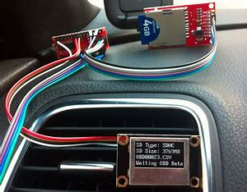

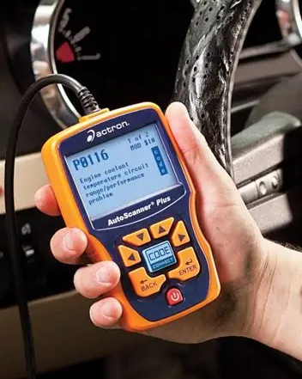

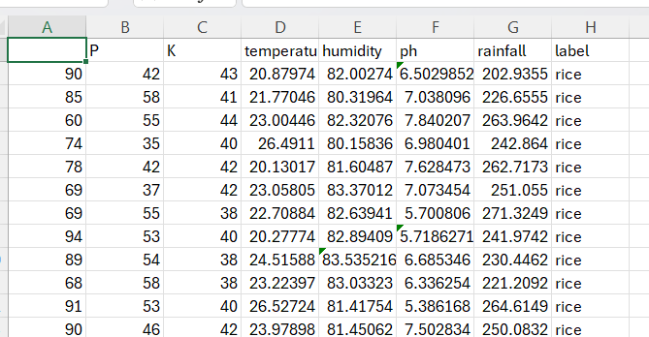
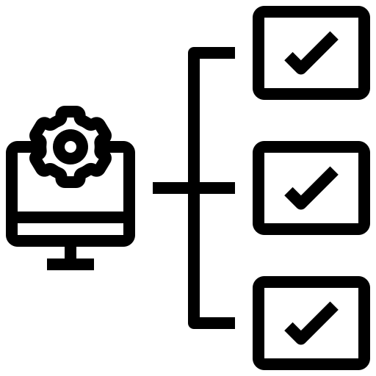
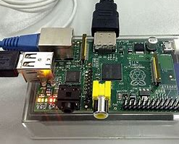

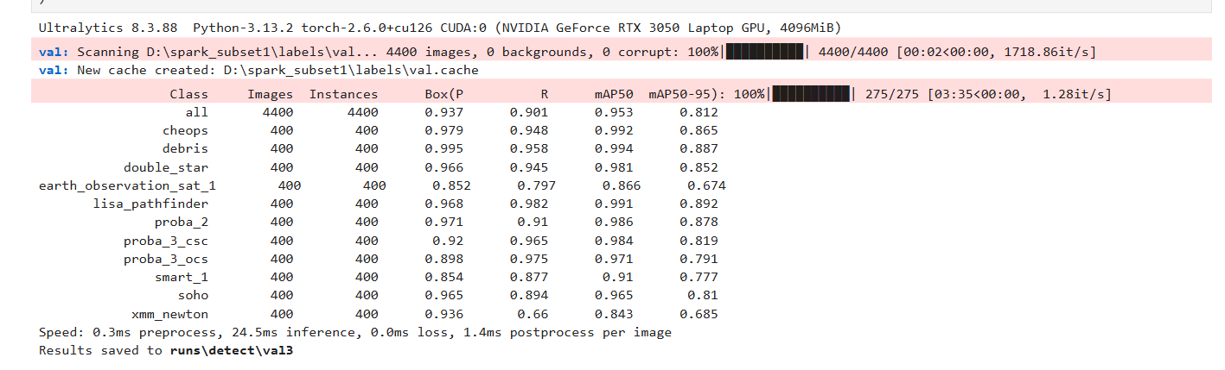

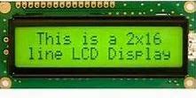
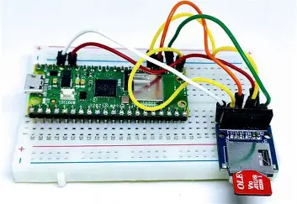

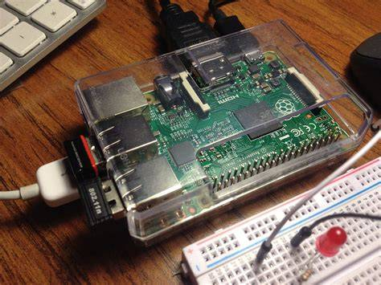

Work Plan
Data
Collection
Data
Collection
ECU Data Via
OBD - II Adaptor
3rd Month
1st Month
Data
Cleaning
Run the GRU in
Raspberry Pi
4th Month
Train the
GRU Model
Display the mass
On LCD display
5th Month
2nd Month
Save GRU Model in Raspberry Pi
Store the Result
On SD Card
6th Month

Slide 4
Budget
S.No | Component | Quantity | Price
1 | Raspberry Pi Model 5 | 1 | 10,000
2 | ELM327 OBDII USB Interface | 1 | 1,500
3 | 16x2 LCD Display | 1 | 200
4 | SD card module | 1 | 2,000
5 | Real time clock module DS3231 | 1 | 120
6 | Voltage Regulator (12V to 5V) | 1 | 160
7 | Push Button Switches | 2 | 100
8 | LED Status Indicators | 5 | 30
9 | Breadboard & Connecting Wires | 1 | 150
10 | Protective Enclosure | 1 | 900
11 | 12V Power Adapter | 1 | 200
12 | Raspberry Pi Adapter | 1 | 1,500
 | Total |  | 19,080
Contingency | 2,000
Consumables | 1,000
Travel | 1,000
Others | 920
Total | 25,000

Slide 5
Sustainable Development Goals (SDG)
Technology Readiness Level (TRL)
Goal 9 - Industry, Innovation & Infrastructure
Innovation : Utilizes GRU algorithms with ±5% accuracy for real-time mass estimation, advancing India's automotive research capabilities and supporting the transition to intelligent transport systems.
TRL 4 - Small Scale Prototype - Technology validated in lab
Simulation of diverse vehicle load conditions through prerecorded CAN-bus signal playback allows for repeatable and controlled evaluation of the prototype’s mass estimation capabilities without requiring full vehicle deployment.
Expected Deliverable
Societal relevance
On-Board Weighing KIT with real-time mass estimation
Certified accuracy performance (± 5% for > 90% load, ± 10% across all conditions)
Installation & operation manual
By stopping overloaded trucks at the source, this KIT helps prevent serious accidents, saving lives
lower fuel consumption and reduced carbon emissions

Slide 6
Thank You

Slide 7
Sustainable Development Goals (SDG)
Technology Readiness Level (TRL)
Goal 9 - Industry, Innovation & Infrastructure
TRL 4 - Small Scale Prototype - Technology validated in lab
Addresses India's critical overloading problem where one in three trucks exceeds legal limits and overloaded vehicles cause 50% of traffic accidents, supporting sustainable transport infrastructure.
Innovation : Utilizes GRU algorithms with ±5% accuracy for real-time mass estimation, advancing India's automotive research capabilities and supporting the transition to intelligent transport systems.
Rigorous laboratory tests will be conducted to confirm that the technology meets defined performance benchmarks, specifically, maintaining mass estimation errors within 10% and achieving data processing rates of at least 10 Hz.
Simulation of diverse vehicle load conditions through prerecorded CAN-bus signal playback allows for repeatable and controlled evaluation of the prototype’s mass estimation capabilities without requiring full vehicle deployment.
Emphasis will be placed on identifying potential technical challenges and limitations through rigorous lab analyses, enabling proactive mitigation strategies and iterative design improvements early in the development process

Slide 8
Expected Deliverable
Societal relevance
On-Board Weighing KIT with real-time mass estimation
Certified accuracy performance (± 5% for > 90% load, ± 10% across all conditions)
Installation & operation manual
By stopping overloaded trucks at the source, this KIT helps prevent serious accidents, saving lives
lower fuel consumption and reduced carbon emissions

Slide 9
Introduction
Conventional Methods used for Vehicle Mass Estimation
Weighing Bridge
Fixed large-scale platforms that directly measure total vehicle weight.
Require specialized infrastructure and designated locations
Not suitable for real-time or continuous vehicle mass monitoring during operation.
Load Cells/Strain Gauges
Sensors installed on suspension or axles measuring load force for onboard weight estimation.
Require vehicle hardware modifications and calibration.
Data - Driven Methods currently used for Vehicle Mass Estimation
Drawbacks of Existing Vehicle Mass Estimation Methods
Weighing bridges require costly, fixed infrastructure and dedicated sites for vehicle weighing, making them unsuitable for continuous or real-time mass monitoring during transit.
These physical methods lack scalability and flexibility, especially for widespread fleet applications needing dynamic, & continuous load monitoring.
The complex, nonlinear behavior of vehicles under varying loads and driving conditions cannot be fully captured by static physical sensors alone, limiting the accuracy of traditional methods.
Our Proposed Solution
Extended Kalman Filter (EKF)
Combines noisy sensor data to give a best estimate of vehicle mass over time.
Requires accurate physical models and careful tuning; struggles with highly nonlinear or complex vehicle dynamics; sensitive to sensor noise and model errors.
Recursive Least Squares (RLS)
sensitive to quality of input data and initial starting assumptions
Needs good initial conditions and persistent excitation
GRU models are designed to learn and remember temporal sequences and nonlinear relationships in the complex vehicle dynamics, handling noise and variability better than traditional physical-model-based filters.
Uses existing vehicle sensor data accessed through standard OBD-II ports, requiring no additional sensors or hardware modifications, which reduces cost and complexity.

Slide 10
Literature Review
Title | Author | year | Journal | Inference
Innovative Approaches for Dynamic System Monitoring | Johnson & Lee | 2024 | Journal of Engineering Research and Reports | Describes adaptive filtering and outlier detection for robust real-time mass estimation under diverse conditions. Integrates wavelet transform and statistical inference methods for stability and noise reduction
ECU Data Processing Techniques for Automotive Applications | Kumar, S., Patel, R., & Sharma, A | 2023 | International Journal of Automotive Engineering | Highlights signal preprocessing/filtering via OBD-II protocols to improve mass estimation from noisy ECU data. Emphasizes the importance of data integrity for parameter estimation.
LSTM-Based Virtual Load Sensor for Heavy-Duty Vehicles | Zhang, H., Wang, L., & Chen, Y | 2024 | IEEE Sensors Journal/Sensors Journal (alternate listing) | Two-layer LSTM network estimates mass for heavy-duty vehicles, modeling complex loading with high accuracy. Training on large data sets is required for real-time implementation.

Slide 11
Work Plan
Foundation & Preparation
To conduct literature review and have a clear understanding of the project scope, all required components in hand, and a solid plan for data collection.
Model Training & Initial Evaluation
To have a fully trained first version of your model and to understand its initial performance and weaknesses.
Hardware Integration & System Validation.
To have a working prototype where the software model runs successfully on the hardware.
Month 2
Month 4
Month 6
Month 1
Month 3
Month 5
Data Handling & Initial Development
To collect a substantial amount of raw data, clean it for use, and have a basic version of your model's code ready.
Model Tuning & Optimization
To have a highly accurate and optimized model that is ready to be deployed on the hardware.
Final Testing, Documentation, & Finalization
To successfully test the final product in a real-world scenario and submit all required project documentation for completion.

