Slide 1
Linux Device Driver: BlueNRG
Govind Sharma

Slide 2
Bluetooth Low Energy

Slide 3
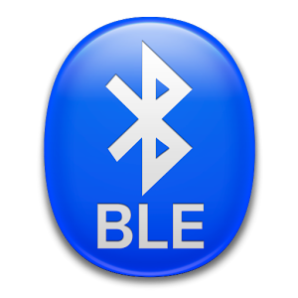
What is BLE?
3
Bluetooth low energy (BLE, marketed as Bluetooth Smart) is a wireless personal area network technology designed and marketed by the Bluetooth Special Interest Group aimed at novel applications in the healthcare, fitness, beacons, security, and home entertainment industries.
It is part of the Bluetooth 4.0 specification.
It aims at being a low energy, low cost, low bandwidth, low power and low complexity extensible framework for exchanging data pertaining to various application fields.

Slide 4
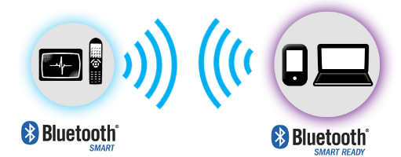
Device Configuration
4
Single mode Devices (Bluetooth smart): These devices are compatible with BLE only. Example: Heart monitors, sensors, other low-power applications.
Dual mode Devices (Bluetooth smart ready): These devices are compatible with both BLE and traditional BR/EDR. Example: Pcs, tablets, smartphones.

Slide 5
Classification of devices
5
Based on chip count
Like devices can be classified on the basis of different compatibility modes, they can also be classified on the basis of the chip configuration of the various layers of BLE.
SoC (system on chip): A single IC runs the application, the host, and the controller.
2) Dual IC over HCI: One IC runs the application and the host and communicated using HCI with a second IC running the controller.
3) Dual IC with connectivity device: One IC runs the application and communicates using a proprietary protocol with a second IC running both the host and the controller. BlueNRG uses this chip configuration.

Slide 6
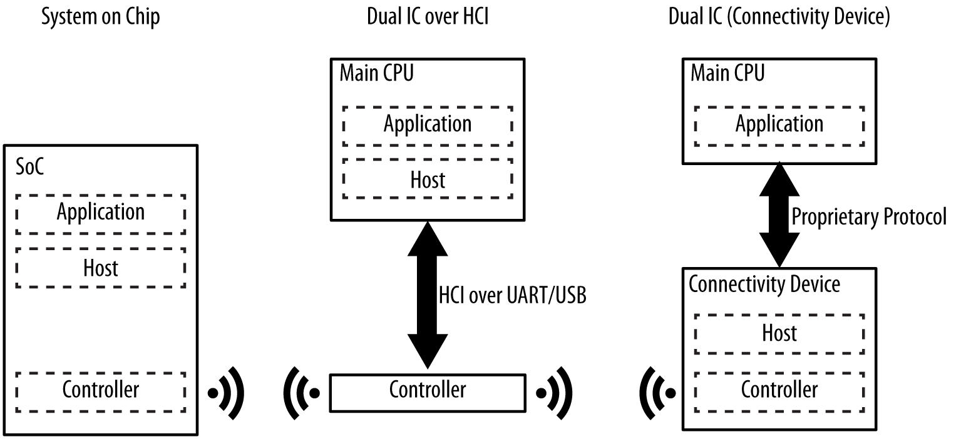
Classification of devices
6
Based on chip count

Slide 7
BLE Architecture
7
The Protocol Stack
The complete BLE protocol stack is divided into layers that work and communicate in succession to achieve the desired operation.
These layers are:
Application (The upper layer containing most of the application logic, User Interface, etc.)
Host (Contains all the upper layer protocols like GAP, GATT, L2CAP, etc.)
Controller (Contains all the lower layer protocols from the Link layer and the Physical layer)
The host layer and the controller layer communicate with each other using the Host Controller Interface (HCI). This allows great flexibility in having the host and controller on different chips and having different manufacturers.

Slide 8
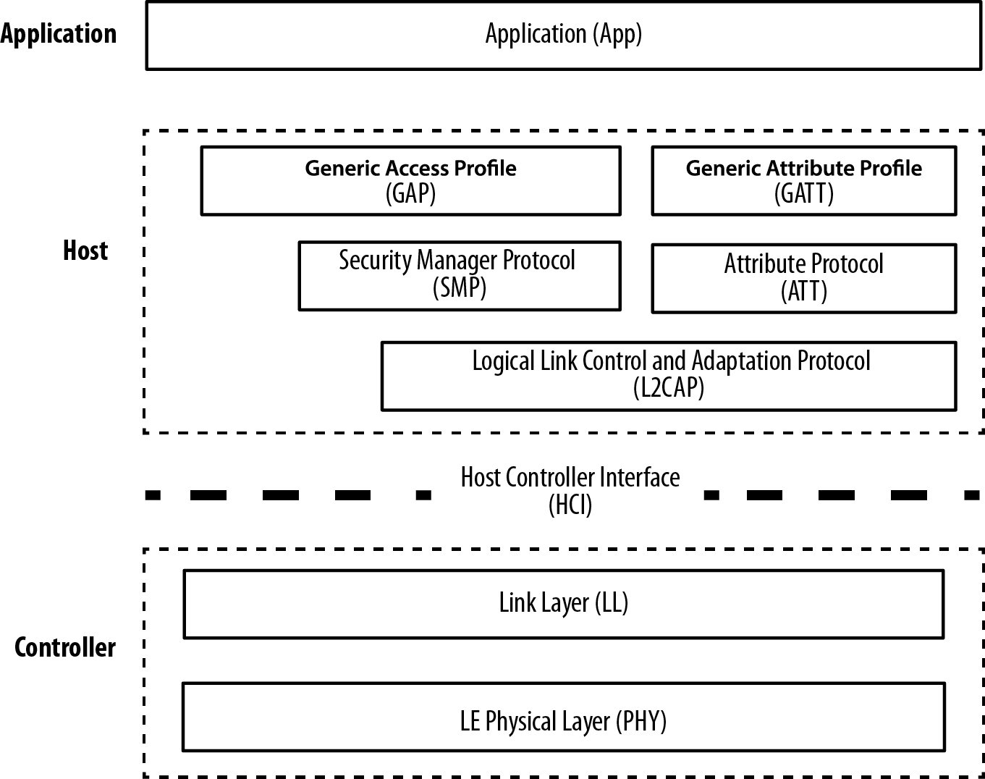
BLE Architecture
8
Linux, Bluetooth and then BlueZ

Slide 9
Limitations
9
The maximum theoretical throughput is 1Mbps which is reduced by several factors to only 5-10KBps in most cases.
The operating range is generally 2-5 metres. This can be extended to 30 metres or so but that will demand higher strain on the battery life of the device.

Slide 10
BlueNRG

Slide 11
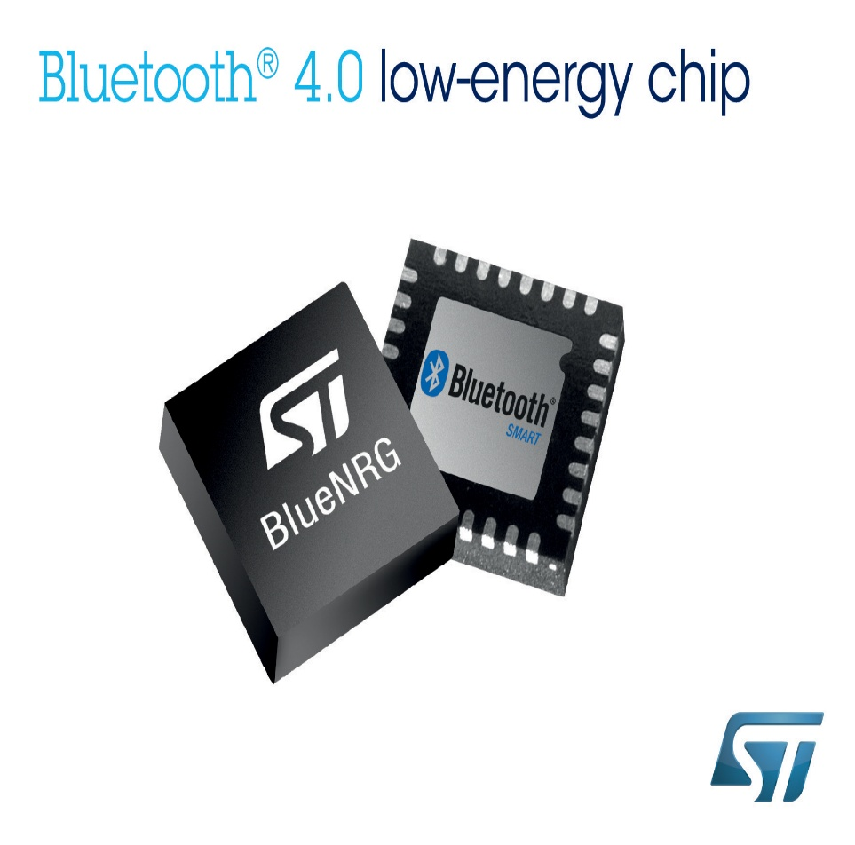
What is BlueNRG?
11
The BlueNRG is a very low power Bluetooth Low Energy (BLE) single-mode network processor, compliant with Bluetooth specification v4.0.
The Bluetooth Low Energy stack runs on the embedded ARM Cortex-M0 core.
The BlueNRG offers the option of interfacing with external microcontrollers using SPI transport layer

Slide 12
BlueNRG
12
The BlueNRG is a single-mode Bluetooth low energy slave network processor, compliant with the Bluetooth specification v4.0. It integrates a 2.4 GHz RF transceiver and a powerful Cortex-M0 microcontroller, on which a complete power-optimized stack for Bluetooth single mode protocol runs, providing:
Slave role support
GAP: peripheral, broadcaster roles
ATT/GATT: client and server
SM: privacy, authentication and authorization
L2CAP
Link Layer: AES-128 encryption and decryption
BlueNRG

Slide 13
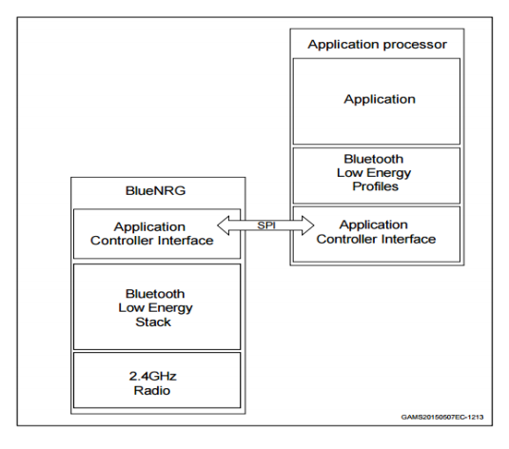
The BlueNRG Interface
13
The external host application processor, where the application resides, is interfaced with the BlueNRG through an application controller interface protocol based on a standard SPI interface.

Slide 14
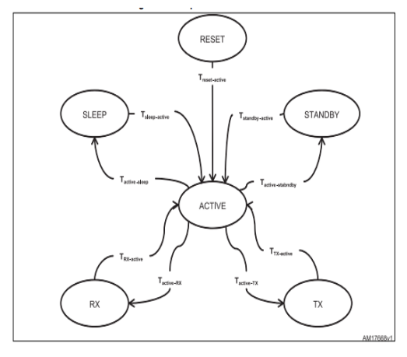
Operating Modes
14
Reset mode
Sleep mode
Standby mode
Active mode Radio mode
Receive Radio mode
Transmit Radio mode

Slide 15
BlueZ

Slide 16

What is BlueZ?
16
BlueZ is the official Linux Bluetooth protocol stack. It is an Open Source project distributed under the GNU General Public License (GPL).
BlueZ kernel is part of the official Linux kernel since version 2.4.6.

Slide 17
History
17
Linux, Bluetooth and then BlueZ
The Bluetooth technology was announced in May 1998 with the goal to create an easy usable cable replacement.
But Bluetooth has proven to be more than a simple cable replacement technology with an enormous scope of applications and a rich set of standard protocol suite.
The first steps into supporting Bluetooth with Linux were done by Axis Communications with their OpenBT Bluetooth Stack in April 1999. Also IBM released its BlueDrekar which was only available as binary modules.
The problem of both stacks was that they are character driven, but the Bluetooth technology is for connecting devices. So it is better to integrate it into the Linux network layer and to use the socket interface as primary API.

Slide 18
History
18
Socket Interface approach
On May 3, 2001, the Bluetooth protocol stack called BlueZ which was written by Qualcomm was released under GPL.
The new stack followed the socket based approach.
A socket in network programming represents the endpoint of a communication link. The idea is that from a software application's point of view, all data being passed through the link must go into or come out of the socket.
Later it was picked up by Linus Torvalds and integrated into the Linux 2.4.6-pre2 kernel.
This led to the Open Source community to support BlueZ as official Bluetooth Protocol Stack for Linux.

Slide 19
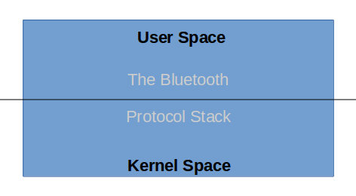
Linux Bluetooth Stack Architecture
19
The whole Bluetooth Stack has been divided into two component stacks in Linux.
One portion of the stack is made part of the kernel space.
The other portion is available as a separate toolkit for the users in the userspace.

Slide 20
The Kernel Space Protocols
20
Low level protocols (L2CAP, RFCOMM, BNEP, HIDP, etc)
Security (SSP, SMP)
Hardware drivers
Provides socket based interfaces to user space
For data (L2CAP, RFCOMM, SCO, HCI)
For control (MGMT, HCI, BNEP, HIDP)
kernel

Slide 21
The User Space Protocols
21
Bluetoothd
Central daemon
D-Bus interfaces for UI and other subsystems
Reduces exposure to low details
Extendible with plugins (eg neard for NFC)
Obexd
Daemon for OBEX profiles
D-Bus interface for UI
Similar architecture to bluetoothd
Tools
Bluetoothctl – command line agent
Btmon -HCI tracer
Set of command line tools useful for testing, development and tracing
User Space

Slide 22
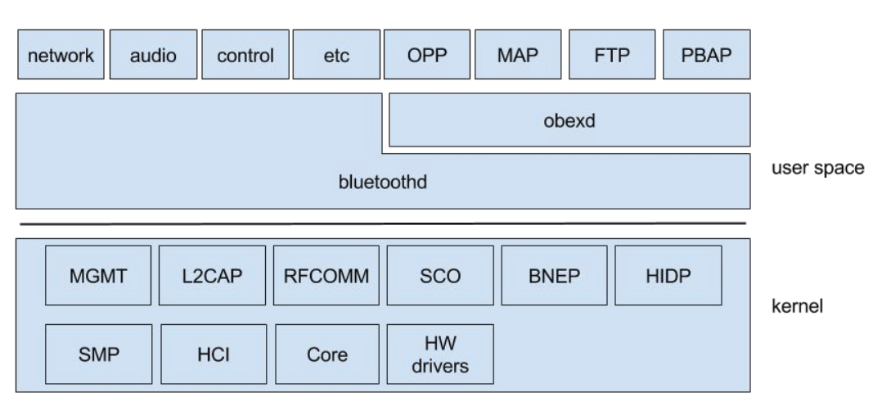
BlueZ Architecture
22

Slide 23
Development

Slide 24
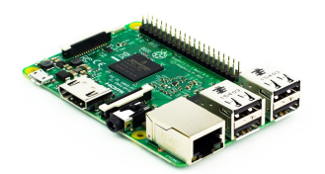
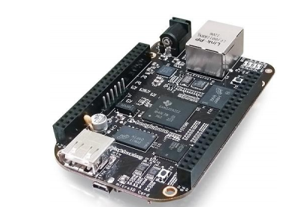
Selecting the host for development
24
Choosing a host system upon which the development is to be had e.g. BeagleBone Black or Raspberry Pi 3.
Raspberry Pi 3 seems like the more obvious choice because of its builtin Bluetooth capabilities and configurations.

Slide 25
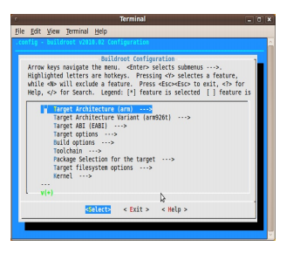
Linux Environment for the host
25
Preparing a Linux environment consisting of a kernel, device tree binaries, bootloader and a root file system consisting of all the necessary software support for proper working of Bluetooth. Buildroot is to be used for this step.

Slide 26
Configuration, Coding, Documentation
26
Enabling SPI support in the host
Configuring the device tree binaries of the board in the Linux kernel so as to recognize BlueNRG as an SPI device.
Coding the driver. This is a big step as it includes many sub steps and considerations from making the driver communicate with the host and then from there making it respond to commands sent from the driver. Once the hardware starts responding then comes the turn of the main coding activity i.e. extending all the features offered by BlueNRG in the driver and mapping them to the command line utilities offered by Bluez.
Documenting the driver.

Slide 27
Flow diagram

Slide 28
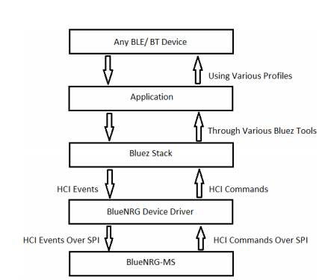
Hardware connections
28

Slide 29
Testing

Slide 30
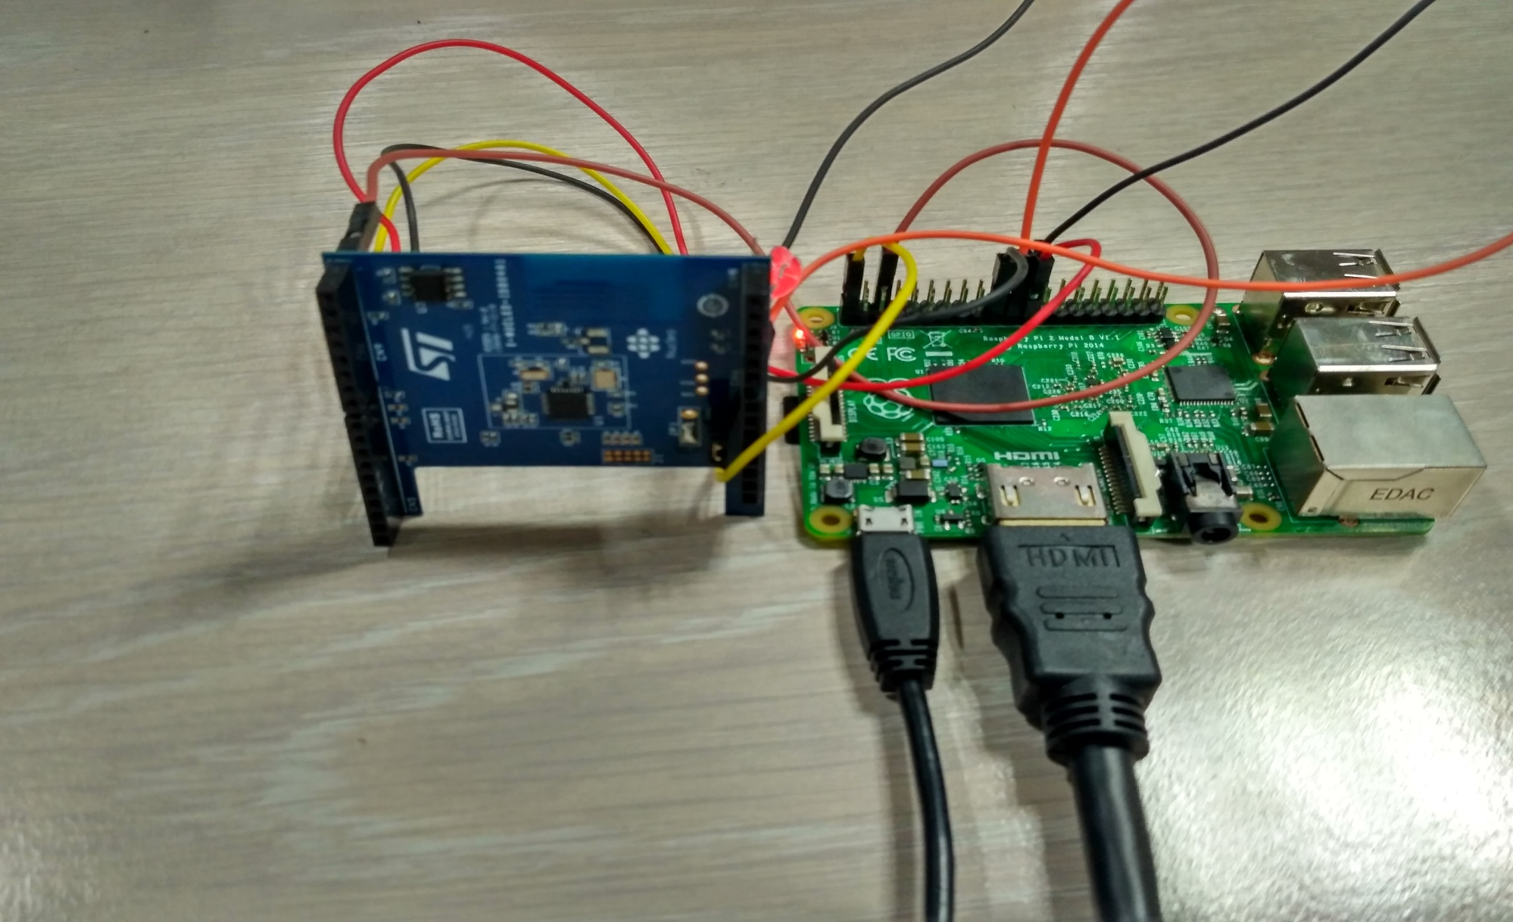
Hardware connections
30
The Bluetooth Stack is divided into three components.
The controller
The Host
The Application
Another important component is the Host Controller Interface.

Slide 31
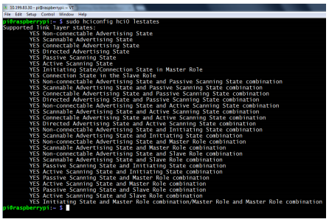
Adapter availability
31
This can be done using the following command
sudo hciconfig hci0 lestates This command should return the output given in the picture.

Slide 32
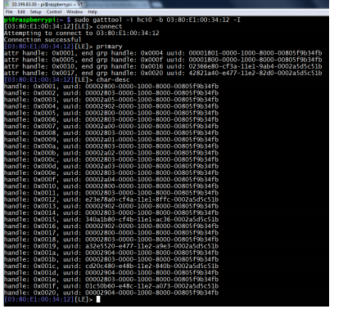
BLE Gatttool Interaction
32
Find out the MAC ADDR of the other device using
sudo hcitool lescan
Open interactive session using gatttool:
sudo gatttool -i hci0 -b MAC ADDR –I
In the interactive sesssion type in the following commands: connect
Read profiles: primary
Read all available characterstics: char-desc
Read the value of a characterstic: char-read-hnd The characterstic handle
Write to a particular characterstc: char-write-cmd handle Value in Hex
Disconnect: disconnect

Slide 33
Thank You!

