Slide 1
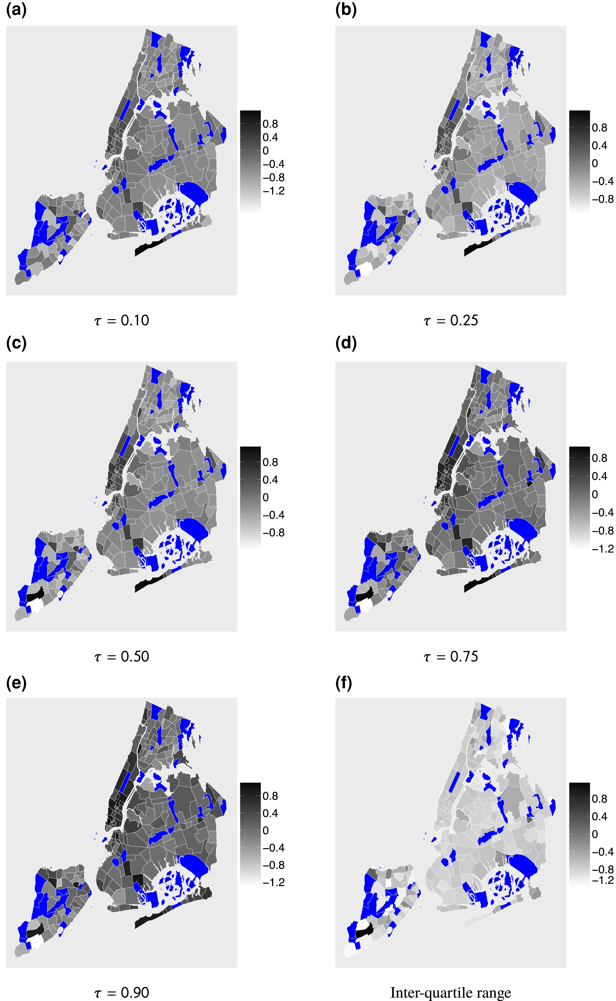
Figure 3. (a–e) Plot estimated spatial effects for τ=(0.10,0.25,0.50,0.75,0.90), while (f) plots the inter-quantile ...
Notes:
Figure 3. (a–e) Plot estimated spatial effects for τ=(0.10,0.25,0.50,0.75,0.90), while (f) plots the inter-quantile range (iqr) measured as the difference between the third and the first quartile of the estimated spatial effects, iqri=si0.75−si0.25 for i=1,2,…,S. The shaded blue areas are districts with no houses such as airports, parks, or fields.
Unless provided in the caption above, the following copyright applies to the content of this slide: © (RSS) Royal Statistical Society 2023. All rights reserved. For permissions, please e-mail: journals.permissions@oup.comThis article is published and distributed under the terms of the Oxford University Press, Standard Journals Publication Model (https://academic.oup.com/journals/pages/open_access/funder_policies/chorus/standard_publication_model)

