Slide 1
Employee Management SYSTEM
Govind Maheshwari Emp_id: 206199

Slide 2
Contents
Introduction
System Workflow
Admin Functionalities
Employee Functionalities
Database Structure
Security Features
SQL Query Examples
Conclusion

Slide 3
INTRODUCTION
The Employee Management System is a Python-based console application integrated with MySQL for efficient management of employee data. The system is divided into two roles: Admin and Employee, with password-based authentication. Admins have full control, allowing them to add, update, delete, and view employee details. They can manage all employee information, including personal details, job positions, and salaries. Employees, on the other hand, can view and edit their own personal information such as phone number, email, and address, and also change their password. This role-based structure ensures data security and task-specific permissions.
The system is powered by a MySQL database, which stores employee information in an employees table and user credentials in a users table. All actions, including data insertion, updates, and deletions, are handled via SQL queries executed within the Python program using the mysql-connector-python library. Passwords are securely entered using the getpass module, ensuring sensitive data remains protected. The system’s design allows for flexibility and scalability, making it an efficient solution for organizations to manage their workforce details.

Slide 4
System Workflow
Database Connection:
Python connects to the MySQL database employee_management.
Employee and user data are stored in tables (employees and users).
User Authentication:
Users log in with a username and password.
The system differentiates between Admin and Employee based
Admin and Employee Menu:
After login, Admins can perform various operations like add, update, delete, and view employee records.
Employees can view and edit their own information and change their password.

Slide 5
Admin Functionalities
Add Employee: Admins can add new employees by entering details such as name, department, salary, and contact info.
Update Employee: Admins can modify specific employee details by their ID (e.g., changing salary, email, or address).
Delete Employee: Admins can delete employees from the database based on their employee ID.
View Employees: Admins can view a specific employee’s details by ID or view all employee data.

Slide 6
Employee Functionalities
View Personal Details: Employees can view their name, department, salary, and other details.
Edit Personal Details: Employees can update their contact information like phone number, email, or address.
Change Password: Employees can securely change their password after authenticating their current credentials.

Slide 7
Database Structure
The system uses two key tables:
employees table: Stores employee information (ID, name, age, department, position, salary, email, phone, address).
users table: Stores login credentials (username, password, role).
Relationships:
Each employee is associated with a user account for login purposes.
Primary Operations:
Admins manage employee details via the employees table.
Login and role management are handled via the users table.

Slide 8
Security Features
Authentication: Each user (Admin or Employee) must log in with a valid username and password, which are verified using MySQL.
Password Masking: The system uses the getpass module to hide passwords during entry.
Role-Based Access: Admins and Employees have different access levels. Admins can modify all employee data, while Employees can only access and update their own data.

Slide 9
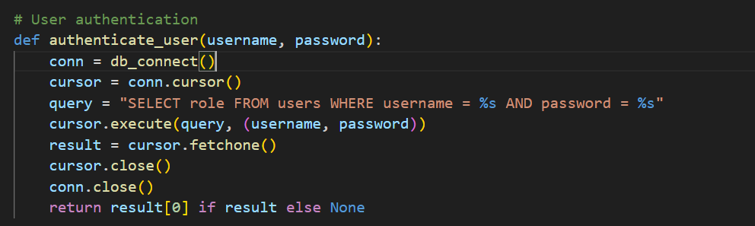
USER authentication

Slide 10
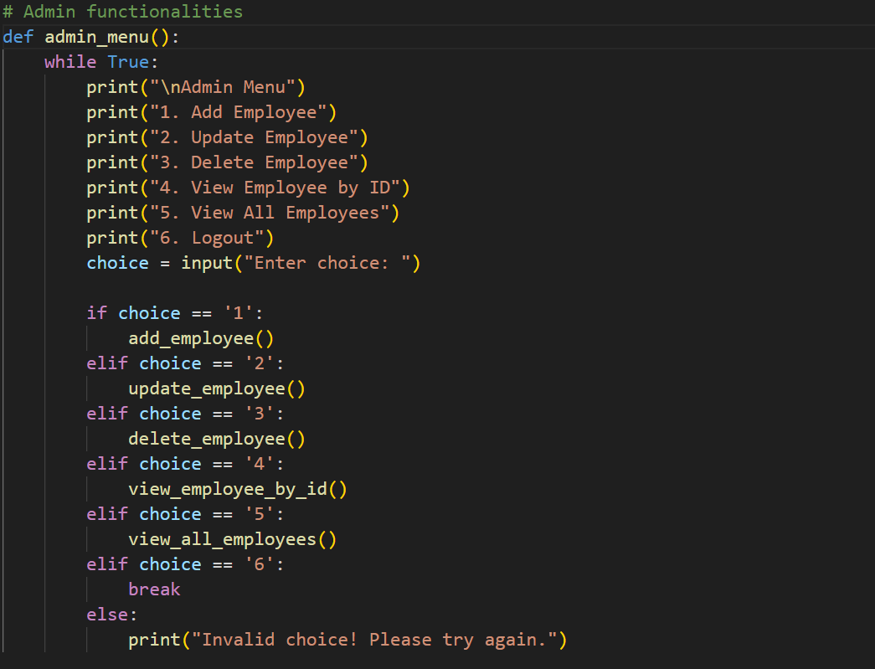
Admin functionalities

Slide 11
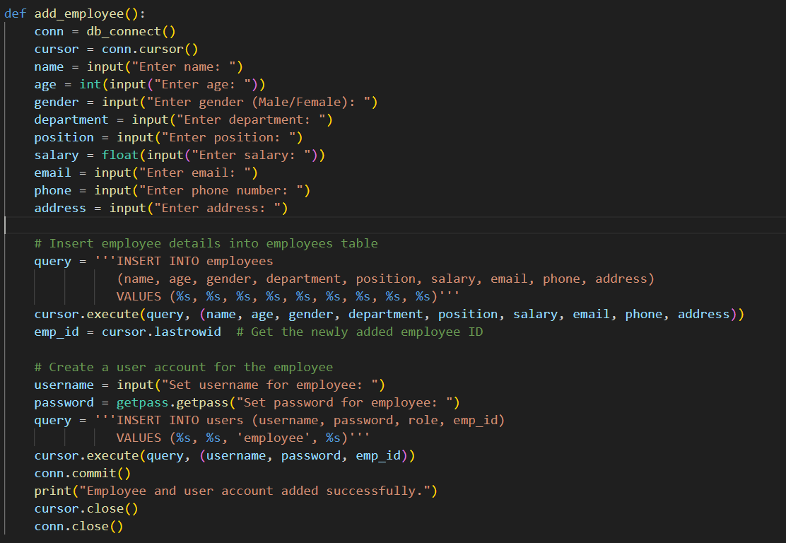
INSERTING EMPLOYEES

Slide 12
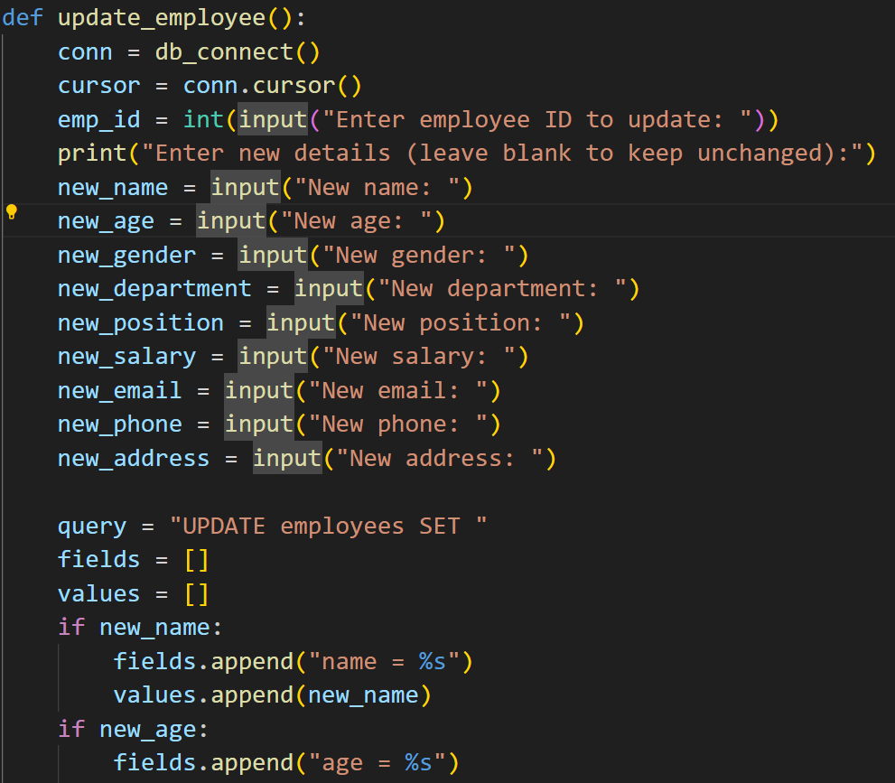
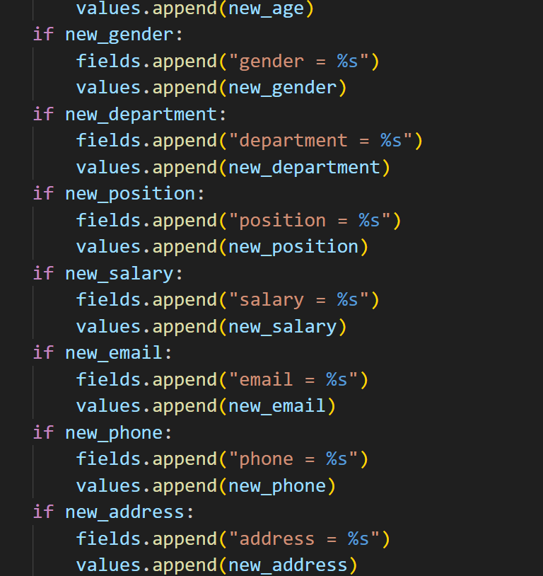
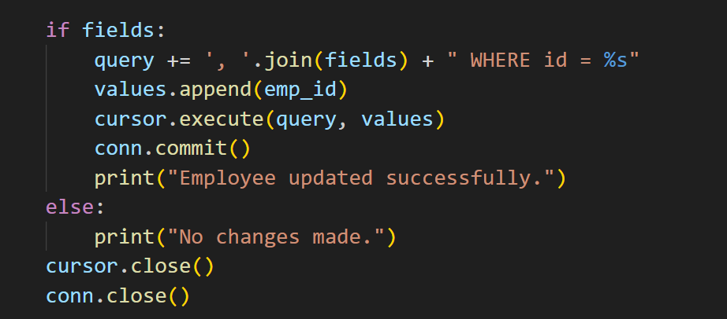
UPDATE EMPLOYEES

Slide 13
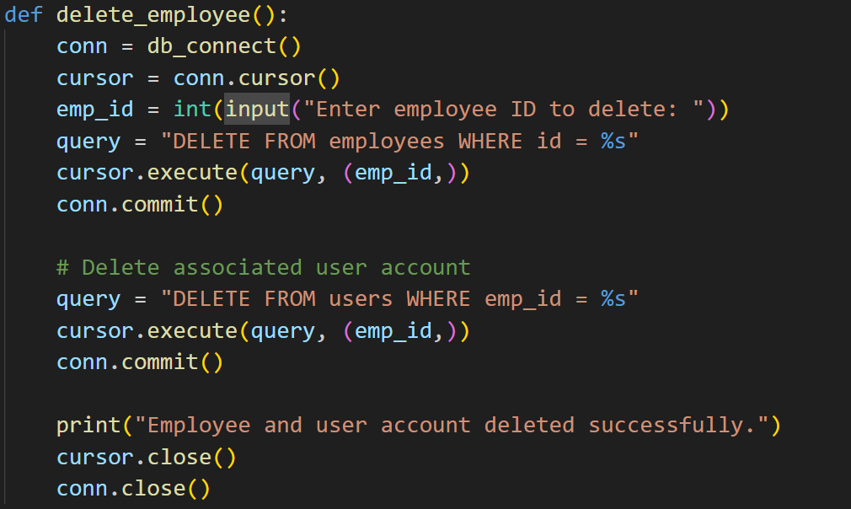
DELETE EMPLOYEES

Slide 14
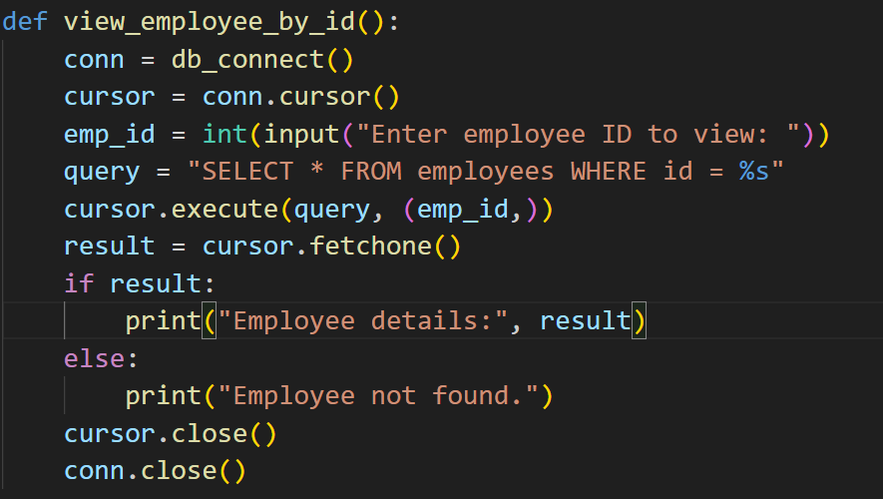
view_employee_by_id

Slide 15
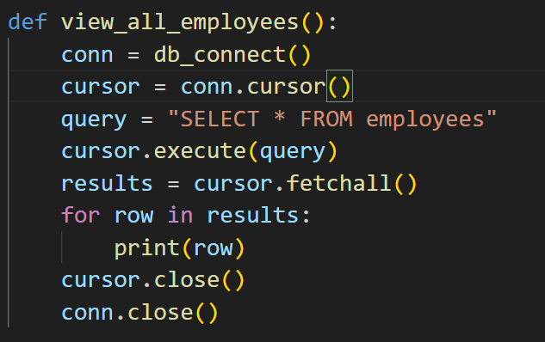
view_all_employees

Slide 16
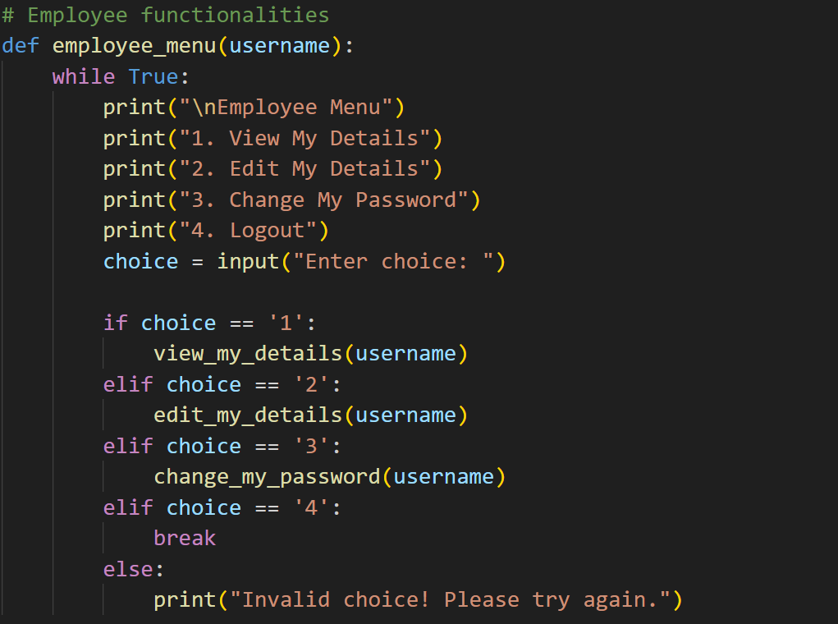
EMPLOYEE functionalities

Slide 17
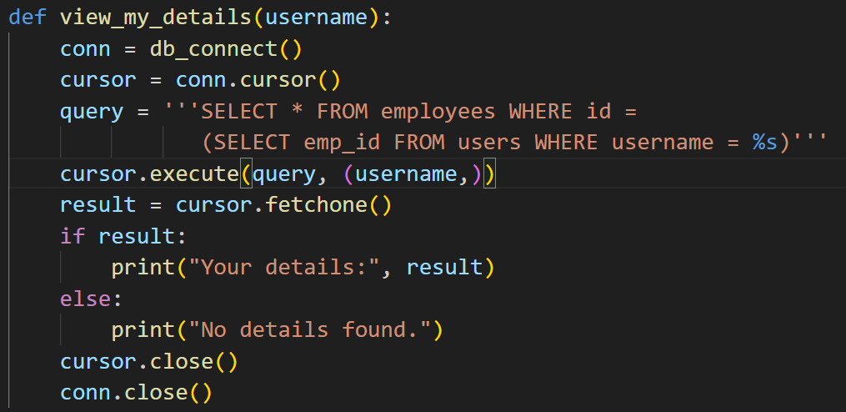
view_my_details

Slide 18
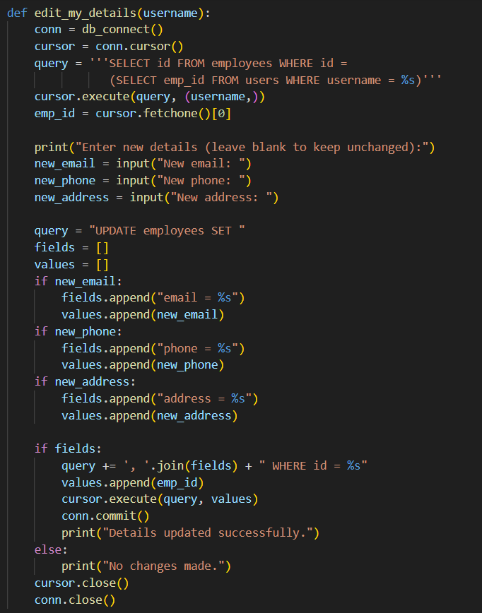
EDIT_MY_DETAILS

Slide 19
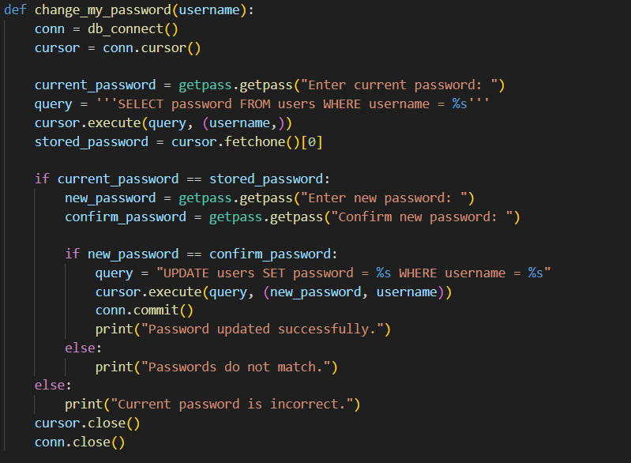
CHANGE EMPLOYEE PASSWORD

Slide 20
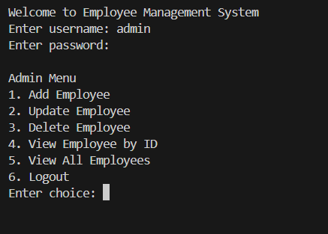
ADMIN MENU OUTPUT

Slide 21
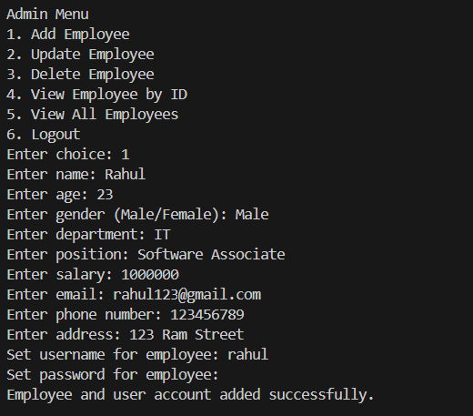
ADDING/INSERTING EMPLOYEE

Slide 22
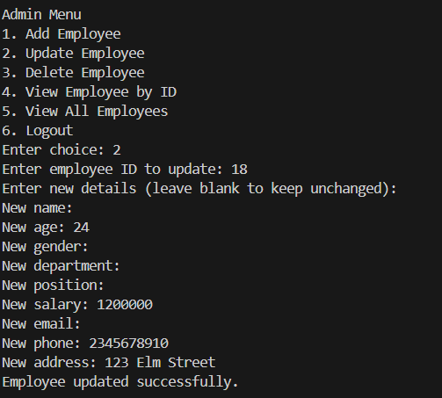
UPDATING EMPLOYEE DETIALS

Slide 23
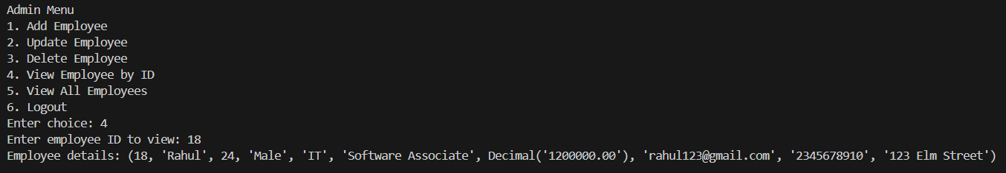
VIEW EMPLOYEE BY ID

Slide 24
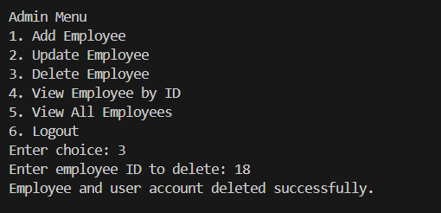
DELETE EMPLOYEE

Slide 25
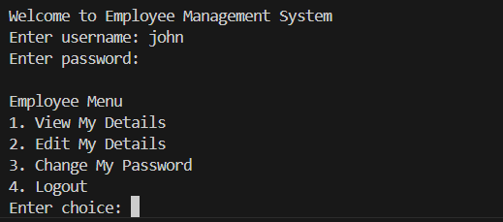
EMPLOYEE MENU

Slide 26
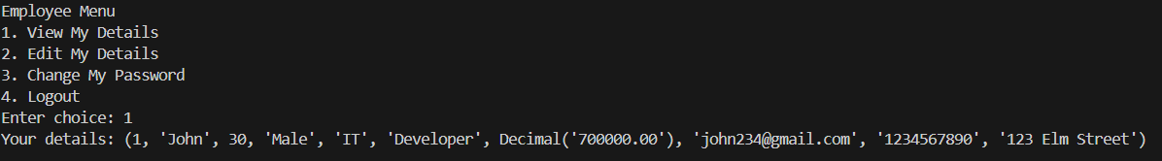
View Employee Details

Slide 27
THANK YOU!

