Slide 1
Structure
parser.py
viz.py
webapp.py

Slide 2
parser.py
Core of the program
NLTK
  Tokenize
  POS Tag
Generates Syntatic Tree

Slide 3
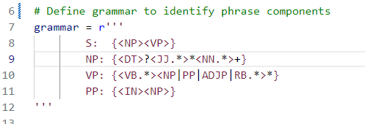
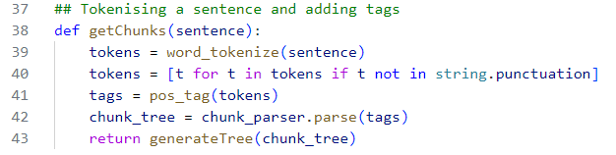
parser.py

Slide 4
vis.py
viz.js - Visualisation Library
CDN - unpkg.com

Slide 5
Links
https://www.nltk.org/
https://webpy.org/
https://app.unpkg.com/vis-network@9.1.10

