Slide 1
Project Report-2: Data Visualization of Bird Strikes between 2000-2011
Technologies: Data Science/Analysis
Domain: Transportation and Communication
Details: This Data includes “Bird Strike with airplanes” details between 2000-2011

Slide 2
1.INTRODUCTION
Purpose: The purpose of this report is to analyze and visually represent the occurrences of bird strikes in the aviation industry between 2000 and 2011 within the domain of Transportation and Communication.
Scope: The report will cover the frequency of bird strikes, affected regions, types of birds involved, and any trends observed during the specified timeframe, focusing on its implications for transportation and communication sectors.
Background: Bird strikes pose a significant threat to aviation safety, impacting the efficiency of transportation and communication systems. By studying and visualizing the data, insights can be gained to enhance safety measures and operational effectiveness in these domains.

Slide 3
2.ANALYSIS
EDA and Data Cleaning:
Since, there are too many missing values in dataset, so dealing the with appropriate method given as:
1.Though the data(Wildlife: Number struck) is numerical but mostly the number of words struck is one and missing values are not that large, so better to replace with mode instead mean.
2.Similarly in "Effect: Impact to flight" column a huge amount of data is missing (around 23500 out of 25500), it is not suitable to replace with any method like mean, mode or median etc, so simply show "Unknown".

Slide 4
3.Since the missing data is quite substantial compared to the available data points, it might not be ideal to remove the entire "Conditions: Precipitation" column. Removing the column could result in a significant loss of information. Instead, you could consider marking the missing values as "unknown" or "missing" to indicate that the data is not available for those specific entries. This way, you can still include the column in your analysis while acknowledging the missing values.
Similar approach for other columns as well, If numerical as contains no outliers mean is correct option otherwise median. On the other hand if categorical and 1 category dominating mostly mode is the correct option. If can't find any of the category to dominate strongly, "Forward fill" and "Backward fill" are also used so that distribution of data do not get affected.

Slide 5
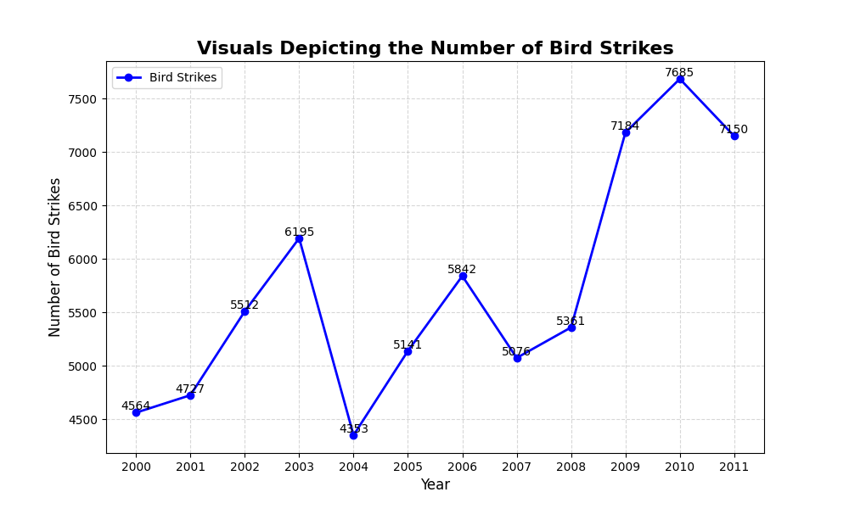
Number of Bird Strikes: The graph shows most of the bird strikes happened in 2010 (7865) and least in 2004(4353).

Slide 6
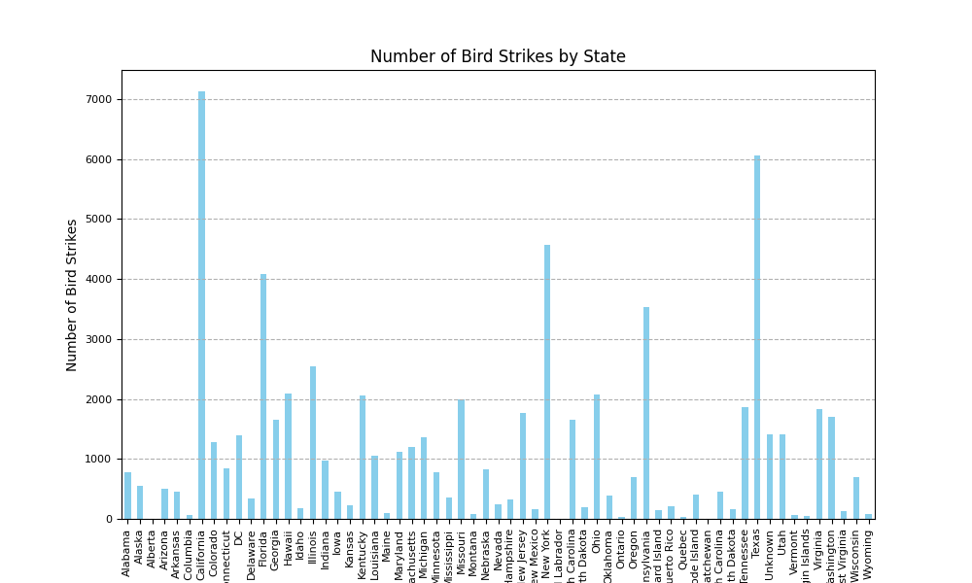
Yearly Analysis & Bird Strikes in US:
Bar graph depicting State-wise in US highest bird strikes happened in California(>7000) and Texas (>6000) while minimum(<100) in "Newfoundland and Labrador", Quebec, Onthrio etc.

Slide 7
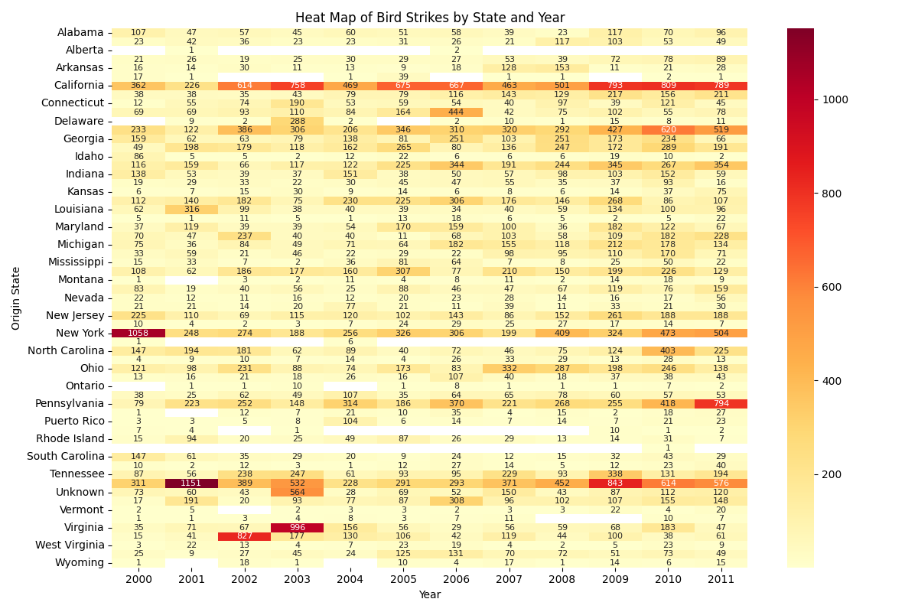
Above Heat Map showing the number of bird-strike over different year in different states of USA.

Slide 8
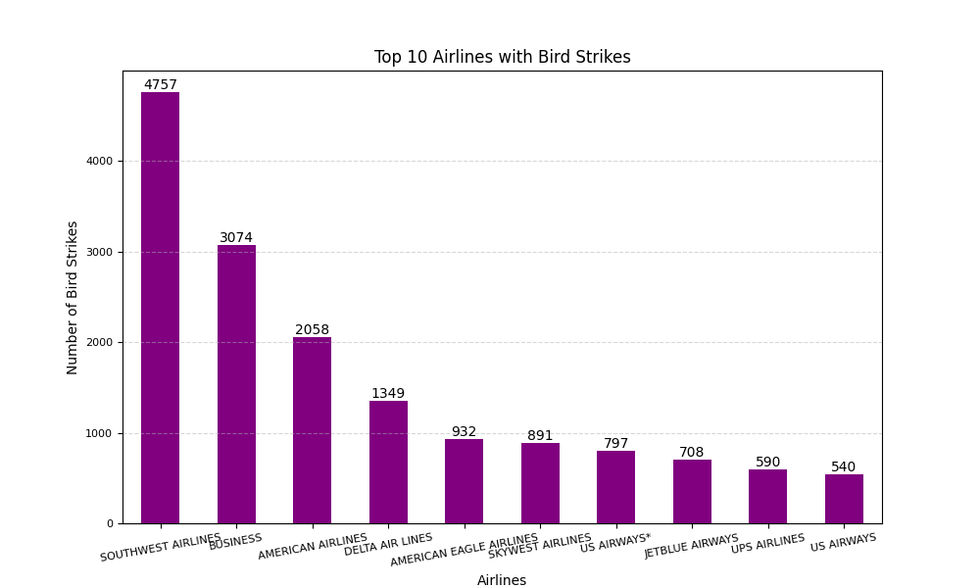
Above bar chart representing Top 10 US Airlines in terms of having encountered bird strikes with number of Bird strikes.

Slide 9
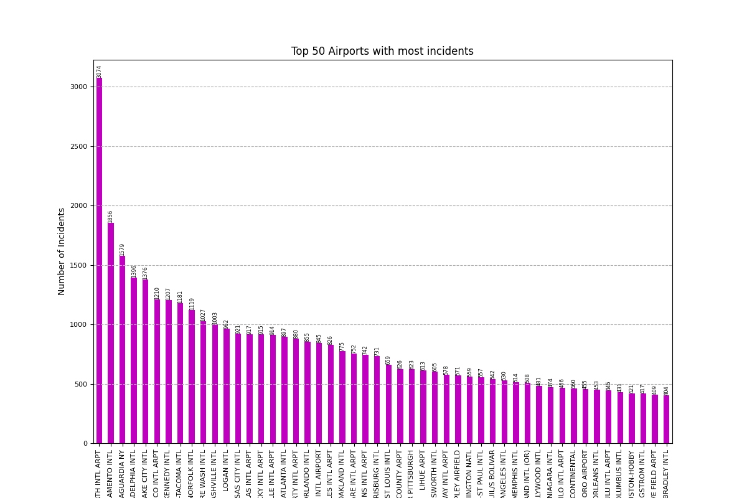
Top 50 Airports
Above chart representing top 50 Airports with most incidents of bird strikes with number of bird strikes.

Slide 10
Yearly Cost Incurred due to Bird Strikes:
Given linechart shows yearwise cost incurred, by analysis it is clear that highest cost incurred in year 2001(23,259,457),2006(18,309,903) while lowest cost incurred in year 2000 (5,635,496),2005(7,026,904)
Given linechart shows yearwise cost incurred, by analysis it is clear that highest cost incurred in year 2001(23,259,457),2006(18,309,903) while lowest cost incurred in year 2000 (5,635,496),2005(7,026,904)
Given Line chart shows Year wise cost incurred, by analysis it is clear that highest cost incurred in year 2001($23,259,457), 2006 ($18,309,903) while lowest cost incurred in year 2000 ($5,635,496), 2005 ($7,026,904)

Slide 11
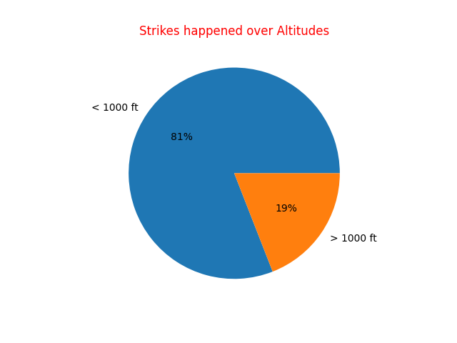
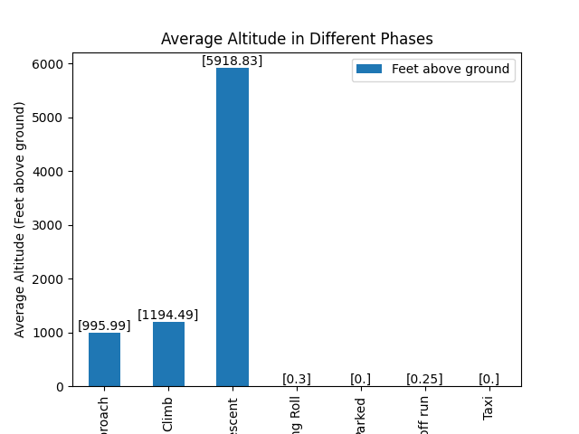
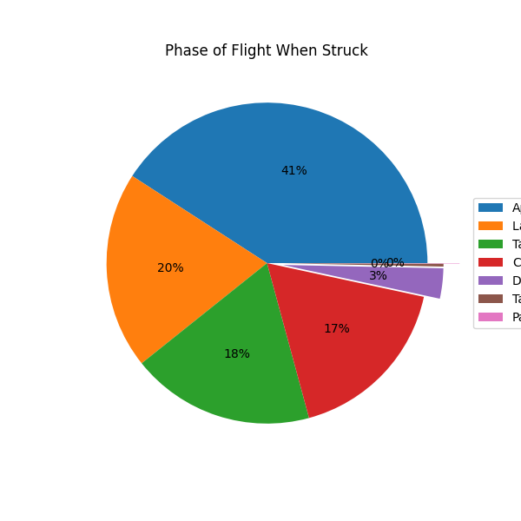
When do most bird strikes occur

Slide 12
Insights:
First Pie chart shows 81% birds struck when airplane was at altitude greater than 1000 feet while only 19% struck at altitude below 1000 feet. Conclusively, higher altitude increases the chances of Bird-Strike.
If we try to figure out on the basis of "Phase of Flight“ Second Pie Chart:
41% bird struck when Approach,
20% when landing,
18% While take of run,
17% during Take-off run and rest are during climb, descent etc.
According to Above Bar Plot Average height of different phases are:
Approach - 995.99 feet
Climb - 1194.49 feet
Descent - around 5920 feet and rest are less than 30 feet.

Slide 13
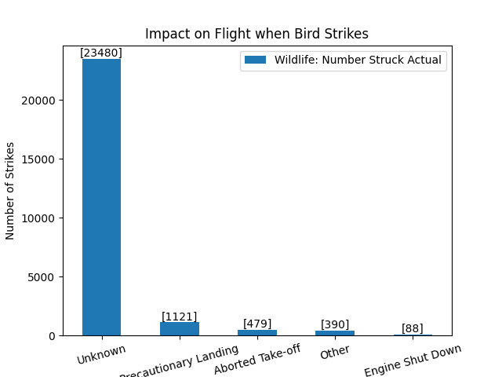
Effect of Bird Strikes:
Impact on Flight may involve "Precautionary Landing", "Aborted Take-off", "Engine Shut Down" and others. In the Above Bar Chart, Out of 25580(around) Mostly cases are Unknown(23480) while Very few cases are known. Out of which:
- Precautionary Landing - 1121 times
- Aborted Take-off - 479 times
- Engine Shut Down - 88 times
- 390 time Others and rest are unknown.

Slide 14
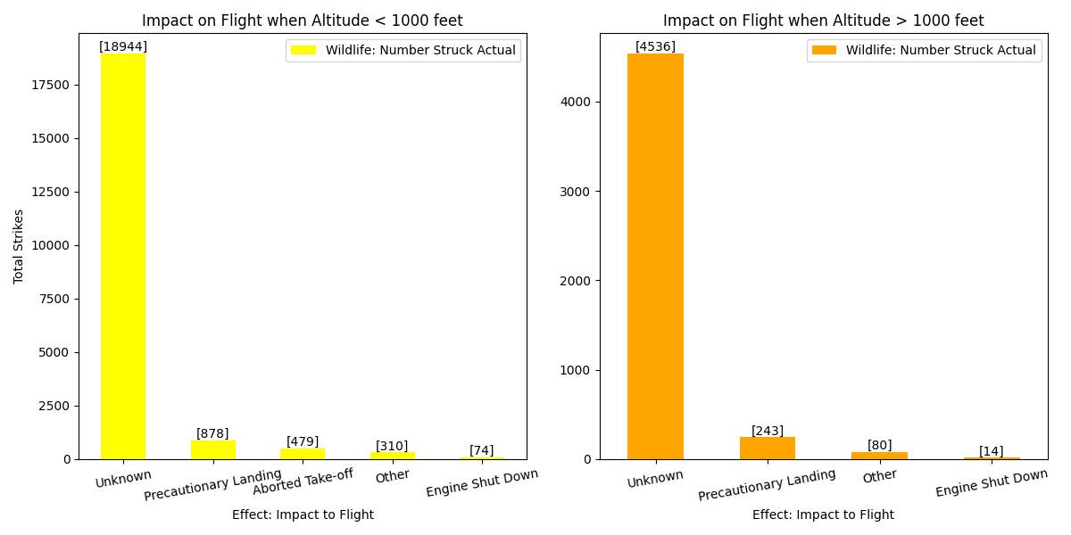
Comparison of Effect, When Struck at Different Altitude
If we compare the Impact we can clearly figure out that impact was more when height < 1000 feet, above that impact wasn't as much as compared. Also their may be some other factors since huge amount of data is still unknown.

Slide 15
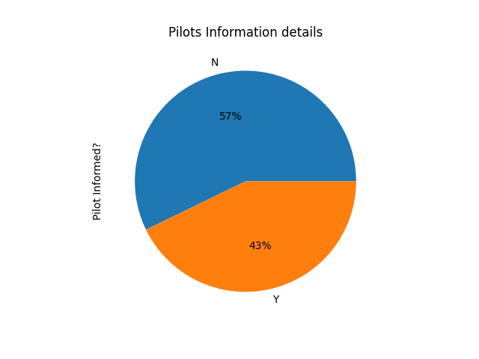
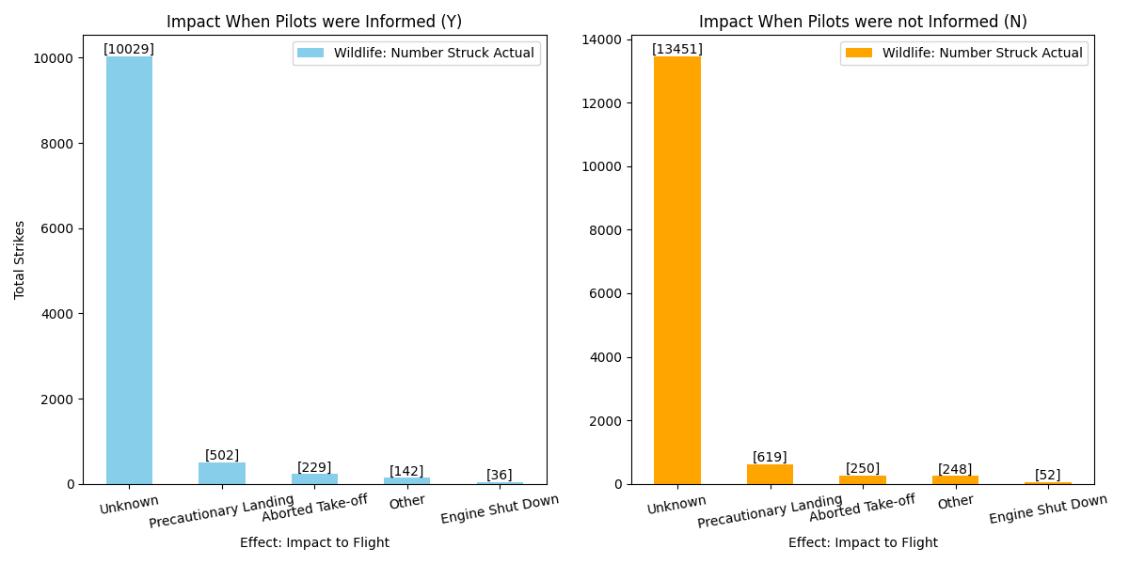
Impact when Pilots Informed and Not Informed: Comparison
In 57% cases pilots were informed and 43% Not informed.
Let's compare the impact of both cases:
As per the distribution or information from Bar graphs:
It is clear that Impact to Flight is comparatively more when Pilots were not Informed while less if Pilots get a Prior information.

Slide 16
3.Conclusion:
Summary of Findings: The analysis of the dataset on bird strikes between 2000-2011 revealed a significant number of incidents involving various types and models of aircraft. - The data highlighted the impact of bird strikes on flight operations, including damage to aircraft, potential risks to passengers, and the need for effective mitigation strategies.
Recommendations: Airlines and aviation authorities should prioritize bird strike prevention measures, such as investing in bird detection technology and implementing wildlife management programs near airports. - Providing comprehensive training to pilots and air traffic controllers on bird strike awareness and response protocols can enhance aviation safety and reduce the likelihood of incidents.
Future Work: Further research could focus on identifying specific bird species involved in strikes, studying their behavior patterns, and developing targeted mitigation strategies. - Collaboration among aviation stakeholders, wildlife experts, and environmental agencies is essential for developing holistic approaches to bird strike prevention and promoting sustainable aviation practices.

Slide 17
THANKYOU

