Slide 1
Melanoma Detection using Deep Learning and Parallelism
Team 6 - Saiyam Doshi & Govind Mudavadkar Instructor: Prof. Handan Liu

Slide 2
Table Of Contents
1. Background
2. Motivation
3. Dataset Description
4. Methodology
5. Results and Analysis
6. Conclusion
7. References
8. Thank you!

Slide 3
1. Background
Melanoma: The most aggressive skin cancer, known for rapid spread and high mortality.
Early Detection: Crucial for improved survival rates. 5-year survival rate is 99% when detected early but drops significantly as cancer progresses.
Importance: Early detection leads to less invasive treatments and prevents metastasis (spread to other organs).
AI in Melanoma Detection:
Integration with Imaging: AI has significantly advanced early detection through various imaging methods.
Dermoscopy: AI algorithms outperform or match dermatologists, with sensitivity of 83.01% and specificity of 85.58%.
Other Imaging Techniques:
Optical Coherence Tomography (OCT): AI achieves 95% accuracy.
Health of Things Melanoma Detection System (HTMDS): Achieves over 98% accuracy in detection and 99% in skin cancer segmentation from dermoscopic images.
Impact: These AI-driven solutions improve accessibility, reduce unnecessary biopsies, and enhance diagnostic efficiency, potentially revolutionizing melanoma screening.

Slide 4
2. Motivation
Skin Cancer Prevalence: Skin cancer is widespread and potentially life-threatening. Early and accurate detection is critical for effective treatment.
Challenges with Traditional Methods:
Manual Inspection: Time-consuming and prone to human error, especially with a large volume of cases.
Need for Automation: Automated image-based diagnostic tools can help overcome these limitations by leveraging machine learning for precise lesion identification.
Project Objective:
Develop a Machine Learning Model: Focus on analyzing high-resolution skin lesion images to differentiate between benign and malignant cases.
Integrate Parallel Computation: Enhance processing efficiency for large datasets, enabling real-time detection and scalability.
Expected Impact:
Enhanced Diagnostic Accuracy: Combining advanced image processing, deep learning, and parallel processing ensures both accuracy and responsiveness.
Empowering Healthcare Professionals: The solution supports dermatologists, streamlines diagnostics, and ultimately aids in better skin cancer detection and treatment.

Slide 5
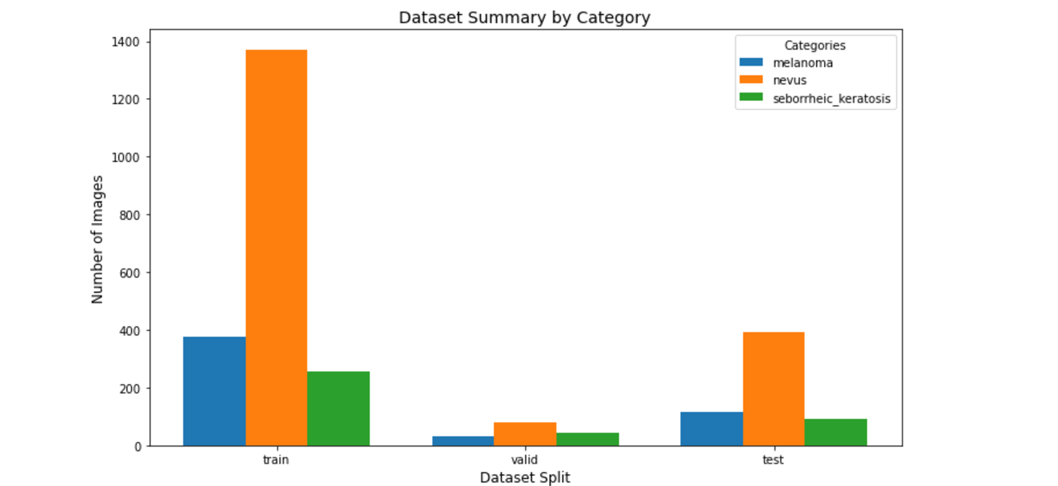
3. Dataset Description
Data Size: Approximately 12.2 GB of images.
Each image is associated with metadata, which includes information about the lesion type, diagnosis, and other clinical features. The primary focus is on melanoma detection, but other labels for benign lesions and non-cancerous conditions are also provided.
Each directory contains three subdirectories:
Melanoma - A type of skin cancer that develops in melanocytes and is often dangerous.
Nevus - Often benign moles that are common but can sometimes transform into melanoma.
Sborrheic_keratosis - A common benign skin growth that is typically non-cancerous.

Slide 6
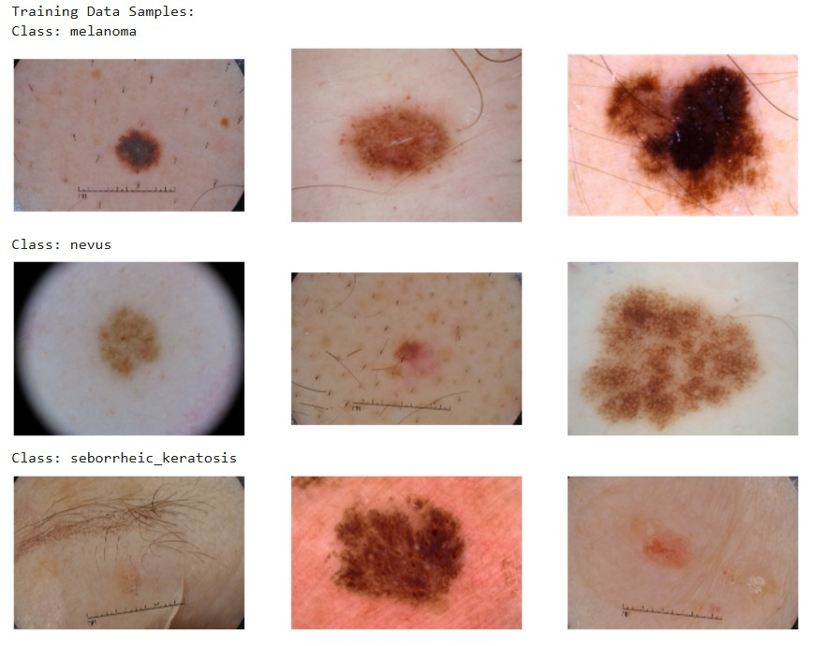
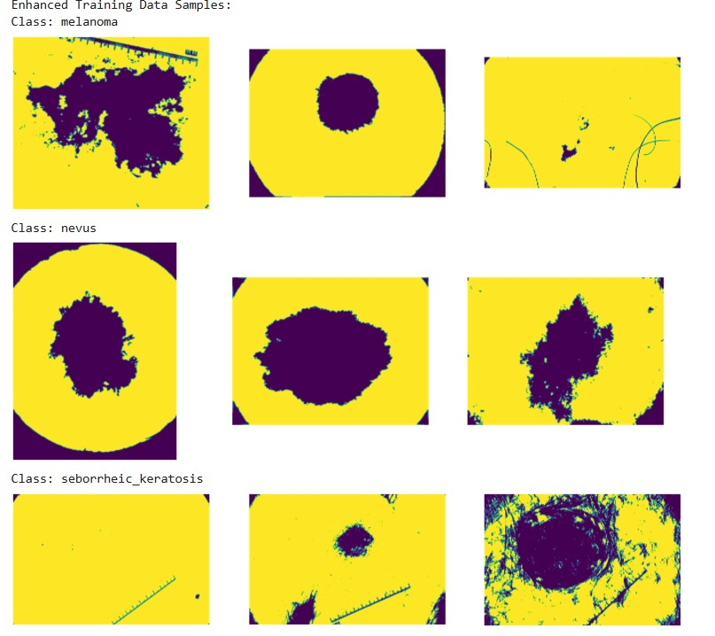
4. Methodology: Dataset Description

Slide 7
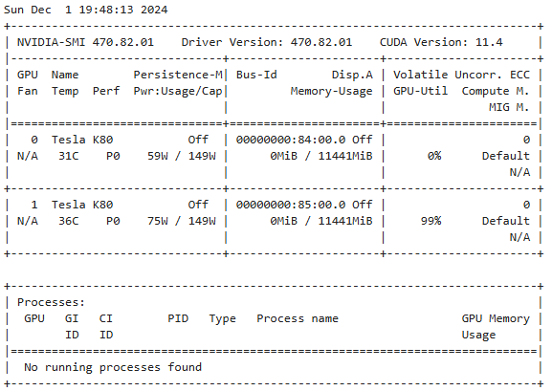
4. Methodology: Environment Setup
Cluster Information
Cluster Name: Discovery
Node Type: Reservation
Environment Configuration
Conda Module: anaconda3/2021.05
Conda Install: Not installed (Checkbox: 0)
Conda Environment: Not specified (Checkbox: 0)
Hardware Configuration
Number of GPUs: 4
CUDA Version: cuda/11.2
Number of CPUs: 8
Memory: 32 GB
Job Configuration
Time Limit: 4 hours
Email on Job Start: Not enabled (Checkbox: 0)
System Architecture
CPU Architecture: x86_64

Slide 8
4. Methodology: DASK Implementation for Data Parallelism
Distributed Computation with DASK: DASK was utilized to parallelize image enhancement tasks across multiple CPUs, improving the efficiency of processing large datasets.
Parallelization Setup: The run_dask_with_cpus function sets up a Dask Client to manage CPU resources, allowing dynamic allocation of tasks to different numbers of CPUs (1, 2, 4, or 8).
Task Creation and Execution:
The code splits the dataset into train, validation, and test sets. For each image in these sets, tasks are created using the process_and_save_image function.
These tasks are added to Dask’s task graph, which is then executed in parallel across the available CPUs using the compute(*tasks) command.
Performance Metrics:
Speedup: The ratio of processing time with 1 CPU versus the time with multiple CPUs, showing how much faster the process is with more CPUs.
Efficiency: The ratio of speedup to the number of CPUs used, measuring the effective utilization of CPUs. Ideal efficiency is 1, indicating linear speedup with increasing CPUs.

Slide 9
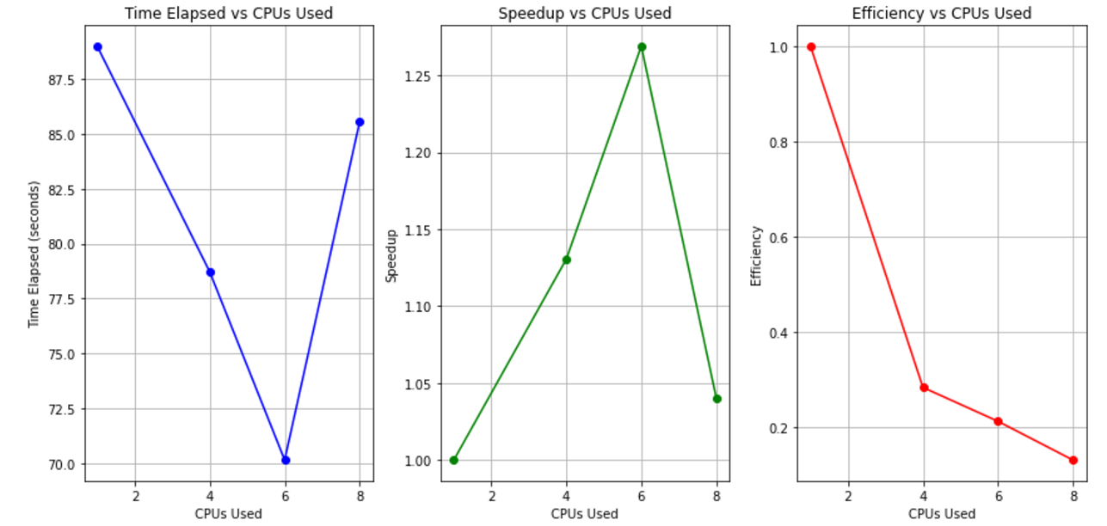
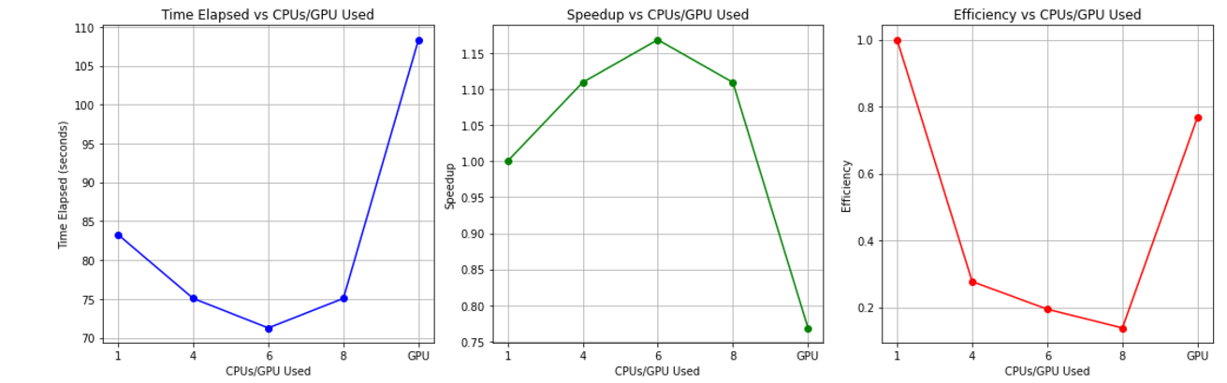
4. Methodology: DASK Objective Evaluation
Speedup and Efficiency and Time Elapsed: CPU vs CPU and CPU vs GPU

Slide 10
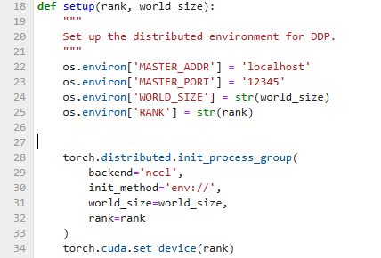
4. Methodology: Model Overview for DDP
Base Architecture
Transfer Learning
Final Layer Modification
Distributed Training
Loss Function
Optimizer
Input Data
Multi-GPU Setup

Slide 11
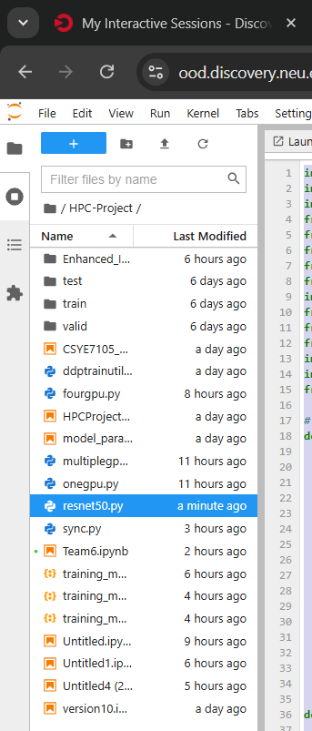
4. Methodology: Workflow of the Process (Logic)
Separate Script for DDP
Executing the Script via Bash
Saving Output in JSON Format:
Plotting Graphs from JSON Data:

Slide 12
4. Methodology: Sync Between Processes
Synchronization Across Multiple GPUs
DistributedDataParallel (DDP) Synchronization:
DDP ensures each GPU has a replica of the model and synchronizes model parameters after every gradient update.
Key Process: After forward and backward passes, an all-reduce operation averages gradients across GPUs, ensuring consistent updates to the model weights.
This synchronization guarantees that all GPUs work with the most up-to-date model, contributing equally to training.
SPAWN Method for Process Initialization:
We use torch.multiprocessing.spawn to initialize training processes on each GPU.
This method starts each process independently while maintaining synchronization, ensuring consistent training across multiple GPUs.
The spawn method helps maintain a controlled environment for communication and parameter updates during distributed training.

Slide 13
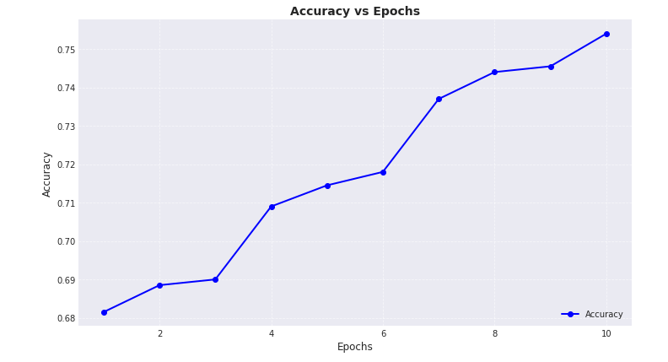
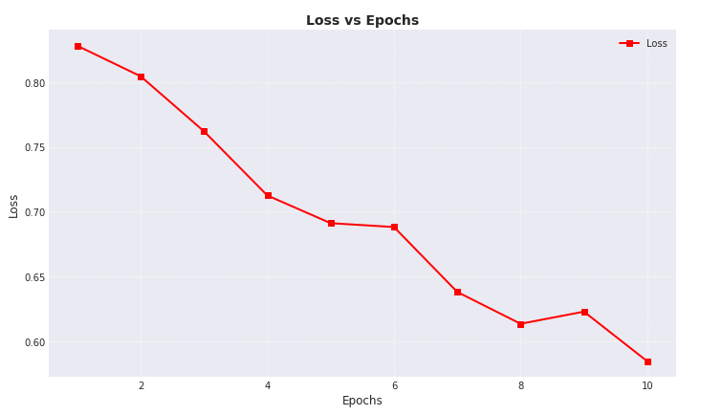
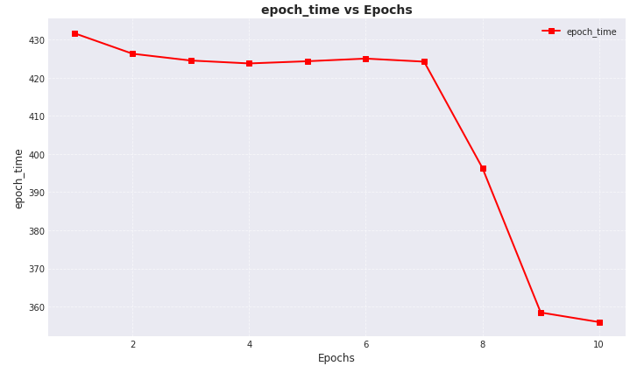
5. Results and Analysis
Performance Comparison of GPUs for Model Parallelism using DDP: Using 1 GPU
Accuracy vs Epochs: Accuracy improves steadily from 0.68 in epoch 1 to 0.75 by epoch 10, with a faster increase after epoch 4, showing no overfitting or underfitting.
Loss vs Epochs: Loss decreases from 0.82 to 0.60 by epoch 10, with minor fluctuations, indicating effective learning and stable convergence.
Epoch Time vs Epochs: Training time per epoch drops from 430 seconds to 360 seconds by epoch 10, likely due to improved GPU utilization and optimizations.

Slide 14
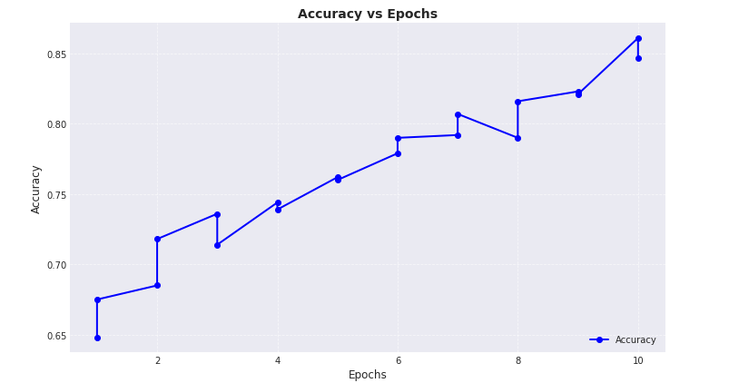
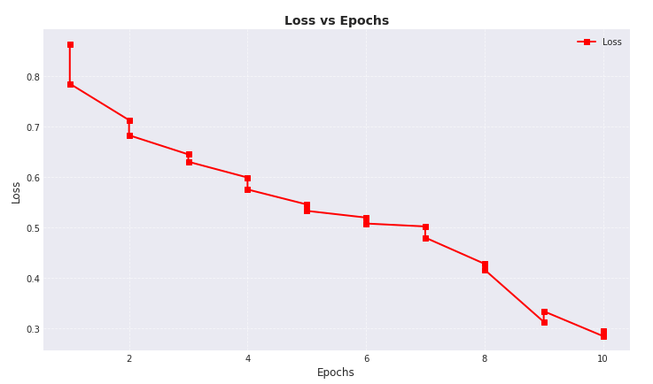
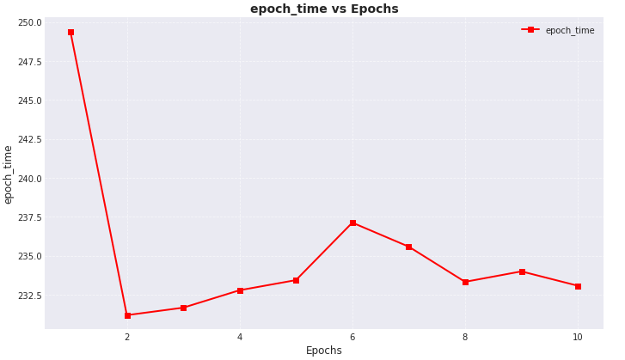
5. Results and Analysis
Performance Comparison of GPUs for Model Parallelism using DDP: Using 2 GPU
Epoch Time vs Epochs: Initial high epoch time drops after the second epoch, stabilizing around 232–235 seconds, indicating efficient model parallelism and minimal fluctuations due to workload distribution or sync delays.
Loss vs Epochs: Loss decreases steadily from 0.85 to 0.3 by epoch 10, suggesting effective gradient synchronization and stable convergence with no significant fluctuations.
Accuracy vs Epochs: Accuracy increases from 65% to 85%, reflecting effective learning, with minor deviations due to batch variability or sync delays, showing DDP's efficiency in maintaining training performance.

Slide 15
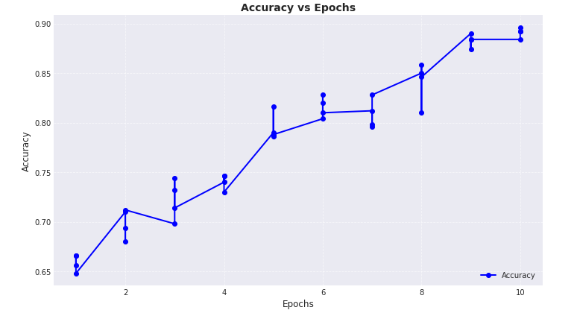
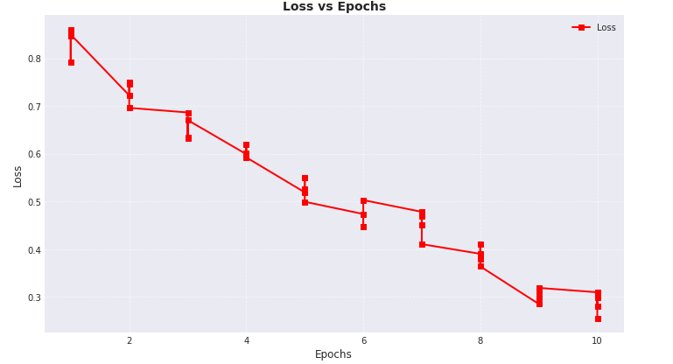
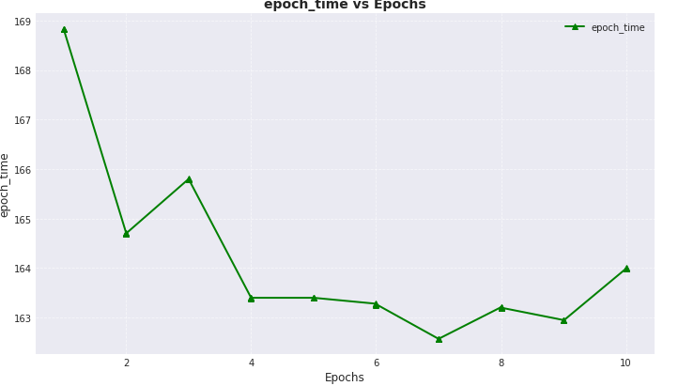
5. Results and Analysis
Performance Comparison of GPUs for Model Parallelism using DDP: Using 4 GPU
Epoch Time vs Epochs: Initial drop in epoch time, followed by minor fluctuations, stabilizing around 163-165 seconds, indicating efficient DDP workload distribution.
Loss vs Epochs: Steady decrease in loss, with faster reduction in earlier epochs and slower convergence later, reflecting effective learning and model convergence.
Accuracy vs Epochs: Accuracy improves consistently from 65% to 90%, with minor fluctuations, indicating effective training and better generalization.

Slide 16
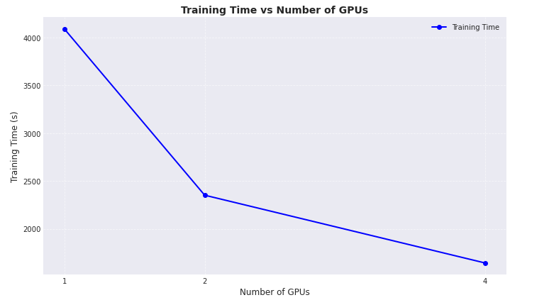
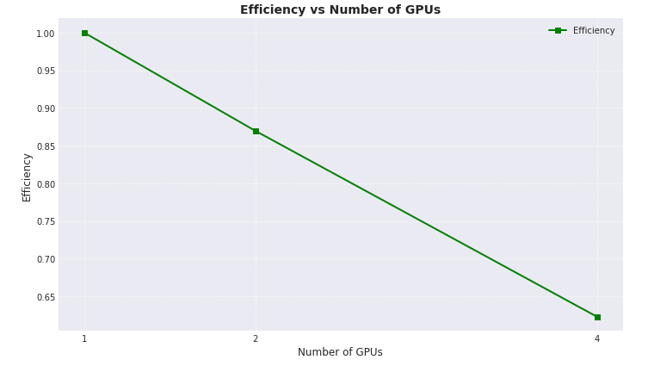
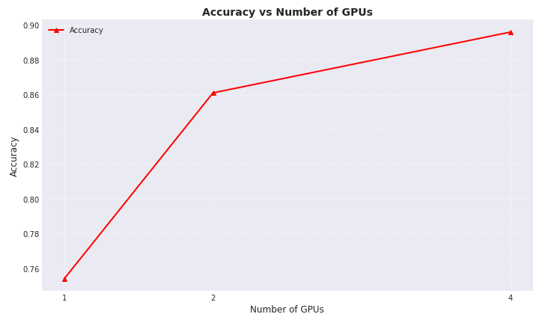
5. Results and Analysis
Performance Comparison of GPUs for Model Parallelism using DDP: 1 VS 2 VS 4
DDP Effectiveness: DDP reduces training time, making parallelism effective.
Optimal GPU Usage: 2 GPUs offer a good balance of speedup and efficiency.
Parallelization Overhead: More GPUs introduce greater communication overhead, reducing efficiency.
Workload Distribution: Dataset/model size may not fully utilize more GPUs.

Slide 17
5. Results and Analysis
Ideal Efficiency with 1 GPU: Maximum efficiency (1), with full resource utilization.
Ideal Efficiency with 1 GPU: Maximum efficiency (1), with full resource utilization.
Parallelization Overhead: More GPUs introduce greater communication overhead, reducing efficiency.
Load Imbalance: Some GPUs may remain idle due to uneven workload distribution.
Diminishing Returns: Adding more GPUs reduces training time less significantly, lowering efficiency.
Efficiency Formula: Efficiency = (Base Line Time) / (Total Time × Number of GPUs), reflecting reduced efficiency when time doesn’t scale linearly.

Slide 18
6. Conclusion
DDP Effectiveness: DDP significantly reduces training time by leveraging multiple GPUs for parallelism, offering better speedup than CPU-based parallelism.
Optimal GPU Usage: 2 GPUs provide a good balance between speedup and efficiency.
Parallelization Overhead: Adding more GPUs increases communication overhead, which can reduce efficiency.
Workload Distribution: Dataset/model size may not fully utilize additional GPUs, impacting efficiency.
Dask for Efficiency: Using Dask for parallelizing image dataset processing effectively improves computation time, demonstrating the importance of proper parallelization techniques for resource optimization.

Slide 19
7. References
https://pytorch.org/tutorials/beginner/ddp_series_multigpu.html
https://jacksoncakes.com/2023/08/20/getting-started-with-distributed-data-parallel-in-pytorch-a-beginners-guide/
https://www.osc.edu/resources/getting_started/howto/howto_pytorch_distributed_data_parallel_ddp
https://medium.com/codex/a-comprehensive-tutorial-to-pytorch-distributeddataparallel-1f4b42bb1b51

Slide 20
Thank you!
Team6 – Saiyam Doshi ＆ Govind Muavadkar

