Slide 1

Group 1
TELCO
Customer Churn Regression Model
Govindu Sathruwan
Abdullah Sheriffdeen
Shahik Shiyam
Iffath Saleem
Aaisha Aamina

Slide 2
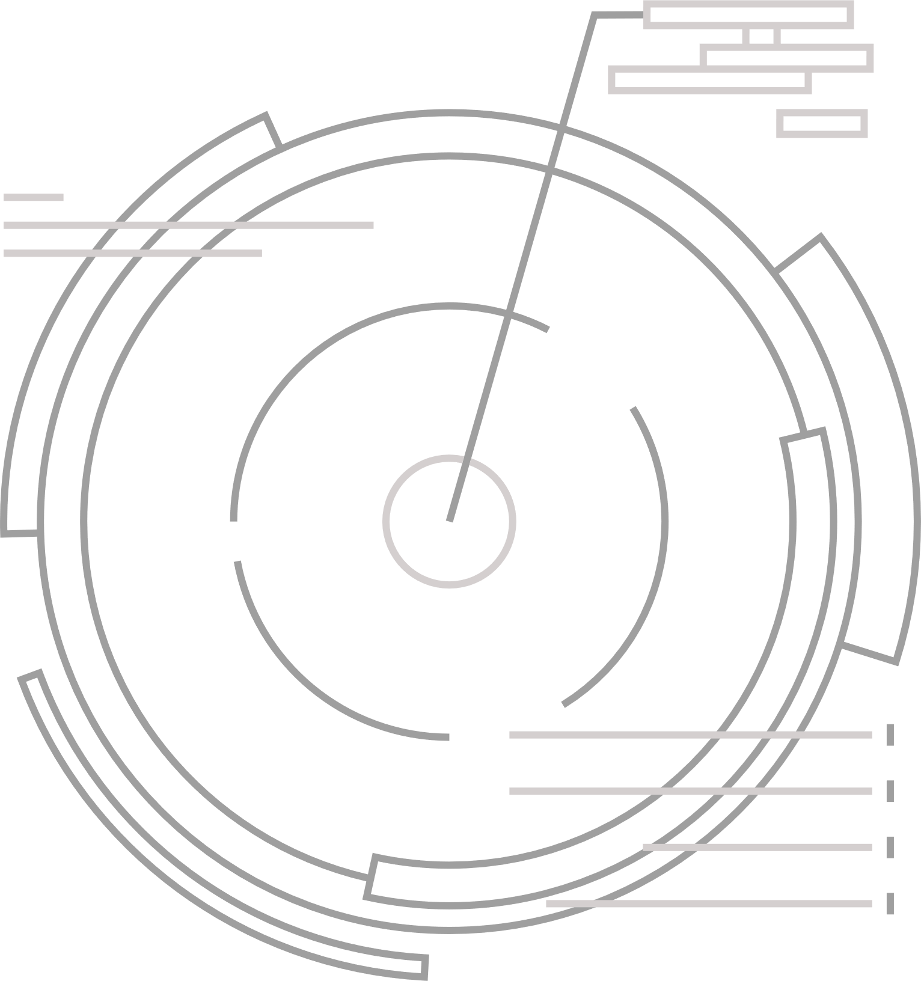
Customer Churn experienced by Telco
Telco is a telecommunication and mobile service provider. Our group aims to focus and identify reasons for the companies loss of customers by observing factors such as customer demographics, location and service among several others.
In the telecommunications industry, loosing customers is extremely costly as a lost customer is unlikely to return and would prefer to stick with their new service provider thus making this a key factor that needs to be evaluated. In the following slides will be highlighting our work and the outcomes in identifying solutions to overcome said issue.

Slide 3

Data Structure and Summary
Data Structure
Data Summary
We begin by making use of the str() function
This is then used to identify the structure of the data
This can be used to analyse the data type and similarly the rows and columns as well
In this scenario it can be noted that there were 7043 rows and 33 columns.
Similarly, a detailed graphic has been provided showing the relevant data types
To find the descriptive summary we take advantage of the summary()
The output provided provides us a statistical summary of several indicators
This can then be applied to our quantitative data to identify patterns
Some statistics that can be observed include the minimum and maximum value, median, mean and finally the interquartile ranges

Slide 4
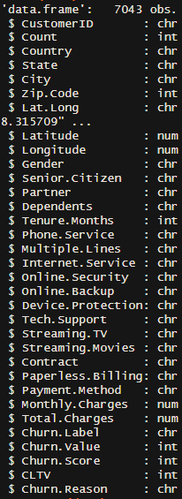
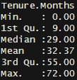
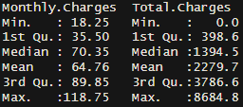
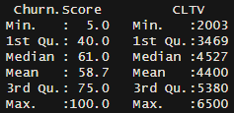

Slide 5

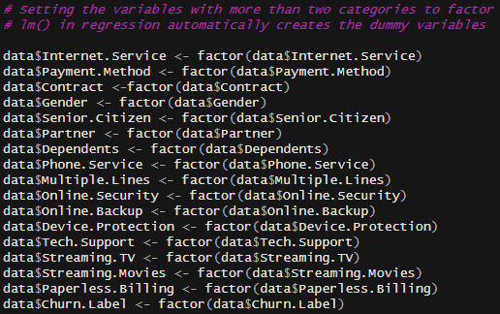

Converting categorical variables into factors
We assign each categorical variable to a factor form so that a multiple linear regression model can be used.
By assigning them as factors, it allows the lm() function to automatically create dummy variables for them.
It is a crucial tool for regression modelling.

Slide 6
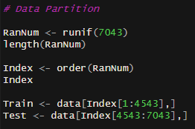
Data Partition
The purpose of this code is to split the dataset into training and test sets to prepare for machine learning and statistical modelling.
65% for Train
35% for Test
Overall it aims to prevent biasness, which enhances our models reliability.

Slide 7

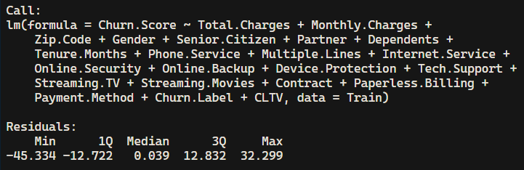

Full Model
Dependent Variable: Churn Score
Represents the likelihood of a customer leaving.
Independent Variables:
All predictors from the dataset were included to build the full model, ensuring a comprehensive analysis.
These include both continuous (e.g., Monthly Charges, Total Charges) and categorical variables (e.g., Internet Service, Contract, Payment Method, and service add-ons like Tech Support and Online Security).
As churn score (Dependent Variable) is a continuous variable, we utilized Multiple Linear Regression for modeling.

Slide 8
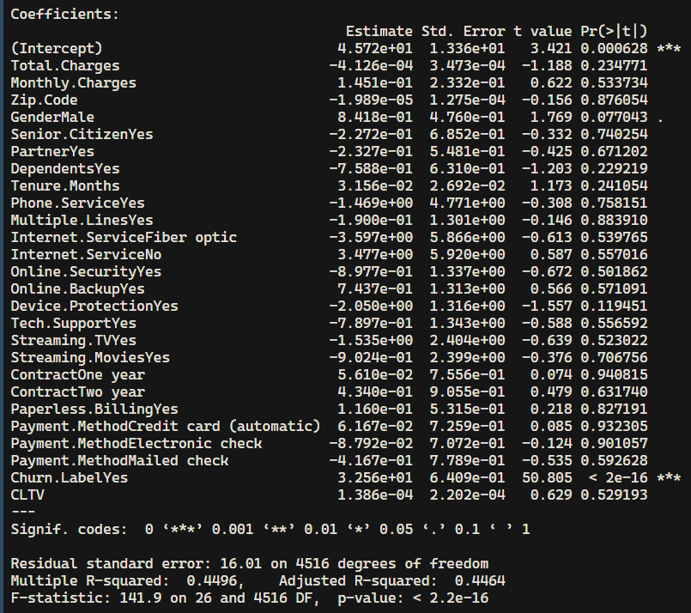

Slide 9
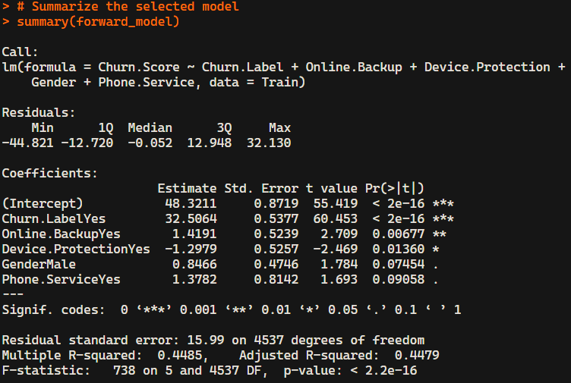
Techniques Used To Obtain Optimum Model
Forward Selection Model
Starts with a null model (No independent variables).
Adds a variable each iteration.
The significant variables are identified based on the AIC value.
Iteration stops when the addition of new variables does not improve the model (eg: r^2 value and AIC value)

Slide 10
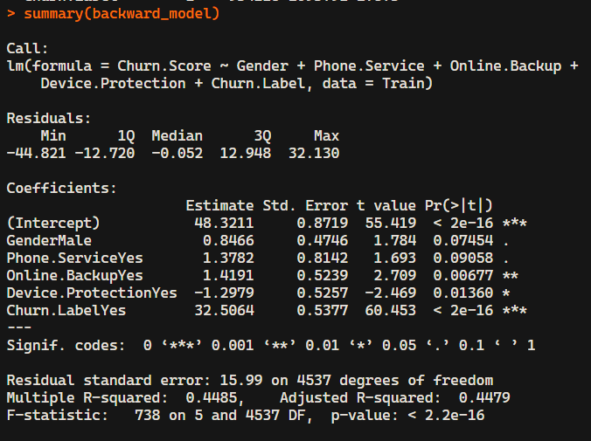
Techniques Used To Obtain Optimum Model
2. Backward Elimination Model
Starts with a full model with all the selected variables.
Removes a variable at each iteration.
The significant variables are identified based on the AIC value.
Iteration stops when the removal of new variables does not improve the model (eg: r^2 value and AIC value)

Slide 11
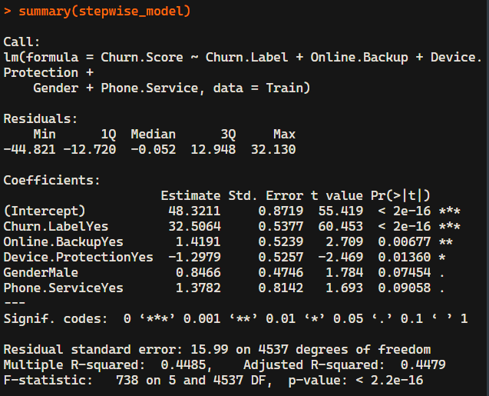
Techniques Used To Obtain Optimum Model
3. Stepwise selection Model
Combines the forward and backward selection model techniques.
Starts with either a full model or null model.
Removes or adds a variable at each iteration depending on the AIC and r^2 values.
Iteration stops when the removal or addition of new variables does not improve the model (eg: r^2 value and AIC value)

Slide 12
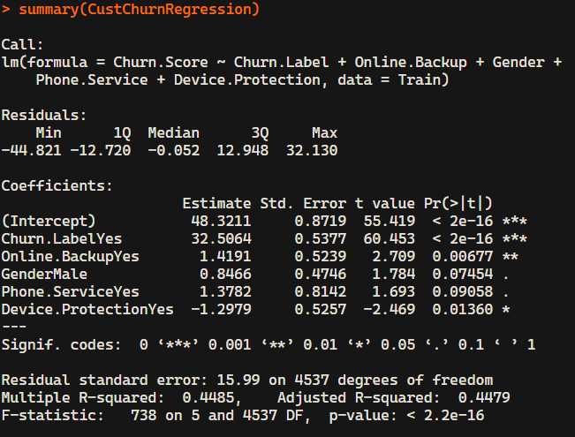
Final Model
Dependent Variable - Churn score
Independent Variables -
Churn Label
Online Backup
Gender
Phone Service
Device Protection
Accept Alternative hypothesis at 5% significance level for 3 variables.
Accept Alternative hypothesis at 10% significance level for 2 variables.

Slide 13
Final Model
Churn.Score=48.3211+32.5064×(Churn.LabelYes)+1.4191×(Online.BackupYes)+0.8466×(GenderMale)+1.3782×(Phone.ServiceYes)−1.2979×(Device.ProtectionYes)
Intercept (48.3211): The predicted Churn.Score when all predictors are at their baseline.
Churn.LabelYes (32.5064): If Churn.Label is "Yes," the Churn.Score increases by 32.5064, holding all else constant.
Online.BackupYes (1.4191): If Online.Backup is "Yes," the Churn.Score increases by 1.4191, holding all else constant.
GenderMale (0.8466): If Gender is "Male," the Churn.Score increases by 0.8466, holding all else constant.
Phone.ServiceYes (1.3782): If Phone.Service is "Yes," the Churn.Score increases by 1.3782, holding all else constant.
Device.ProtectionYes (-1.2979): If Device.Protection is "Yes," the Churn.Score decreases by 1.2979, holding all else constant

Slide 14
Final Model
RSE - measures the average deviation (16) of the observed Churn Score values from the values predicted by the model.
Adjusted R^2 - indicates the proportion of the variance (45%) in the dependent variable (Churn Score) explained by the independent variables.
High F statistic (738) combined with low P value (<2.2×10^-16) means that the model as a whole is significant. It tests the null hypothesis that all regression coefficients are equal to zero.

Slide 15
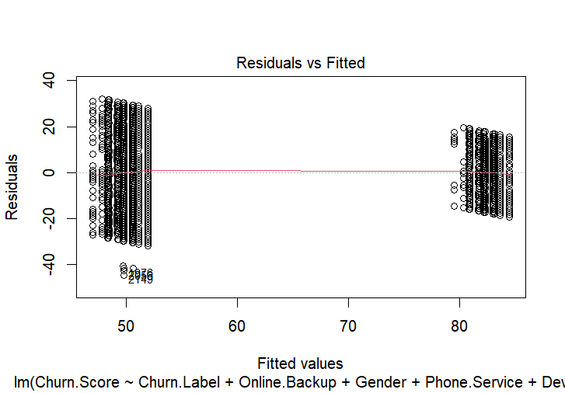
Model Diagnostics
The Residuals vs Fitted plot helps identify non-linearity, unequal error variance, and outliers. Ideally, the points should be randomly distributed around the horizontal line without any distinct pattern.
The residuals appear scattered without a clear pattern, which suggests that the assumption of linearity is reasonably met.

Slide 16
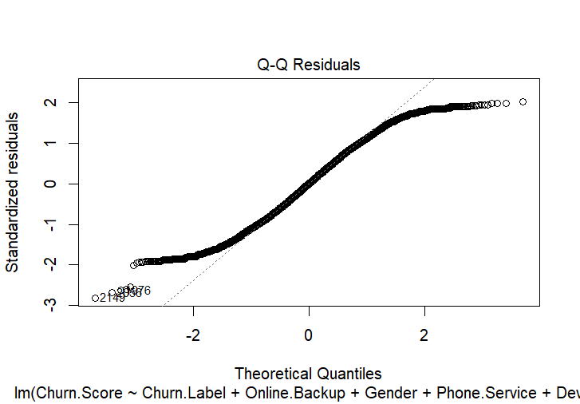
Model Diagnostics
A Q-Q plot is a tool used to check if data,
follows a specific distribution,
usually the normal distribution.
Left Tail (bottom-left): The points curve below the line, indicating heavy tails (Negative residuals -predicted value > actual value).
Right Tail (top-right): The points curve above the line, indicating heavy positive tails or high outliers. (Positive residuals - predicted value< actual value)

Slide 17
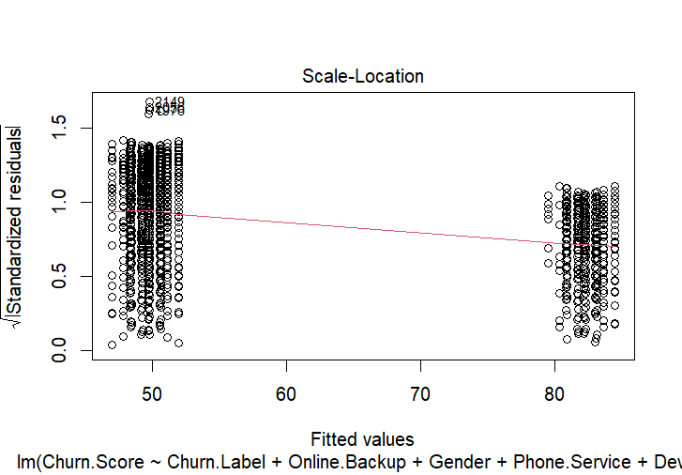
Model Diagnostics
This plot tests for homoscedasticity and ensures that the variance of residuals is consistent across fitted values.
For this plot to be effective, the plots should be randomly spread.
The spread of points appears relatively consistent

Slide 18
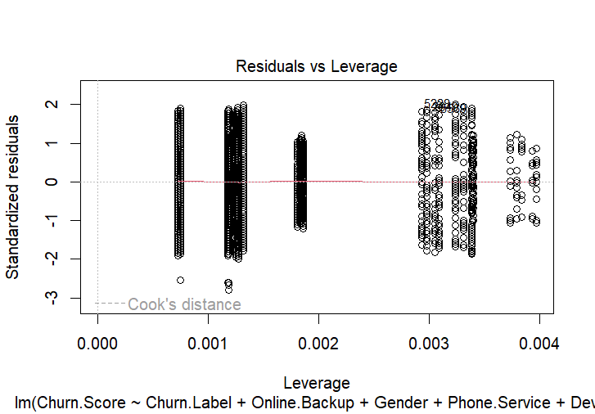
Model Diagnostics
This plot identifies the influential data points that have a significant impact on the regression model. Impactful observations would play a key role in influencing the model

Slide 19
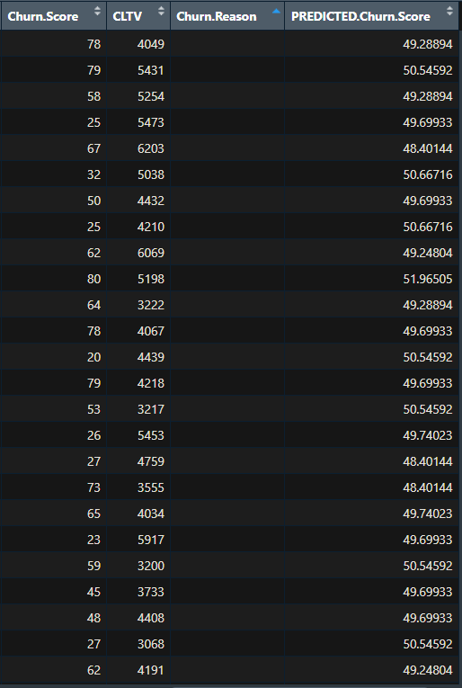

Prediction Test
A new column was created in test data frame with the predicted churn scores from the test data and our final model.

Slide 20

THANK YOU

