Slide 1
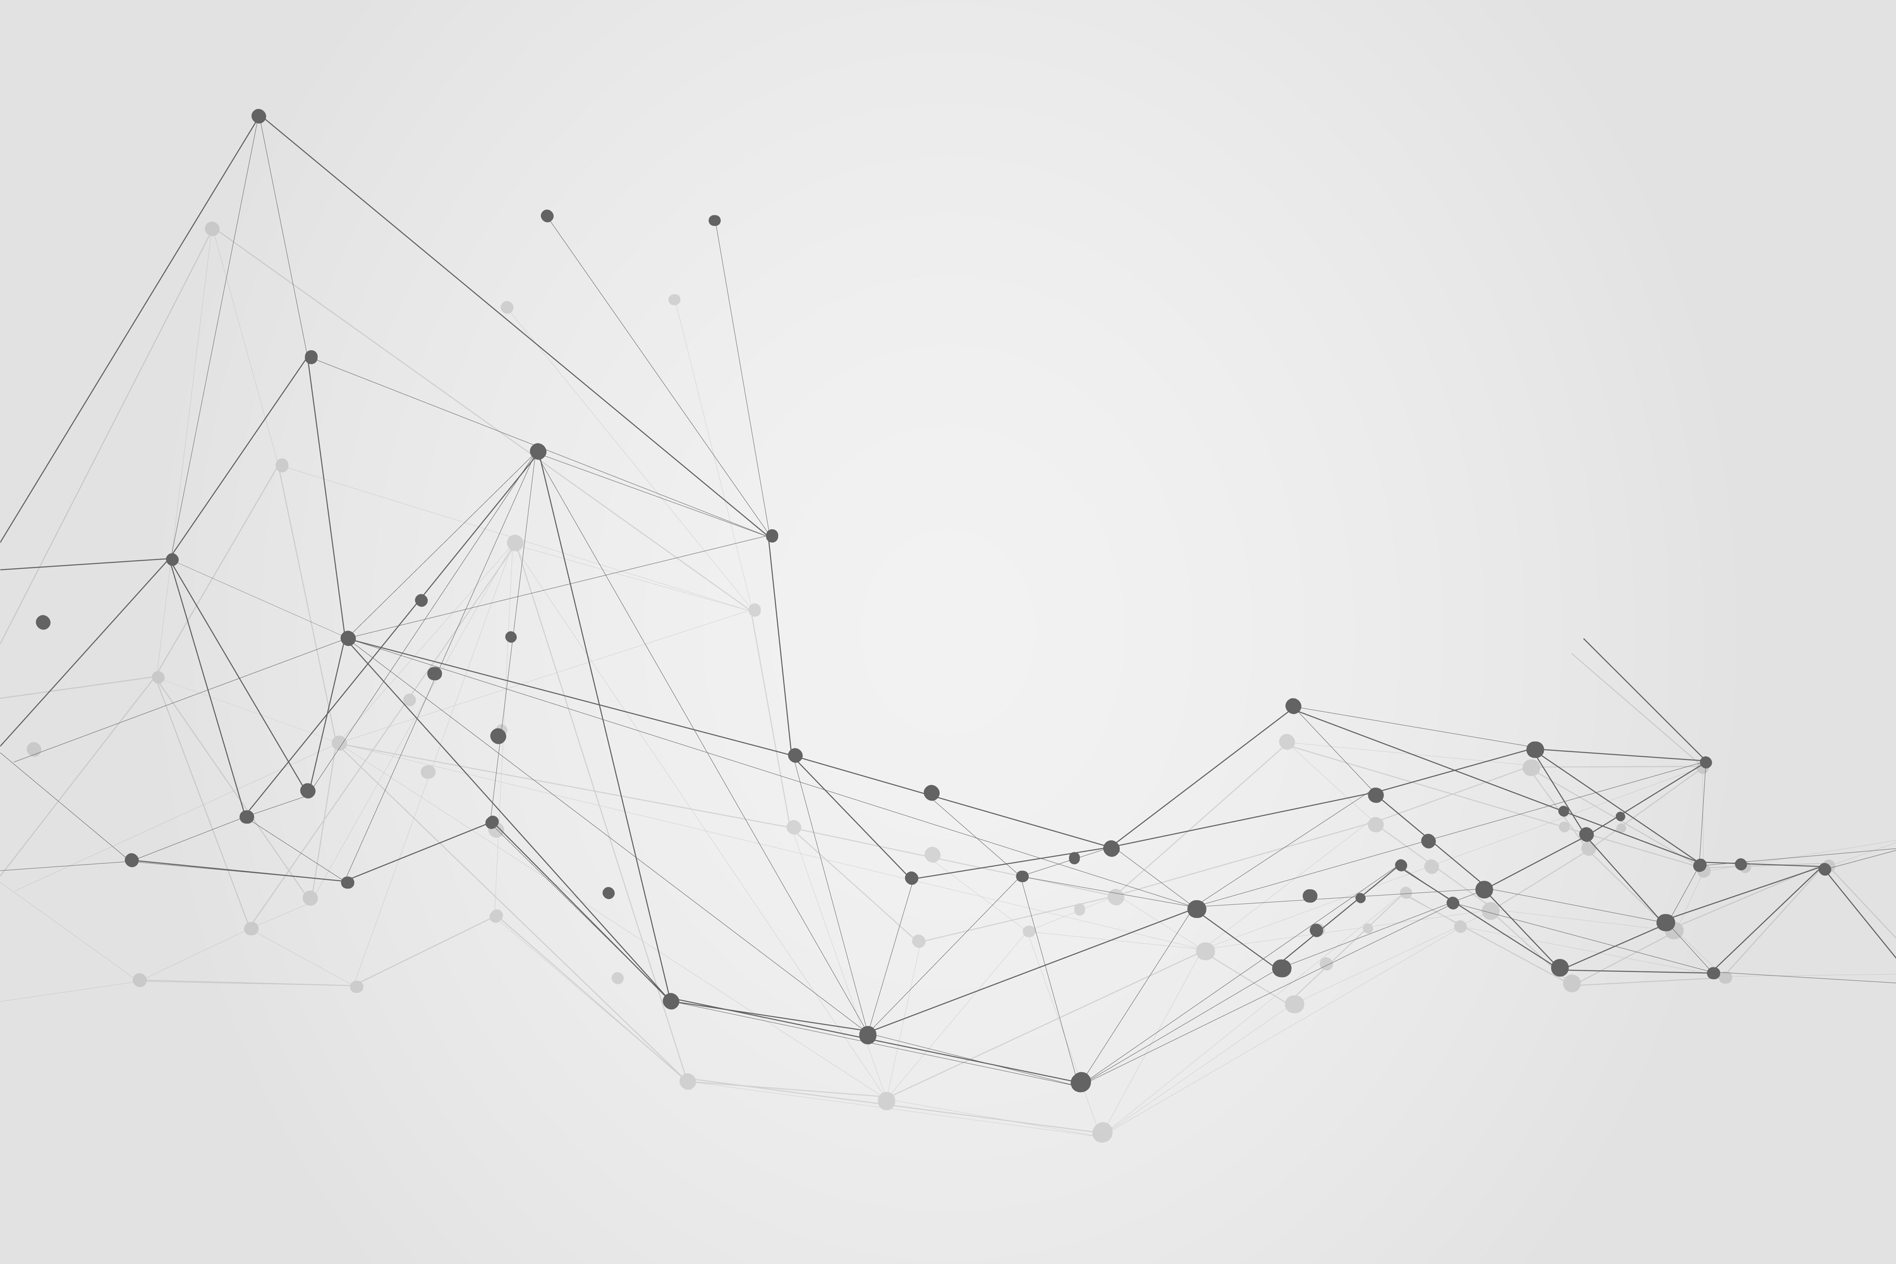
Group 1
Predicting and Analyzing Customer Churn at Telco Using Regression Models
Govindu Sathruwan
Abdullah Sheriffdeen
Shahik Shiyam
Iffath Saleem
Aaisha Aamina

Slide 2

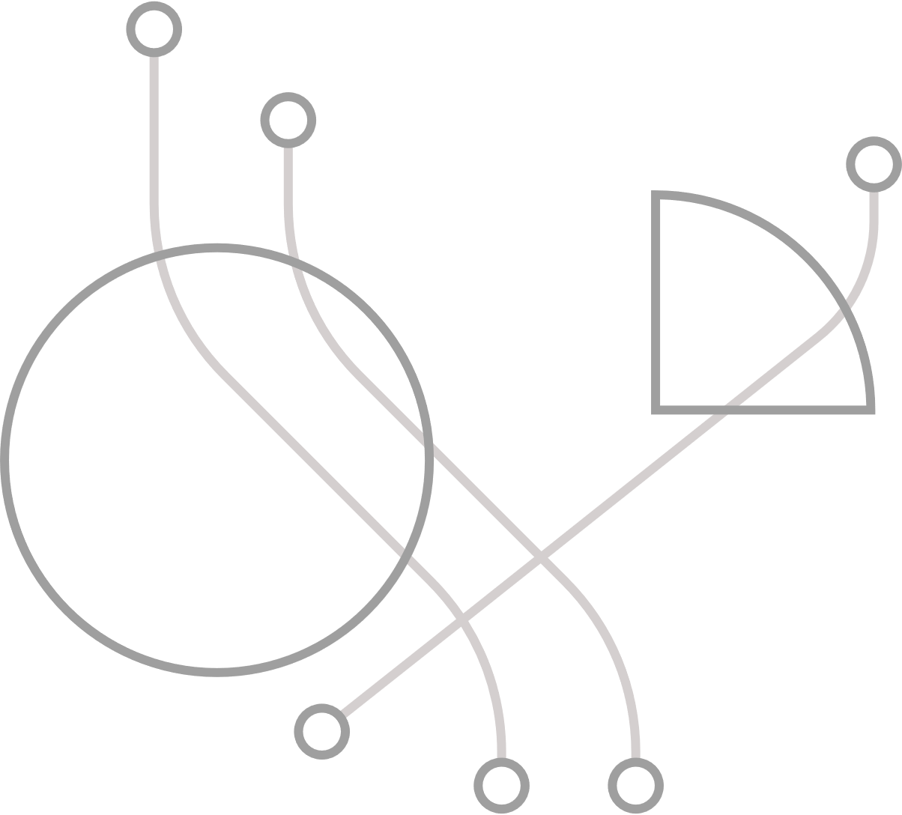
Purpose
Identify and analyze key factors driving customer churn at Telco using regression modeling.
Leverage customer demographic, service, and account data for churn prediction.
Develop a prediction model to reduce churn rates.
Help Telco:
Retain existing customers.
Reduce acquisition costs.
Improve overall profitability.
Ensure Telco remains competitive in the telecommunications industry.
.

Slide 3
Problem statement and background
Customer churn is a critical issue for telecom companies, directly impacting revenue and profitability. High churn rates indicate dissatisfied customers and increased costs for acquiring new ones. Identifying the reasons behind churn and addressing them effectively is key to maintaining a competitive edge.
Significance: According to past research, retaining customers is 5-10 times more cost-effective than acquiring new ones. Churn analysis helps reduce revenue loss, improve satisfaction, and foster loyalty in competitive market.
Background: Telecom companies face intense competition in a saturated market, with churn often driven by poor service, pricing issues, or lack of personalization. Predictive analytics now enable proactive churn prevention, making data-driven solutions crucial for success.
.

Slide 4
Gap Analysis
Gap analysis, is identifying the gap between the current situation and where an entity aims to be. This allows to identify the necessary steps to bridge the gap.
As customer churn is an issue for Telco, gap analysis will help identify steps to overcome this problem.
Current state
As Telco is experiencing customers leaving for one reason or another.
This has a knock on effect on sales, reputation and thereby profitability of Telco. This prevents them from performing well in the competitive market
Desired state
Whats desired by Telco is to hold onto customers and improve loyalty. This will allow Telco to generate a consistent flow of revenue and maintain market share, allowing to reduce churn.
Action Plan
Understand customer pain points
Improve customer service
Increase customer engagement
Offer competitive pricing

Slide 5
Objectives and research questions
Main Objective: Aims to focus and identify reasons for the companies loss of customers by observing factors and develop strategies to reduce churn rates while improving customer satisfaction.
Specific Objectives:
Identify key factors driving customer churn (e.g., pricing, service quality, contract types).
Develop a predictive model to forecast customers at risk of churning.
Propose actionable recommendations for retention strategies based on the findings.
Research Questions:
What are the primary factors influencing customer churn at Telco?
How do demographic, usage, and service-related variables correlate with churn?
Can predictive modeling effectively identify customers likely to churn?
What strategies can Telco implement to minimize churn and enhance customer loyalty?
.

Slide 6
Methodology
DATA COLLECTION
Dataset - IBM Telco customer churn dataset retrieved from kaggle.
It was a secondary data source with data already available.
DATA PREPROCESSING
The dataset was analyzed for Missing values, duplicate columns and erroneous entries.
Set categorical variables as factors to assist the lm function to automatically create dummy variables .
The dataset was also split into training and test sets to prepare for machine learning and statistical modelling.

Slide 7
Models Used to Analyze Customer Churn
Model Overview
Goal: Analyze customer churn at Telco.
Data:Customer details such as monthly charges, internet service, and payment methods.
Model Selection Techniques
Forward Selection: Begin with no variables, adding those that most improve the model until no significant gains are observed.
Backward Elimination: Start with all variables, removing the least impactful ones until further removal does not enhance the model significantly.
Stepwise Selection: Optimizes the model by adding and removing variables.
Final Model - Key Factors:
Churn Label: Customer departure indicator.
Online Backup: Usage of backup services.
Gender: Male or female.
Phone Service: Phone service availability.
Device Protection: Use of protection services.
Summary: Predicts customer churn likelihood based on these factors, showing correlations between services and customer traits.

Slide 8
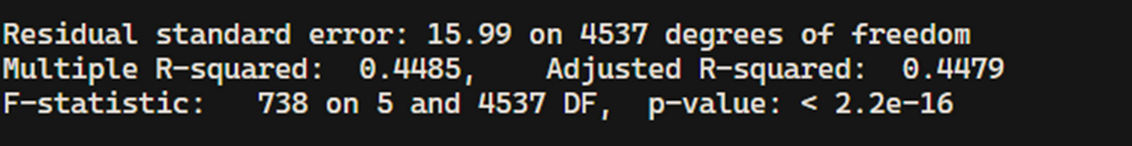
Model Performance
RSE - measures the average deviation (16) of the observed Churn Score values from the values predicted by the model.
Adjusted R^2 - indicates the proportion of the variance (45%) in the dependent variable (Churn Score) explained by the independent variables.
High F statistic (738) combined with low P value (<2.2×10^-16) means that the model as a whole is significant. It tests the null hypothesis that all regression coefficients are equal to zero.

Slide 9
Model Insights
Churn.Score=48.3211+32.5064×(Churn.LabelYes)+1.4191×(Online.BackupYes)+0.8466×(GenderMale)+1.3782×(Phone.ServiceYes)−1.2979×(Device.ProtectionYes)
Intercept (48.3211): The predicted Churn.Score when all predictors are at their baseline.
Churn.LabelYes (32.5064): If Churn.Label is "Yes," the Churn.Score increases by 32.5064, holding all else constant.
Online.BackupYes (1.4191): If Online.Backup is "Yes," the Churn.Score increases by 1.4191, holding all else constant.
GenderMale (0.8466): If Gender is "Male," the Churn.Score increases by 0.8466, holding all else constant.
Phone.ServiceYes (1.3782): If Phone.Service is "Yes," the Churn.Score increases by 1.3782, holding all else constant.
Device.ProtectionYes (-1.2979): If Device.Protection is "Yes," the Churn.Score decreases by 1.2979, holding all else constant

Slide 10
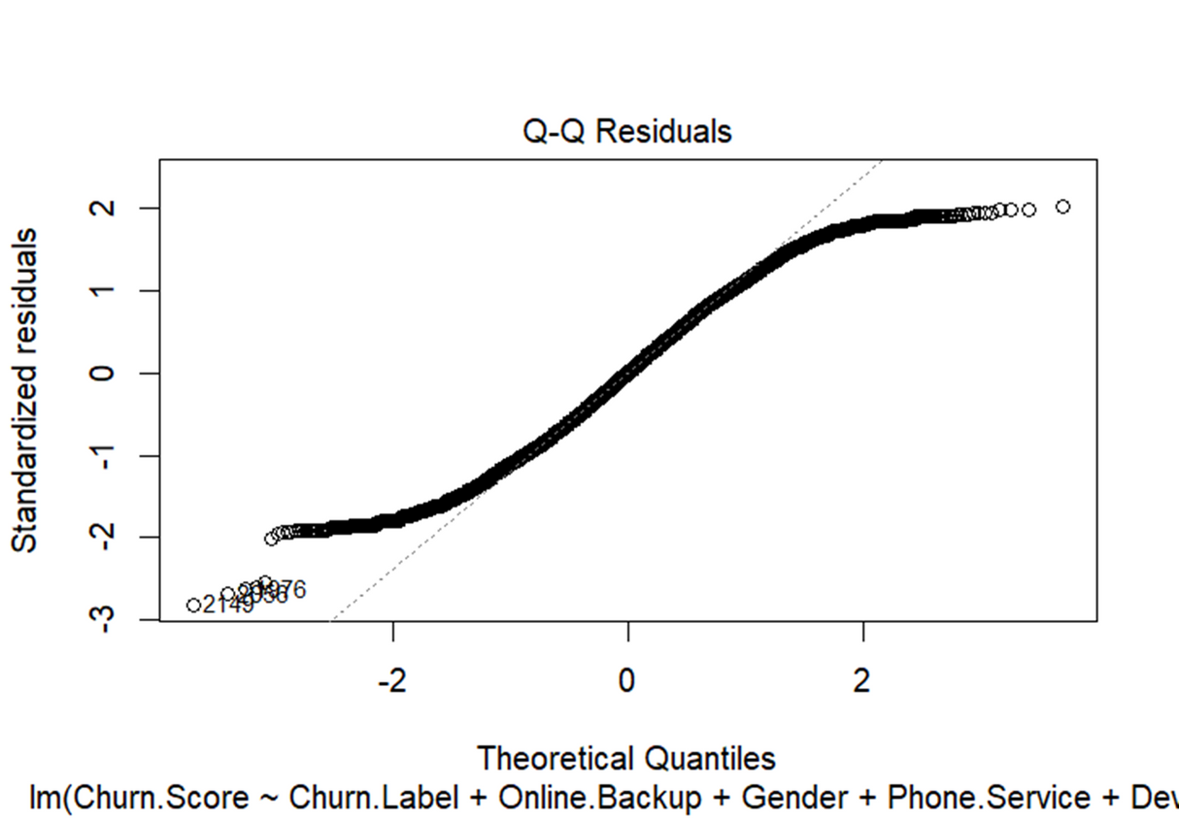
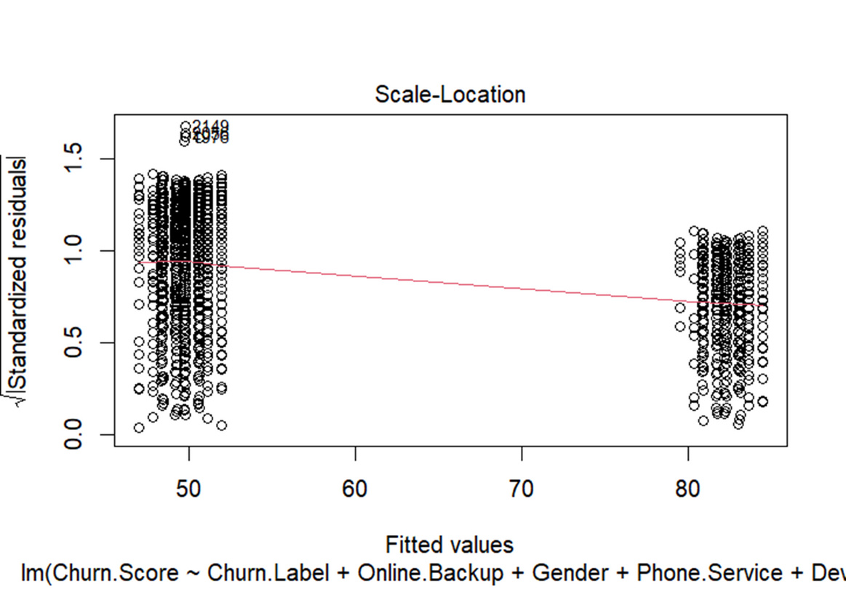
Model Diagnostics
To assess if the residuals follow a normal distribution
To check for homoscedasticity (constant variance of residuals)

Slide 11
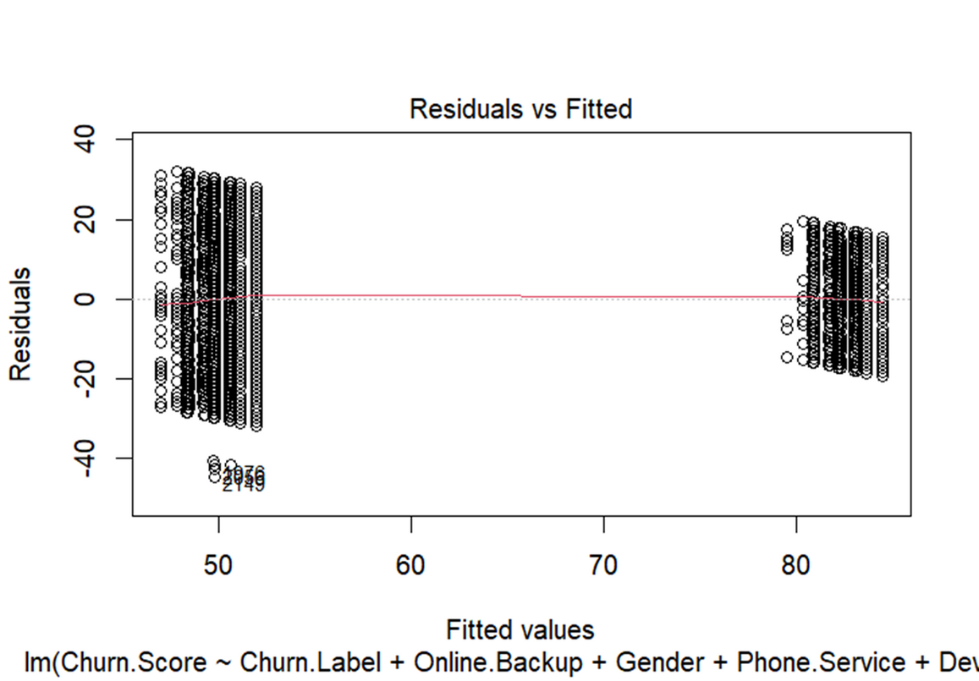
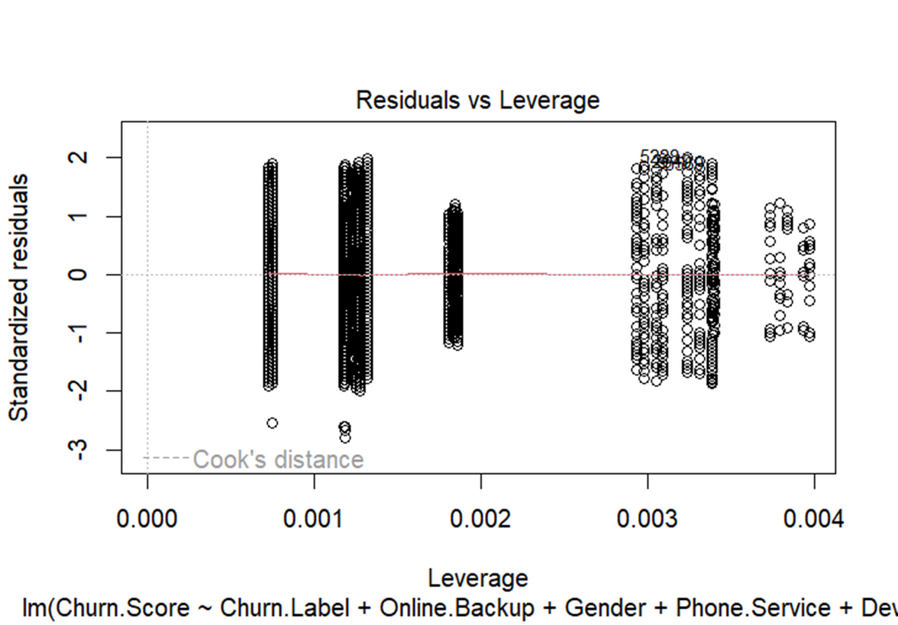
Model Diagnostics
To check for non-linearity, unequal error variances, and outliers
To identify influential data points that have a disproportionate impact on the model.

Slide 12
Recommendation
To enhance customer experience and brand performance, consider these strategies:
1. Improve Customer Service
- Train agents on diverse customer needs.
- Use customer data for personalized support.
2. Boost Brand Image
- Implement targeted promotions.
- Highlight your unique selling proposition.
3. Offer Specialized Services
- Create tailored packages for different groups.
- Provide customizable plans.
4. Enhance Network Quality
- Invest in reliable infrastructure.
- Upgrade to the latest technology (e.g., 5G).
5. Gather Customer Feedback
- Conduct regular satisfaction surveys.
- Implement changes based on feedback.

Slide 13
Challenges and Limitations
The use of a synthetic dataset : This can limit realism and generalization as it may not mimic real-life scenarios in certain aspects.
Poor predictive power : The model only explains 45% of the churn, this limits the predictive power of the model, despite it providing useful insights.
Limited variables : Certain variables effecting customer churn may not have been considered.

Slide 14
Conclusion
Summary:
We analyzed why customers leave Telco.
Identified key factors that contribute to churn.
Developed a model to predict churn.
Impact:
Our recommendations aim to reduce churn and keep customers happy.
Improving customer service, brand image, and network quality are key steps.
Future Steps:
Continuous Monitoring: Regularly monitor and update the churn model to ensure its accuracy and relevance.
Evaluate Recommendations: Implement the recommendations and evaluate their effectiveness in reducing churn.
Adapt to Changes: Stay adaptable to changes in customer behavior and market trends to continuously improve retention strategies.

Slide 15
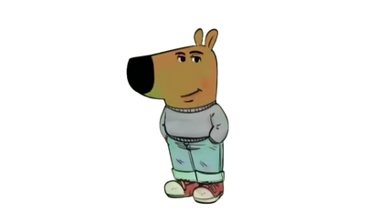
THANKYOU

