Slide 1
O K C O M P U T E R
P R E S E N T S
FRAUDCHECK

Slide 2


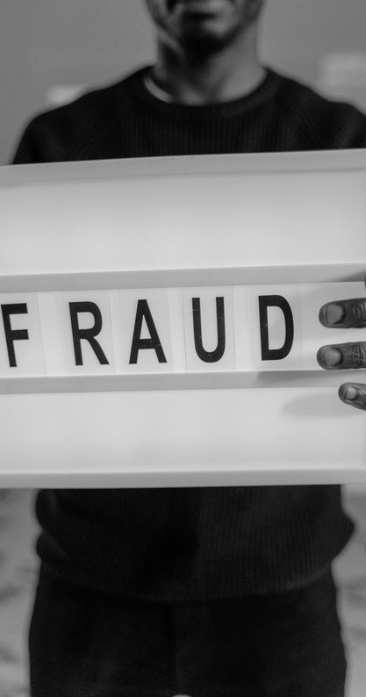
Problem Statement
Fraud has become a major problem in e- commerce and a lot of resources are being invested to recognize and prevent it. Present fraud detection and prevention systems are designed to prevent only a small fraction of fraudulent transactions processed, which still costs billions of dollars in loss. There is an urgent need for better fraud detection and prevention as the online transactions are estimated to increase substantially in the coming year.

Slide 3


Our Solution
A fraud detection application, using Machine Learning to detect and display fraudulent transactions that have been inputted.
We propose a data driven model using machine learning algorithms on big data to predict the probability of a transaction being fraudulent or legitimate

Slide 4
Where do we go next?
H O W T O G E T T H E R E ?

Slide 5

IMPLEMENTATION
Using Machine Learning

Slide 6

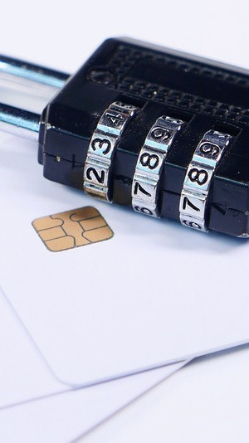
Why FraudCheck

Slide 7


Uses ML
Accuracy
Simple to use
User Friendly

Slide 8

M A C H I N E
Technology Used
L E A R N I N G
D J A N G O
P Y T H O N
H T M L
C S S

Slide 9
ML Prediction Technology
A random forest classifier model was trained on a synthetic fraud detection data set from kaggle with an f score of 0.99 with cross validation
classifier
https://www.kaggle.com/ntnu-testimon/paysim1

Slide 10
The model was trained on historical e-commerce credit card transaction data to predict the
probability of any future transaction by the customer being fraudulent.

Slide 11

SCREENSHOTS

Slide 12

Home Page

Slide 13
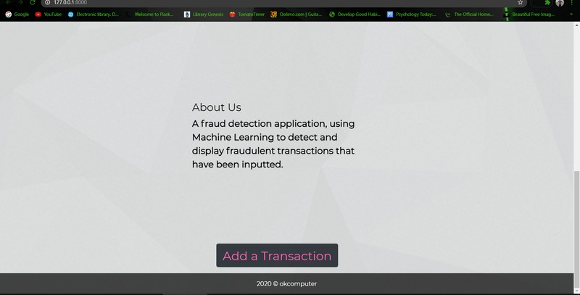

Slide 14
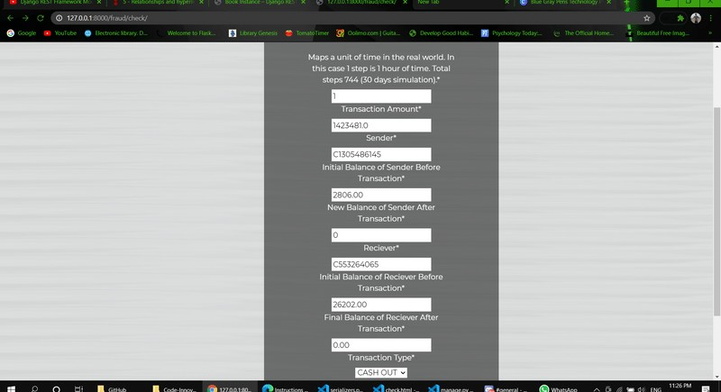
Check Transaction

Slide 15
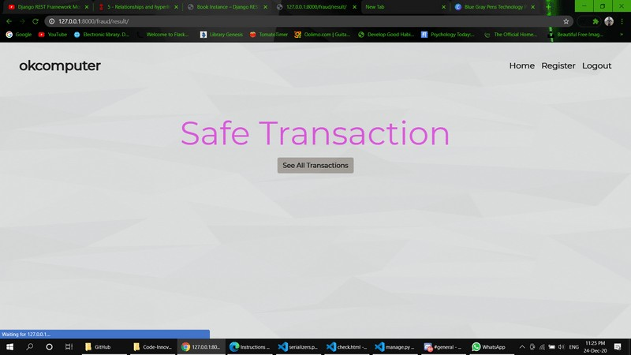
Result

Slide 16
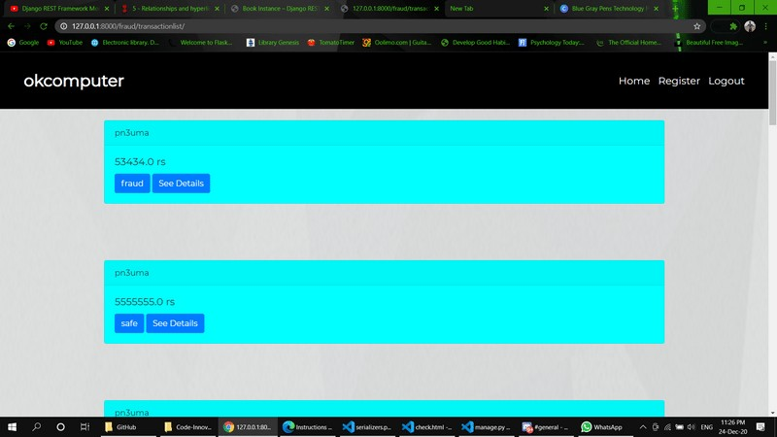
Transaction History

Slide 17

FINANCIAL ANALYSIS
MOBILE APP
SAAS MODEL
PERSONAL PROFILE
FUTURE SCOPE

Slide 18

NEW TECHNOLOGY TOMORROW
Supervised machine learning algorithms like Support Vector Machine, Gradient Boost and combinations of these are implemented and their performance are
TO THE FUTURE
compared. While at the same time the problem of class imbalance is taken into consideration and techniques of oversampling and data pre-processing are performed before the model is trained on a classifier.

Slide 19
What we have built is a prototype of a predictive product, but you still have to push it through the engineering roadmap. We need is a team of professional Software Engineers by our side to take our (disposable) proof of concept and turn it into a performant, reliable, loosely coupled and scalable system!

Slide 20
Be Inspired
I THINK , THEREFORE I AM
RENÉ DESCARTES

