Slide 1
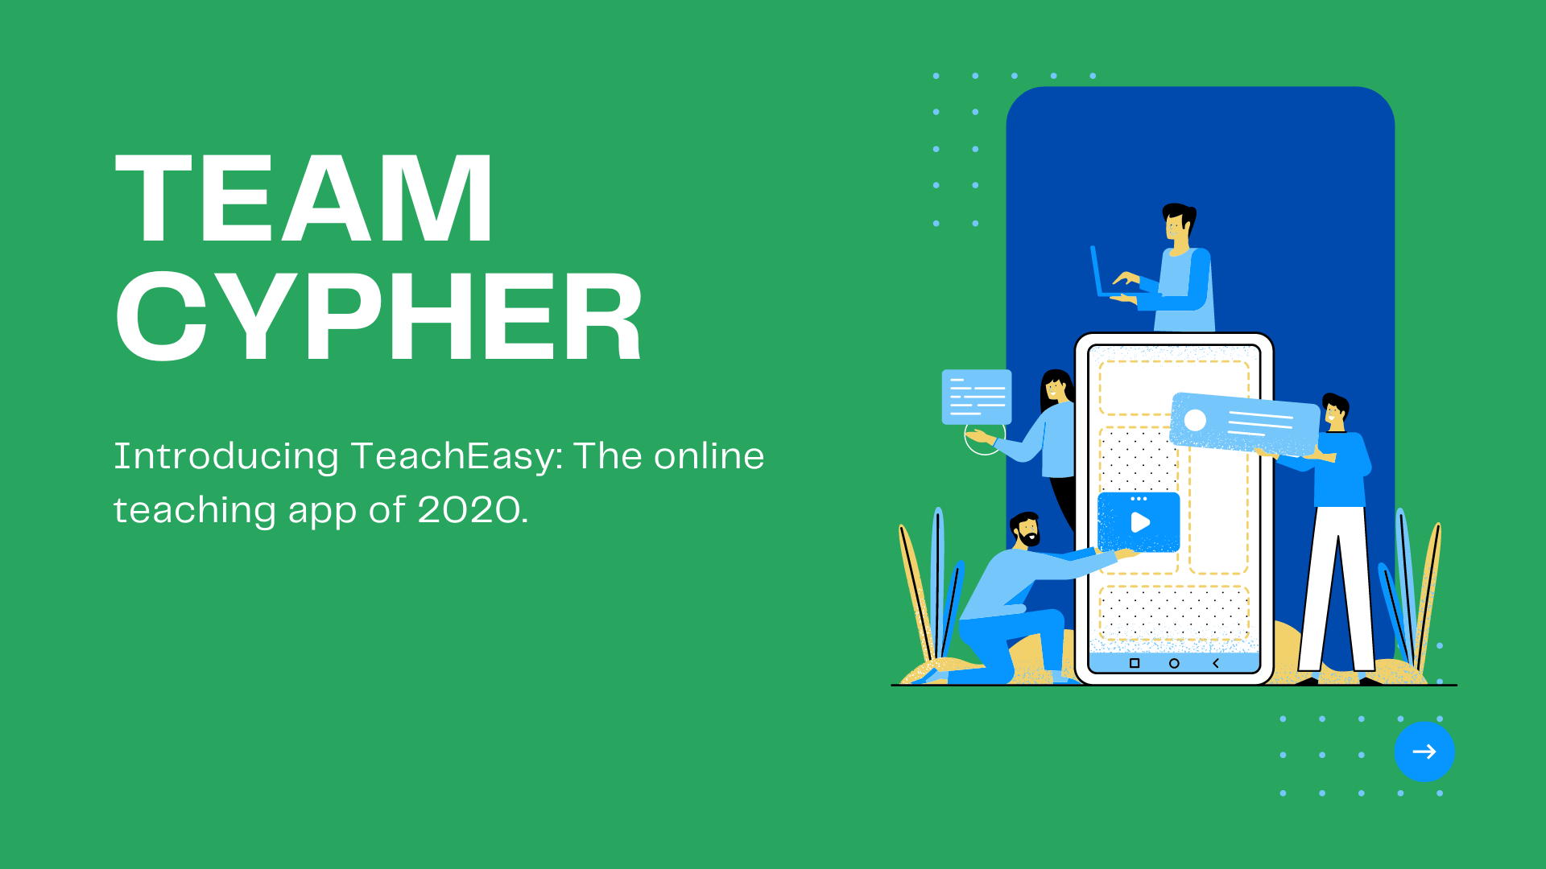

Slide 2


Slide 3
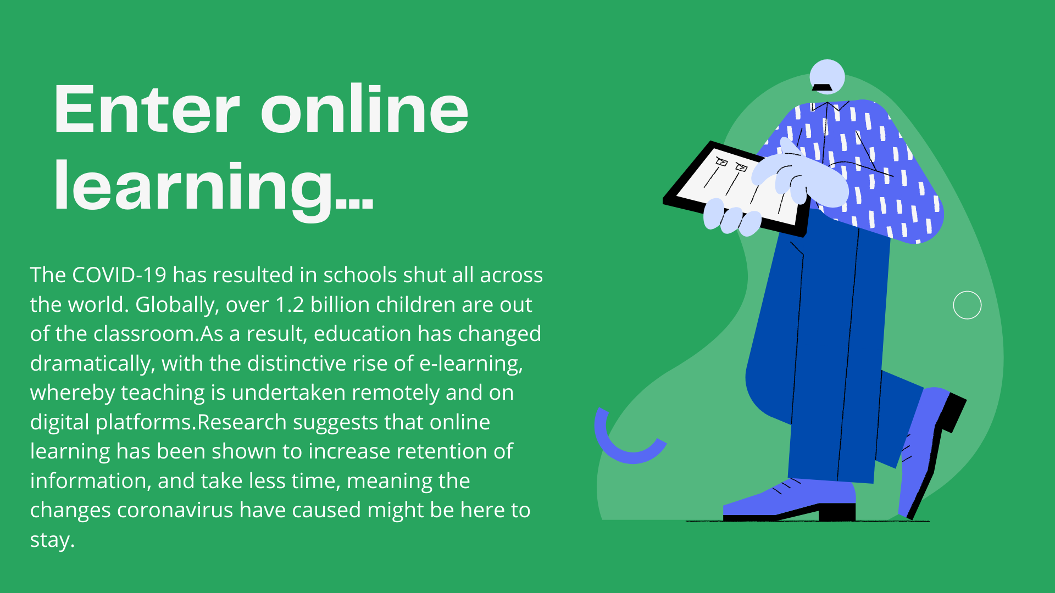

Slide 4
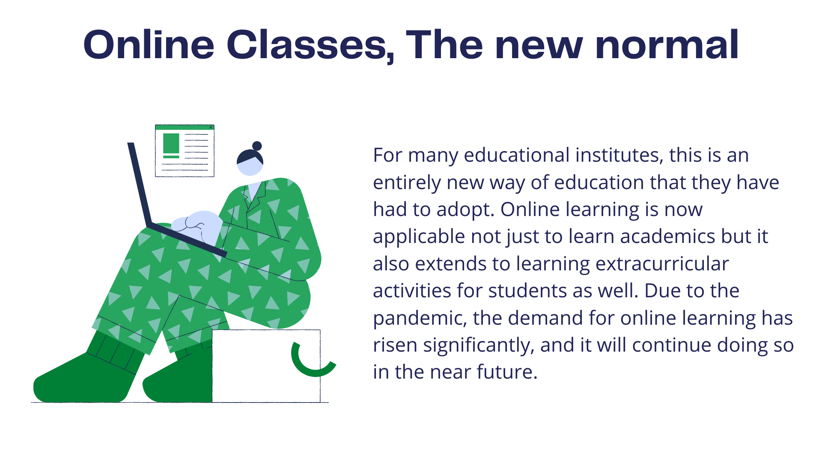

Slide 5
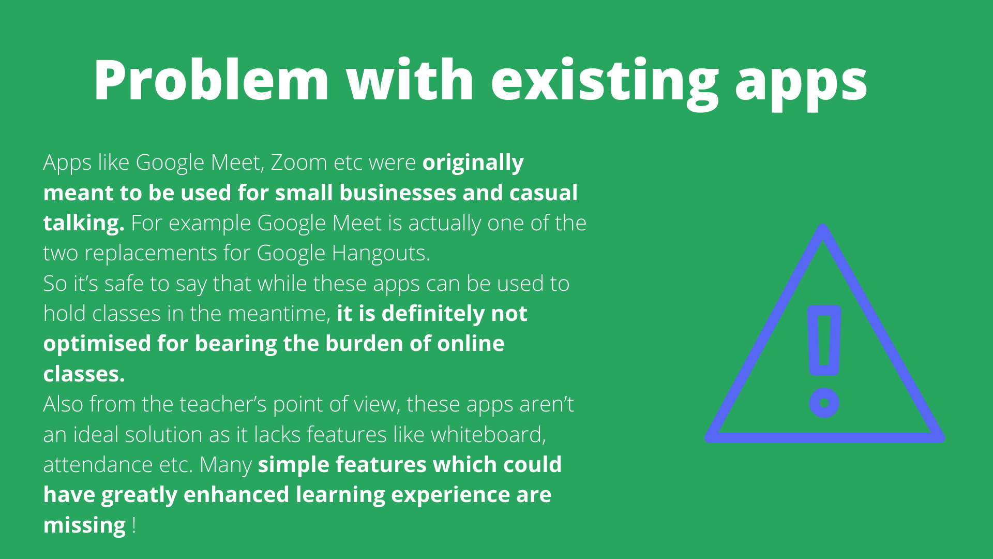

Slide 6
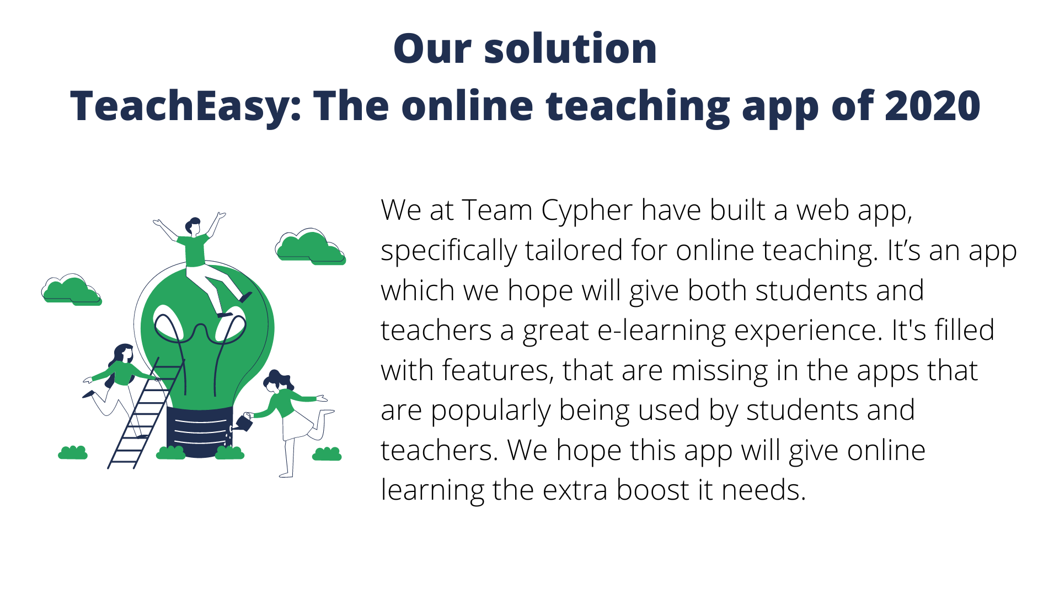

Slide 7
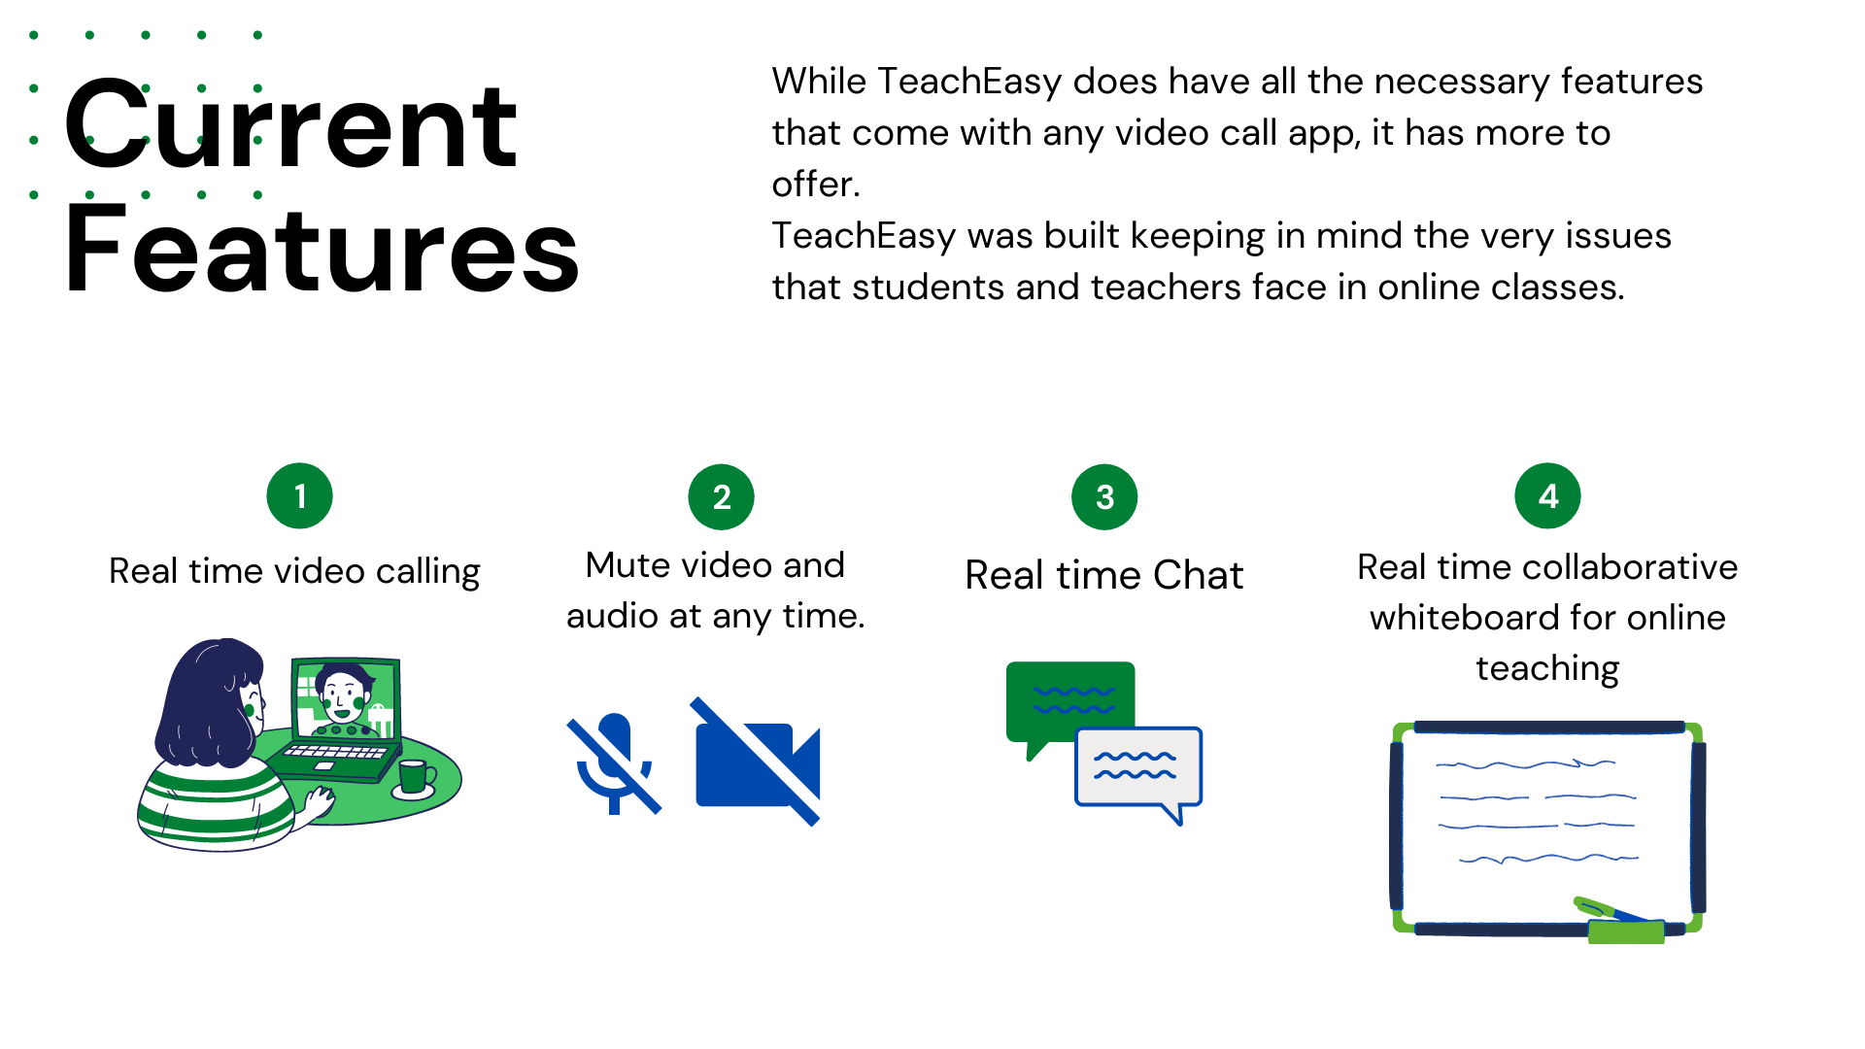

Slide 8
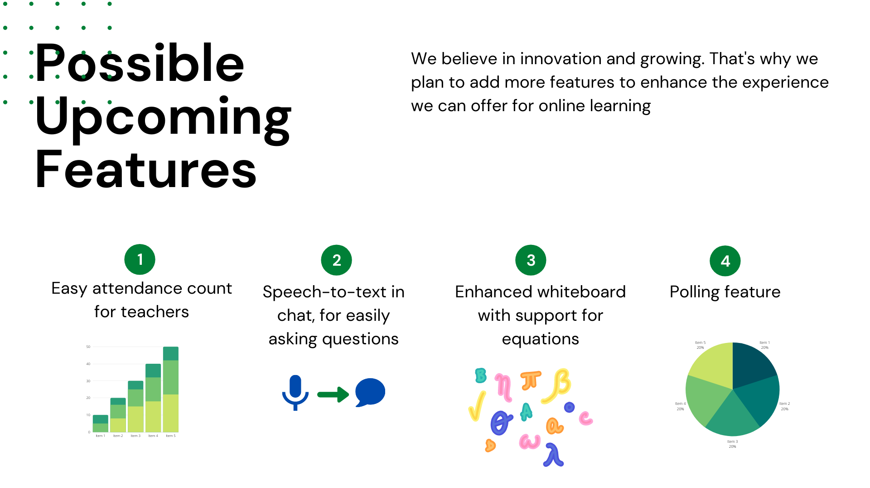

Slide 9
DEMO
Because what’s better than seeing it in action for yourself ;)
Check out a short two minute demo in the next slide or on Youtube. (use fullscreen for better clarity)
Hope you enjoy!

Slide 10
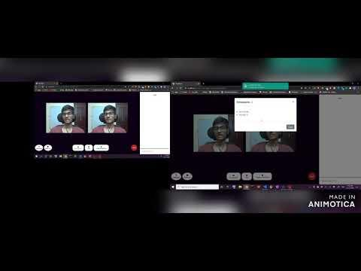

Slide 11
SCREENSHOTS OF ALL PAGES

Slide 12
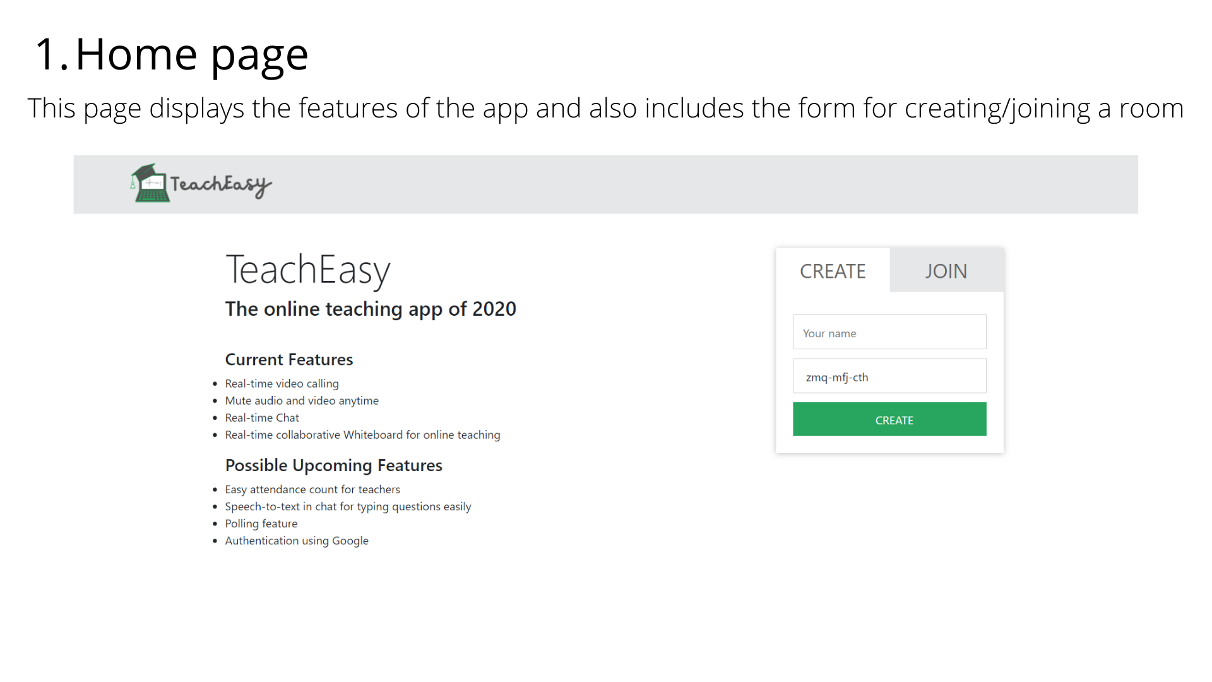

Slide 13
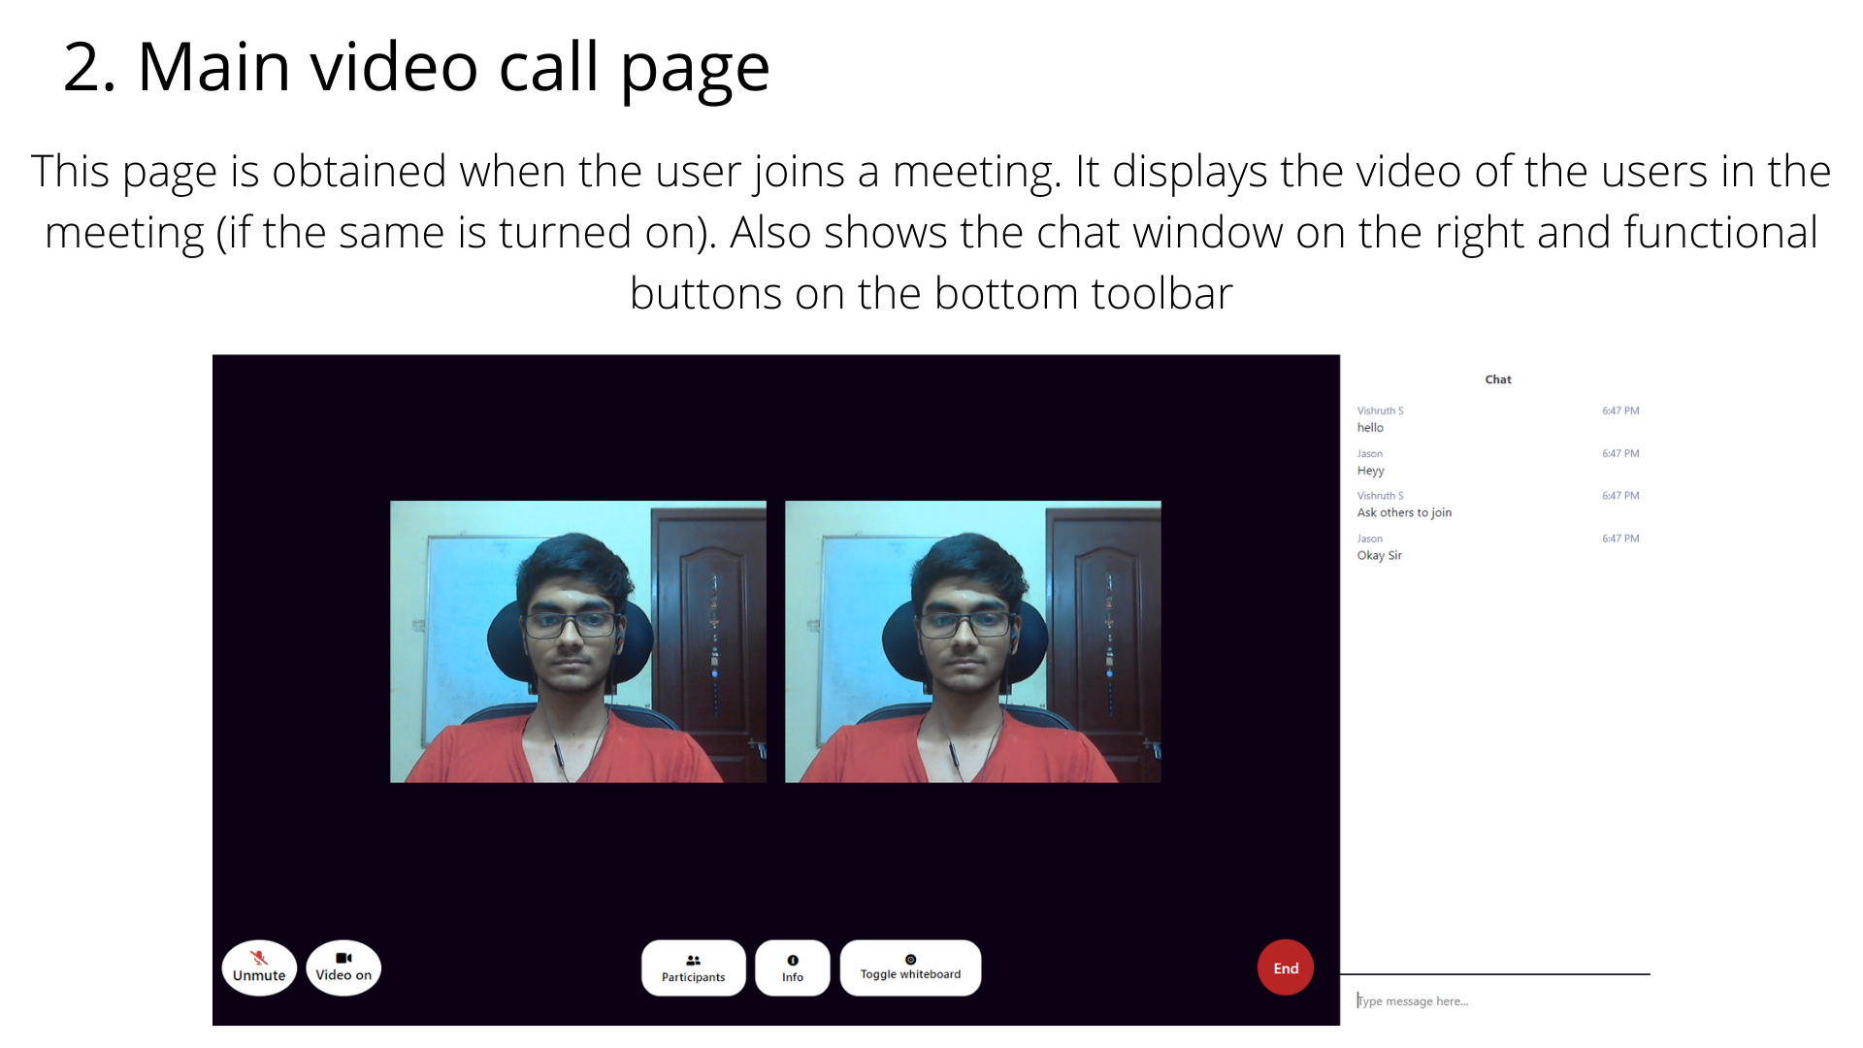

Slide 14
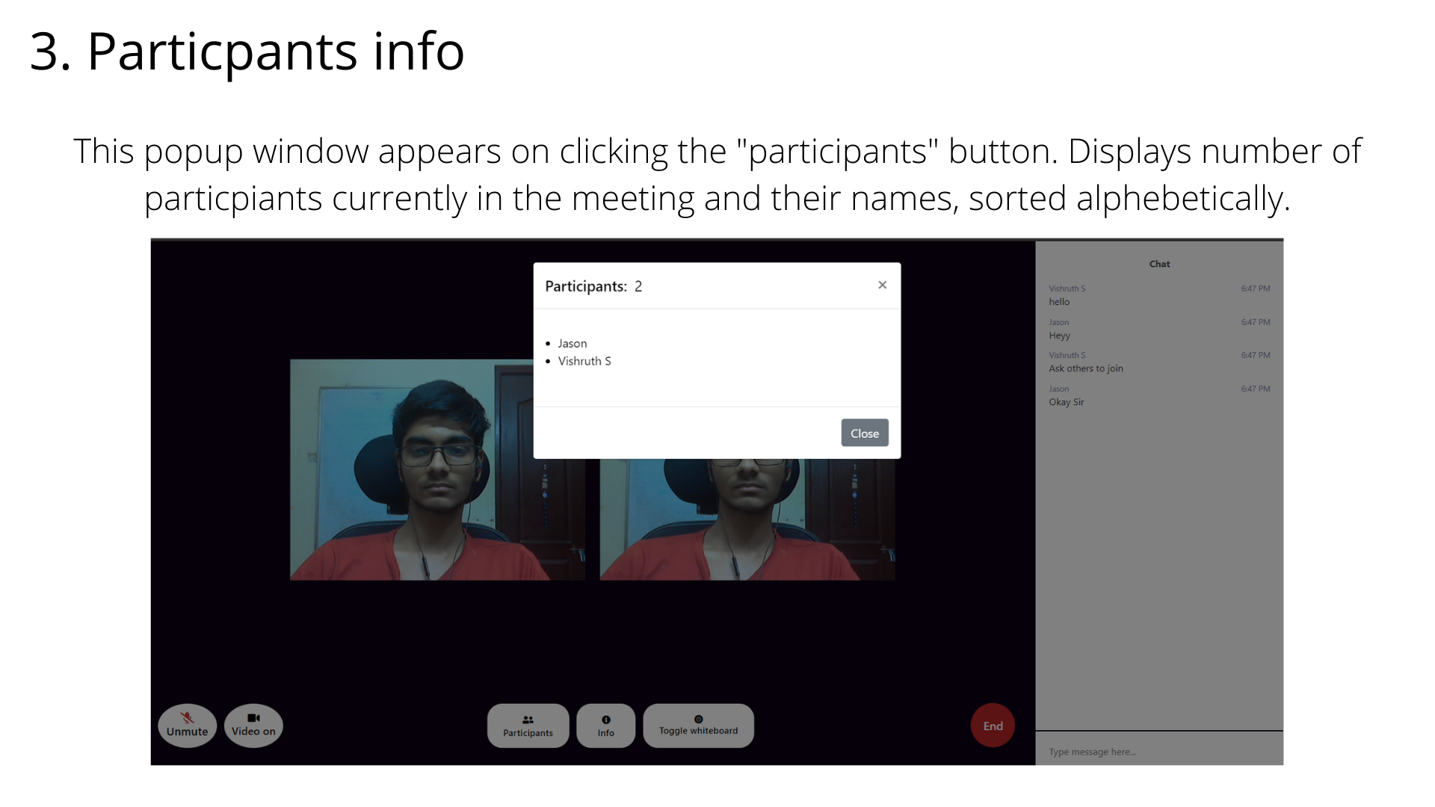

Slide 15
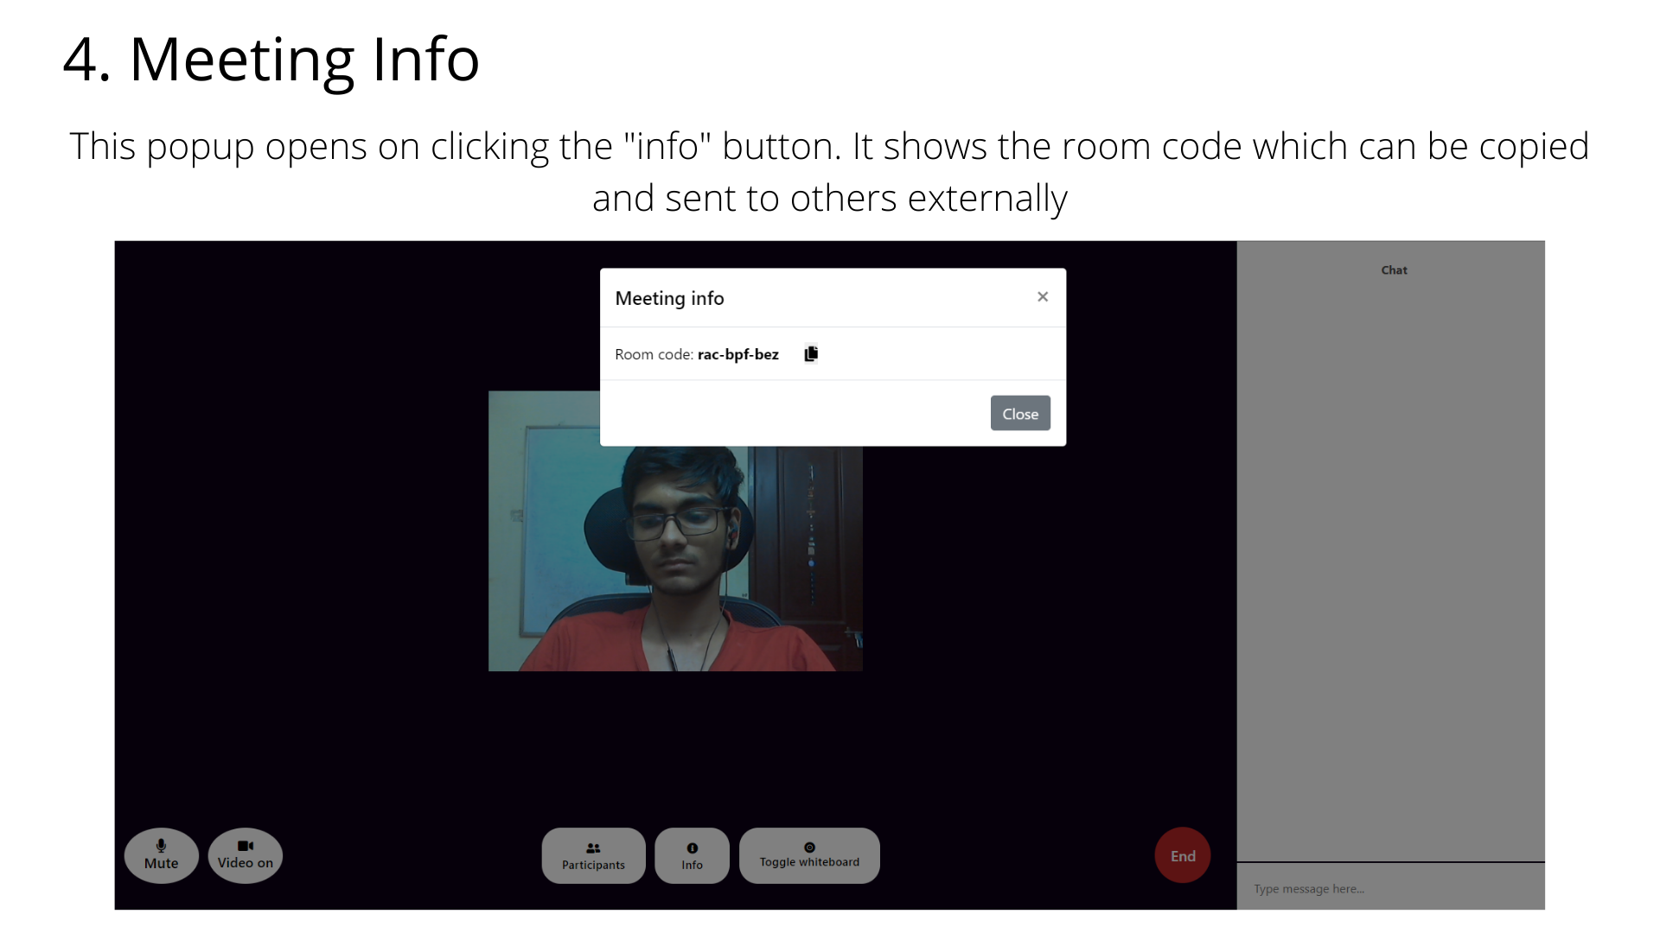

Slide 16
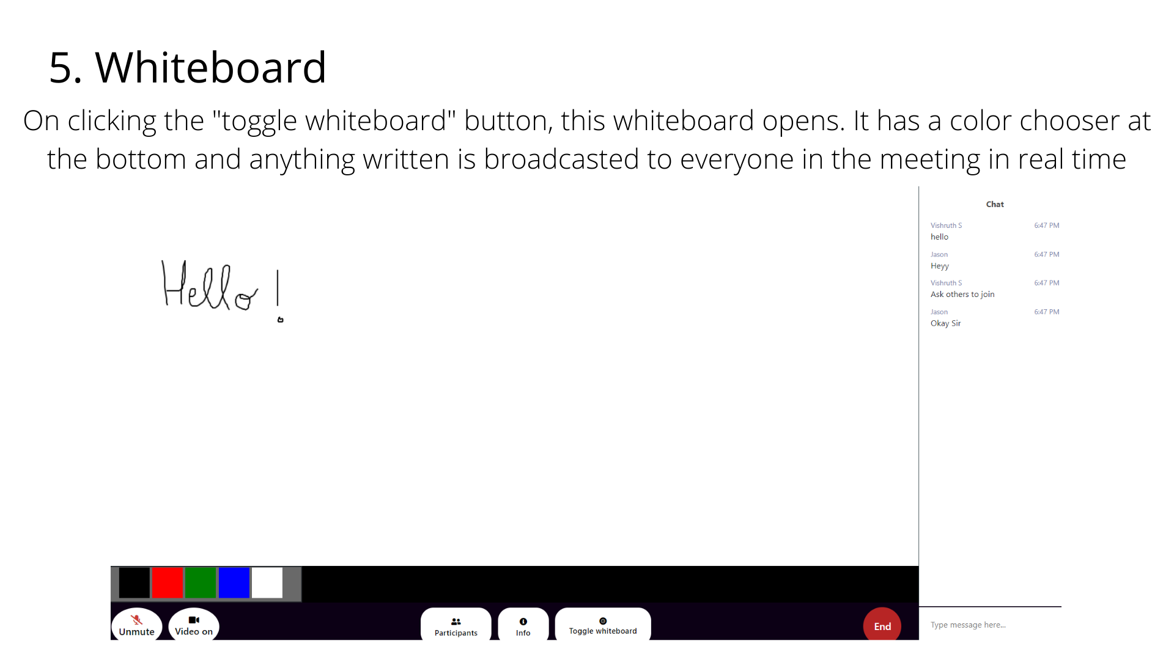

Slide 17
Technologies used
HTML
CSS
JavaScript
NodeJS
SocketIO
Github Repo Link
https://github.com/Vishruth-S/TeachEasy

Slide 18


