Slide 1
ANALYSNG COVID-19 CASES IN KERALA
Team Name : Amigos
Members : Sangeeth S, Roshan Antony, Anagha Nageri, Vaishnav V M

Slide 2
CONTENTS
Introduction
Objective
Tools Used
Overview
COVID-19 Cases Timeline
Description of Tools Used
Code

Slide 3
INTRODUCTION
COVID-19 has disrupted the livelihood of many people.
The number of cases in India has been on the rise.
Many people have lost their jobs and hence their earnings.

Slide 4
OBJECTIVE
This project aims to build a predictive model to analyse COVID-19 cases in Kerala and hence identify a possible year by which the number of cases comes down to nil.

Slide 5
TOOLS USED
NumPy
Pandas
MatPlotLib
Seaborn
FBProphet
Scikit-learn

Slide 6
OVERVIEW
December 9, 2020 - COVID-19 deaths in India - 141,000.[6]
Started in India in January 2020.
Deaths grew alarmingly for first 3-4 months.
Government regulations, social distancing etc. reduced the cases.

Slide 7
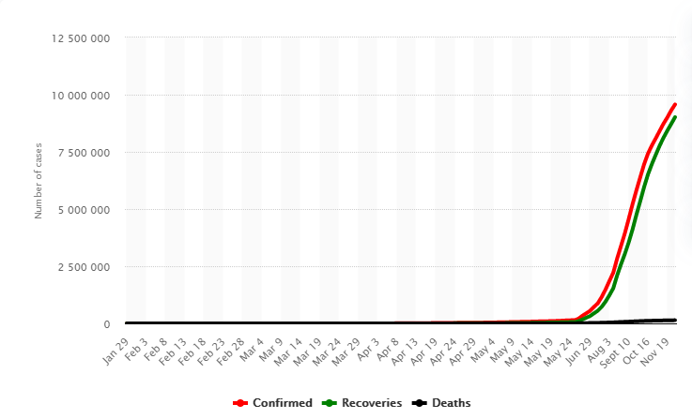
COVID-19 CASES TIMELINE
Figure 1 : COVID-19 Cases Timeline in India[4]

Slide 8
DESCRIPTION OF TOOLS USED

Slide 9
NUMPY
Package in Python.
Used for scientific computing.
Performs different operations.
Useful tool for data analysis.
Fast computation.

Slide 10
PANDAS
Data Analysis and Manipulation Tool.
Similar to NumPy
Applications – Data Science and Machine Learning

Slide 11
MATPLOTLIB
Data Visualisation Tool
Different types of visualisation possible.
Capable of changing minute details of a figure.

Slide 12
SEABORN
Data Visualisation Library
High-level interface
Built on MatPlotLib
Higher quality visualisation compared to MatPlotLib.

Slide 13
FBPROPHET
Helps in time-series forecasting
Fits the data using linear model.
Useful for large datasets.

Slide 14
SCIKIT-LEARN
Free Machine Learning Software
Supports classification, regression and clustering algorithms.
Widely used in Machine Learning applications

Slide 15
CODE
Link to Code : COVID-19 Kerala Analysis

Slide 16
CONCLUSION
Realized the model of COVID-19 cases in Kerala.
Visualised the model for COVID-19 cases.
Learnt how to build a predictive model.

Slide 17
REFERENCES
“Prediction Models for COVID-19 clinical decision making”- Artuur M Leeuwenberg, Ewoud Schuit : https://doi.org/10.1016/S2589-7500(20)30226-0
“Predictive analytics in health care: how can we know it works?” – Ben Van Calster, Laure Wynants, Dirk Timmerman, Ewout W Steyerberg, Gary S Collins : https://doi.org/10.1093/jamia/ocz130
Kaggle : https://www.kaggle.com/imdevskp/covid-19-in-india
Statista(As of December 10, 2020) : https://www.statista.com/statistics/1104054/india-coronavirus-covid-19-daily-confirmed-recovered-death-cases/
Machine Learning Mastery : https://machinelearningmastery.com/how-to-connect-model-input-data-with-predictions-for-machine-learning/
GitHub : https://github.com/CSSEGISandData/COVID-19

