Slide 1

BeingMom
PERSONALIZED MATERNAL ASSISTANCE APP
1

Slide 2
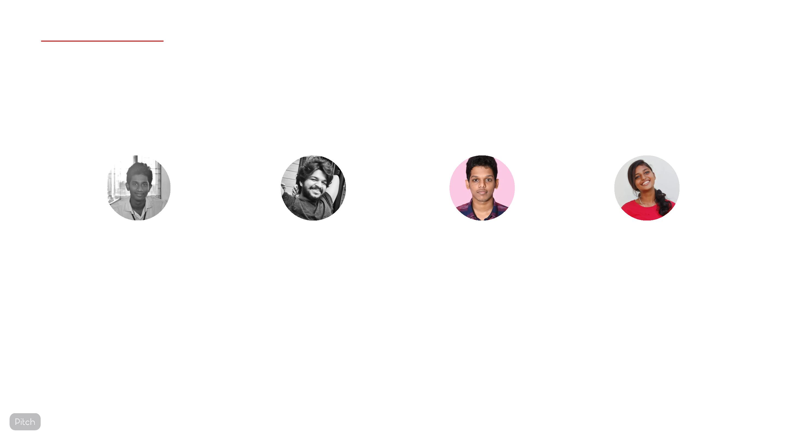
OUR TEAM
KRISHNADAS BABU
KRIDHARTH N VINOD
RISHIKESH K
ROSY TRESS
GOVT. MODEL ENGINEERING COLLEGE,
THRIKKAKARA
2

Slide 3

TABLE OF
CONTENTS
1
Problem
Solution
Product
Market
2
3
4
3

Slide 4

THE PROBLEM
Due to the increasing trend of nuclear families lack of
personal assistance is an issue of concern to most new
parents during the pregnancy period.
In a highly populated country like India healthcare facilities
for mother and child should be accessible easily at the
fingertips.
The post-pregnancy phase also requires keen observation
and assistance for both the mother and child.
During an emergency situation, the lack of immediate
response may adversely affect the health of the mother
and child.
4

Slide 5

What?
THE PROBLEM
Lack of personal assistance during the pregnancy period.
Lack of healthcare facilities available at the ꢀngertips.
Lack of immediate response during the pregnancy period.
Lack of advice and assistance during the pregnancy period.
Why?
Lack of advice and assistance during the pregnancy and post pregnancy phase
can adversely aꢁect the health of both the mother and child.
Lack of immediate response during emergencies can lead to unfortunate
situations.
Why now?
The outbreak of the pandemic has made it diꢂcult and riskier for a pregnant
mother to meet the Doctor in person.
The changing life style has left most of the new parents in need for a
personalized assistance facility.
5

Slide 6

Daily development timeline
OUR PRODUCT
According to expected delivery date, it will generate a whole timeline on daily development of
the child.
Appointments
Fixing an appointment with the doctor through the platform.
Hospitals
A list of hospitals nearby can be looked upon for emergencies.
Reminders and Notiꢀcations
The proposed checkup dates and medicines reminder will be notiꢀed by the app.
Community Forum
A local community forum can be created so that mothers can connect others with the same
experience.
Emergency Alert
Primary contacts will be alerted in case of medical emergencies.
6

Slide 7

THE SOLUTION
A personalized healthcare app for parents to
get regular assistance during the pregnancy
and parenting period, helping you keep track
of your pregnancy week by week, remember
your due date, and provide you proper
healthcare tips.
7

Slide 8

TARGET USERS
• As a parent, you can get instant assistance for your child's
healthcare.
• A Doctor can join with their account to provide medical advice and
help.
• A medical helper (Nurse, ASHA, etc)can also join to provide some
guidance.
• Parents of a fully grown child can share some insights or their
experiences.
8

Slide 9

MARKET
POTENTIAL
Taking into account the number of new parents and
the total number of certified gynecologists in India the
market in India alone consists of more than 25 million
users per year.
The majority ofꢀwomenꢀ(95%) wereꢀpregnancyꢀe-
healthꢀseekers. Mostꢀwomen searchꢀfor information on
theꢀInternetꢀonce a month or more, most often during
the early stages ofꢀpregnancy.
9

Slide 10

User market in India per year
~25M ~24.2M ~0.7M
TOTAL
CHILD BIRTHS IN INDIA PER
YEAR
CERTIFIED
AVAILABLE USERS IN INDIA
GYNECOLOGISTS
10

Slide 11

BUSINESS
MODEL
Business Structure
• Market - Pregnant women and parents who need maternal
assistance.
• Client-Client & Doctor-Patient Referrals
• Key Partners - Government and private healthcare providers
• Social media and print advertising
11

Slide 12

COMPETITION
Competitive Advantages
☑ Dedicated maternal assistance tips and tracking with available
assistance of professional gynecologists.
☑ Emergency Contact service that allows all your close ones in case of
an emergency at the single tap ofꢁa button
☑ Location and directions to all the hospitals located around the user
☑ Week by week tracking and diet recommendation.
12

Slide 13

The tech stack of our application.
FLUTTER
FIREBASE
JAVA
GOOGLE MAP API
13

Slide 14
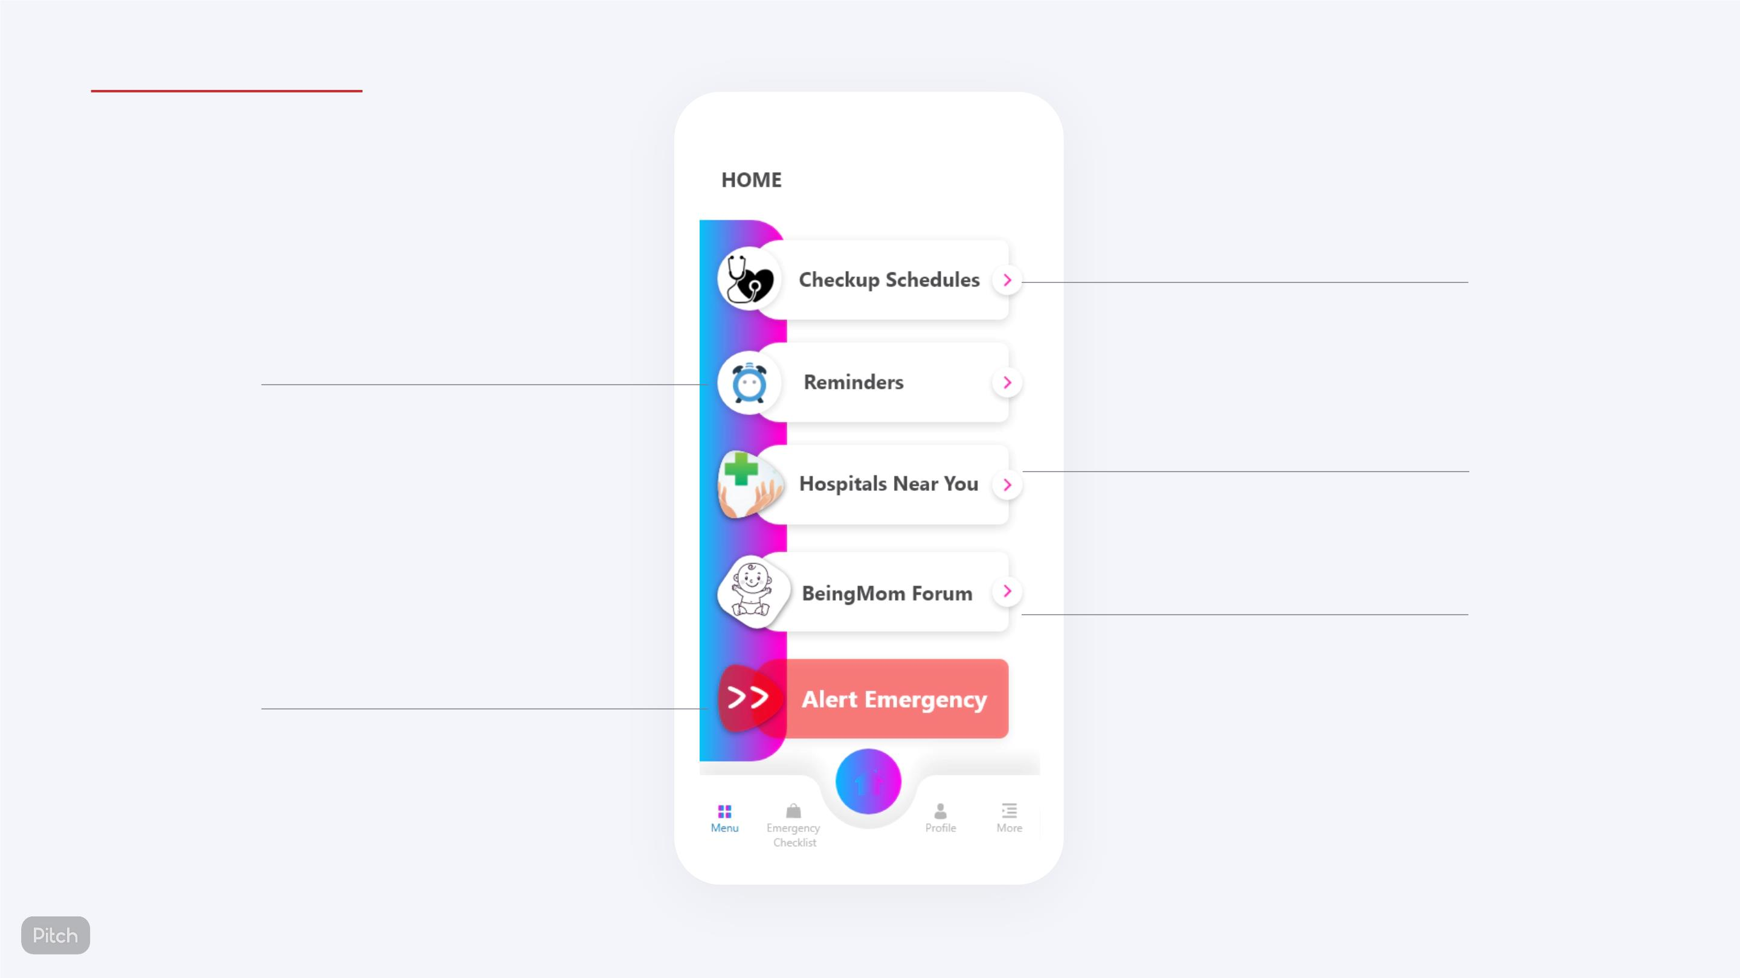
OUR PRODUCT
Schedule appointments
with doctors
Reminders for diet and
checkups
Find hospitals
around you
Community
Forum
Emergency Slider
14

Slide 15
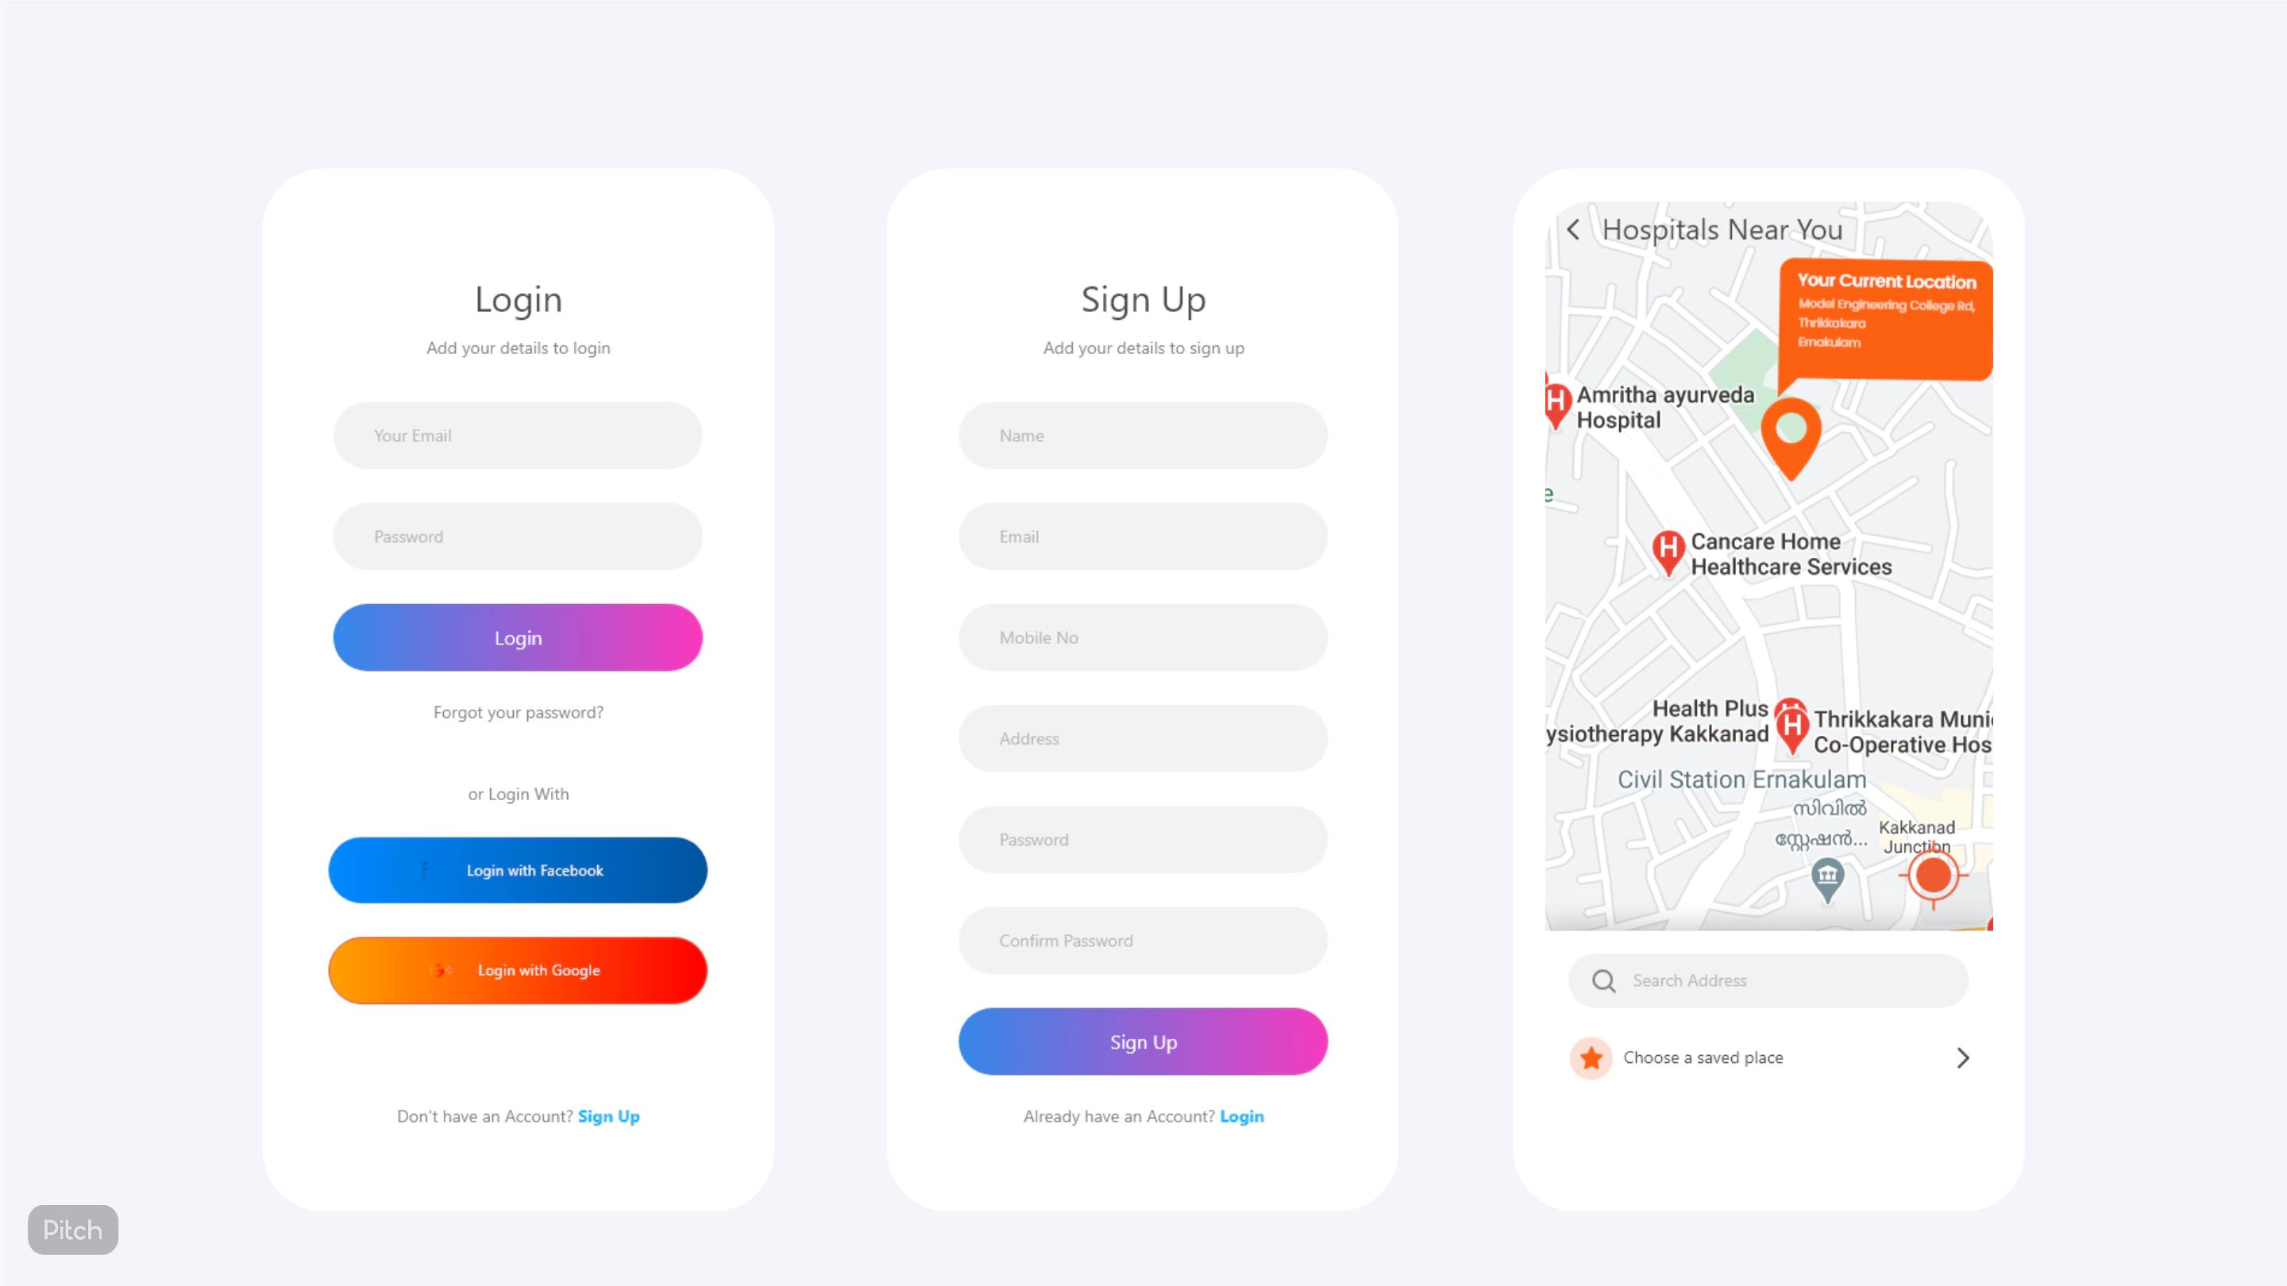
Login
Sign Up
Hospital Location
15

Slide 16
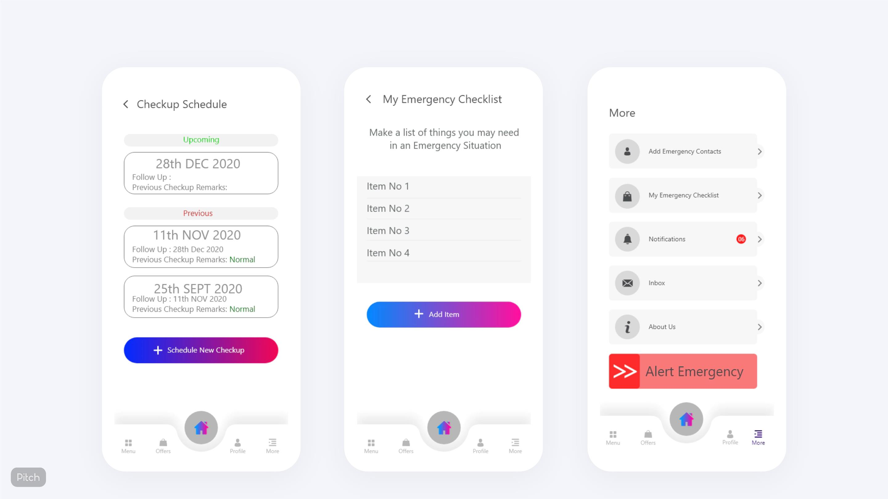
Checkup Schedule
Emergency Checklist
Dashboard Pull
16

Slide 17
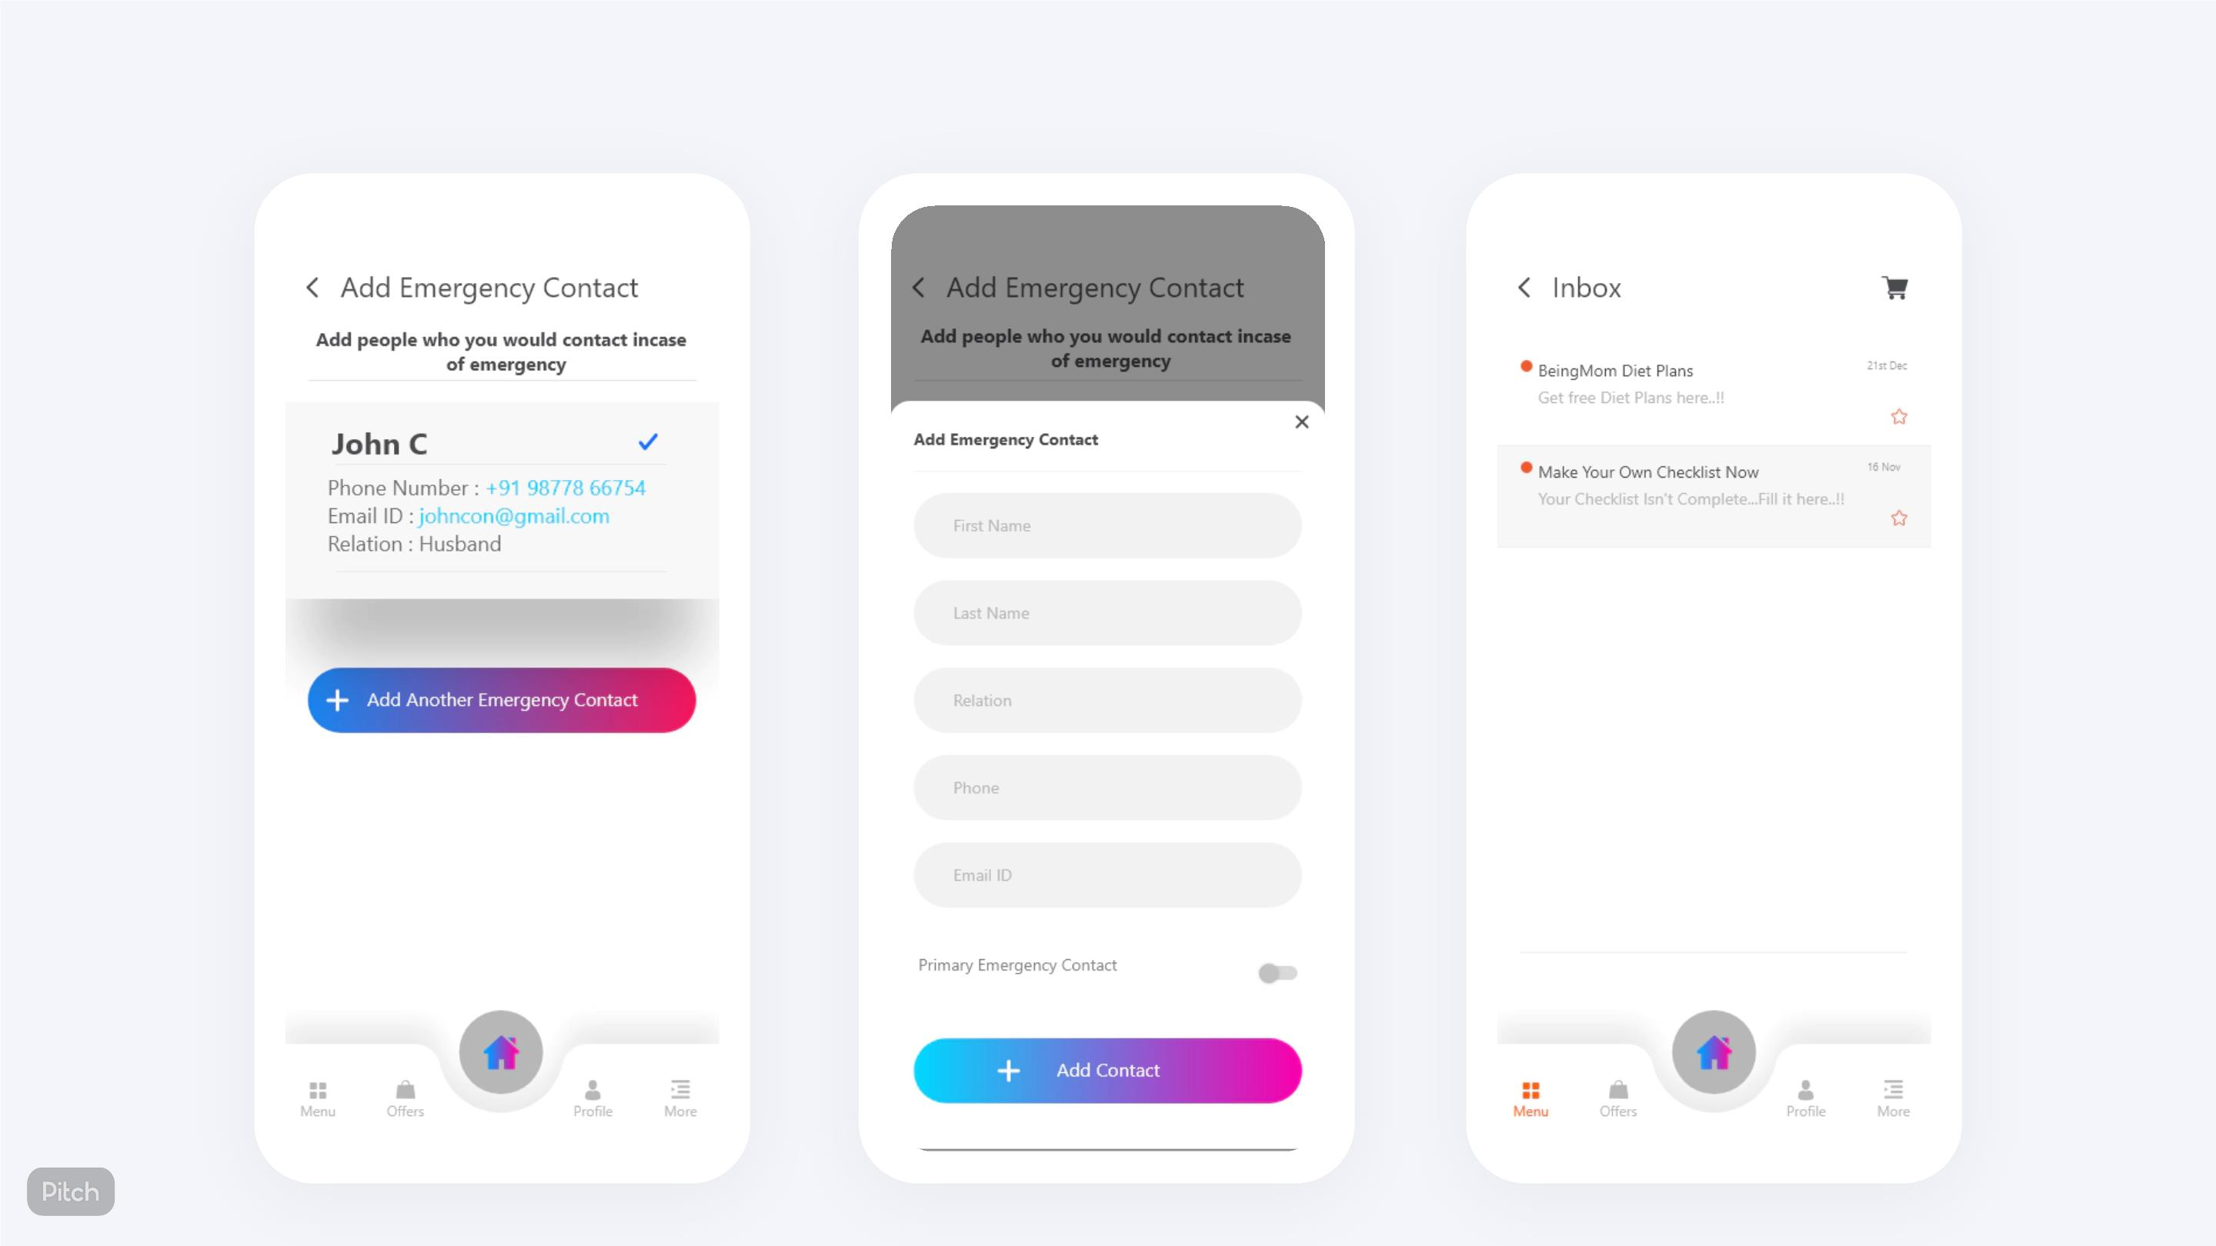
Emergency Contact
Add Contacts
Inbox
17

Slide 18

Our Mission
To provide all the mothers with proper
and quality healthcare and
assistance at their fingertips.
18

Slide 19

Thank you
19

