Slide 1


Slide 2
TABLE OF CONTENTS
01
04
02
05
03
06
WHY ?
IN ACTION
Necessity is the mother of innovation.
Lets watch it unfold
OUR MISSION
FUTURE SCOPE
What we envision
We don’t plan to stop here
WHAT WE BUILT
OUR TEAM
This is what we have been working on
Even when the bugs were upon us, we fought together

Slide 3


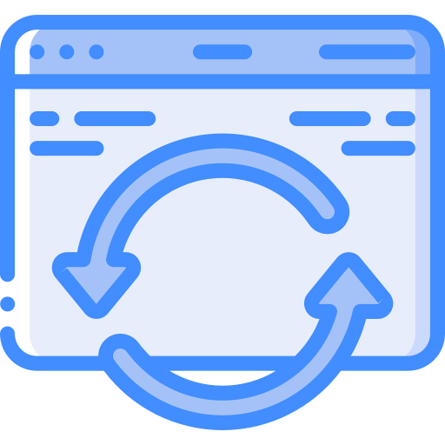
WHY ANOTHER HEALTH APP
01
02
03
NEED FOR A GENERAL PURPOSE HEALTH APP
ONLINE BLOOD BANKS THAT BROADCAST NOTICES LEADING TO SPAM
HEALTH UPDATES ARE CONFINED TO HEALTH TIPS THAT ARE SOMETIMES SUBJECTIVE
Notes:
1.Even though there are many health related apps that cater to specific user needs, there is a need for a general health care app to cater to all these needs alike.
2.Available blood bank support facilities does not have features that verify user’s eligibility to donate blood, provisions to send blood request to relevant users and to connect donors and receiver.
3.Health tips are featured in many available applications and yet there isn’t many platforms that provide notices for region specific health camps, NGO supports, financial aids etc.

Slide 4


WHY ANOTHER HEALTH APP
04
05
TO MANAGE MEDICAL DOCUMENTS AS SOFT COPIES
SOME CRITICAL MEDICAL HISTORY DETAILS DOES NOT REACH THE DOCTORS AT THE RIGHT TIME
Notes:
1.Medical history is highly important data of any person. Even with the expansion of technology, medical history management isn’t prioritised by most health are applications
2.All medical data are important but still some previous health conditions can impact future diagnosis drastically. Current technology does not try to classify these and provide it to a doctor during emergency.

Slide 5
OUR VISION
We believe in making life easier for humanity by making health resources more accessible, manageable and retrievable. We believe in integrating information technology with health care to expand opportunities beyond what is conventional.
Self care gains a broader platform through Health Care Plus and its quest to push its boundaries further. Health Care Plus aims at becoming your single stop for self care.

Slide 6
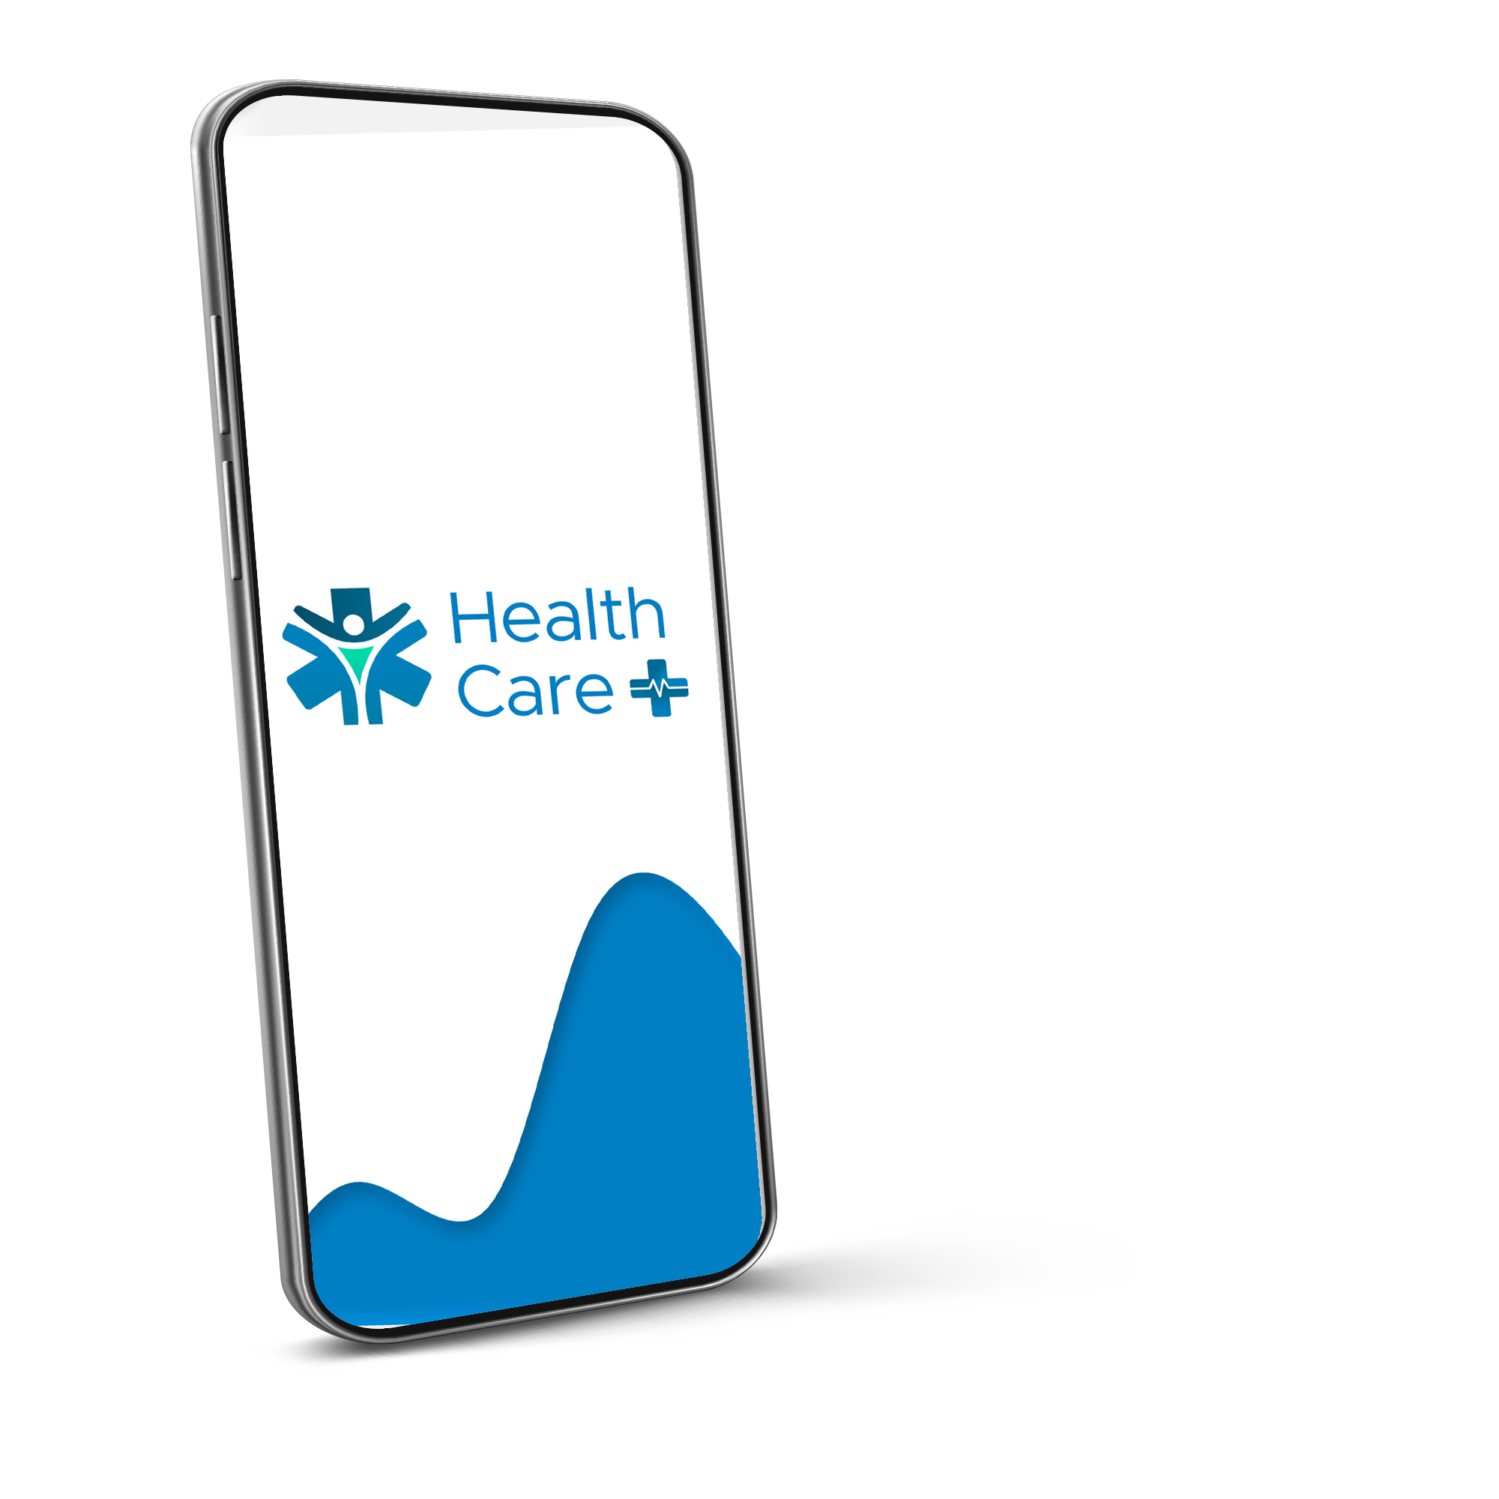
ABOUT THE APP
+
Health Care Plus aims at making life easier by providing a user centric general health care platform that caters to various health necessity. Health Care Plus is integrating health and technology to its fullest to make accessible health solutions.

Slide 7
WHAT WE ARE WORKING ON
CONSULT
MANAGE
With ease through our secure environment
Medical history and prescriptions through our Health Vault
DONATE
STAY PROTECTED
Because now every drop of blood saves a life even more effectively
With the emergency support system that saves your life and sensitive data alike
STAY UPDATED
Stay updated with all relevant health updates

Slide 8
CONSULT
Consult through convenient modes of consultation such as chat, scheduled calls or offline sittings.
Pre-book appointments
Search and find the right doctor around you
Get medical advices through chats
Share previous history with your doctor

Slide 9
CONSULT OPTIONS
Chat
Book A Session
Video Conference
You can chat with your doctor for medical advice
Book an appointment with the doctors around you
Video conference is our upcoming feature to facilitate live online session

Slide 10
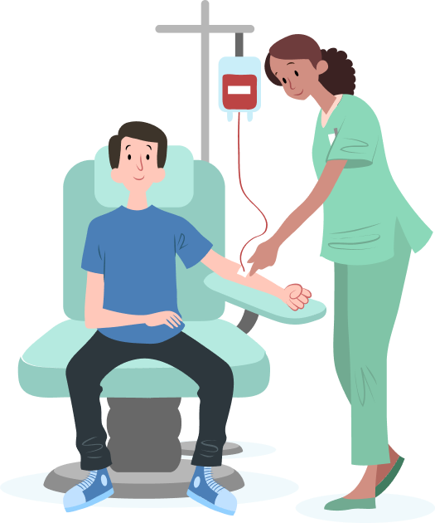
DONATE
Blood donation toggle to make eligible to donors’ status visible.
Eligibility check for interested donors based on weight and donate history.
Receive only relevant blood request based on user’s blood group.
Place valid requests for blood donors easily.
Up-to-date Blood bank page.

Slide 11
KNOW IF YOU ARE ELIGIBLE TO DONATE
01. Check Age
02. Check Weight
The user must be aged between 18-65 to donate
Minimum weight for blood donation is 45Kg
03. Past Donation
04. Your Blood group
A person can only donate again after 60 days
Every donor can only donate based on their blood group

Slide 12
WHAT IS NEW
Users receive blood request notices for which they could donate.
Units of blood required is highlighted.
Number of required units of blood decreases as donors confirm to donate.
Once the need is met, the card is automatically removed from donate feed.
Users can post blood requirements after filling in credentials.
The requester receives contact details of confirmed donors.
We stand out from other blood bank support apps

Slide 13
STAY UPDATED
A dedicated updates page for regional, general and covid related health updates.
Dedicated Covid page.
General updates on activities of voluntary groups.
Regional page to notify about local facilities.
These updates include check up camps, financial aids for dialysis or medicines etc.

Slide 14
COVID UPDATES
01
02
03
04
VIEW DAILY STATS
BUY COVID CARE SUPPLIES
FIND TEST CENTERS NEAR YOU
GET VACCINE UPDATES

Slide 15

STAY PROTECTED
Emergency ambulance service.
Well defined blood donation portal
App prompts users to select critical data to help doctors in an emergency situation
Safe and organised storage for medical history and documents.
Secure payment modes to book appointments.

Slide 16
EMERGENCY SUPPORT FEATURES
EMERGENCY DETAILS
A universal emergency code permits doctors to access a QR code through the emergency dial of the patient’s phones to obtain patient’s emergency details
BLOOD BANK
Users can post blood requirement and obtain contacts of confirming users, blood banks, voluntary organisations and their coordinators
AMBULANCE
Users can easily call an ambulance when they see or are in an emergency situation

Slide 17
MANAGE
Organize your medical records in digital format.
Tag your documents as critical info and choose what your doctor must know in an emergency.
Keep your prescriptions and medical data accessible.

Slide 18
THE H-VAULT
MEDICAL HISTORY
DOCUMENTS
PRESCRIPTION
Track your past appointments and blood donation history
Store and organise your health reports as soft copy
Store prescriptions separately to increase accessibility
Notes:
STORE AND ORGANISE YOUR HEALTH REPORTS AS SOFT COPY

Slide 19



HEALTH CARE+ IN ACTION
Here is a short video of our
prototype in action.
{ Click here if there is any error playing this video }

Slide 20
Future Scope
Video consultations.
Doctor’s access to critical information during emergency through a safe system of data exchange.
Vaccination Timelines
Finderscope that lists healthcare camps and related NGO activities in locality
Tie ups with hospitals to directly exchange health report to user via app

Slide 21
OUR TEAM
Anagha S Menon
Sidharth S
Joel Joseph Jude
Ashwin Girish
The contents main
Our debugging king
Our all in all
The UI expert

Slide 22
THANK YOU

