Slide 1
MEDITRACKER
In a hurry ? Do not worry meditracker has got your back!

Slide 2
Aim
Our website mainly aims in helping people and doctors to keep track of their medical records digitally in a hindrance free manner and forget the dilemma of keeping all the prescriptions safe and sound in large files.

Slide 3
Solution
By feeding the medical details of people into this website people no longer will have to carry their medical files and prescriptions to show their medical history to doctors and hospitals. More over this website helps to stores all the data, be it from any hospital into this website.

Slide 4
Working
The patient can login to their MediTracker account by filling in the login credentials which will take them to the homepage. Here they will be able to view their medical summary and also keep it up to date by uploading recent files.
This can be accessed by the patient as well as the physician.

Slide 5
Tech Used
HTML
CSS

Slide 6
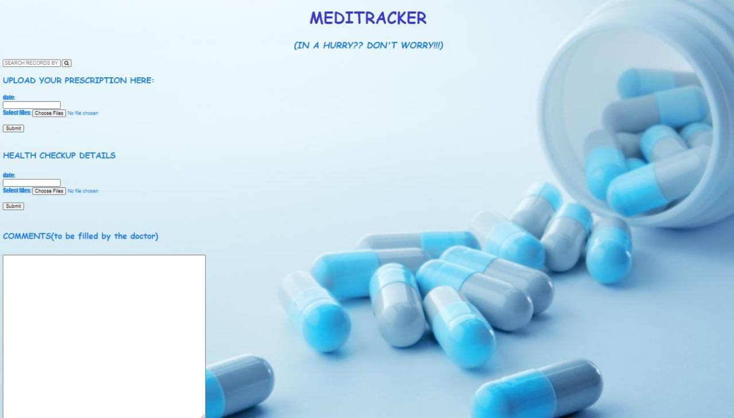
Preview

Slide 7
Advantages of using MediTracker
The physician can get regular information on the patient’s health even if the patient lives far away.
With the patients approval, close relatives can keep on track of their health and can schedule appointments by monitoring the updates.

Slide 8
Done by:
Sradha N S
Anu John
Anagha Narayanan
Nasreen K Basheer

Slide 9
Thank You!

