Slide 1
SKYNET

Slide 2
What is SKYNET ?
Online educational platform
Helps you find available courses
Explore different platforms for the same course
Easy to find authorized educational websites
Quick access to websites of individual platforms

Slide 3


FRONTEND BACKEND

Slide 4
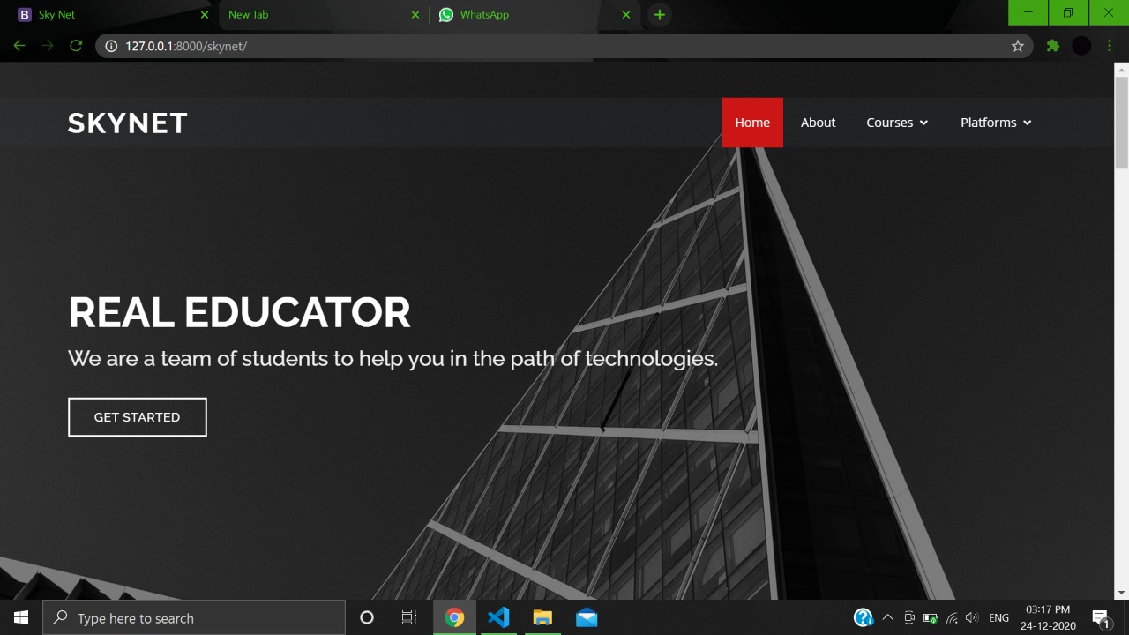
Homepage

Slide 5
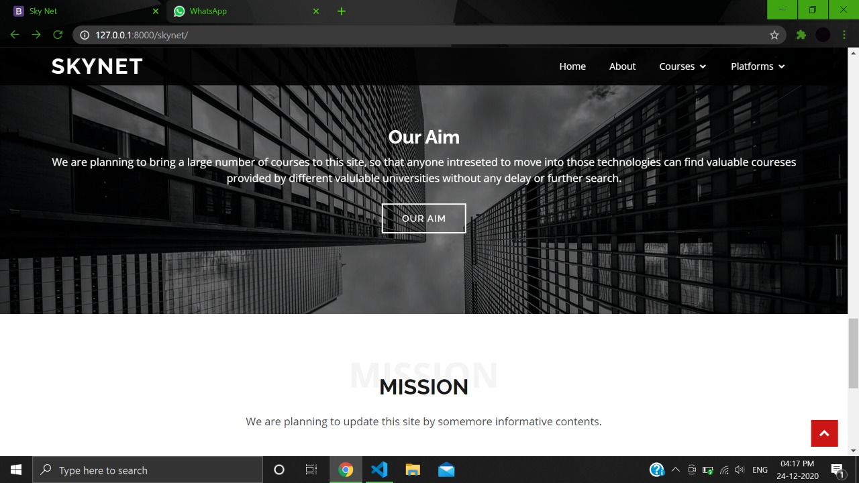

Slide 6
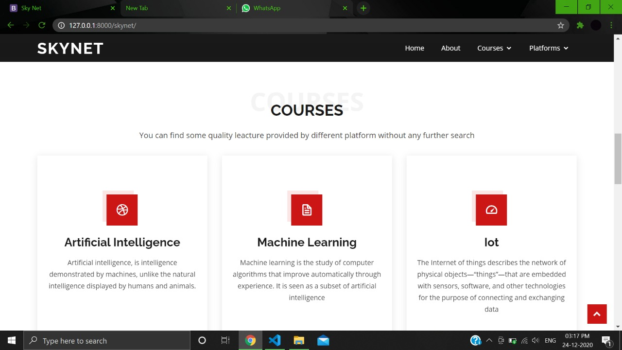
Courses Available:

Slide 7
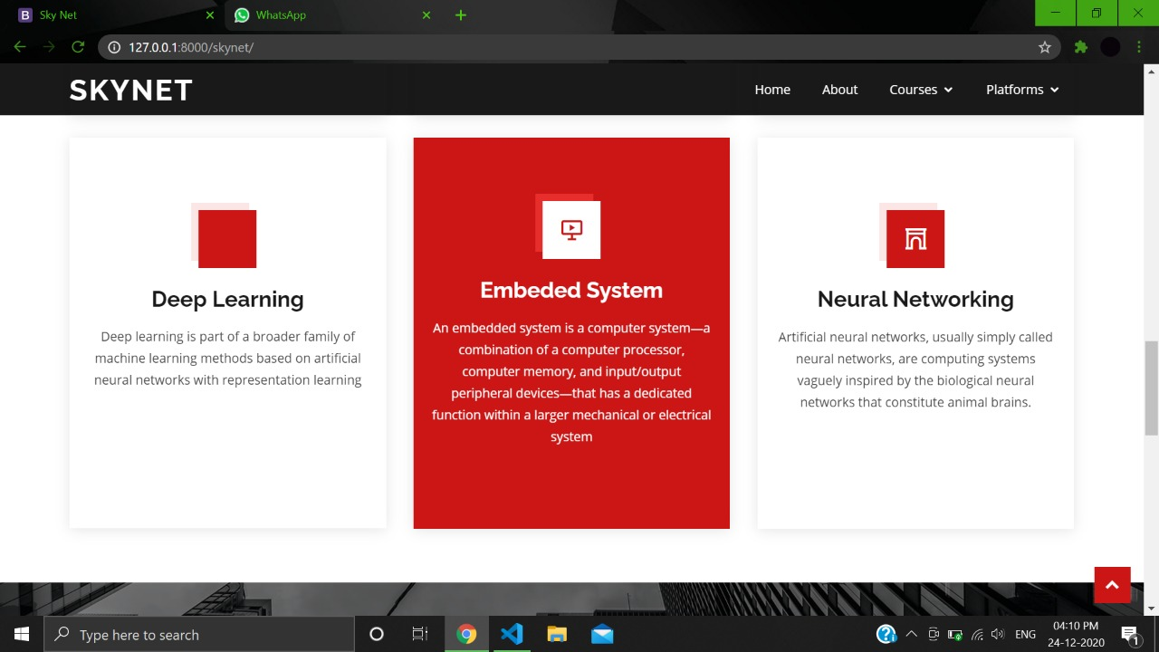

Slide 8
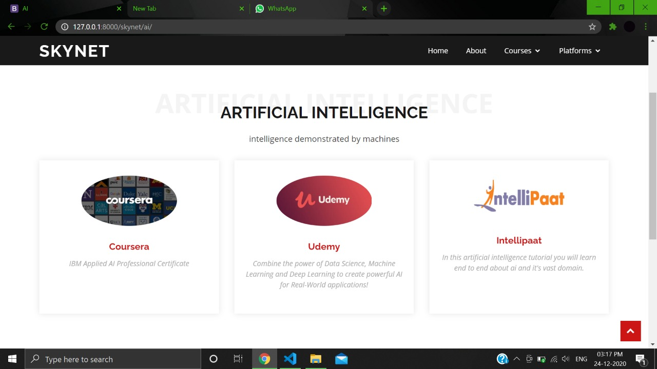
Educational websites available for each course:

Slide 9
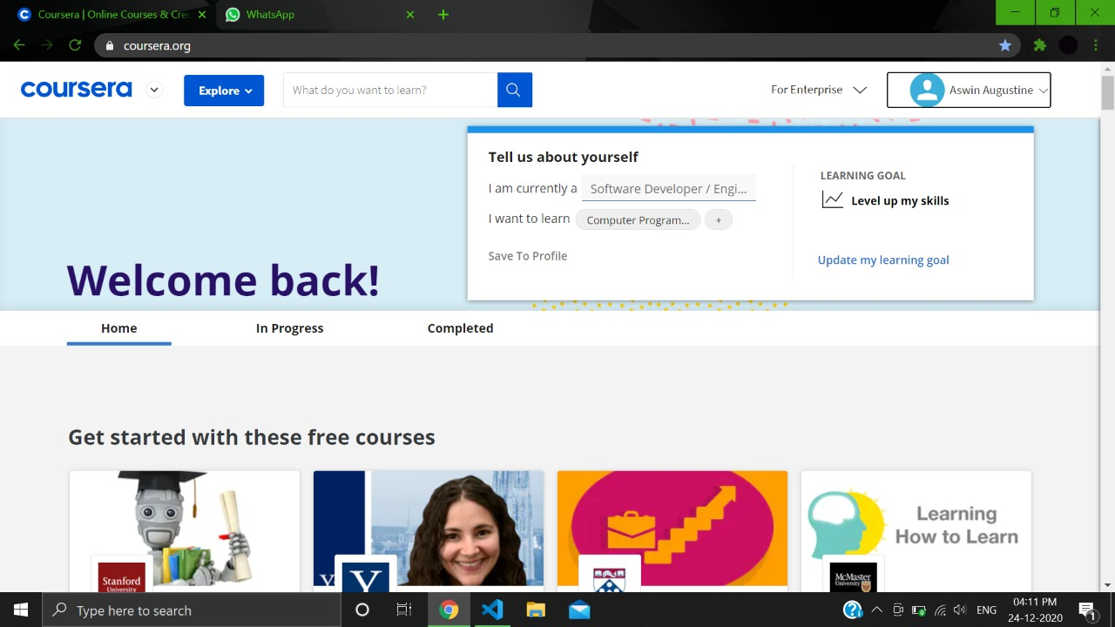
On choosing a platform:

