Slide 1
FITBIT THE VIRTUAL HEALTH ASSISTANT
Prepared by
Aimy Lenson
Devikrishna N
Geona Jimy
Siny Ann James

Slide 2
INTRODUCTION
Disclaimer : Outputs are system generated recommendations only
Existing model uses structured data to predict the disease (Not a good method when it comes to complex diseases)
Mainly focus on disease prediction based on symptoms

Slide 3
OBJECTIVE
Provides awareness of disease symptoms among people
Helps to educate people about the early symptoms
Provide practical advice for preventing the spread

Slide 4
MOTIVATION
Increase in the incidence of chronic diseases
According to a report in 2015 ,86.6% of deaths were due to chronic diseases
With the development of big data analytic technology early disease detection is possible

Slide 5
SCOPE
Automation of disease prediction
To save the environment by using paper free work
To increase the accuracy and efficiency so that patients can get direct help
Management of disease related data

Slide 6
SYSTEM ARCHITECTURE
.
Training data
Data Transformations
Processed data
Data Timing
User Input
(symptoms)
Disease Prediction Model
Predicted Disease and Precautionary Measures

Slide 7
ALGORITHM
1. Start
2.Read choice ‘c’
3.Check if c=1
Read symptoms ‘cs’
*check if symptom cs=1
print “likely to suffer from hand foot and mouth disease”
*check if symptom cs=2
print”likely to sufer from ringworm”
*check if symptom cs=3
print”likely to suffer from chikenpox”

Slide 8
.
*check if symptom cs=4
print”likely to suffer from scabbies”
*check if symptom cs=5
print”likely to suffer from impetigo”
4.Check if c=2
Read symptoms ‘cs’
*check if symptom cs=1
print”likely to suffer from hepatitis A”
*check if symptom cs=2
print “likely to suffer from norovirus or rotavirus”
* check if symptom cs=3
print”likely to suffer from verocytoxin”
*check if symptom cs=4
print”likely to suffer from shigella”

Slide 9
.
5.Check if c=3
Read symptom ‘cs’
*check if symptom cs=1
print”likely to suffer from influenza”
*check if symptom cs=2
print”likely to suffer from streptococcal sore throat”
*check if syptoms cs=3
print”likely to suffer from pertussis”
6.Check if c=4
Read symptom ‘cs’
*check if symptom cs=1
print”likely to suffer from conjunctivitis”
*check if symptom cs=2
print”likely to suffer from meningitis”
*check if symptom cs=3
print”likely to suffer from mumps”
7.Stop

Slide 10
.
Basic Process:
a) Enter symptoms
b) Disease prediction
c) Provides safety measures

Slide 11
USES
Helps people to get insights into their health
Suggest safety measures
Dramatically lowers risk of severe health complications by detecting disease at early stage itself
Provides fore- knowledge of possible diseases
However to avoid misinterpretations user must consult doctors of respective symptoms

Slide 12
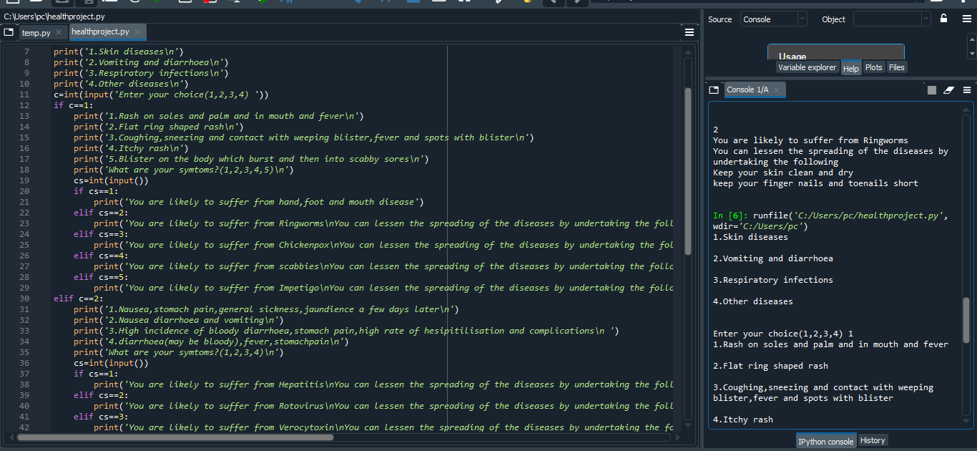
PROGRAM CODE AND OUTPUT

Slide 13
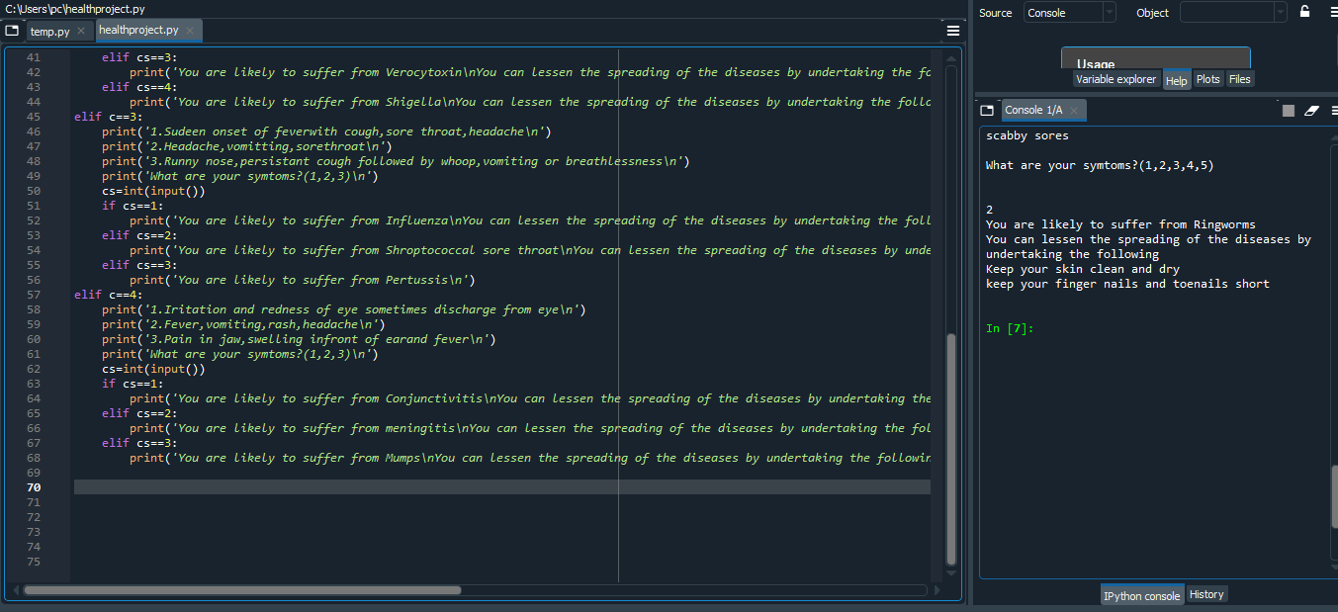

Slide 14
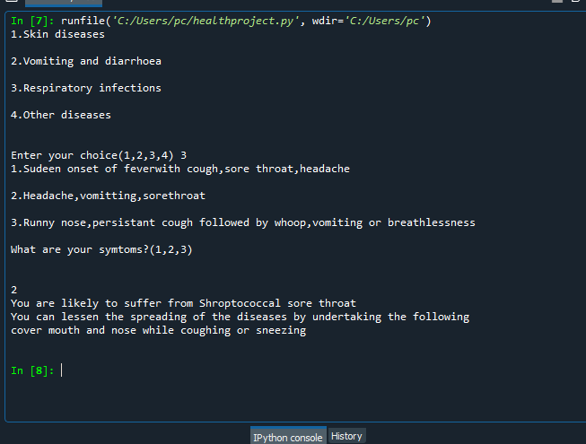

Slide 15
CONCLUSION
Authenticates the huge scope of machine learning algorithms in disease prediction
Prove useful in urgent case where
Patient is unable to reach doctor
Emergency case and do not have doctor in an area
Preliminary examination of patients

Slide 16
REFRENCES
https://developer.android.com/design/index.html
http://www.livescience.com/36519-diseases-
http://www.saedsayad.com/naive_bayesian.htm

