Slide 1
//01
UrChoices
The app for making right choices

Slide 2
Experimentation
03
The way of life
05
Cracking the safe
07
Why
09
UrChoices
15
Contents
//02

Slide 3
//03
E X P E R I M E N T A T I O N
Life is made of Never ending choices.....

Slide 4
But we never get to pick or...
We don't know what to pick
The choices we make makes the path for us. We may be right or We may be wrong but we have to be confident at every decisions. In most cases we are not. That's because we couldn't choose, our options were limited, we didn't know the extend of our opportunities or somebody picked something for us
//04
M A D E F O R A H E A L T H Y M I N D S E T

Slide 5
//05
Brand Guidelines 2020
The Problems that
exist
T
The Way of Life

Slide 6
//06
THE INABILITY TO CHOOSE
THE CONTROL OF OTHERS
PEER PRESSURE
The options that are available now is an ocean of opportunities
, We are in fast paced lifestyles. We select one or choose something others reccomend.
We dont stop and listen to the heart that contributes evrything
Sometimes our life is controlled by sparks or literally other people. They choose something that they want us to become.
Sometimes our heroes makes us do something so we could become them
The lives that exist near us influence us in so many ways. Like everything that exists between us humans we are pressured to achieve success from an example. As every fingerprint is individual, every human being creates their own success

Slide 7
//07
Cracking the safe
If we map out the ocean, then it will be easy for navigators to reach the Land of Dreams
The Solution

Slide 8
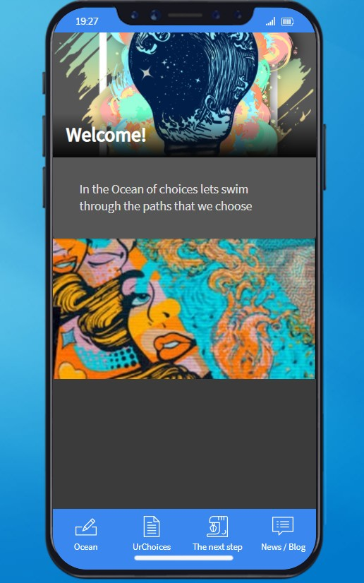
UrChoices

Slide 9
//09
Mapping
DECISIONS
No Pressure
The Choices that represent what we need is mapped to find the right option that we need to settle. It may b multi, hobby, passion, whatever it may be , Its UrChoice
An Individual becomes the decision maker as he/she has access to every resources needed
Life is about simplicity. You pick something, you try it, you don't like it and you move on. Don't settle for something that is very low in your standards
Why

Slide 10
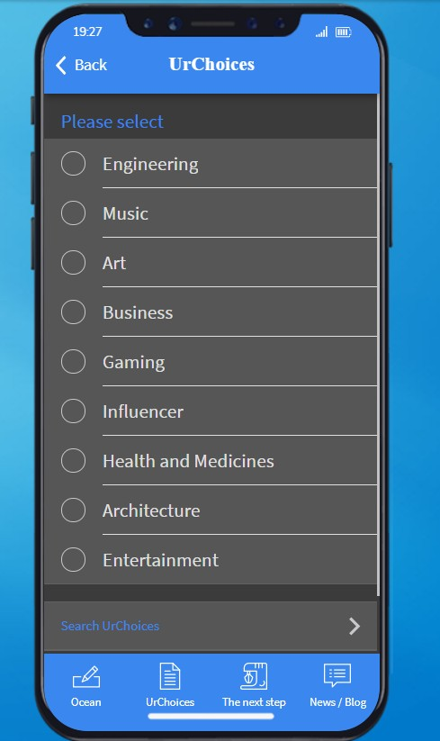
Multitude of Options

Slide 11
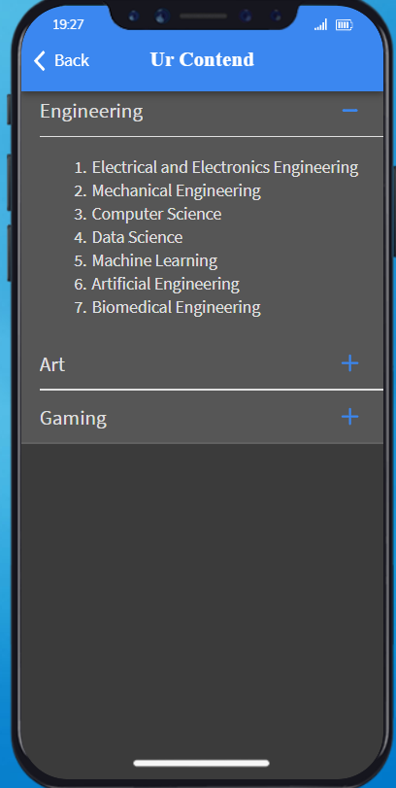
//11
Personalised Mapping
.

Slide 12
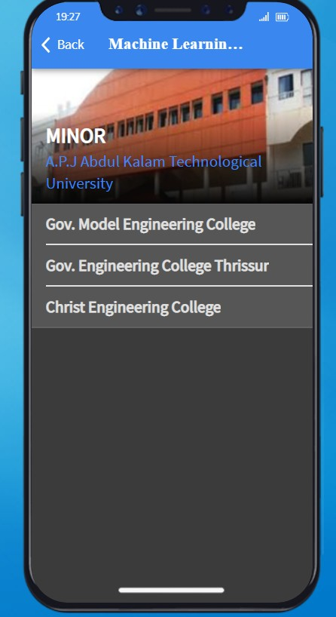
Details on Faculty and services
//12

Slide 13
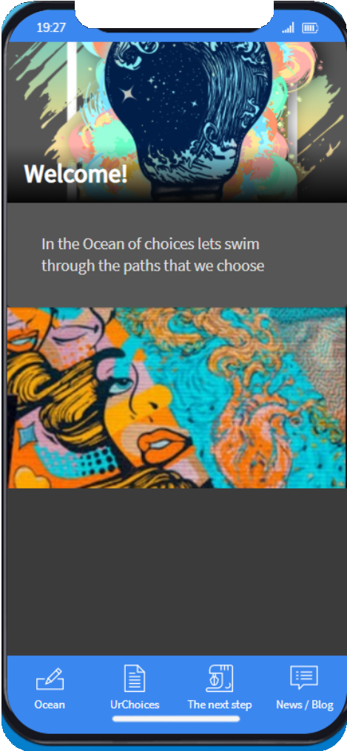
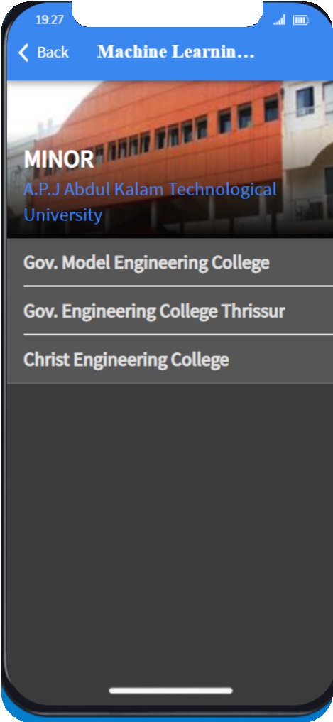


A P P L I C A T I O N
AstraStrong
TM
AstraStrong
TM
Digital formats
Applications
//13

Slide 14

EVERYTHING AND MORE
Information about all the courses after 10th
Subjects included in th stream Information about all colleges and courses
Admission criteria will be spcified for each colleges
Information about fee structures and exams for each courses
//14

Slide 15
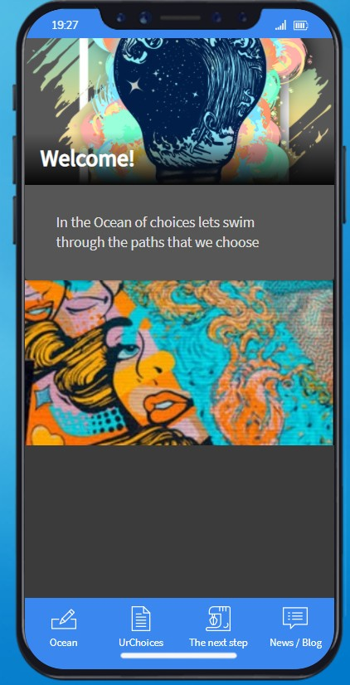
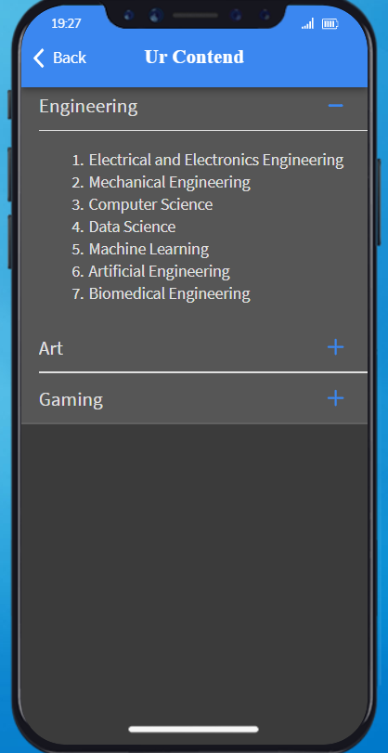
UrChoices

