Slide 1

EDUCATION DURING THE PANDEMIC
PROBLEM STATEMENT

Slide 2
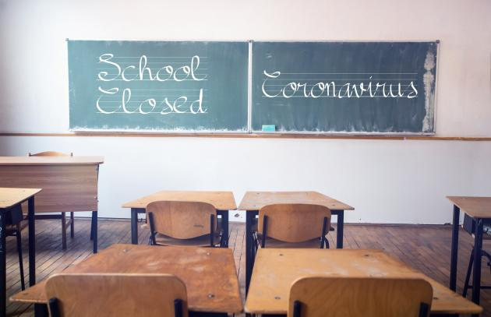
THE EDUCATIONAL INSTITUTIONS ACROSS THE GLOBE WAS CLOSED DUE TO THE COVID-19 PANDEMIC.
AS CHILDREN ARE ONE OF THE MOST VULNERABLE GROUP, THIS WAS AN ABSOLUTELY NECESSARY MEASURE.

Slide 3
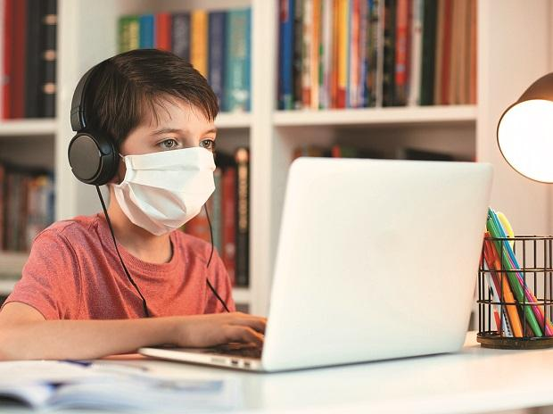
Institutions across the globe switched to online learning so as to continue the education
They made use of electronic devices to provide children with live and recorded classes.
The government of Kerala even made use of television to give access to all children their right to education

Slide 4

BUT ARE THEY REALLY BENEFITTED FROM THESE??
The monotonous classes have practically killed the energy and enthusiasm to learn in many children ranging from kinder garden to universities.
Unfortunately, technical issues are bound to happen in an online only environment.
Staying motivated and alert in becomes a Herculean task in this remote learning.
Lack of in-person interaction takes a toll on their mental health as well.
Above all these, the increasing workload of assignments and homeworks makes student life in this pandemic a difficult one.

Slide 5
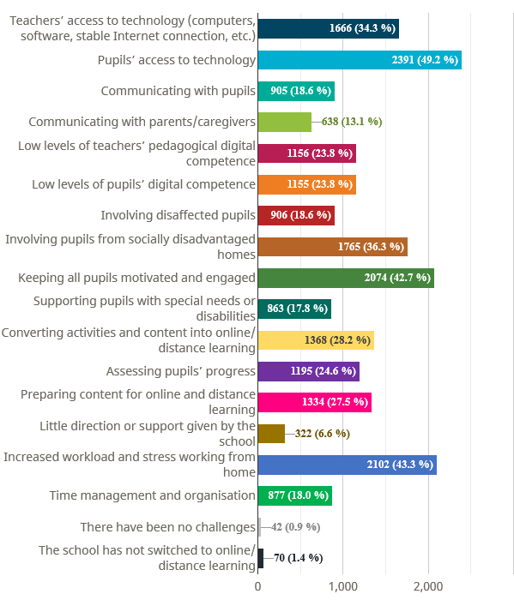
This survey explore opinions on online and distance teaching from across Europe was open on School Education Gateway from 9 April to 10 May and attracted a record number of respondents – 4859 – of whom 86% were teachers or school heads.
These were the main challenges faces by teachers and students in their online learning.

Slide 6


Same is the case of online evaluation.
Teachers mainly conduct open book exams or traditional exams which students can attempt from their homes.
Students either find new ways of copying or byheart things without understanding the concept
Earlier teachers could examine the problems of each student and tell them personally, but this is not possible in this online evaluation.
Even though teachers conduct online tests and quizzes, students simply does it without understanding the existing problems in what they have learnt.

Slide 7

So a new system of evaluation has to come up according to these changed times where students should be able to revise and well as evaluated
There should also be provision for them to understand their mistakes and learn more about a topic.

Slide 8
With all the previous mentioned points we have come up with a solution...

Slide 9
QUIZME A fun and interactive quiz application!

Slide 10
Features
Subject wise quizzes
Our quiz app will contain quizzes divided by subjects, set by respective teachers.
Challenge friends
Students can send challenges to their peers to promote group learning.

Slide 11
Weekly Reminder
Students get reminders and notifications on their progress and prompts to continue their learning.
Starring/Flagging Questions
Important questions that users come across in the quiz can be flagged. All flagged questions can be accessed separately later with their respective answers.

Slide 12
Leaderboard
Users can view recent quiz challenge results as well as each of their peer's score status on the leaderboard to promote healthy competition.
Multiplayer
In order to encourage more students to use the app this feature enables them to attempt quizzes in teams to improve their knowledge and skillset

Slide 13
Answer Explanations
Explanations for difficult questions can be checked after quizzes if needed
Performance Streak
A streak can be maintained if you cover a particular amount of portions/questions regularly

Slide 14
Flash Cards
This feature enables students to type out questions and answers they wish to revise onto flash cards. Similar to traditional flash cards, the question will be entered on one side and answers on the back of virtual flash cards which can then be randomly generated.

Slide 15


We hope that this application will make learning fun for students and also make assessment easy for teachers!

