Slide 1


Slide 2
PROJECT IDEA
The basic idea of Nutri-Track is all about to maintain healthy body in online mode.
The website comprises of ’BMI Calculator’, ‘Calorie Counter’ & ‘Statistical weekly reports’.
The site is user friendly and compatible on different browser which allows you to be systematic.
The website allows user to create an account and use the site with the respective login.
It allows the user to calculate their BMI & Calorie , hence recommending healthy alernatives to sustain disease-free body as much extend.

Slide 3
TECH STACK
The tech stack used here is Django which uses Python as the programming language,HTML,CSS,JavaScript.
Django is high-level Python Web framework that encourages rapid development , clean & pragmatic design.
HyperText Markup Language(HTML) is for adding meaning to raw content by maeking it up
Cascading Style Sheets(CSS) is for formatting that marked up content
JavaScript is for making that content formative and interactive

Slide 4
Necessity of the Project
Nutrition is a critical part of health and development.
Better nutrition is related to improved infant,stronger immune systems,lower risk of non-communicable diseases,longevity,etc…
But the inappropriate intake of calories leads the individual to chronic diseases,obesity,underweight,etc…
The increase in physical inactivity due to the increasingly sedentary nature of many forms of work,changing modes of transportation & increasing urbanization affects the BMI .

Slide 5
Raised BMI is major risk factor for non-communicable diseases such as cardiovascular diseases,diabetes,some cancers & musculoskeletal diseases.
Aged people too aren’t concern of their health nowadays,their ignorance to food decrease their BMI.
Lower BMI result in weakened immune system,fragile bones & feeling tired

Slide 6
Benefits of the Project
This site helps the individual to calculate BMI,intake calories,calories burned due to healthy alternatives & statistical weekly reports.
Individuals daily routine is monitored and according to their BMI and calories special steps are taken:
Deficient in calories then healthy foods are prescribed which puts you away from diseases.
Most probably calories are burn’t by controlling food and if necessary with the help of some workouts.
This makes the individual Fit.

Slide 7
Daily task , appropriate intake of food & ability to do activities at any time makes them better day by day
Hence, they would be able to control blood pressure, Cancer prevention, reduce inflammation, boost immune system, control weight & prevent cardiovascular disease as much as extend
Aged ones daily routine is monitored and if necessary their weekly reports can be shared to family doctor

Slide 8
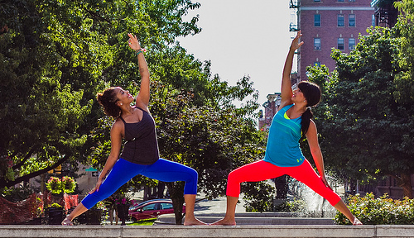
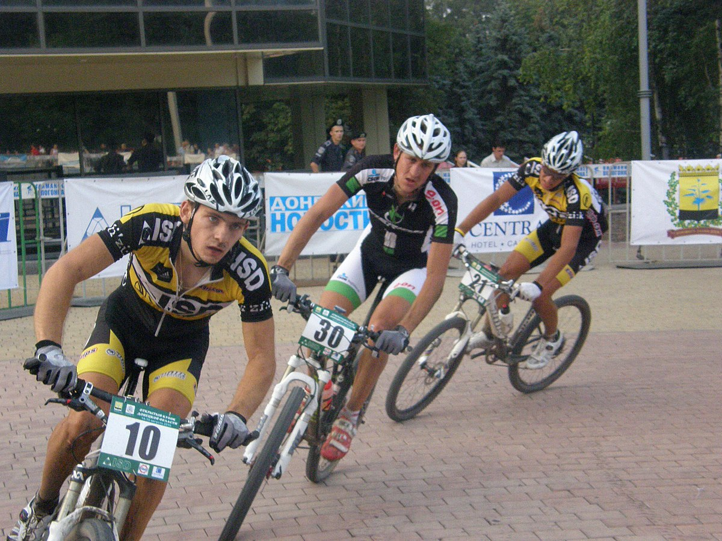
This Photo by Unknown Author is licensed under CC BY
This Photo by Unknown Author is licensed under CC BY-SA

Slide 9
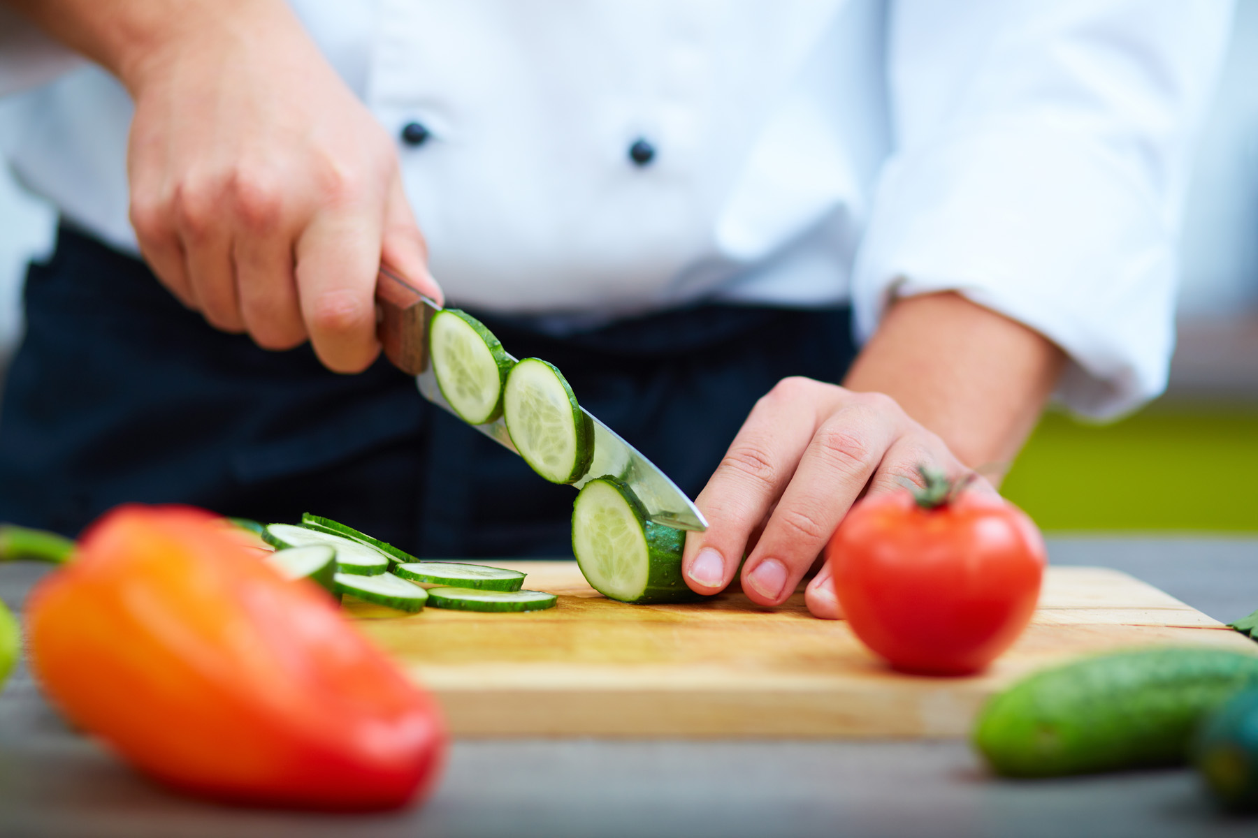
This Photo by Unknown Author is licensed under CC BY-NC-ND

Slide 10
PROBLEM STATEMENTS
Enabling a patient-centered information exchange system.
Personal medical assistant.
Our site acts as a personal medical assistant since it recommends healthy alternatives to get a fit body
Individual’s informations too are secured as much as posible
Solution :

Slide 11
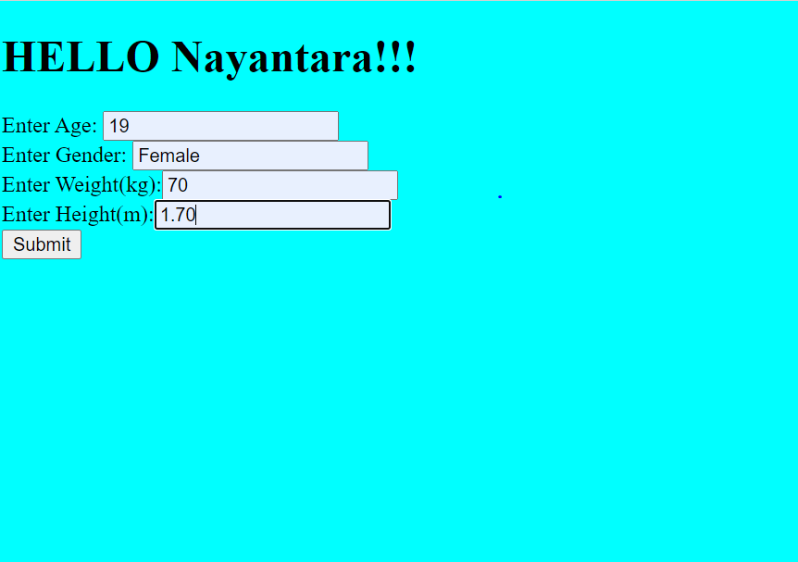

BMI

