Slide 1
ZIP DEMONS
Sreehari N Madhav Hari Govind P K

Slide 2
CONTENTS
STOCK MARKET
WHY?
HOW?
LIMITATIONS OF DESIGN
CONCLUSION
REFERENCES

Slide 3
STOCK MARKET
A stock market is the aggregation of buyers and sellers of stocks (also called shares), which represent ownership claims on businesses
These may include securities listed on a public stock exchange, as well as stock that is only traded privately, such as shares of private companies which are sold to investors through equity crowdfunding platforms.
Investment in the stock market is most often done via stock brokerages and electronic trading platforms. Investment is usually made with an investment strategy in mind.

Slide 4
WHY?
Ease of use- The data available is spread throughout different webpages. Getting to know all the info from a single webpage will be easier for people who want to participate in stock trade
Faster- Having all the data in a single page is more effective in doing work faster and saves a lot of effort and time
Real Time- We are able to access the data real time and get immediate updates on whether stock rises or falls
Comparability- Able to compare the rate of stock of different companies together at the same place

Slide 5
HOW?
We create a website using HTML
Stylizing is done using CSS
Hamburger menu and fetching is done using javascript
The graph is plotted using chart.js package
We use REST API from alphaVantage
Using alphaVantage we get the API key for getting real-time stock data

Slide 6
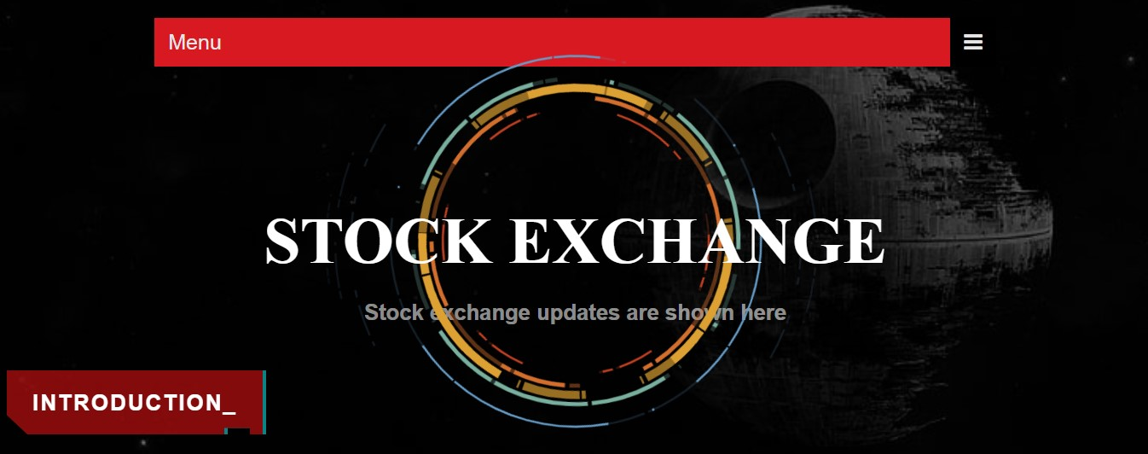

Slide 7
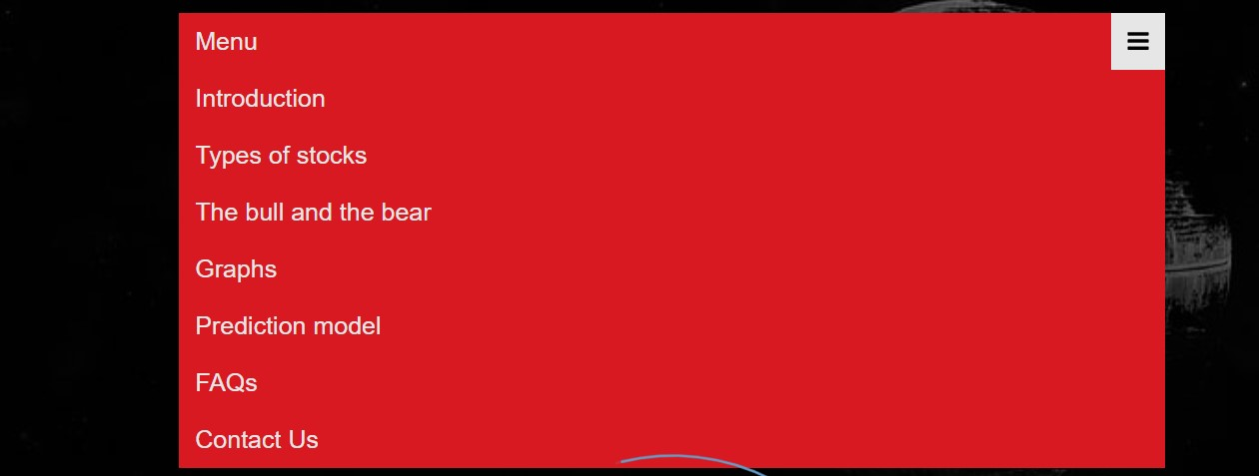

Slide 8
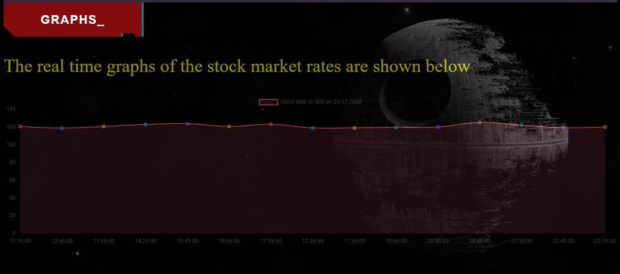

Slide 9
LIMITATIONS OF DESIGN
Only a certain amount of different stock rate can be shown
No option of direct or indirect investment in stock
No particular prediction system set up (As of know)
Only a limited amount of data can be shown in a webpage

Slide 10
CONCLUSION
Set up a conglomerated web page where users are able to find
Current stock of major companies are mainly shown
Graphical progression of each company in a week
Comparability of different companies stock simultaneously
Hope to create a system that can predict the rise or fall of stock rate based on past and present inputs.

Slide 11
THANK YOU

