Slide 1
Diabetes Tracker

Slide 2
Diabetes
Metabolic disease that causes high blood sugar
Chronic disease
3Types:
Type 1 diabetes
Type 2 diabetes
Gestational diabetes

Slide 3
Types
Type I diabetes (insulin dependent):
Also known as juvenile diabetes
Occurs when the body fails to produce insulin.
Usually diagnosed in childhood.
Causes:
Body’s own immune system attacks and destroys beta cells in pancreas, where insulin is made.

Slide 4
Types
Type 2 diabetes(non-insulin dependent):
Most common type .
Affects the way the body uses insulin.
Rates increasing due to obesity, lack of exercise and unhealthy diet.
Causes:
Occurs when body becomes resistant to insulin

Slide 5
Types
Gestational diabetes:
Occurs in women during pregnancy
Gestational diabetes does not occur in all women and usually resolves after giving birth.
High risk of type 2 and cardiovascular disease
Causes:
Hormonal changes during pregnancy.

Slide 6
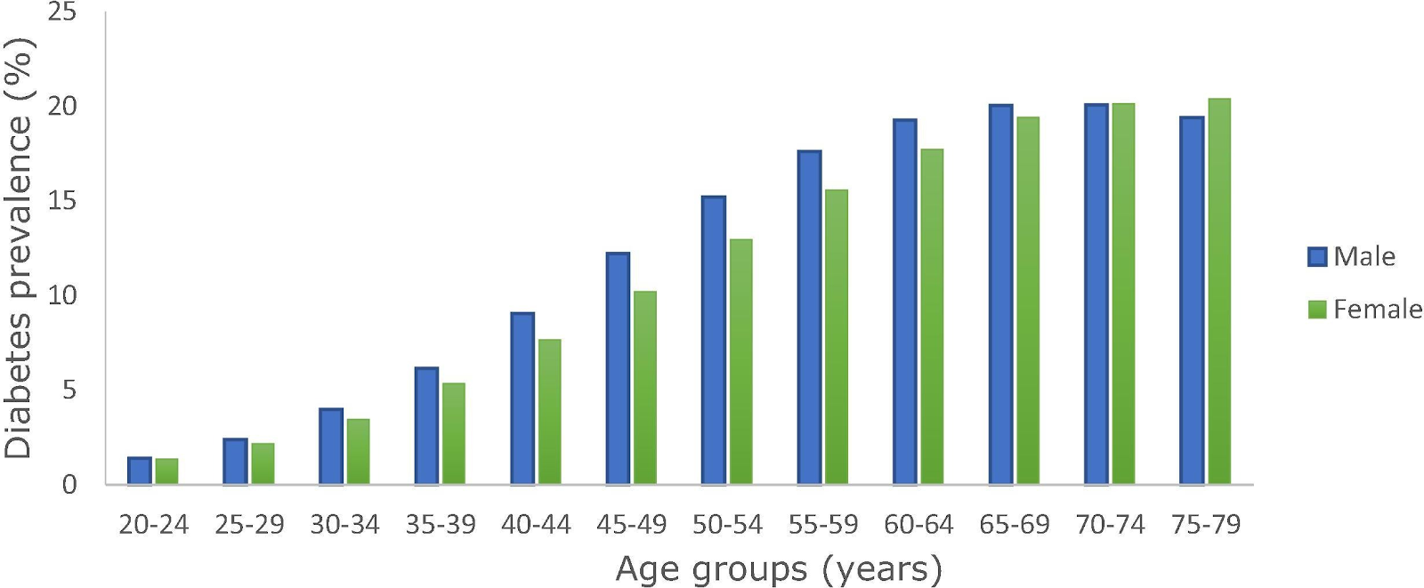
Statistics
The global diabetes prevalence in 2019 is estimated to be 9.3% (463 million people), rising to 10.2% (578 million) by 2030 and 10.9% (700 million) by 2045.
The prevalence is higher in urban (10.8%) than rural (7.2%) areas, and in high-income (10.4%) than low-income countries (4.0%).
One in two (50.1%) people living with diabetes do not know that they have diabetes.

Slide 7
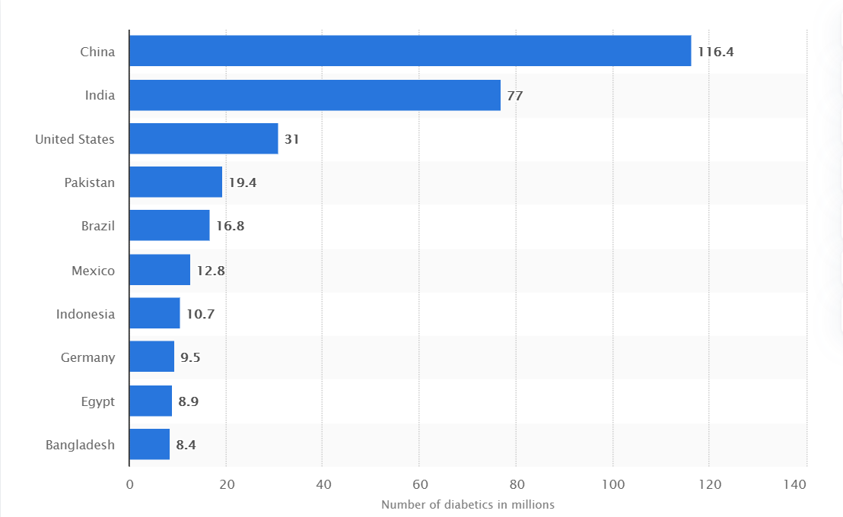
Top Diabetic Countries Worldwide

Slide 8


Framework used:
The application is build using flask , a micro web framework.
This is a simple application for diabetes tracking made using flask.
The app has a few features that helps in the same.

Slide 9
App Features
Track your history
Chat with your doctor
Calorie calculator
Chatbot
Get latest News & articles on diabetes

Slide 10
Relevance
No cure
Treatment can only lower symptoms
Need to maintain healthy food habits
Need to track progress
Requires constant attention
B.E.A.T Diabetes
Be physically active
Eat a Healthy diet
Abcs(know & control)
a1c, blood pressure, cholesterol and smoking
Take your medication

Slide 11
Future Scope

