Slide 1
CIS Hackathon
CORRECTEASY
Every teacher’s companion
Team Members:
Ardra Mohan
Malavika Rajesh Vikraman
Sandra Jacob
Sanjana S

Slide 2
PROBLEM STATEMENT
Due to the ongoing pandemic, the education system is one that has been gravely affected.
As schools shut down, teachers needed to rapidly adapt to new contexts of teaching and help students learn online.
They are also in the middle of meeting
the social emotional and academic needs.
of students during these challenging times.
Correcting and grading answer sheets of
students has been one of the tiring jobs for
the educators.
Notes:
PROBLEM STATEMENT

Slide 3

ABSTRACT OF CORRECTEASY
CorrectEasy is a web application that can help teachers make online answer sheet correction easier.

Slide 4
PIPELINE
Mark prediction
Final mark list generation
Generate final mark list
Calculate marks based on keywords in answer
Handwriting recognition
Answer comparison with key
Vision API detects handwriting
Check if keywords are present in answers
Notes:
Lifecycle

Slide 5






TECHSTACK
SQLite3
Django
Bootstrap
CSS
Java Script
HTML

Slide 6


Advantages of CorrectEasy
Easy and fast
User friendly
Easy correction and fast evaluation of answer sheet
Provides easy way to upload answer sheet of students
Automated
High accuracy
Compared with the answer key, predicts the mark of each student
Powered by Google’s Vision API, CorrectEasy provides variety of other features too

Slide 7
USER EXPERIENCE
1
3
5
Answer key for the test/assignment is
uploaded
CorrectEasy finds out the keys from the answer sheet
Predicts the mark for the test/assignment
2
4
6
Upload the answer sheet of the student
Shows the keys present from the students sheet
Teachers can easily analyze the students answer using CorrectEasy!

Slide 8
FUTURE SCOPE
Mathematical
Equations
Multiple Answer sheet correction
Feedback assessment
Login for each Faculty
A provision to receive individual personal feedbacks from the faculty
Each faculty will have their personalised dashboard after logging into the webapp
Can use Mathpix API for accurate detection and recognition of mathematical equations and formulae
Teacher can provide a folder with multiple answer sheets and the answer and get it corrected in a single click

Slide 9
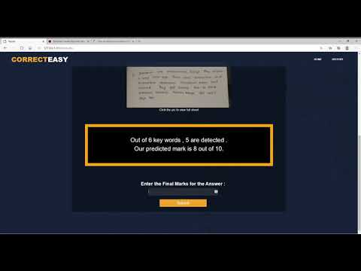
DEMO

Slide 10

Thank you!

