Slide 1

DAILY HEALTH
Team - AMPLITUDE

Slide 2
Introduction
An online health monitoring device.
Measures physiological parameters – temperature, pulse rate, etc.
Arduino, Bolt and two biosensors are used.
Biosensors:
- Plug and play type Pulse Sensor.
- LM35, precession Integrated Circuit Temperature Sensor.

Slide 3
Bolt Iot and Bolt Cloud – to send alert message via Telegram(App) with respect to change in Temperature.
Arduino – used to plot graphs
Uses: - for monitoring health of senior citizens.
- for finding physiological parameters of soldiers.

Slide 4
Motivation and relevance
Direct medical support is not available due to COVID-19 pandemic .
Elderly in need of constant monitoring .
Soldiers in remote areas in need of urgent medical assistance.
Monitor patients who are bed ridden
Doctors needs to observe the vitals of the patient who are not able to be physically present for the checkup.

Slide 5
Remote areas where medical facilities are not available in abundance.
Provide efficient medical assistance when needed.
Easy to use.
Required data can be accessed online.
Hospital visits can be reduced.

Slide 6
Components
6. Jumper
7. USB
8. BOLT Wi-Fi Module
Bread Board
Pulse Sensor
Temperature Sensor LM35
USB cable A/B for Arduino
Arduino

Slide 7
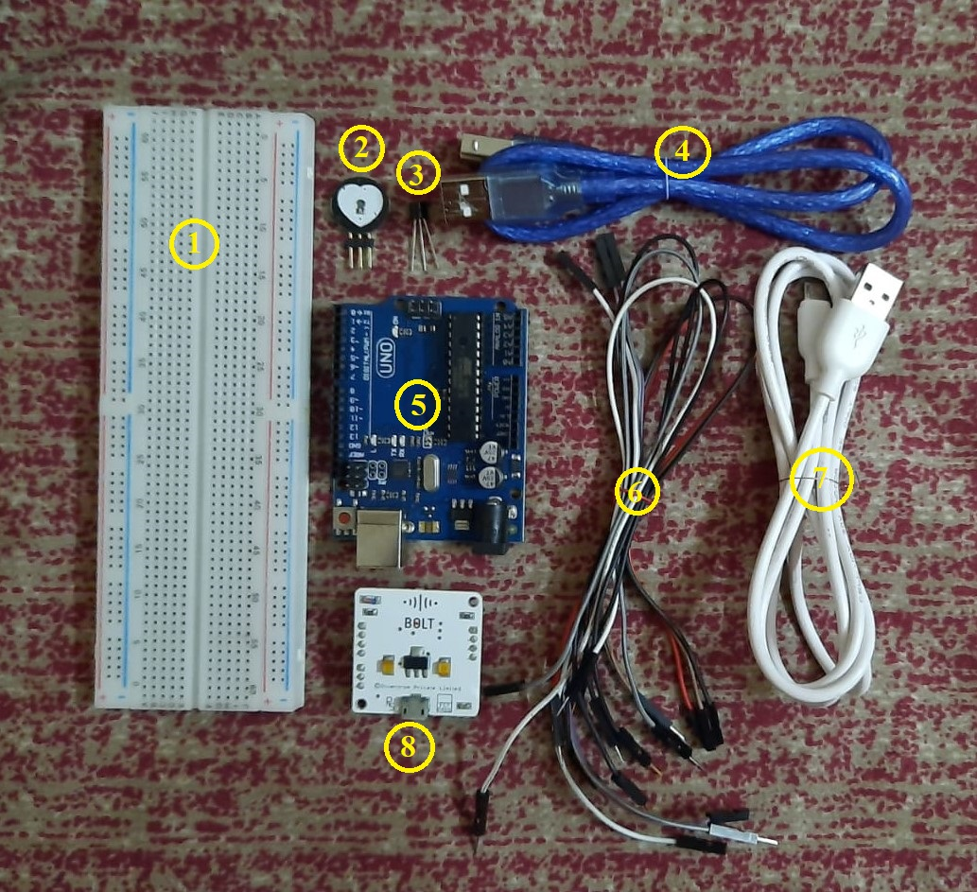

Slide 8
WORKING
Arduino and Bolt module are the main components.
Two bio sensors :
Pulse sensor- the LED in the sensor starts emitting light when place above vein.
- when there is blood flow through the veins it can be detected.
LM35 – output voltage varies based on the temperature around it.
- temperature between -55°C to 150°C can be measured.
- there will be a rise of 10mV for very 1°C increase.
Pulse sensor
LM35 Temperature sensor

Slide 9
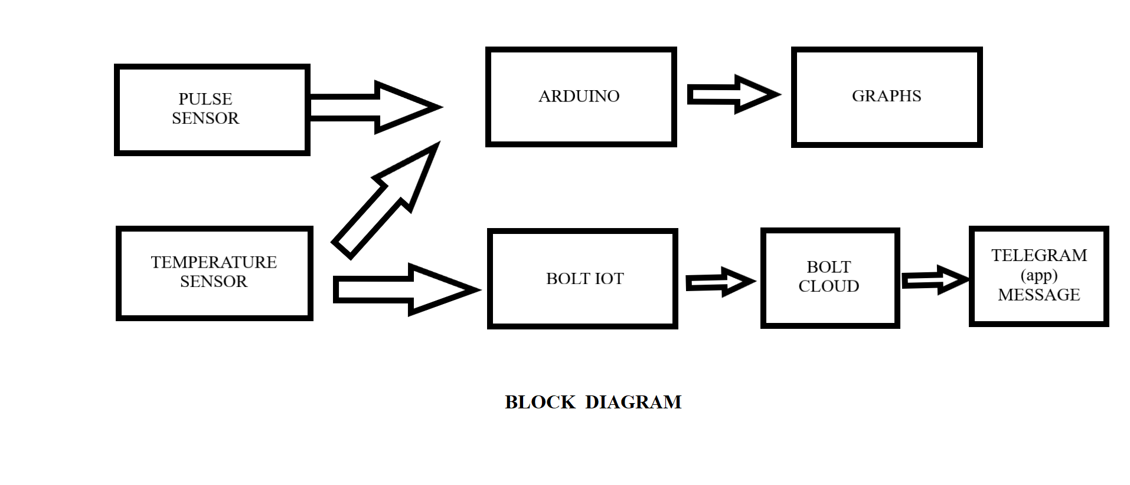

Slide 10
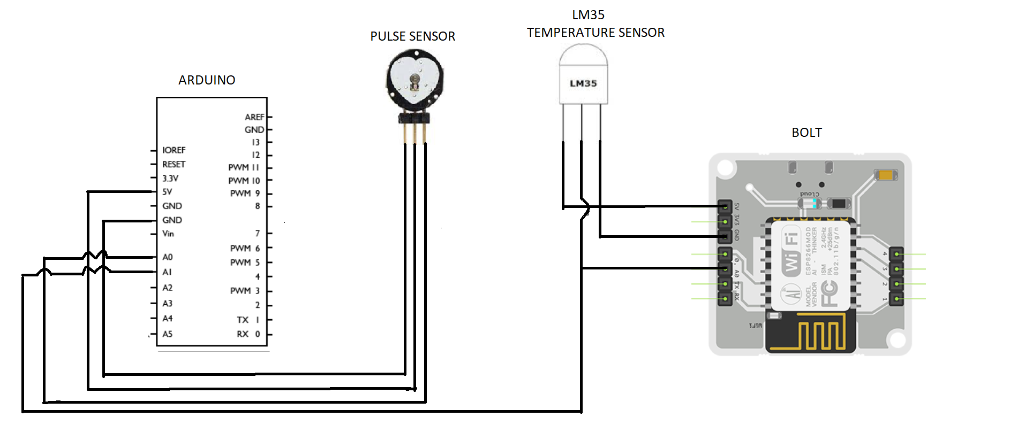
Circuit diagram

Slide 11
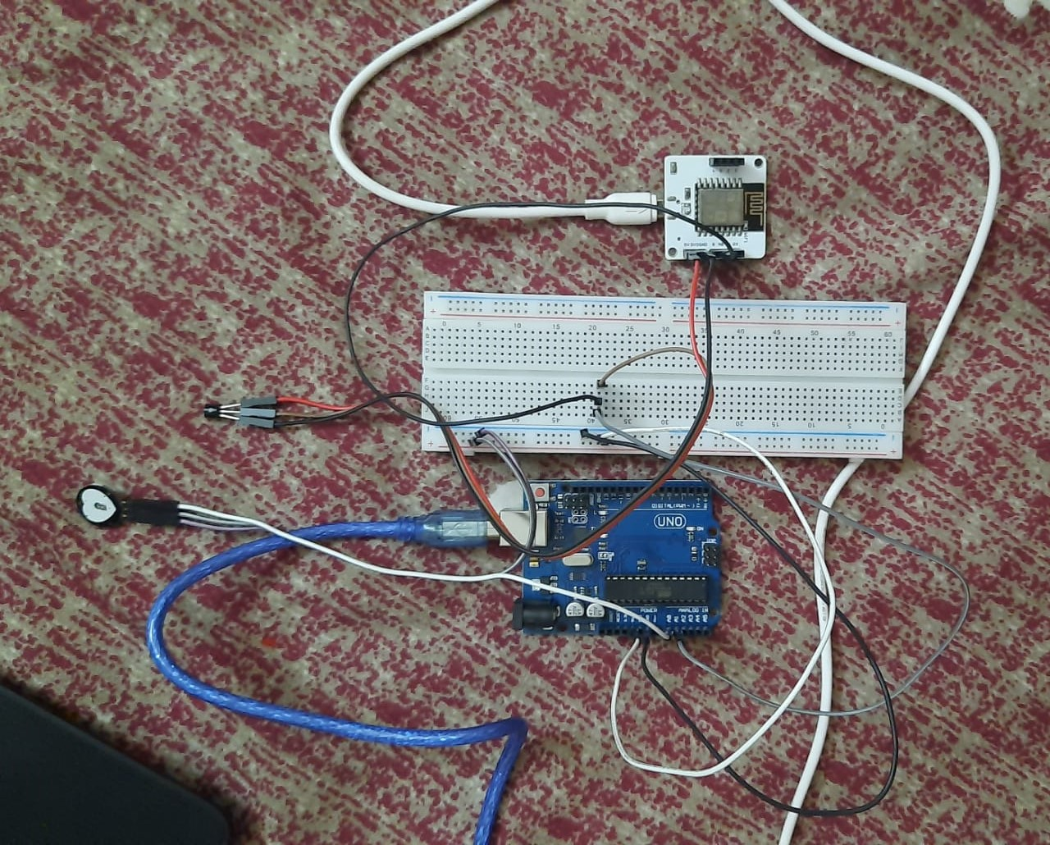

Slide 12
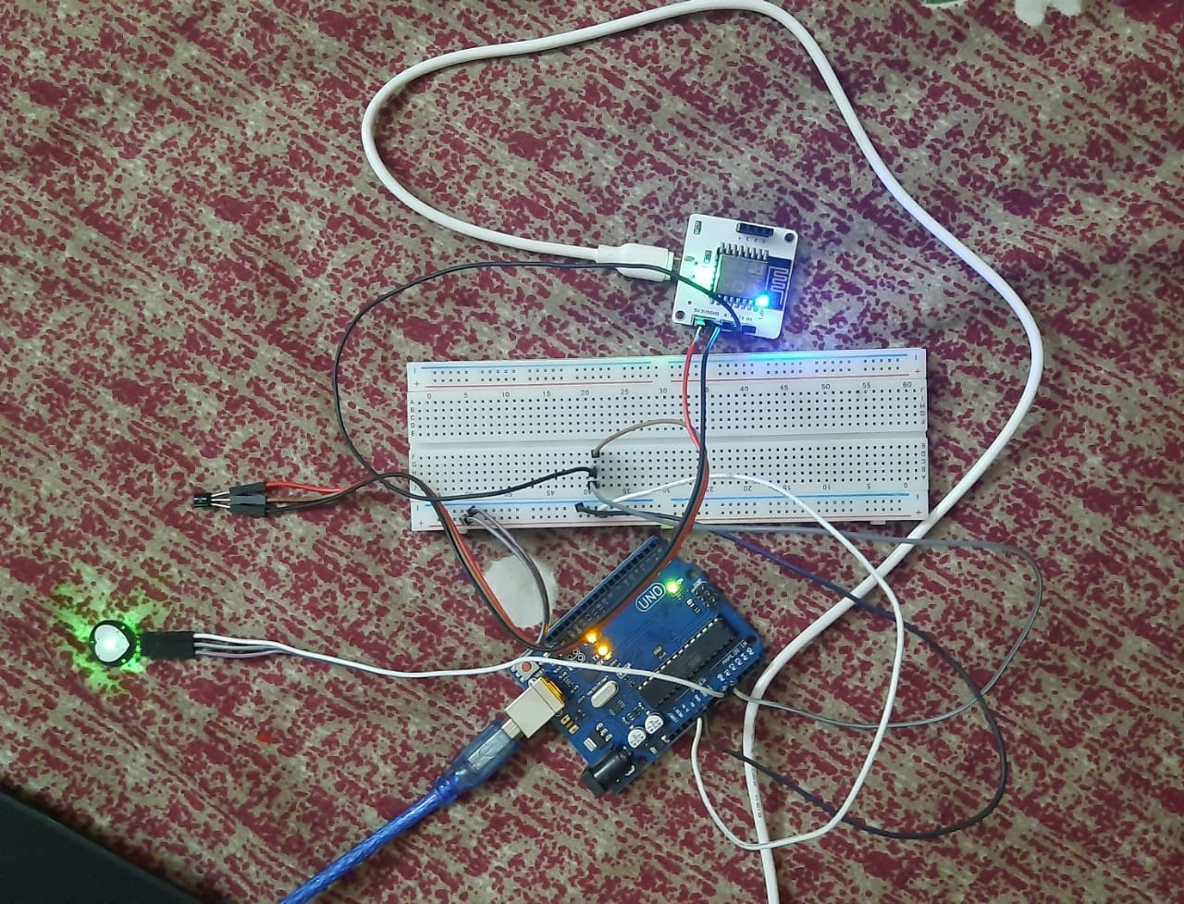

Slide 13
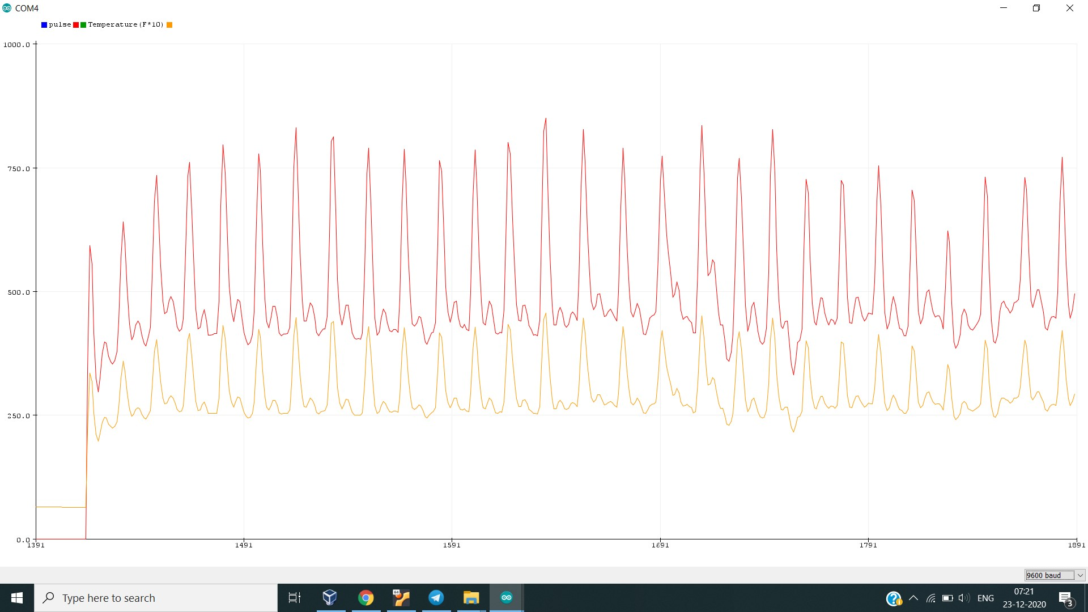
Pulse sensor, when placed above vein, read the value of pulse rate.
The value is given to Arduino, a graph is plotted based on the input values.

Slide 14
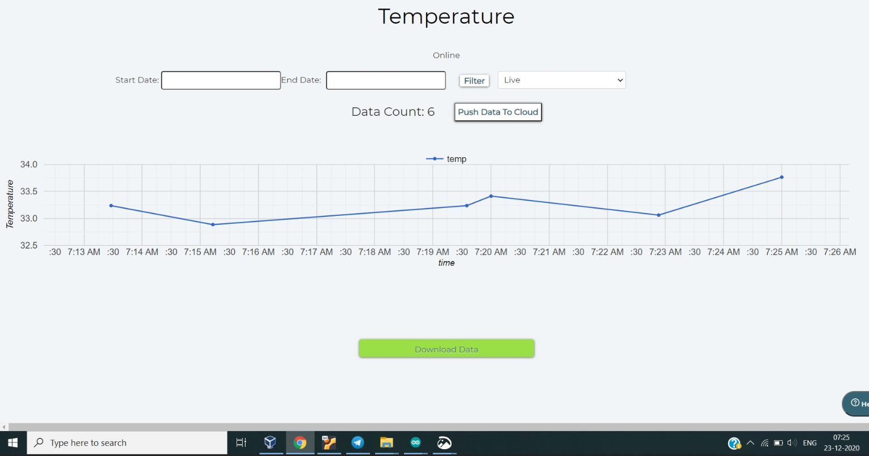
Temperature sensor gives the value of the temperature into the Bolt Cloud.
Bolt Cloud plots graph based on the input values.

Slide 15
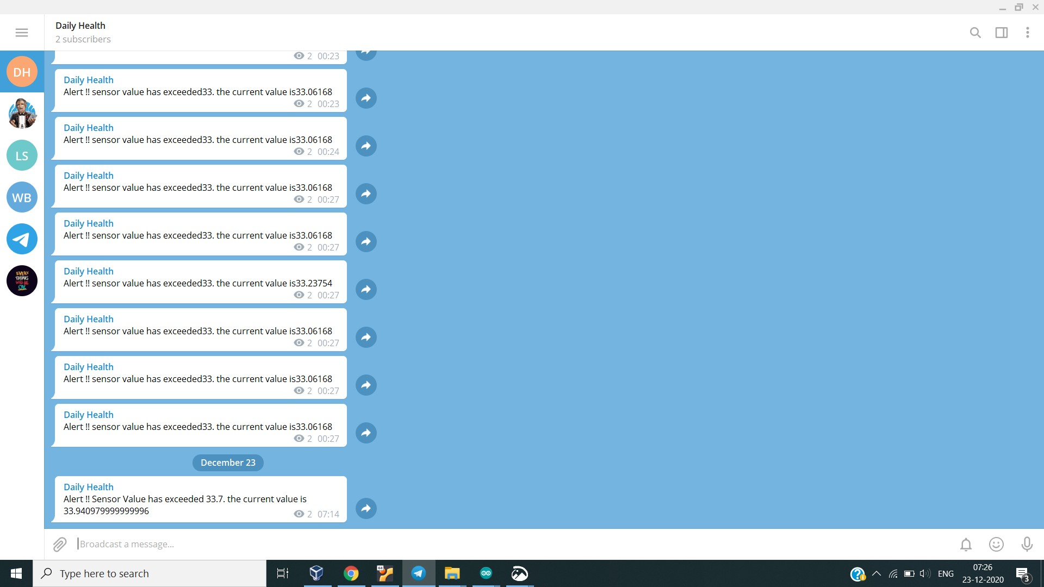
When a value of temperature above threshold value is recorded, an alert is send through Telegram(App).

Slide 16
Link to project demonstration:
https://drive.google.com/file/d/1WWYhTOCYeyLDmtFRri899c-oQKfAEXvl/view?usp=sharing

Slide 17
CODE
In Arduino:
void setup() {
// put you set up code in here to run once:
Serial.begin(9600) ;
}
Void loop() {
// put your main code here to ren repeatedly:
int pulse = analogRead(A0);
int temp = analogRead(A2);
Serial.print(“pulse: ”);
Serial.print(pulse) ;
Serial.print(” “)
float mv = (temp/2.048);
float farh = (mv * 9)/ 5;
float tem = farh + 32;
Serial.print(“Temperature (F*10) :);
Serial.println(tem) ;
}

Slide 18
In Bolt:
setChartLibrary(‘google-chart’);
setChartLibrary(‘Temperature’);
serAxisName(‘lineGraph’);
add(183);
mul(0.0977);
mul(1.8);
plotChart(‘time_stamp’,’temp’);

Slide 19
Bolt code for Telegram:
File - conf.py:-
bolt_api_key = "XXXX-XXXX-XX-XXX"
device_id = "BOLT2411545"
telegram_chat_id = "@XXXX"
telegram_bot_id = "botXXXX"
threshold = 33.7
import requests
import json
import time
from boltiot import Bolt import conf mybolt = Bolt(conf.bolt_api_key, conf.device_id)
def get_sensor_value_from_pin(pin):
"""Returns the sensor value. Returns -999 if request fails"""
try:
response = mybolt.analogRead(pin)
data = json.loads(response)
if data["success"] != 1:
print("Request not successfull")
print("This is the response->", data)
return -999

Slide 20
sensor_value = int(data["value"])
return sensor_value
except Exception as e:
print("Something went wrong when returning the sensor value")
print(e)
return -999
def send_telegram_message(message):
"""Sends message via Telegram"""
url = "https://api.telegram.org/" + conf.telegram_bot_id "/sendMessage"
data = {
"chat_id": conf.telegram_chat_id,
"text": message
}
try: response = requests.request(
"POST",
url,
params=data
)
print("This is the Telegram URL")
print(url)
print("This is the Telegram response")
print(response.text)
telegram_data = json.loads(response.text)
return telegram_data["ok"]

Slide 21
except Exception as e:
print("An error occurred in sending the alert message via Telegram")
print(e)
return False
while True:
# Step 1
sensor_value = get_sensor_value_from_pin("A0")
print("The current sensor value is:", sensor_value)
# Step 2
if sensor_value == -999:
print("Request was unsuccessfull. Skipping.")
time.sleep(10)
continue
# Step 3
if sensor_value >= conf.threshold:
print("Sensor value has exceeded threshold")
message = "Alert! Sensor value has exceeded " + str(conf.threshold) + \
". The current value is " + str(sensor_value)
telegram_status = send_telegram_message(message)
print("This is the Telegram status:", telegram_status)
# Step 4
time.sleep(20)

Slide 22
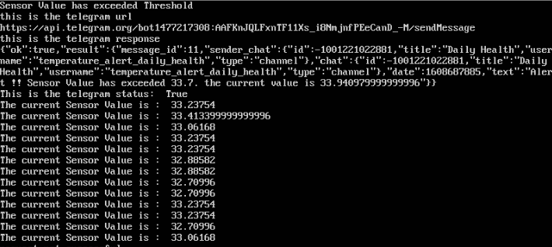

Slide 23
Future scope
This project can be integrated with mobile apps to monitor the physiological parameters of a person with out being present physically.
Rural areas having inadequate health facility can use this project to conduct the basic checkups.
Using this project people can do their regular health checkup during the pandemic without going to hospitals.

Slide 24
Conclusion
Conjoins Medicine and Engineering Fields.
Very useful for observing the physiological parameters of the senior citizens, patients, and soldiers.
Can also be used in areas lacking efficient medical assistance system.

Slide 25
Result
The project Daily Health is successfully implemented.
Body temperature and pulse rate is measured and corresponding graphs are plotted.
Telegram alerts are obtained at threshold value.

Slide 26
Thank You

