Slide 1
ee2022

Slide 2
TEAM
Arya.S.Kartha
Electrical & Electronics Engg.
Govt. Model engineering college,Thrikkakara
Nazarin Nizar
Electrical & Electronics Engg.
Govt. Model engineering college,Thrikkakara
Mohamed Nadeer
Electrical & Electronics Engg.
Govt. Model engineering college,Thrikkakara
Aishwarya Shibu
Electrical & Electronics Engg.
Govt. Model engineering college,Thrikkakara

Slide 3
Abstract
A simple,user friendly mobile application that can enhance the daily routine of students throughout their class hours.
An effective manner in which important updates regarding the classes are brought to the attention of all students equally the first time.

Slide 4
Pain Points
Students do not get a proper idea of classes attended and missed as attendance reports are usually handled and maintained by teachers.
Chances for students to miss important messages shared through whatsapp,mails,etc.
Difficulties in passing informations from teachers to class representatives and then to students.

Slide 5
Basic Idea
A modified attendance app.
All important updates that are received via mails, chats etc, can be made available within a single application.
A well informative attendance log with details including the no of classes missed/attended.
The app also includes a dedicated notice board where teachers can post details of schedule changes if any, class tests, exams etc.
A platform that incorporates details of every activities that a student goes through during his/her class time.

Slide 6
Features
Well organized attendance log
Can be used in mobile to track student attendance with ease.
Can track statistics of classes missed.
Notice Board
Helps notifying students with important messages.

Slide 7
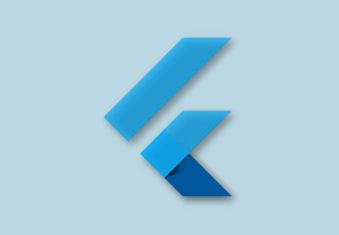
Technology used
Flutter
Flutter is Google's UI toolkit for crafting beautiful, natively compiled applications for mobile, web, and desktop from a single codebase.

Slide 8
Why flutter?
Its free and open source
Faster and simple app developments
collection of amazing widgets
One code base for both Android and iOS platforms
Simple to learn

Slide 9
Dart is a client-optimized programming language for apps on multiple platforms. It is developed by Google and is used to build mobile, desktop, server, and web applications.
Why Dart is preferred?
Enables the user to run it on mobile,web and desktop.
Completely open source
Easy to learn for people with basic programming language
Dart

Slide 10
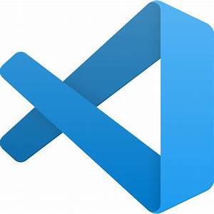
Visual studio code
Visual Studio Code(VSC) is a code editor redefined and optimized for building and debugging modern web and cloud applications.
Super fast and lightweight Source Code Editor which can be used to view,edit,run and debug source code for application.

Slide 11
APP DEMO

Slide 12
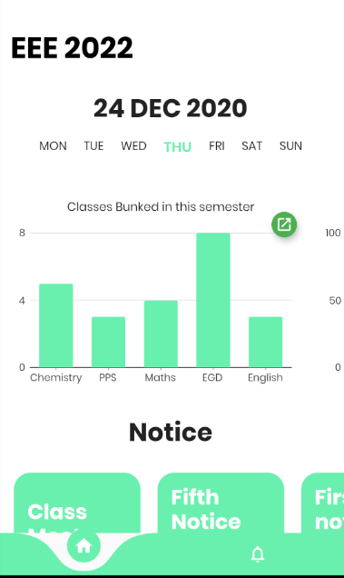
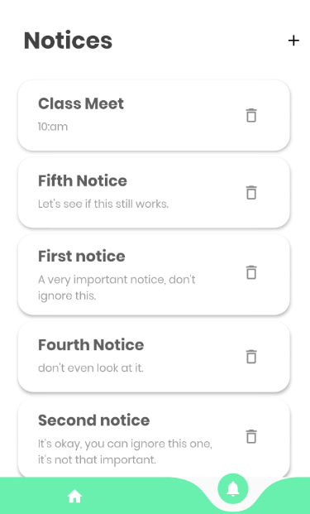

Slide 13
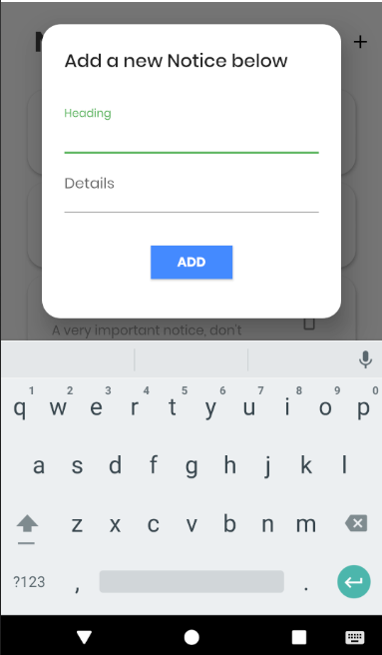
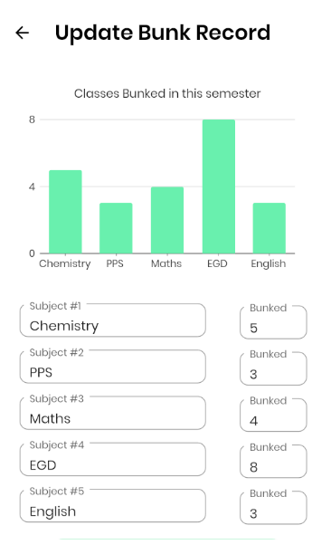

Slide 14
Target Users
Primary users are the Students, who will be the ones to benefit more from the app.
Then comes the Faculties who can easily assess the performance and activities of the students.
Future Scope
Mark percentage of students can be added that can be accessed when logged in.
Time table for each batch can also be encorporated.

Slide 15
Conclusion
Academic life of students can be made better using the application.
Inspite of not being in the college/school, teachers can give assignments, activities, project works etc, from wherever they are, which saves a lot of class time for them.
With proper implementation of the app it can be made sure to provide the faculties as well as student a trouble free environment in the classrooms.

Slide 16
Thank You.

