Slide 1
ALERTING MEDICINE BOX
TEAM:CHAOS

Slide 2
INDEX
AIM
BLOCK DIAGRAM
COMPONENTS USED
WORKING
HOW TO USE
SPECIFICATIONS
CIRCUIT DIAGRAM
PROGRAM
WORKING MODEL
REFERENCES

Slide 3
AIM
We are making a simple Medicine Reminder Using Arduino which reminds us to take medicines 1 or 2 or 3 times a day.
This medicine box focuses to help patients who needs to frequently take their medications or vitamins supplements.

Slide 4
BLOCK DIAGRAM
RTC
ARDUINO UNO
LED
BUZZER
LCD DISPLAY
PUSH BUTTON SWITCHES

Slide 5
COMPONENTS USED
ARDUINO UNO - Programmed codes for the project is uploaded to ARDUINO chip using usb cable. It is the brain of our project.(cost-Rs.450)
RTC DS1307-It is a 6 terminal device.The chip mainly contains seconds, minutes,hour info.We can adjust the time for our use using this chip.(cost-Rs 200)
BUZZER-It alerts by making a buzzing sound.
JUMBER WIRES-For connecting between modules.
LCD display-To observe the time intervals for the user(costs nearly Rs.200)
LED AND PUSH BUTTONS

Slide 6
WORKING
The arduino is programmed in such a way that the time for the alarm can be adjusted using the push button switches.
We should allot the alarm for each of the tray containing medicines using the LCD display and push button switches
When the time we give matches with that of RTC(real time clock) corresponding tray will be illuminated with LED and buzzer notification.

Slide 7
The user can take the medicines according to the reminder.
The user also can set the time for next medicine which is to be taken in the same day or upcoming days.
The RTC library is download from GIThub and added to ARDUINO IDE1.8.13
Power supply can be given through USB cable or 5V adapter.

Slide 8
SPECIFICATIONS
The box contains trays to fill medicines according to users need.
The box also have the provision if two or more medicines have to be taken at a time.
A facility to check pulse and oxygen rate is also added.
Box can be portable if 5V battery supply is connected.

Slide 9
HOW TO USE
Simply open the individual trays using the specially designed fingertip tabs.
Place your pills, vitamins and supplements into the appropriate tray and close the lids.
The box will alert you with a flashing light and buzzing sound at the programmed times.
Then open the tray and have your medicines or remove or pour them into your hands.

Slide 10
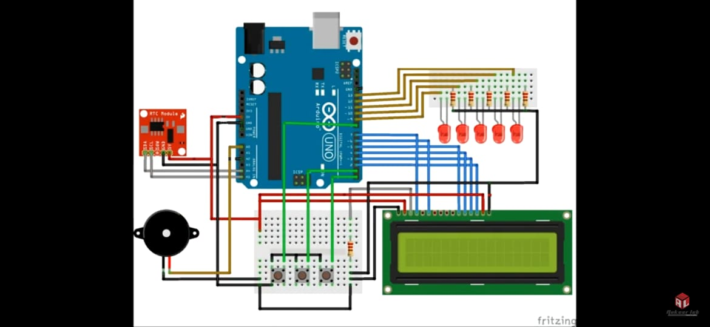
CIRCUIT DIAGRAM

Slide 11
PROGRAM
https://drive.google.com/file/d/17FLajJvNQGOTGQbH3Gg7IoX_3WGC8wAI/view?usp=sharing

Slide 12
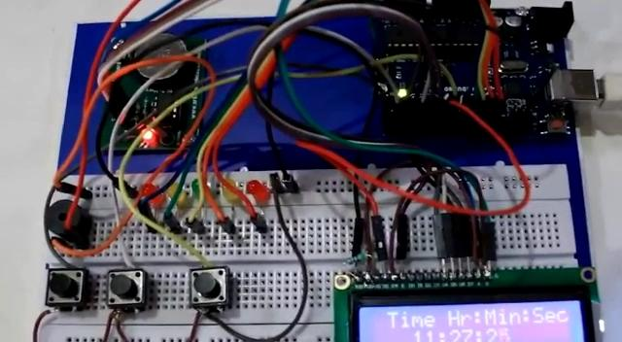
WORKING MODEL

Slide 13
REFERENCES
[1] Dr.Diaa Salama, Mohamed Abd-ELfattah, “Smart drugs:Improving Healthcare using Smart Pill Box”, Future Computing and Informatics Journal, Benha University, November 2018
[2] N kripa, R Vasuki, R kishore Kanna,“GSM controlled Automatic Medicine Reminder System”, International Journal of Innovative Technology and Exploring Engineering, LJITEEE, July 2019

