Slide 1
By: CLOUD69 MODEL ENGINEERING COLLEGE
RANKGRAB

Slide 2



PROBLEM STATEMENT
With the worldwide impact of COVID and other related issues there is a need to transform classroom experiences to a e learning experience. We intend to bring about a platform to do the same.
Both parents and children nowadays want a system where they can stay upto date with modern technology. They want something interactive and not just seemingly off the books.
This is where we come in. Inspired by the various e-learning platforms we aim to alleviate them especially for the lower grade classes to enable them to access a variety of options.

Slide 3
SUMMARY OF THE PROJECT IDEA
We figured that by using lucrative games and activities along with easily accessible Youtube videos we could make the process of learning more engaging and fun.
According to “Kids Under COVID”, a research study and survey, 78% of Indian parents are unwilling to send their wards to school immediately post lockdown.
Realizing the burgeoning potential of STEM subjects for a lucrative future, 23% of parents have engaged their children in an online robotics class during the lockdown period, while 32% have engaged them in an online coding class.
Understanding the future potential of such projects we aim to develop a studying mechanism that not only focuses on ROTE learning of the STEM subjects but to integrate the entire learning system into a system of games and checks where each user proceeds to the next level of learning through a series of games and competitions. Materials they require will be provided and can be used. Competitions against the computer as well as with students of the same level can be accessed as well.
Implementing these with the help of artificial intelligence is another aspect we would like to use. AI would help create rankboards as well which will help the students get a motivation to finish their corresponding levels.

Slide 4
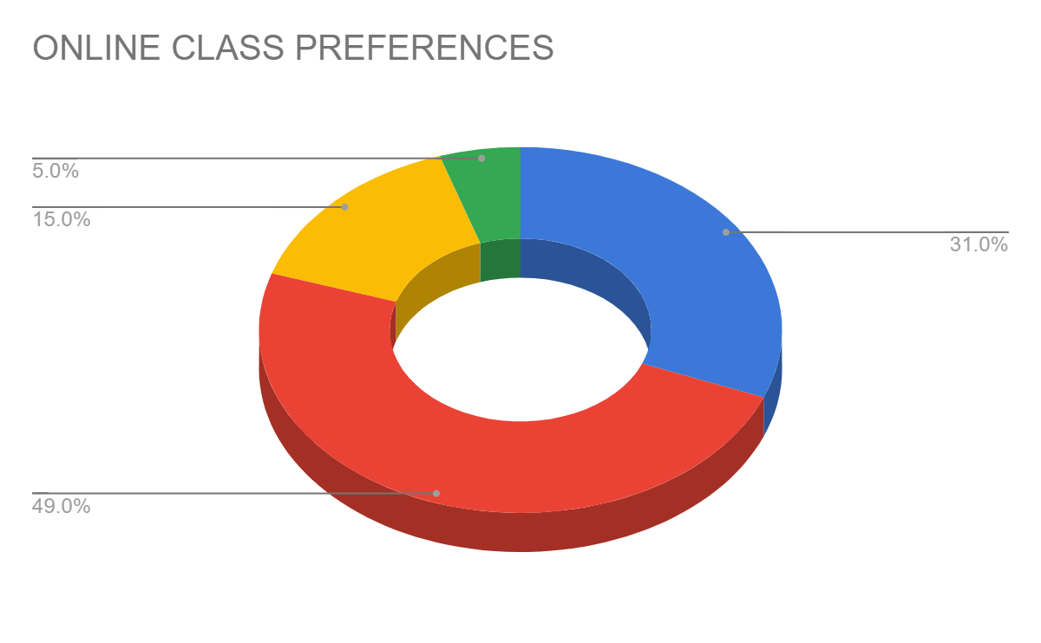
31% who prefer classroom coaching.
49% who prefer online classes for 2 hours a day and interactive sessions.
15% who prefer online class for the entire duration of school hours
Referenced from Times of India

Slide 5
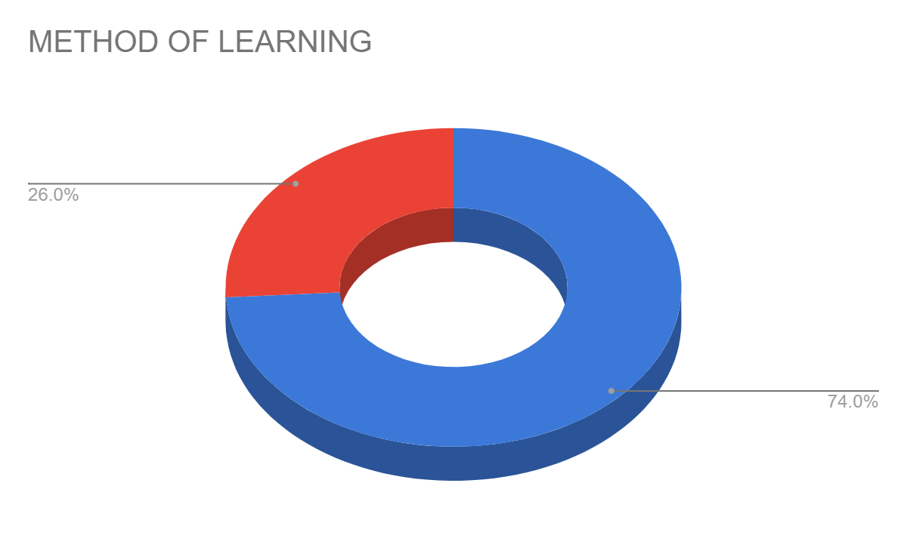
74% students prefer interactive online sessions instead of the classroom rote method as is the method.
Referenced from Guide2Research

Slide 6
BUSINESS MODEL CANVAS

Slide 7
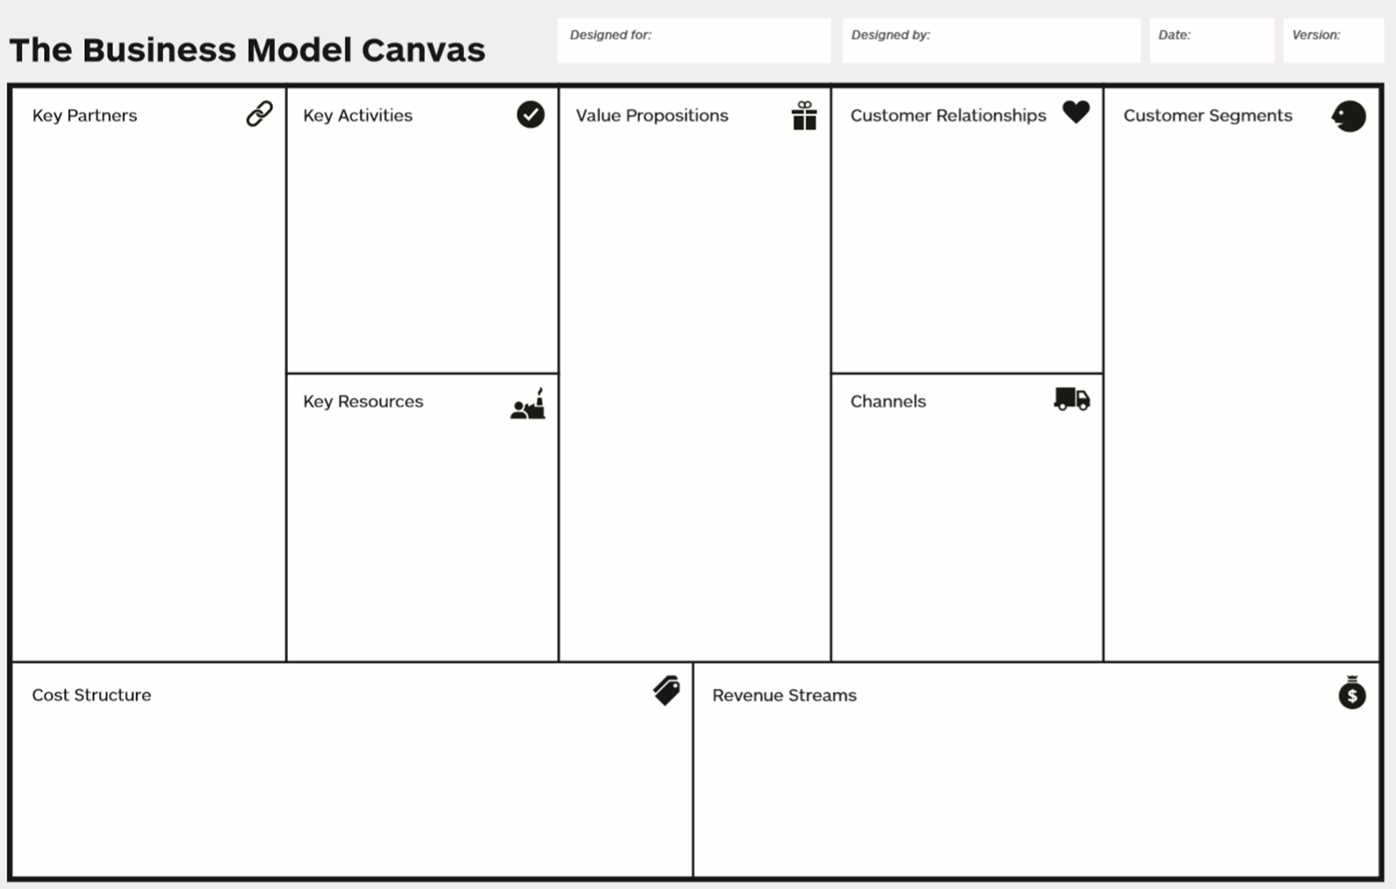
Educators
Teachers
Educational institutions
Animators
Tying up with educational institutions,teachers and people from various educational backgrounds to create a new system of learning.
Bringing forth a hands on developmental approach to learning.
A new mechanism of learning which enables the students to learn and identify things not just in their syllabus but also related to their daily life.
This creates a plethora of opportunities for teachers and educators who wish to pursue something other than the conventional mode.
Students from grade 3 to 8.
Students whose parents wish for outside the box thinking opportunities and learning facilities.
Introducing interactive relationships, which is a combination of both customer and personal opinions.
Online Community and a strong base in multiple social media communities.
App builders and maintenance team.
Animators and teachers.
Through social media handles.
Through advertising in the form of newspapers etc.
Connecting with other educational apps.
Value driven cost structure.
COGS
Subscription model / pay per use

Slide 8
VALUE PROPOSITION CANVAS

Slide 9
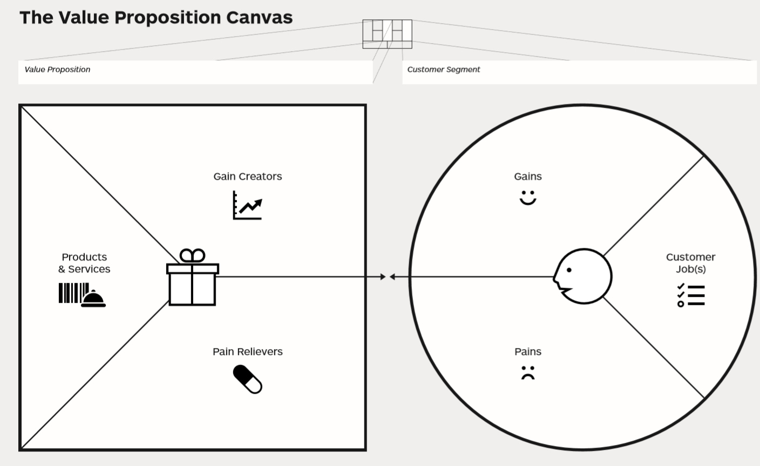
Varied opportunities.
A more structured way of learning.
Faster progress and more interesting.
Customized analytics.
Mobile/cloud integration.
Offering hands on learning experience with available items.
Providing it in subsidized rates for lower income households.
Real time analytics
Update of latest educational facilities and methods.
Recommendations via the mobile app.
Feedback
Sharing it to their fellow friends and family.
Unequal access to the materials.
Low Internet availability
Students get a sharper edge over those following the conventional mode of learning.
They would be able to grasp concepts faster.

Slide 10
Our process is easy
First
Second
Last
Employ animators,teachers and other educational staff to brainstorm different methods for teaching concepts.
Creating an app that employs quizzes,games,hands on learning approach and competitive streaks to induce learning.
Releasing the app out to a selected students in the first trial and then out to the public with the necessary modifications.

Slide 11
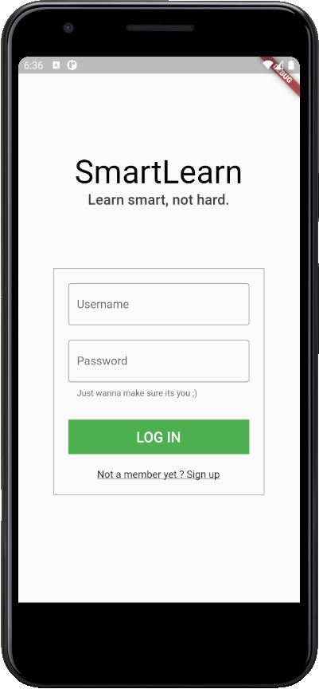
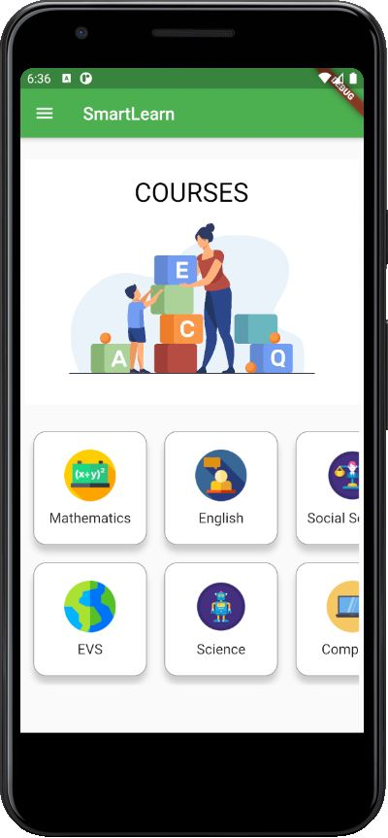
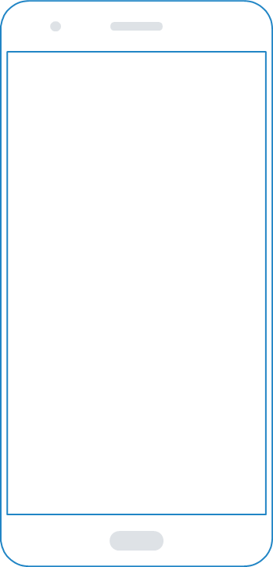
Mobile project

Slide 12
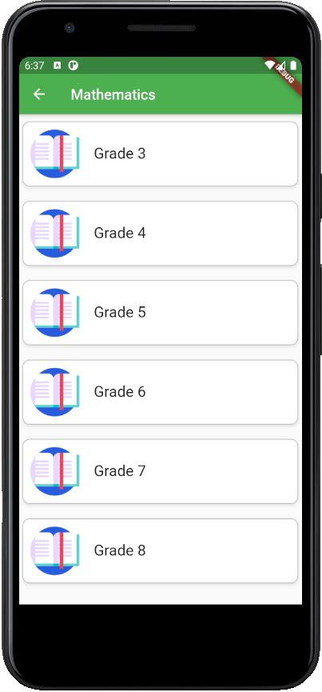
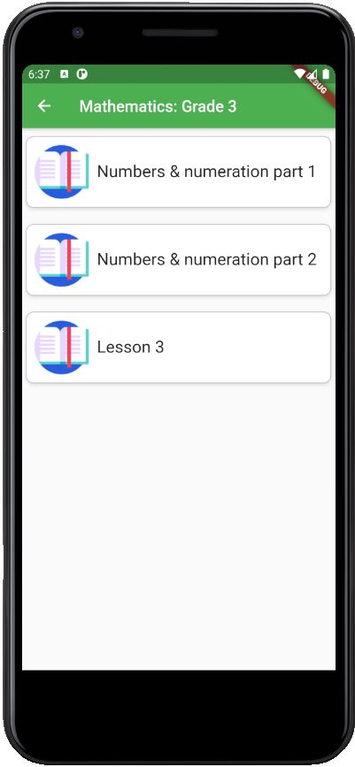
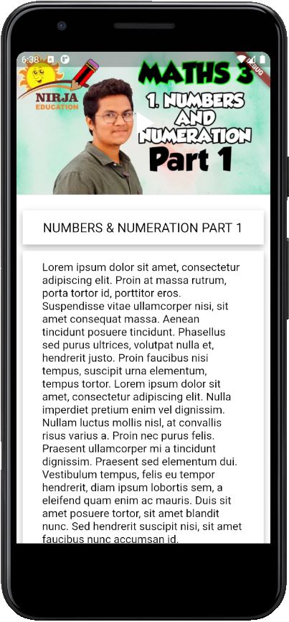

Slide 13
THANK YOU
Team members:
Abraham Jacob Kurialanickal
Gokul Sagar
Mohammed Shijin K
Sneha Hassan

