Slide 1
Patient Database Management Web App

Slide 2
Team
Alan
Faheem
Poorab
Sahil

Slide 3
Objective

Slide 4
Practice Management Tool for Clinical Establishments
Health Record for Patients

Slide 5
Functionality

Slide 6
Keep track of Patients
Setup patient details, prescriptions and micro manage your clinical establishment

Slide 7
Get your Health Records
All your medical prescriptions in one place

Slide 8
Wireframe

Slide 9
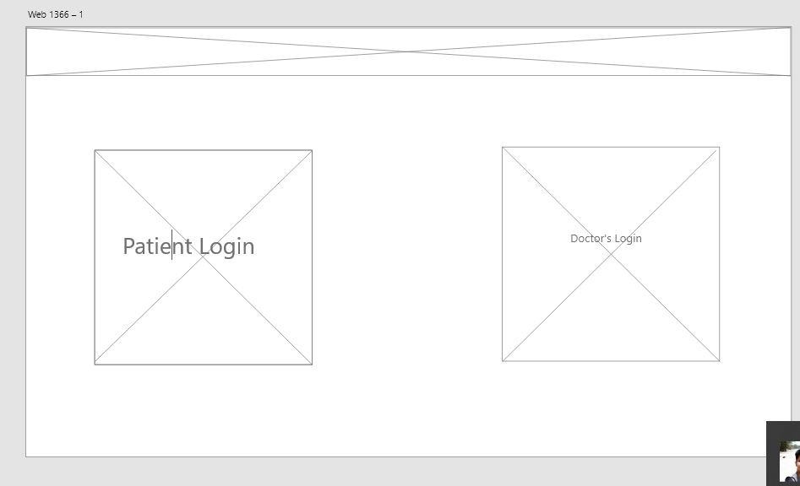

Slide 10
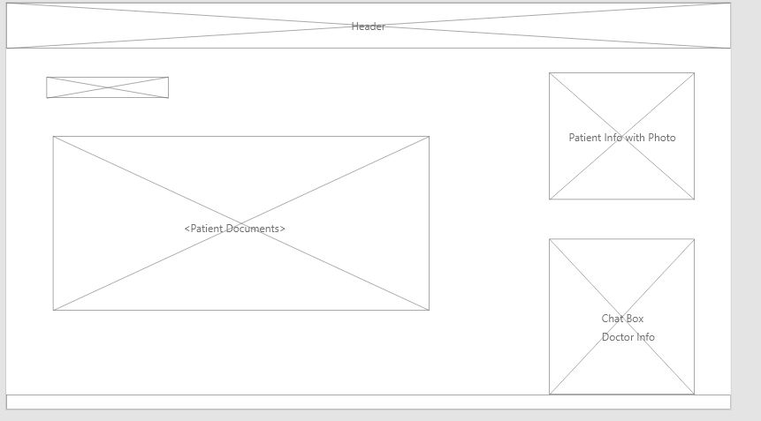

Slide 11
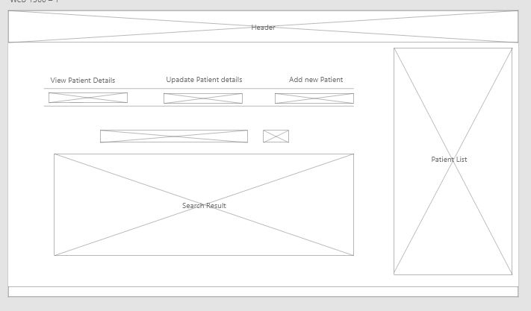

Slide 12
Design Prototype

Slide 13
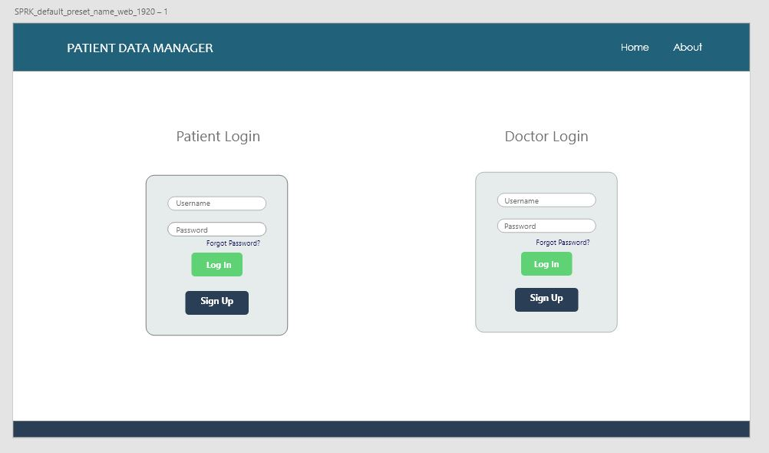

Slide 14
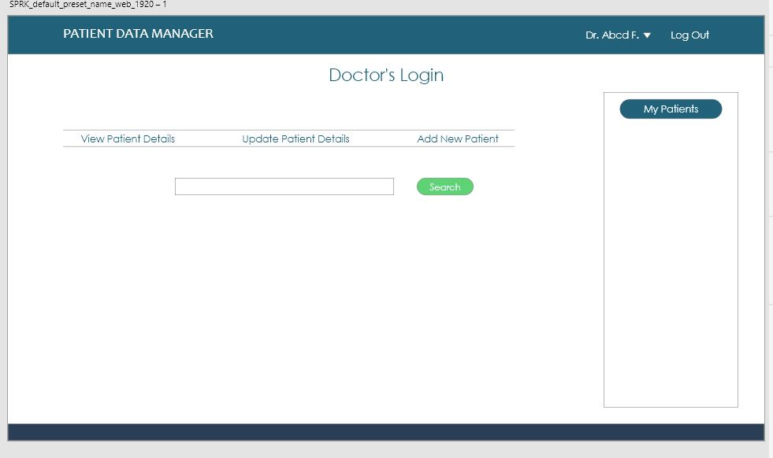

Slide 15
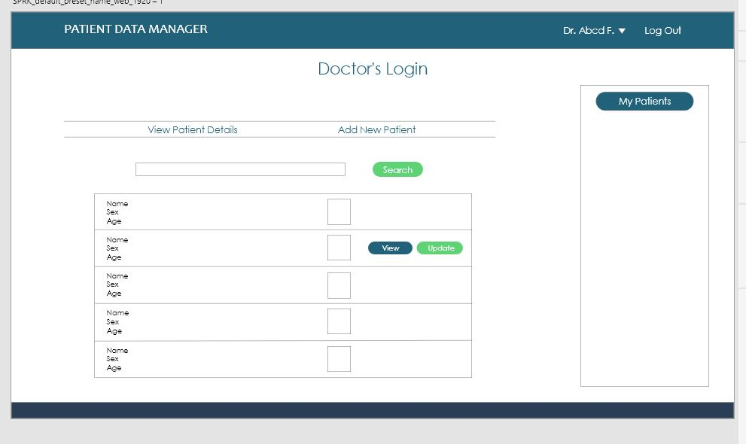

Slide 16
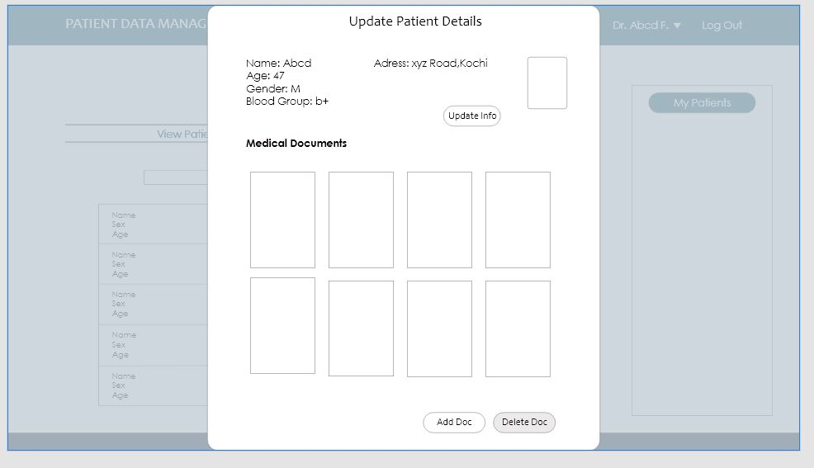

Slide 17
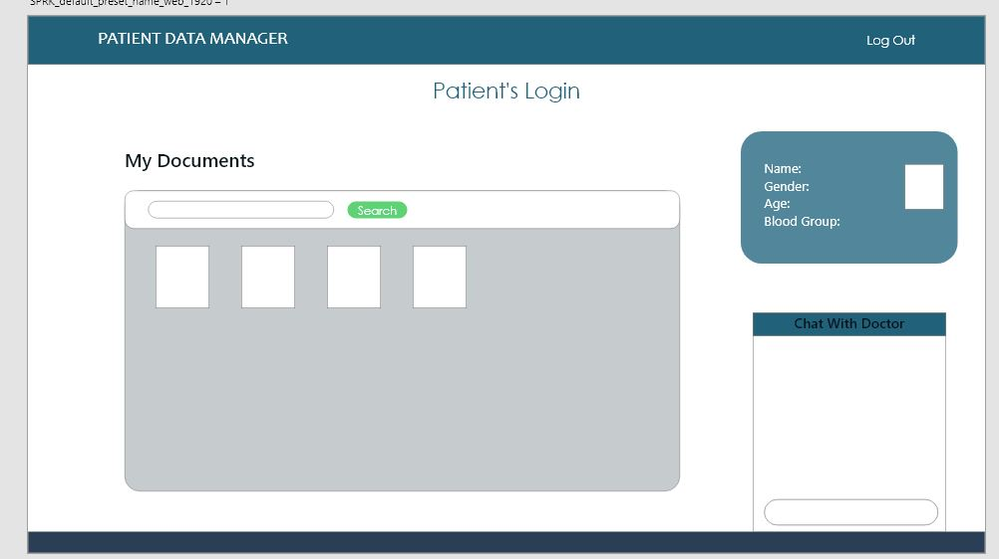

Slide 18
Tech Stack - MERN

Slide 19
Big shout-out to our mentors -
Befin & Sidharth

Slide 20
Thank You

