Slide 1
IoT based patient monitoring system
Team Hack O’ Holics

Slide 2
WHAT WE BRAINSTORMED??? IDEA!!
Here in this project, we will make an IoT based Health Monitoring System which records the patient heart beat rate and body temperature and also send an email/SMS alert whenever those readings goes beyond critical values. Pulse rate and body temperature readings are recorded over ThingSpeak and Google sheets so that patient health can be monitored from anywhere in the world over internet. A panic will also be attached so that patient can press it on emergency to send email/sms to their relatives.

Slide 3
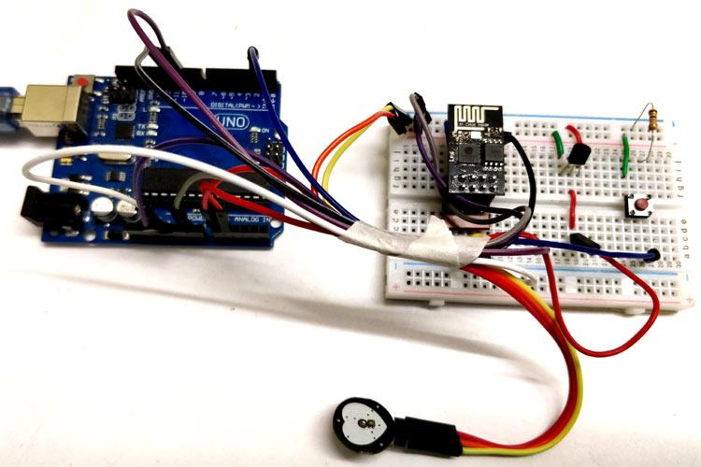
OUR FUTURE PROJECT WILL LOOK LIKE THIS

Slide 4
WHAT ALL DO WE NEED NOW?
Materials required
Arduino Uno and Programming Cable
ESP8266 Wifi module
LM35 temperature sensor
Pulse rate sensor
Push button
10k Resistor
Male-female wires
Breadboard

Slide 5
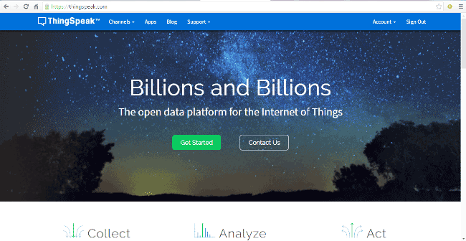
What exactly is the process?
ThingSpeak provides very good tool for IoT based projects. By using ThingSpeak site, we can monitor our data and control our system over the Internet, using the Channels and webpages provided by ThingSpeak. ThingSpeak ‘Collects’ the data from the sensors, ‘Analyze and Visualize’ the data and ‘Acts’ by triggering a reaction.
ThingSpeak to monitor patient heartbeat and temperature online using internet. We will also use IFTTT platform to connect ThingSpeak to email/message service so that alert message can be sent whenever the patient is in critical state.
Step 1:-
First of all, user needs to Create a Account on ThingSpeak.com, then
Sign In and click on Get Started.

Slide 6
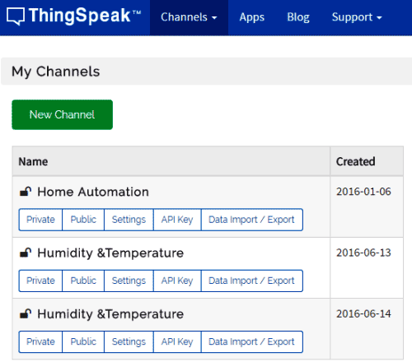
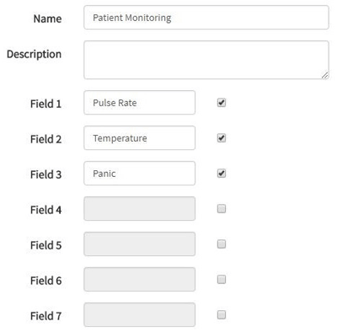
Step 2:-
Now go to the ‘Channels’ menu and click on New Channel option
on the same page for further process.
Step 3:-
Now you will see a form for creating the channel, fill in the Name and Description as per your choice. Then fill ‘Pulse Rate’, ‘Temperature’ and ‘Panic’ in Field 1, Field 2 and Field 3 labels, tick the checkboxes for the Fields. Also tick the check box for ‘Make Public’ option below in the form and finally Save the Channel. Now your new channel has been created.

Slide 7
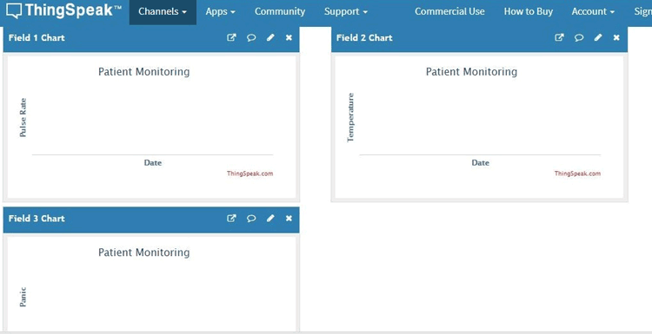
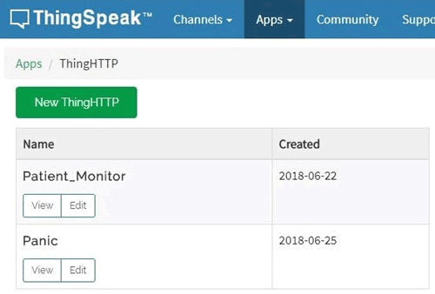
Step 4:-
You will see three charts as shown below. Note the Write
API key, we will use this key in our code.
Step 5:-
Now, we will use ThingHTTP app of the server to trigger the IFTTT applet for data entry to Google sheets and send email/sms. ThingHTTP enables communication among devices, websites, and web services without having to implement the protocol on the device level. You can specify actions in ThingHTTP, which you want to trigger using other ThingSpeak apps such as React.

Slide 8
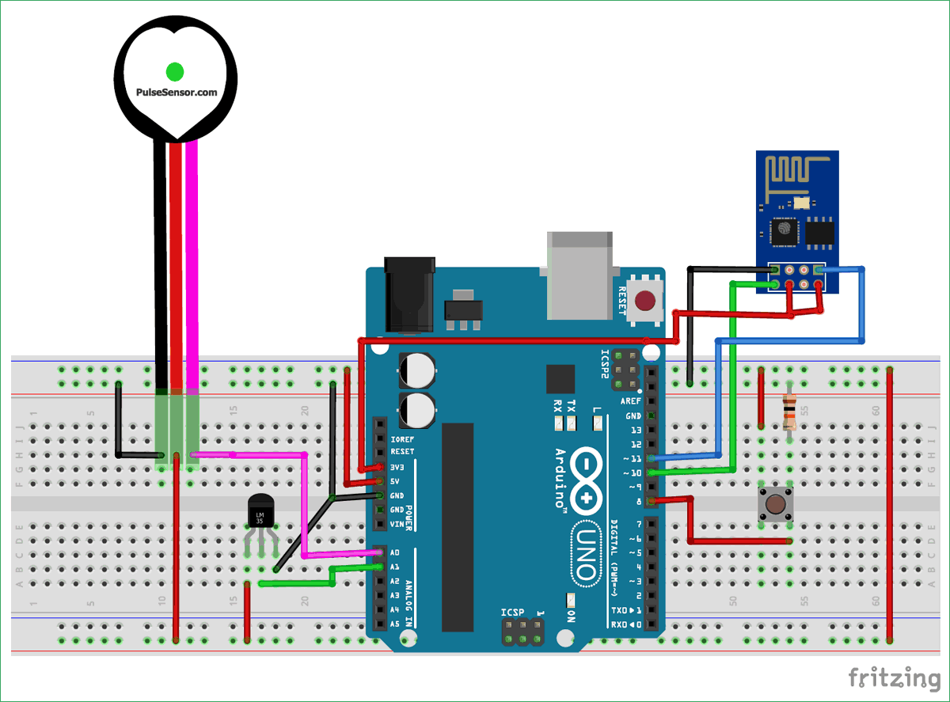
Circuit diagram

Slide 9
WHY DID WE CHOOSE THIS?
To reduce the distance between doctors and patients, from any part of the world doctors could analyze patients.
More easy for both doctors and patients incase of lod patients , running through hospitals each and everytime can be avoided.
Death caused due to late arrival to hospital can be avoided.
Huh! Now atleast let the doctors and nurses take rest.

Slide 10
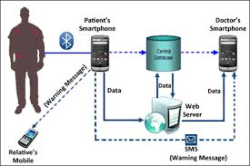
SOCIAL IMPACT:
Many patients in rural area die untreated because of travelling long distance to consult doctors. This telemedicine removed this barrier using this advanced IoT technology. Telemedicine is completely reliant on IOT, this IoT innovation give a stage to advancement and change of tele social insurance and telemedicine. IoT technology is nothing but millions of objects around us are interconnected and interact between each other, these objects can sense data by communicating to relevant objects and share that in between them. Recently this technology is becoming more popular due to plenty of usage of mobile devices, embedded system communication and database cloud computing etc.
The main purpose of this work is to develop a solution based on an ontology with ability to monitor the health status and recommendations of workouts with chronic diseases architecture.

Slide 11
Future scope:
The system and the app can be modified to include various other biological parameters. The raspberry pi mentioned earlier can be configured as a web server so that multiple devices can be connected to it as the same time. The system can also be configured to work as a small LAN inside a hospital so that the doctor can receive regular updates on all of his/her patients on his/her Android device. It can also be modified to send alerts to the doctors in case any one of the parameter stars behaving abnormally so that the doctor or the hospital can be notified immediately and the necessary arrangements can be taken to avoid it. The hospital can maintain a complete database of all their patients in their vicinity and patients can have their own system in their homes which will be directly linked to the hospital’s system so that any changes can be immediately acknowledged. Also a ‘Special Emergency Distress and Service (SEDS)’ can be implemented which will be fully dedicated to the database and calls the emergency service directly.
Due to further technological advancements in the future the existing system can be modified in various ways and allowed to incorporate many more features thus making it truly a portable and a personal health monitoring system.

