Slide 1
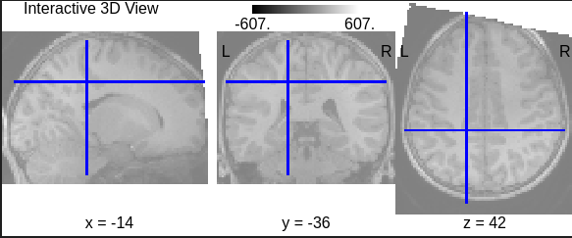
Interactive 3D Anatomical MRI View
• Displays T1-weighted MRI across sagittal, coronal, and axial planes.
• Crosshair shows exact voxel used for anatomical inspection.
• Ensures orientation and alignment before atlas mapping.
• Critical for reliable ROI extraction for depression analysis.

Slide 2
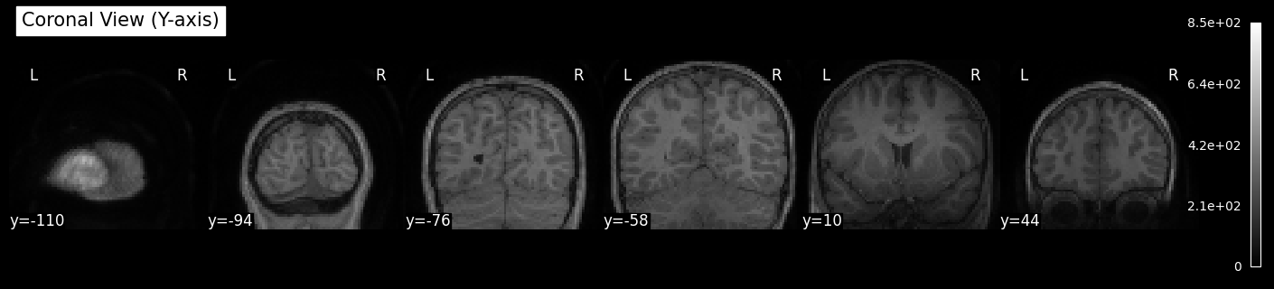
Coronal View — Y-axis (Set 1)
• Coronal slices from anterior to posterior brain areas.
• Highlights hippocampus, amygdala, and cingulate cortex.
• Used to verify structure before functional connectivity extraction.
• Ensures accurate mapping for depression detection pipelines.

Slide 3
Coronal View — Y-axis (Set 2)
• Additional coronal sweep showing deeper structural contrast.
• Useful for QC of white/gray matter boundaries.
• Helps confirm no rotation or slicing artifacts.
• Supports high-quality Pseudo Atlas alignment.

Slide 4
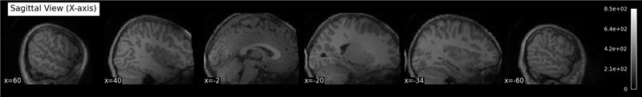
Sagittal View — X-axis
• Sagittal slices from left to right hemisphere.
• Displays corpus callosum, frontal cortex, and midline structure.
• Ensures complete anatomical coverage.
• Required for accurate multi-atlas graph generation.

Slide 5
Additional Coronal Panel
• Another coronal panel confirming structural stability.
• Used for contrast & intensity validation.
• Ensures consistency before computing functional connectivity.

Slide 6
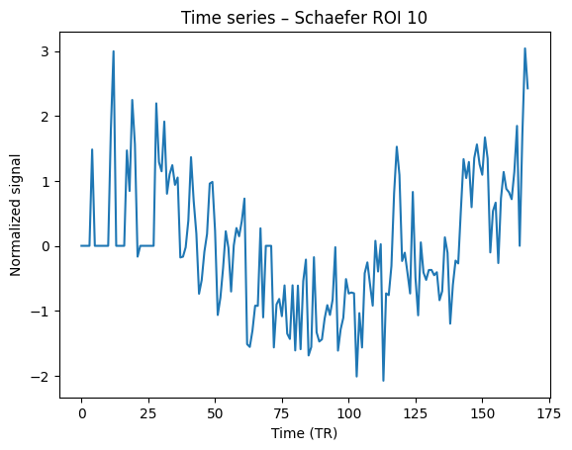
BOLD Time Series — Schaefer ROI 10
• Neural activation signal over time for ROI 10.
• Used to compute functional connectivity edges.
• Depression linked to altered signal variability.
• Forms node features for GNN-based classification.

